Slide 1

CNN Based Image Classification
Xiaoling Long
Hongyu Chen
Ruiqi Luo

Slide 2
00
Outline
Definition of Image Classification
Successful CNN in ImageNet
Efficient network on the image classification.
Application Based on CNN Based image classification
Notes:
<number>

Slide 3
01
Definition of Image Classification
The classical problem in computer vision, image processing, and machine vision is that of determining whether or not the image data contains some specific object, feature, or activity.
Notes:
<number>

Slide 4
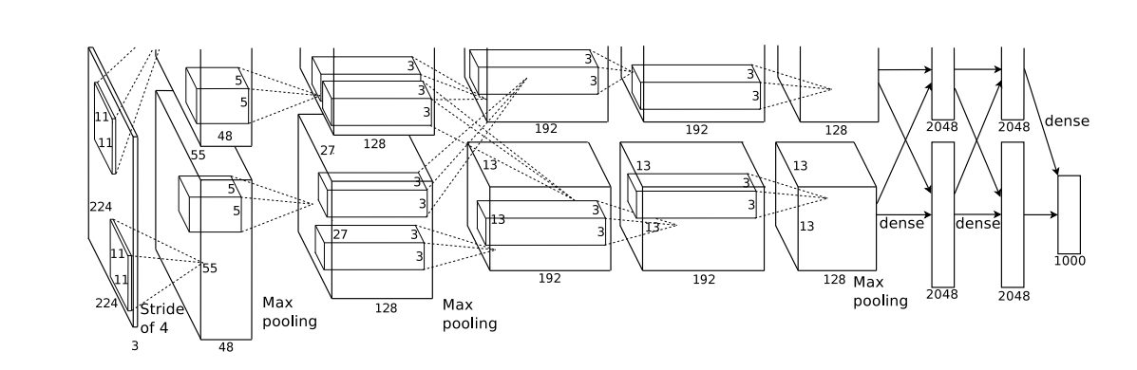
02
Successful CNN in ImageNet
Figure 1. AlexNet which is the first one CNN succeed in ImageNet
Notes:
<number>

Slide 5
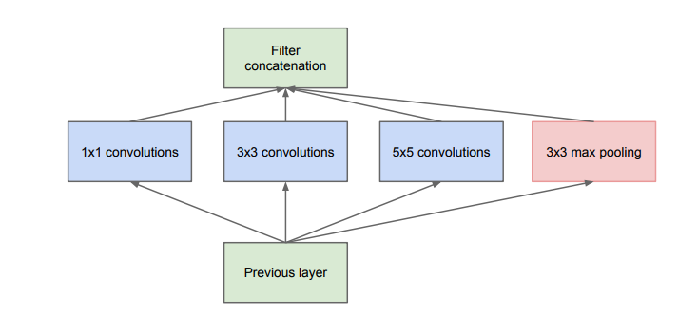
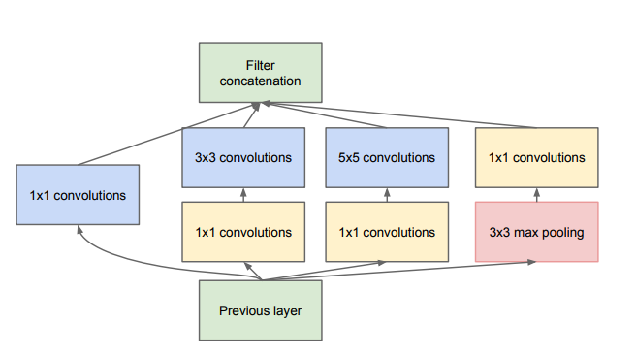
02
Successful CNN in ImageNet
Figure 2. Inception model in GoogLeNet. Left: Basic Inception model;
Right: Inception with dimension reductions
Notes:
<number>

Slide 6
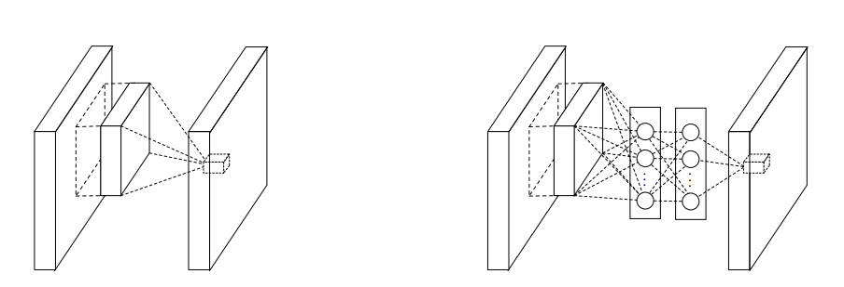
02
Successful CNN in ImageNet
Figure 3. Comparison of linear convolution layer and MLPconv layer.
Left: Normal convolution layer; Right: Replace with a Multi-Layer Perceptron(MLP).
Notes:
<number>

Slide 7
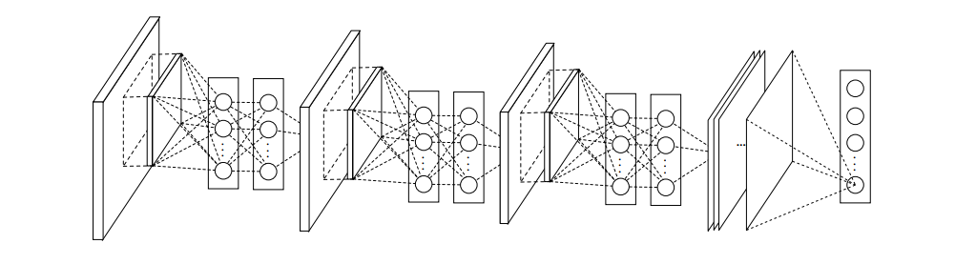
02
Successful CNN in ImageNet
Figure 4. Network in Network. Stacked by MLPconv layers and one
Global average pooling layer
Notes:
<number>

Slide 8
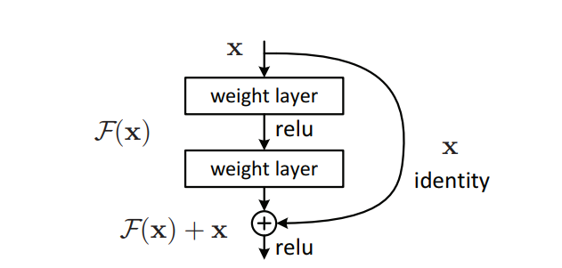
02
Successful CNN in ImageNet
Figure 5. Residual learning. ResNet is stacked by these modules
and one global average pooling layer.
Notes:
<number>

Slide 9
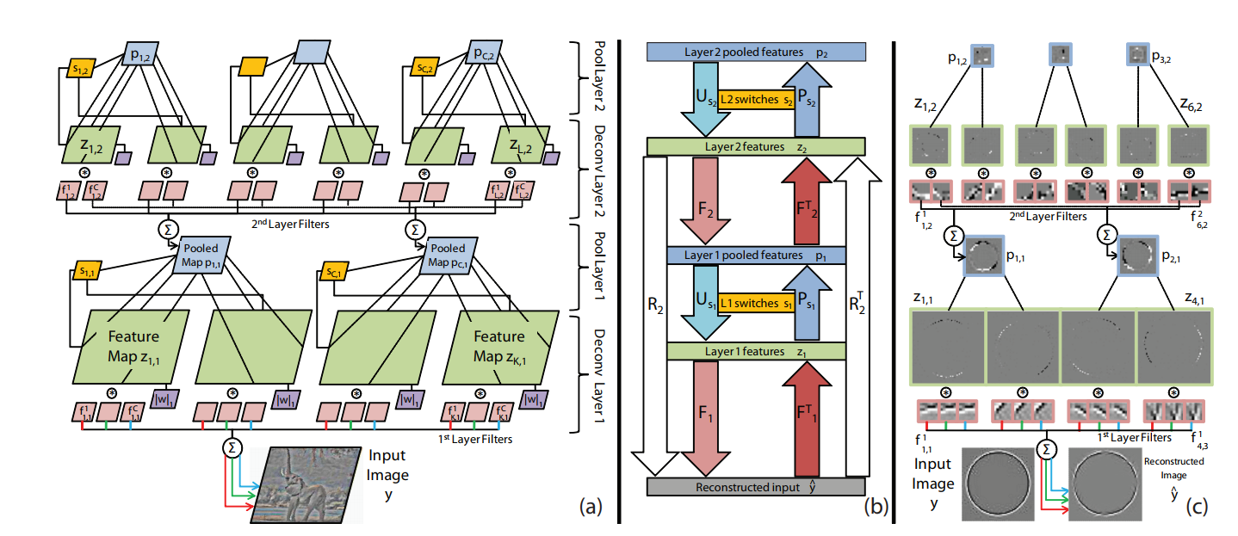
02
Successful CNN in ImageNet
Figure 6. Adaptive Deconvolutional Networks. This method is used in ZFNet for understanding and visualization CNN
Notes:
<number>

Slide 10
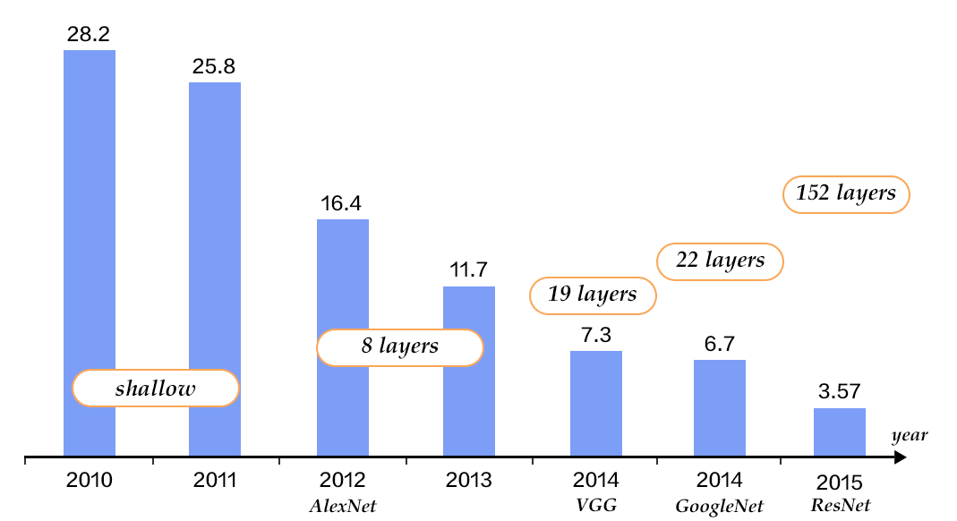
02
Successful CNN in ImageNet
Figure 6. performance on the Imagenet
Notes:
<number>

Slide 11
03
Sliding window method
Notes:
<number>

Slide 12
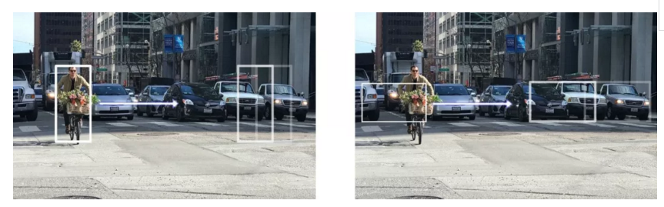
03
Sliding window method
Notes:
<number>

Slide 13
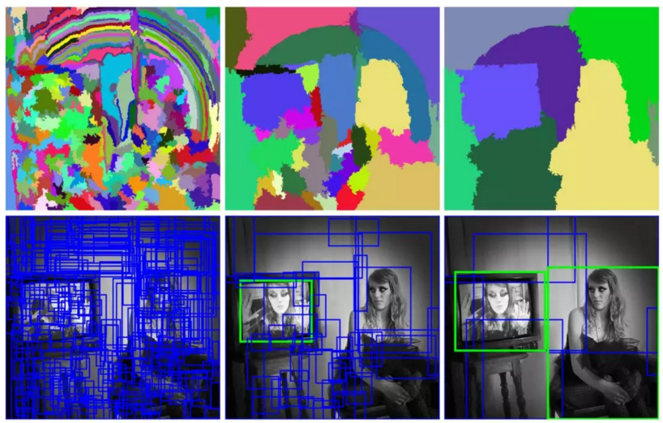
03
Selective search method
Notes:
<number>

Slide 14
03
R-CNN
Notes:
<number>

Slide 15
03
Fast R-CNN
Notes:
<number>

Slide 16
03
Faster R-CNN
Notes:
<number>

Slide 17
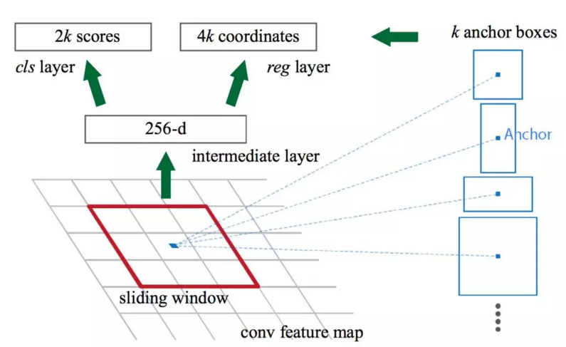
03
Faster R-CNN (region proposal)
Notes:
<number>

Slide 18
03
Faster R-CNN (region proposal)
Notes:
<number>

Slide 19
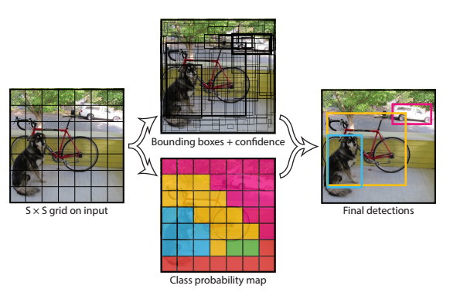
03
YOLO
Notes:
<number>

Slide 20
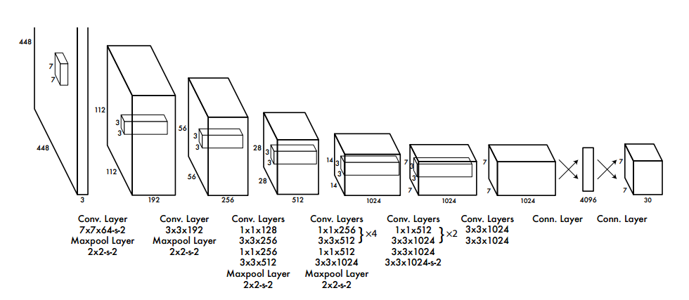
03
YOLO
Notes:
<number>

Slide 21
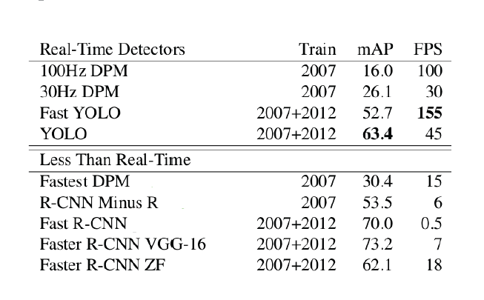
03
Test performance
Notes:
<number>

Slide 22
04
CNN Based medical image classification
Datasets usually small
Using a pre-trained CNN to their tasks
A pre-trained CNN is adapted to the application at hand.
Notes:
<number>

Slide 23
04
CNN Based medical image classification
Polyp detection(肠息肉的检测)
Pulmonary Embolism Detection(肺栓塞的检测)
Intima-Media Boundary Segmentation(血管造影)
Notes:
<number>

Slide 24
CNN Based medical image classification
04
Polyp detection
Extract images from 40 short colonoscopy videos.
Training set contains 3,800 frames with polyps and 15,100 frames without polyps.
Test set contains 5,700 frames with polyps and 13,200 frames without polyps.
Notes:
<number>

Slide 25
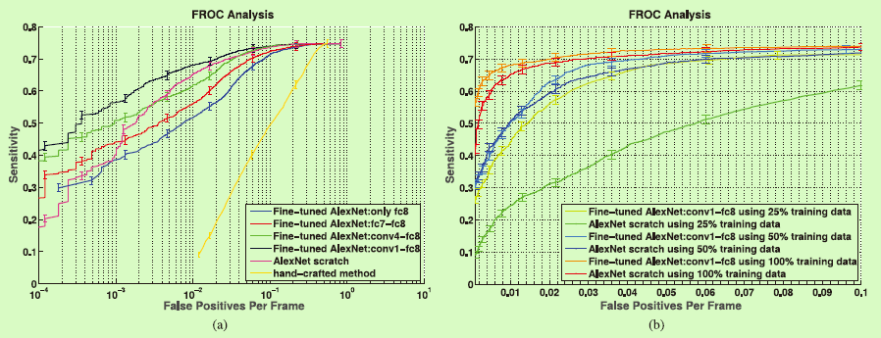
04
CNN Based medical image classification
Polyp detection
(a) Comparison between incremental fine-tuning, training from scratch, and a handcrafted approach [42]. (b) Effect of reduction in the training data on the performance of CNNs trained from scratch and deeply fine-tuned CNNs.
Notes:
<number>

Slide 26
04
CNN Based medical image classification
Pulmonary Embolism Detection
Extract dataset from 121 CT pulmonary angiographies.
Training set contains 434 frames with pulmonary embolism and 3406 frames without pulmonary embolism.
Test set contains 253 frames with pulmonary embolism and 2162 frames without pulmonary embolism.
Notes:
<number>

Slide 27
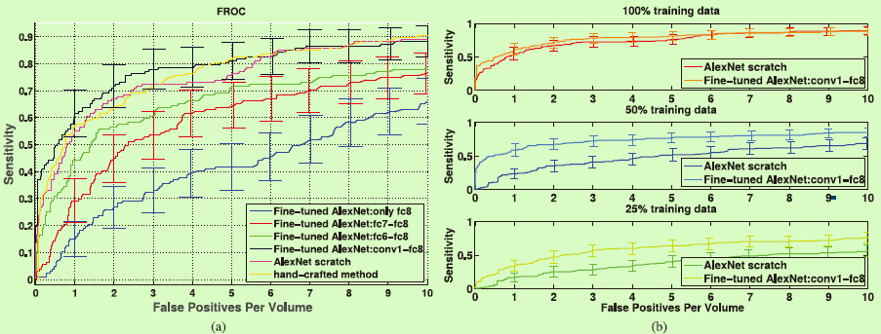
04
CNN Based medical image classification
Pulmonary Embolism Detection
(a) Comparison between incremental fine-tuning, training from scratch, and a handcrafted approach. To avoid clutter in the figure, error bars are displayed for only a subset of plots. A more detailed analysis is presented in Table S2 in the supplementary file.(b) Effect of reduction in the training data on the performance of CNNs trained from scratch and deeply fine-tuned CNNs.
Notes:
<number>

Slide 28
04
CNN Based medical image classification
Intima-Media Boundary Segmentation
Extract dataset from 92 carotid intima-media thickness (CIMT) videos. The expert reviews each video to determine 3 ROIs which can be measured reliably.
The authors divided the ROIs into a training set with 144 ROIs and a test set with 132 ROIs.
For training and fine-tuning the CNNs, the authors extracted a stratified set of 200,000 training patches from the training ROIs.
Notes:
<number>

Slide 29
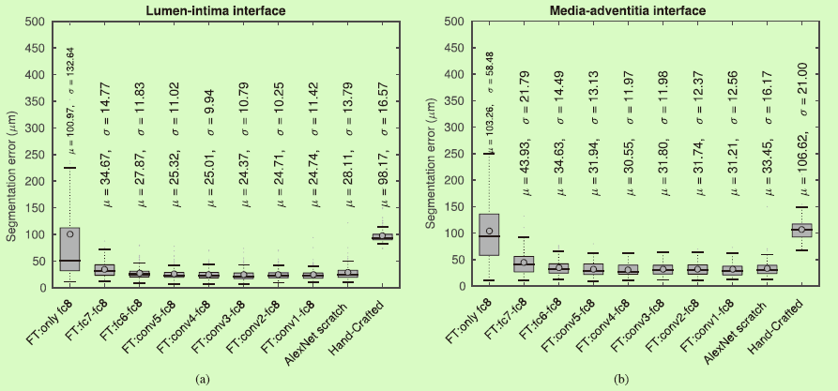
04
CNN Based medical image classification
Intima-Media Boundary Segmentation
Box plots of segmentation error for (a) the lumen-intima interface and (b) the media-adventitia interface.
Notes:
<number>

Slide 30
04
Challenges
Low resolution and blur images are still a challenge
Recognize classes not in the training set
Need a large amount of labeled training data
Need much extensive computational and memory resources
Notes:
<number>

Slide 31
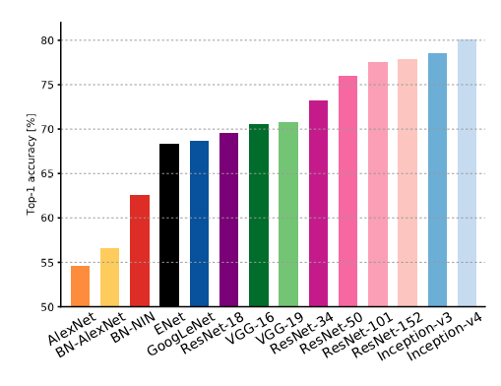
Validation accuracies for different architctures
Canziani A, Paszke A, Culurciello E, et al. An Analysis of Deep Neural Network Models for Practical Applications[J]. arXiv: Computer Vision and Pattern Recognition, 2016.

Slide 32
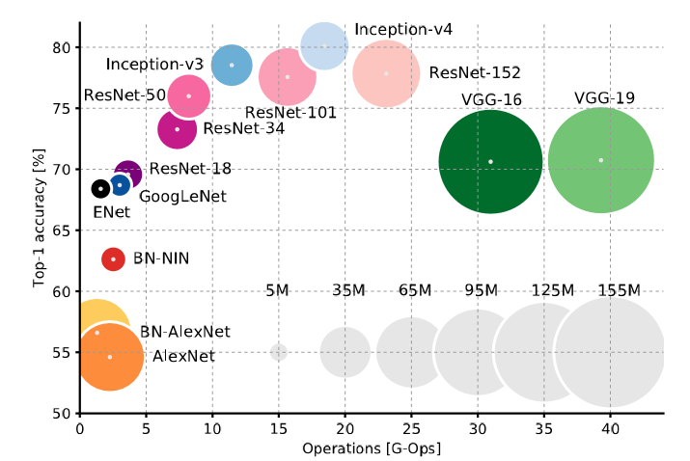
Accuracy and size of the model
Canziani, Alfredo, Adam Paszke, and Eugenio Culurciello. "An Analysis of Deep Neural Network Models for Practical Applications." arXiv: Computer Vision and Pattern Recognition (2016).

Slide 33
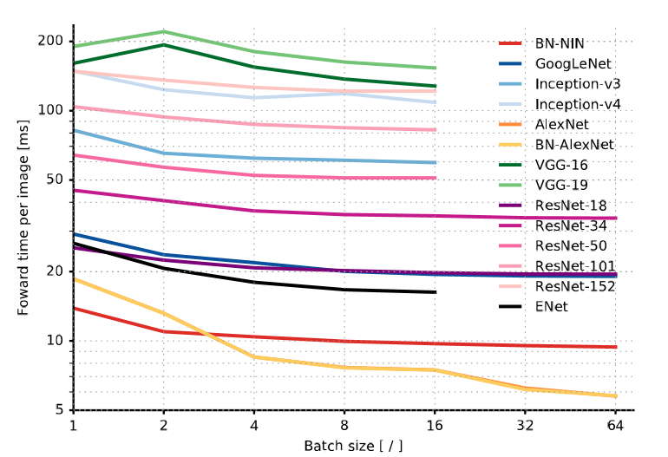
Inference time
Canziani, Alfredo, Adam Paszke, and Eugenio Culurciello. "An Analysis of Deep Neural Network Models for Practical Applications." arXiv: Computer Vision and Pattern Recognition (2016).

Slide 34
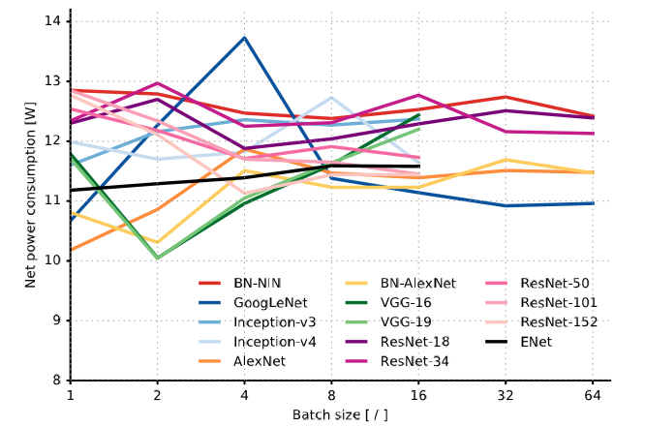
Power
Canziani, Alfredo, Adam Paszke, and Eugenio Culurciello. "An Analysis of Deep Neural Network Models for Practical Applications." arXiv: Computer Vision and Pattern Recognition (2016).

Slide 35
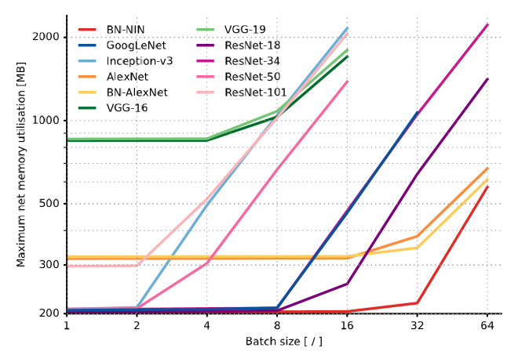
Memory
Canziani, Alfredo, Adam Paszke, and Eugenio Culurciello. "An Analysis of Deep Neural Network Models for Practical Applications." arXiv: Computer Vision and Pattern Recognition (2016).

Slide 36
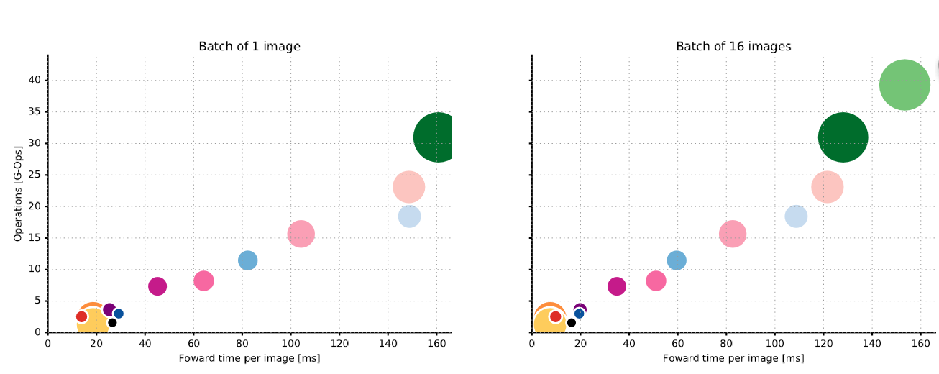
Canziani, Alfredo, Adam Paszke, and Eugenio Culurciello. "An Analysis of Deep Neural Network Models for Practical Applications." arXiv: Computer Vision and Pattern Recognition (2016).

Slide 37
Accuracy criteria
TOP 1 error: The correct answer is the top guess
TOP 5 error: The correct answer is in the top-5 guess

Slide 38
Dataset
MINIST
ImageNet
COCO
PASCAL VOC
CIFAR
Open Image

