Slide 1

CNN Based Image Classification
Xiaoling Long
Hongyu Chen
Ruiqi Luo

Slide 2
00
Outline
Workload
Successful CNN in ImageNet
R-CNN and Further work
Application Based on CNN Based image classification
Notes:
2

Slide 3
01
Workload
Everybody read about 13 papers in different aspect
Xiaoling Long focus on successful CNN in ImageNet and some inspiring Network
Hongyu Chen work …
Ruiqi Luo reads most paper about application in medical image processing
Notes:
3

Slide 4
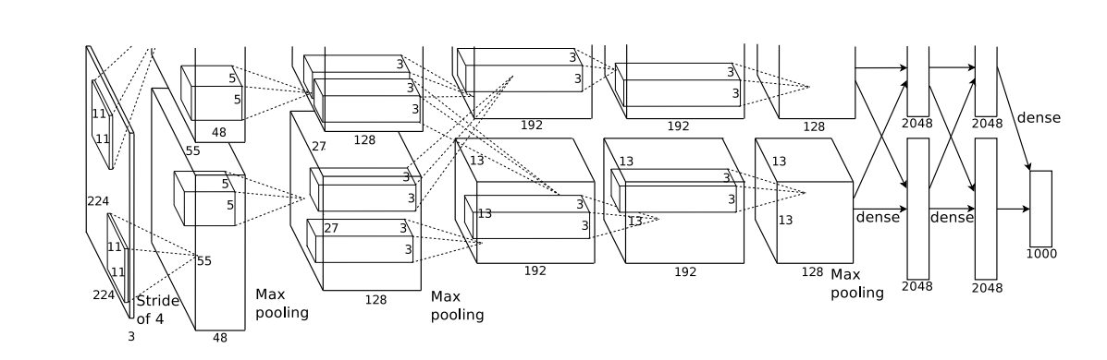
02
Successful CNN in ImageNet
Figure 1. AlexNet which is the first one CNN succeed in ImageNet
Notes:
4

Slide 5
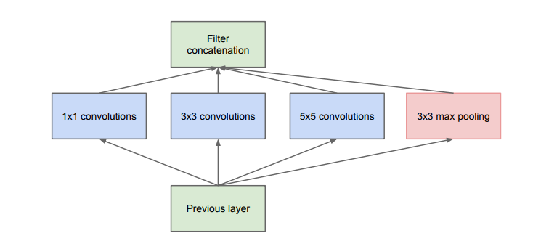
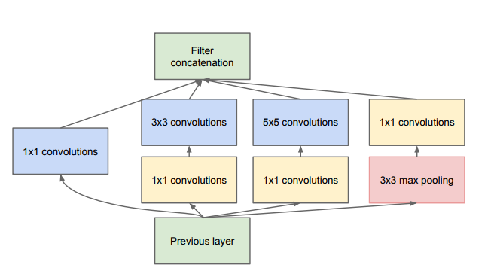
02
Successful CNN in ImageNet
Figure 2. Inception model in GoogLeNet. Left: Basic Inception model;
Right: Inception with dimension reductions
Notes:
5

Slide 6
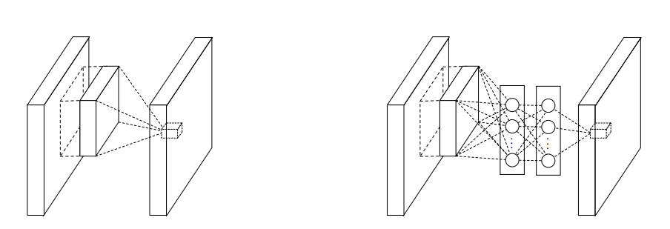
02
Successful CNN in ImageNet
Figure 3. Comparison of linear convolution layer and MLPconv layer.
Left: Normal convolution layer; Right: Replace with a Multi-Layer Perceptron(MLP).
Notes:
6

Slide 7
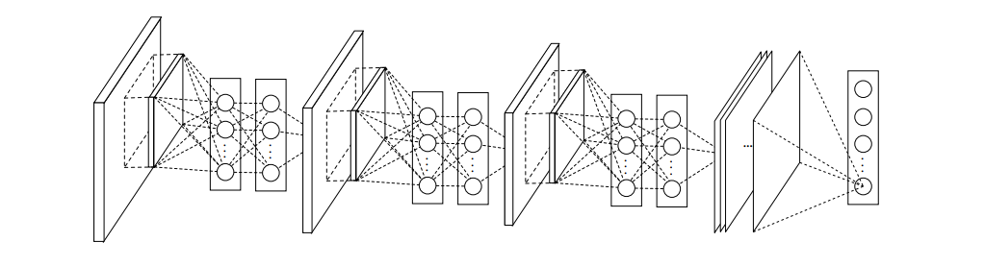
02
Successful CNN in ImageNet
Figure 4. Network in Network. Stacked by MLPconv layers and one
Global average pooling layer
Notes:
7

Slide 8
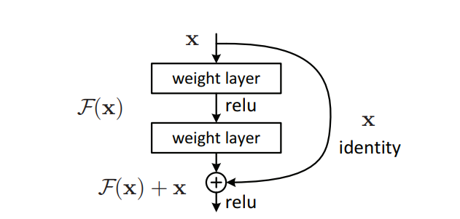
02
Successful CNN in ImageNet
Figure 5. Residual learning. ResNet is stacked by these modules
and one global average pooling layer.
Notes:
8

Slide 9
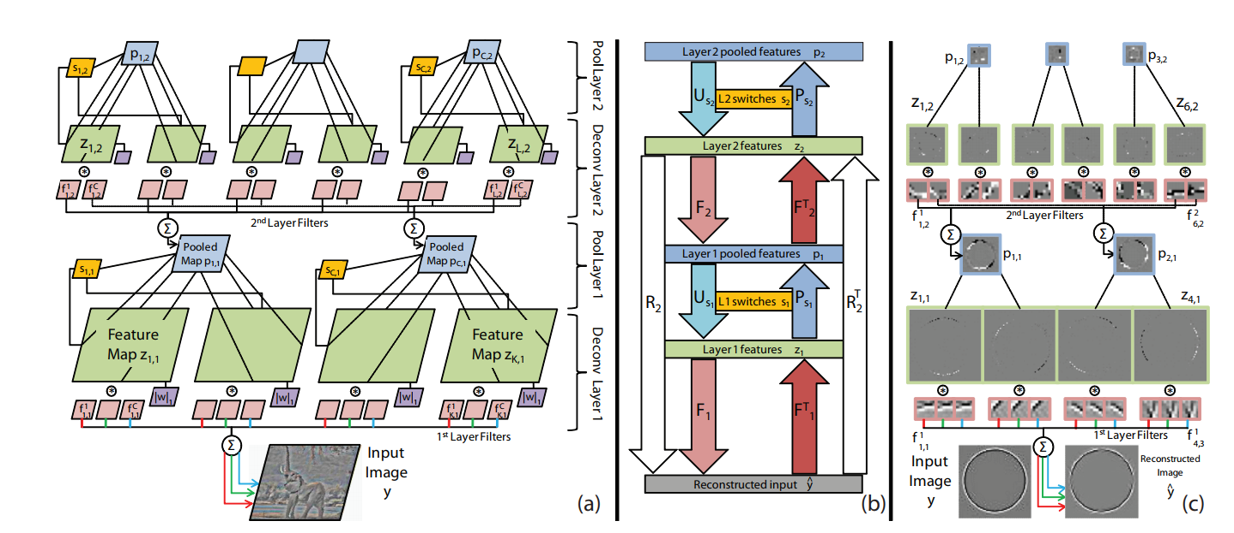
02
Successful CNN in ImageNet
Figure 6. Adaptive Deconvolutional Networks. This method is used in ZFNet
for understanding and visualization CNN
Notes:
9

Slide 10
03
R-CNN and Further work
Notes:
10

Slide 11
CNN Based medical image classification
04
CNN can extract a set of discriminating features at multiple levels of abstraction.
But train a deep CNN with full training is very complicated, because it may
1.Need a large amount of labeled training data
2.Need much extensive computational and memory resources
3.Overfitted
Notes:
11

Slide 12
CNN Based medical image classification
04
The recent research on transfer learning in medical imaging can be categorized into two groups. The first group consists of works wherein a pre-trained CNN is used as a feature generator. The second group consists of works wherein a pre-trained CNN is adapted to the application at hand.
Notes:
12

Slide 13
CNN Based medical image classification
04
Since datasets on medical images are usually small and involve privacy issues, the dataset used to train the CNN too small to train the full network.
In order to increase the accuracy, we can use the method of pre-training and fine-tuning.
The main advantage is that the same effect can be achieved in a shorter time than from scratch training.
Notes:
13

Slide 14
CNN Based medical image classification
04
Pre-training means using the model which has been trained by others to do the classification. For example, in survey, some authors use the pre-trained Alexnet to do the training.
Fine-tuning means to fix other parameters unchanged and to retrain the last few layers of the network, and then use the smaller learning rate to train the entire network.
Notes:
14

Slide 15
CNN Based medical image classification
04
Polyp detection
Pulmonary Embolism Detection
Intima-Media Boundary Segmentation
Notes:
15

Slide 16
CNN Based medical image classification
04
Polyp detection
Extract images from 40 short colonoscopy videos.
Training set contains 3,800 frames with polyps and 15,100 frames without polyps.
Test set contains 5,700 frames with polyps and 13,200 frames without polyps.
Notes:
16

Slide 17
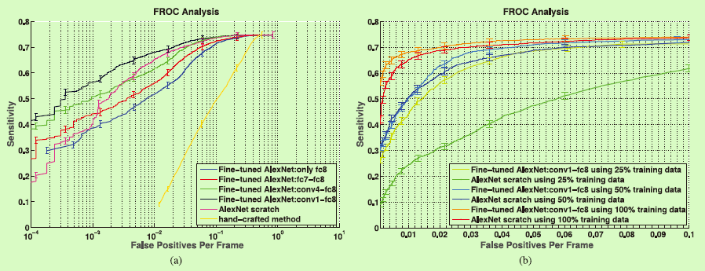
CNN Based medical image classification
04
Polyp detection
(a) Comparison between incremental fine-tuning, training from scratch, and a handcrafted approach [42]. (b) Effect of reduction in the training data on the performance of CNNs trained from scratch and deeply fine-tuned CNNs.
Notes:
17

Slide 18
CNN Based medical image classification
04
Pulmonary Embolism Detection
Extract dataset from 121 CT pulmonary angiographies.
Training set contains 434 frames with pulmonary embolism and 3406 frames without pulmonary embolism.
Test set contains 253 frames with pulmonary embolism and 2162 frames without pulmonary embolism.
Notes:
18

Slide 19
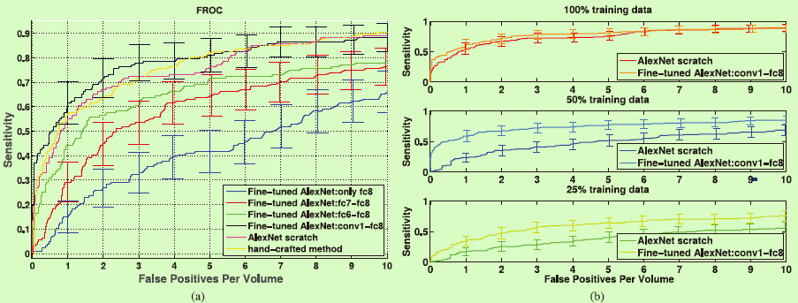
CNN Based medical image classification
04
Pulmonary Embolism Detection
(a) Comparison between incremental fine-tuning, training from scratch, and a handcrafted approach. To avoid clutter in the figure, error bars are displayed for only a subset of plots. A more detailed analysis is presented in Table S2 in the supplementary file.(b) Effect of reduction in the training data on the performance of CNNs trained from scratch and deeply fine-tuned CNNs.
Notes:
19

Slide 20
CNN Based medical image classification
04
Intima-Media Boundary Segmentation
Extract dataset from 92 carotid intima-media thickness (CIMT) videos. The expert reviews each video to determine 3 ROIs which can be measured reliably.
The authors divided the ROIs into a training set with 144 ROIs and a test set with 132 ROIs.
For training and fine-tuning the CNNs, the authors extracted a stratified set of 200,000 training patches from the training ROIs.
Notes:
20

Slide 21
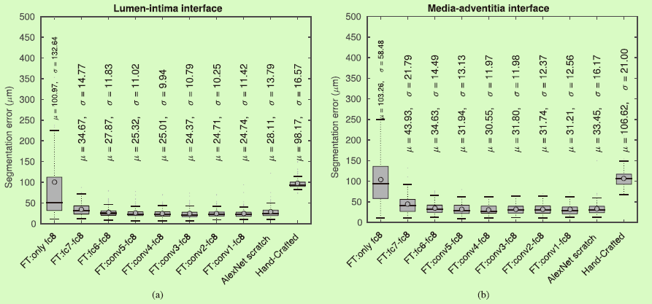
CNN Based medical image classification
04
Intima-Media Boundary Segmentation
Box plots of segmentation error for (a) the lumen-intima interface and (b) the media-adventitia interface.
Notes:
21

Slide 22
CNN Based medical image classification
04
Through the layer-wise fine-tuning, one can learn the effective depth of tuning, as it depends on the application at hand and the amount of labeled data available for tuning. Layer-wise fine-tuning may offer a practical way to achieve the best performance for the application at hand based on the amount of available data.
In these experiment we can know the potential of CNNs for medical imaging applications.
Notes:
22

Slide 23

THANKS!

