Slide 1
Camott-EcoSim
By Scott Saunders and Camilo Talero

Slide 2
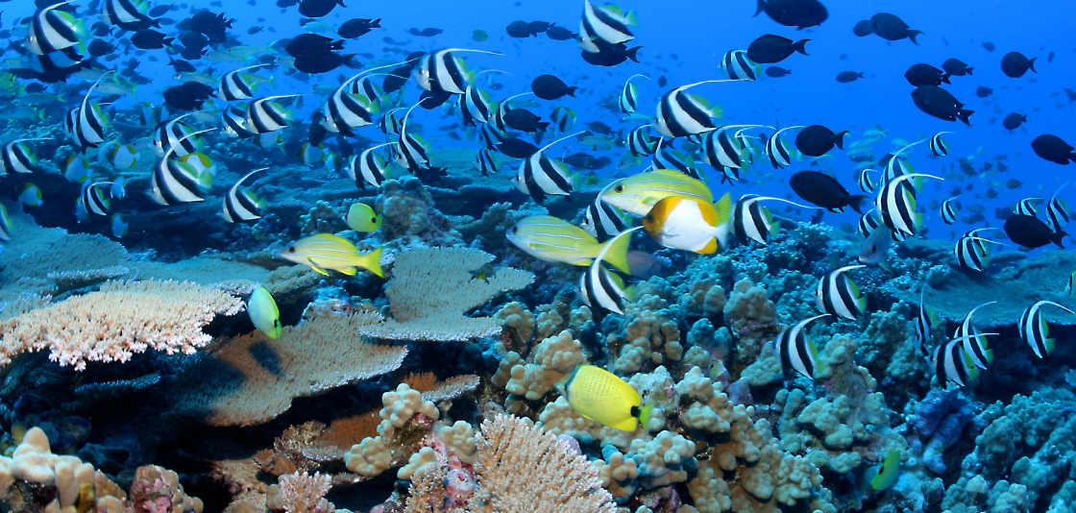
Introduction:
Ecosystems are emergent systems that evolve.

Slide 3
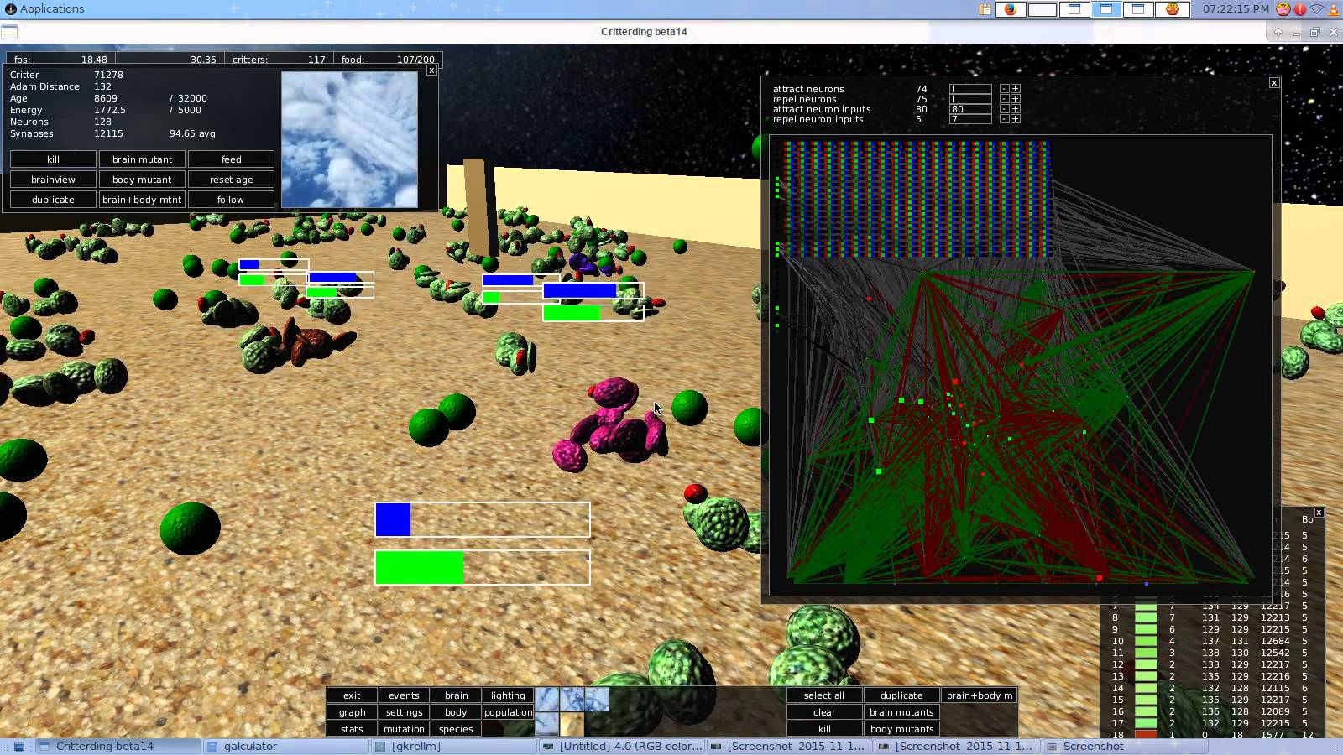
Inspiration
Critterding, an evolution simulator.

Slide 4
Project overview
We want to create a simple ecosystem simulator in which an original set of “creatures” changes and evolves over time.
The evolution should be guided by adjustable environment parameters such as food distribution, altitude, population density…
We hope to see behaviours such as predator-prey relationships, emerge over time.

Slide 5
The Creatures
Creatures should start with a simple “body” (they are blobs)
We permit creatures to reproduce, in-place evolve, or starve to death.
Body parts have hard coded attributes (initial cost,energy use, movement modifiers, detectors, defenses)
For control, we will have a hard coded brain or an evolving neural network brain.

Slide 6
The environment
Food: Creatures need to eat this for energy.
Region attributes: different areas of the environment should have different attributes (e.g cold → more energy used)
Environment properties should be customizable (i.e the original state should be decided by the user)

Slide 7
Challenges
Neural Network brain-trainer: Having some sort of quick-trainer for new creatures. (So they know to try to get food)
Pre-built Environments for the creatures to be in
Procedurally generated environments.
More components/parts for creatures.

