Slide 1
RLPD algorithm
concept

Slide 2
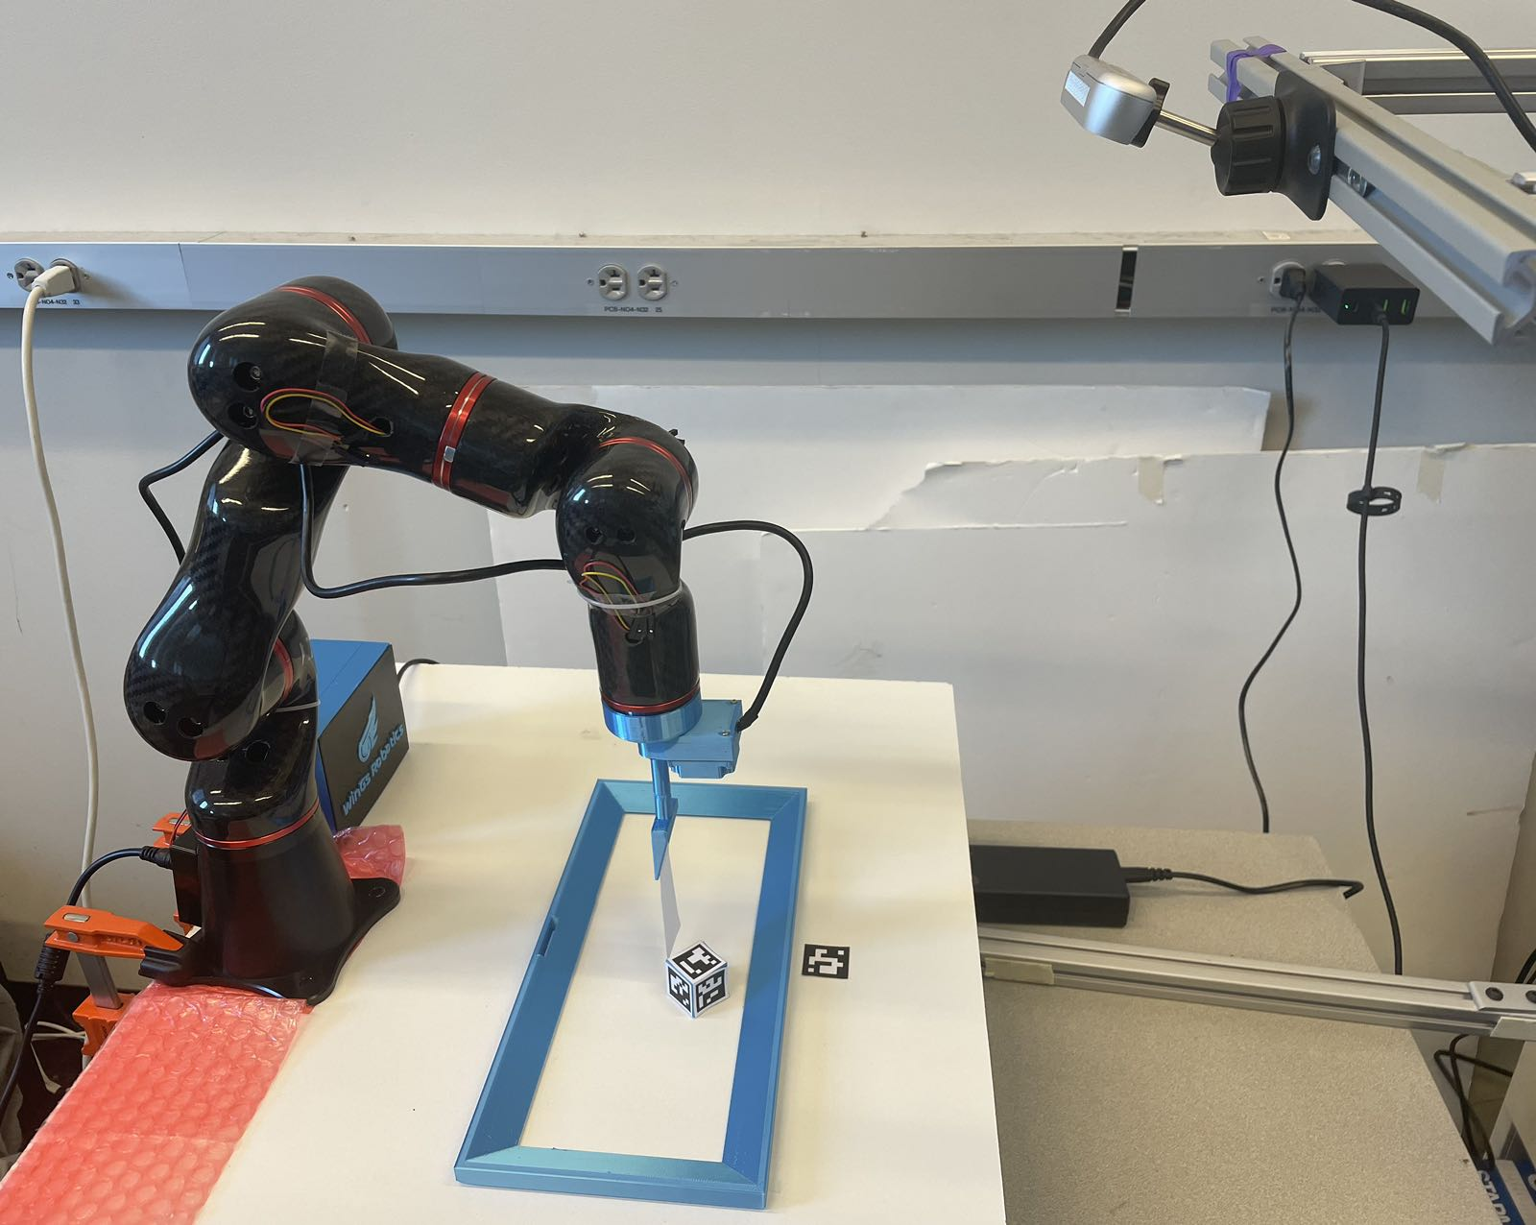
Communication with Hardware
30Hz
AR Code
Positions
Estimation
Read the cube position
Communication
Write EEP
FK
Action([x’, y’, rz’])
Robot Arm
APIs
80Hz
Read EEP
IK
Get_state()

Slide 3
Definitions
Dataset Dict:
Stage
State
Action
Reward
Mask
Done
Next State
Int stage # Has two stages, switch the two target positions, eliminate the need for environment reset
Array.Float [x, y, rz, xc, yc] # x, y, rz are the end-effector positions (EEP) of robot arm, xc, yc is the position of the cube
Array.Float [x’, y’, rz’] # x’, y’, rz’ are the end-effector position velocities (EEV)
Float reward # Reward is negatively propositional to the distances between cube & EEP times cube & target position
Float mask # Time limit cutoff
Boolean done # Task done or not
Array.Float [x, y, rz, xc, yc] # Next state
Buffer Json:
{
{
“Stage”: 1,
“State”: [0.12, 0.34, 0.12, 0.34, 0.82],
“Action”: [0.12, 0.59, 0.98]
“Reward”: 900.83
“Mask”: 1.0
“Done”: False
“Next State”: [0.13, 0.34, 0.12, 0.34, 0.82]
}
{
“Stage”: 1,
“State”: [0.12, 0.34, 0.12, 0.34, 0.82],
“Action”: [0.12, 0.59, 0.98]
“Reward”: 900.83
“Mask”: 1.0
“Done”: False
“Next State”: [0.13, 0.34, 0.12, 0.34, 0.82]
}
{
“Stage”: 1,
“State”: [0.12, 0.34, 0.12, 0.34, 0.82],
“Action”: [0.12, 0.59, 0.98]
“Reward”: 900.83
“Mask”: 1.0
“Done”: False
“Next State”: [0.13, 0.34, 0.12, 0.34, 0.82]
}
…
}

Slide 4
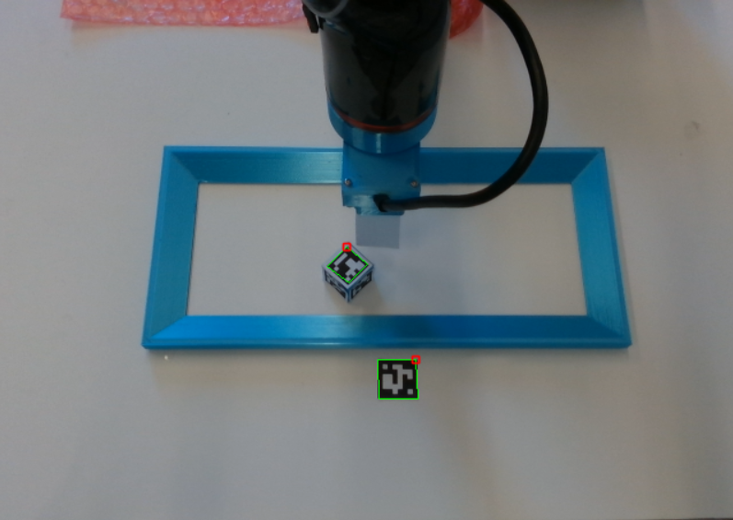
Stage
Int cur_stage
Stage update
Int new_stage
update_Stage()
Get_state()
Reward
Get_state()
Calculate Reward
Int reward
get_reward()
update_Stage()

Slide 5
Generate Offline dataset
Datasets Buffer
Experts’ Action
Experts
Communication
Prior Dataset
Output
Json
Experts’ Observation
Dataset update
Calculate Reward
Stage update
State Update

Slide 6
Online Training
Combine & Convert
Datasets
RLPD Train
Sample from Offline dataset
Action
Communication
Prior Dataset
Json
Datasets Buffer
Generate Offline dataset
Sample from Online dataset
Reward Update
Stage update
State Update
Online dataset update

Slide 7
experiment
Task
Move the cube between two different goals → partially observed
Find the cube on the field → partially observed
Reach out to certain location → fully observed, with reset

Slide 8
experiment
With/without pretrain
With
Without
With pretrain but with different offline data ratio
0.5, 0.9, 0.1
Different amount of offline data
About 1000 data points
About 100 data points

Slide 9
discussion

Slide 10
Future work
With/without pretrain
With
Without
With pretrain but with different offline data ratio
0.5, 0.9, 0.1
Different amount of offline data
About 1000 data points
About 100 data points

