Slide 1
Definitions
Dataset Dict:
Stage
State
Action
Reward
Mask
Done
Next State
Int stage # Has two stages, switch the two target positions, eliminate the need for environment reset
Array.Float [x, y, rz, xc, yc] # x, y, rz are the end-effector positions (EEP) of robot arm, xc, yc is the position of the cube
Array.Float [x’, y’, rz’] # x’, y’, rz’ are the end-effector position velocities (EEV)
Float reward # Reward is negatively propositional to the distances between cube & EEP times cube & target position
Float mask # Time limit cutoff
Boolean done # Task done or not
Array.Float [x, y, rz, xc, yc] # Next state
Buffer Json:
{
{
“Stage”: 1,
“State”: [0.12, 0.34, 0.12, 0.34, 0.82],
“Action”: [0.12, 0.59, 0.98]
“Reward”: 900.83
“Mask”: 1.0
“Done”: False
“Next State”: [0.13, 0.34, 0.12, 0.34, 0.82]
}
{
“Stage”: 1,
“State”: [0.12, 0.34, 0.12, 0.34, 0.82],
“Action”: [0.12, 0.59, 0.98]
“Reward”: 900.83
“Mask”: 1.0
“Done”: False
“Next State”: [0.13, 0.34, 0.12, 0.34, 0.82]
}
{
“Stage”: 1,
“State”: [0.12, 0.34, 0.12, 0.34, 0.82],
“Action”: [0.12, 0.59, 0.98]
“Reward”: 900.83
“Mask”: 1.0
“Done”: False
“Next State”: [0.13, 0.34, 0.12, 0.34, 0.82]
}
…
}

Slide 2
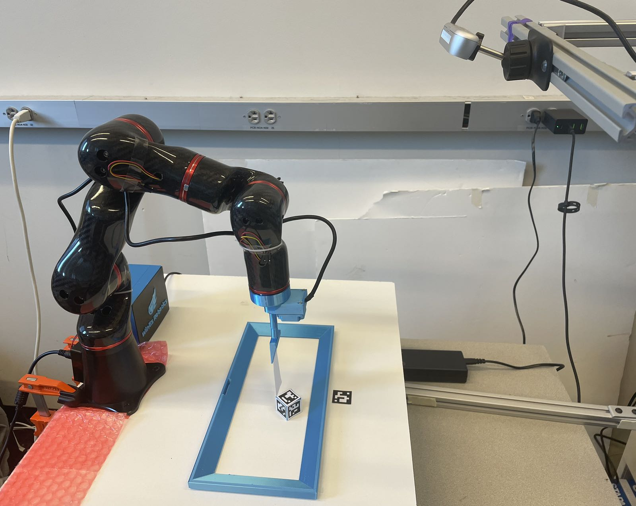
Communication with Hardware
30Hz
AR Code
Positions
Estimation
Read the cube position
Communication
Write EEP
FK
Action([x’, y’, rz’])
Robot Arm
APIs
80Hz
Read EEP
IK
Get_state()

Slide 3
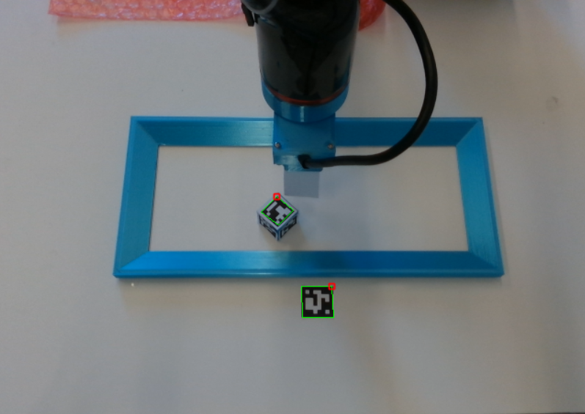
Stage
Int cur_stage
Stage update
Int new_stage
update_Stage()
Get_state()
Reward
Get_state()
Calculate Reward
Int reward
get_reward()
update_Stage()

Slide 4
Generate Offline dataset
Datasets Buffer
Experts’ Action
Experts
Communication
Prior Dataset
Output
Json
Experts’ Observation
Dataset update
Calculate Reward
Stage update
State Update

Slide 5
Online Training
Combine & Convert
Datasets
RLPD Train
Sample from Offline dataset
Action
Communication
Prior Dataset
Json
Datasets Buffer
Generate Offline dataset
Sample from Online dataset
Reward Update
Stage update
State Update
Online dataset update

