Slide 1
Definitions
Dataset Dict:
Stage
State
Action
Reward
Mask
Done
Next State
Int stage # Has two stages, switch the two target positions, eliminate the need for environment reset
Array.Float [x, y, rz, xc, yc] # x, y, rz are the end-effector positions (EEP) of robot arm, xc, yc is the position of the cube
Array.Float [x’, y’, rz’] # x’, y’, rz’ are the end-effector position velocities (EEV)
Float reward # Reward is negatively propositional to the distances between cube & EEP times cube & target position
Float mask # Time limit cutoff
Boolean done # Task done or not
Array.Float [x, y, rz, xc, yc] # Next state
Json:
{
{
“Stage”: 1,
“State”: [0.12, 0.34, 0.12, 0.34, 0.82],
“Action”: [0.12, 0.59, 0.98]
“Reward”: 900.83
“Mask”: 1.0
“Done”: False
“Next State”: [0.13, 0.34, 0.12, 0.34, 0.82]
}
{
“Stage”: 1,
“State”: [0.12, 0.34, 0.12, 0.34, 0.82],
“Action”: [0.12, 0.59, 0.98]
“Reward”: 900.83
“Mask”: 1.0
“Done”: False
“Next State”: [0.13, 0.34, 0.12, 0.34, 0.82]
}
{
“Stage”: 1,
“State”: [0.12, 0.34, 0.12, 0.34, 0.82],
“Action”: [0.12, 0.59, 0.98]
“Reward”: 900.83
“Mask”: 1.0
“Done”: False
“Next State”: [0.13, 0.34, 0.12, 0.34, 0.82]
}
…
}

Slide 2
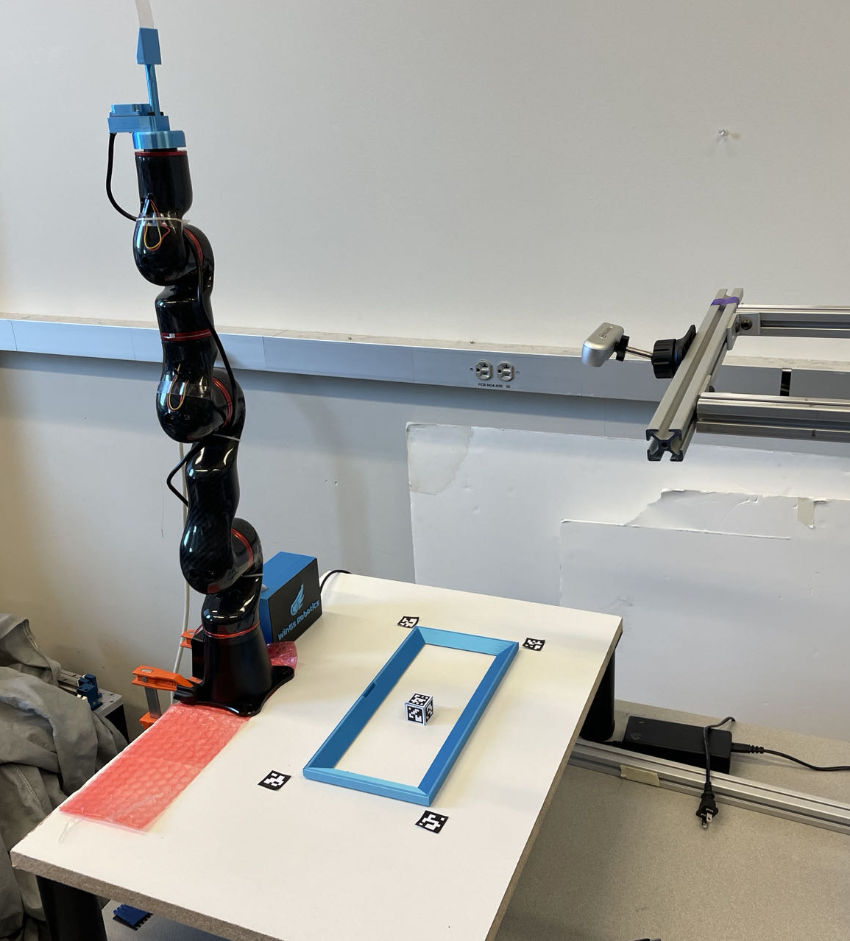
Communication with Hardware
30Hz
AR Code
Positions
Estimation
Read the cube position
Communication
Write EEP
FK
Action([x’, y’, rz’])
Robot Arm
APIs
80Hz
Read EEP
IK
Get_state()

Slide 3
Stage
Int cur_stage
Stage update
Int new_stage
update_Stage()
Get_state()
Reward
Get_state()
Calculate Reward
Int reward
get_reward()
update_Stage()

Slide 4
Generate Offline dataset
Datasets Buffer
Experts’ Action
Experts
Communication
Prior Dataset
Output
Experts’ Observation
Dataset update
Calculate Reward
Stage update
State Update

Slide 5
Online Training
Datasets Buffer
RLPD Train
Sample from Offline dataset
Action
Communication
Generate Offline dataset
Prior Dataset
Sample from Online dataset
Reward Update
State Update
Online dataset update

