Slide 1
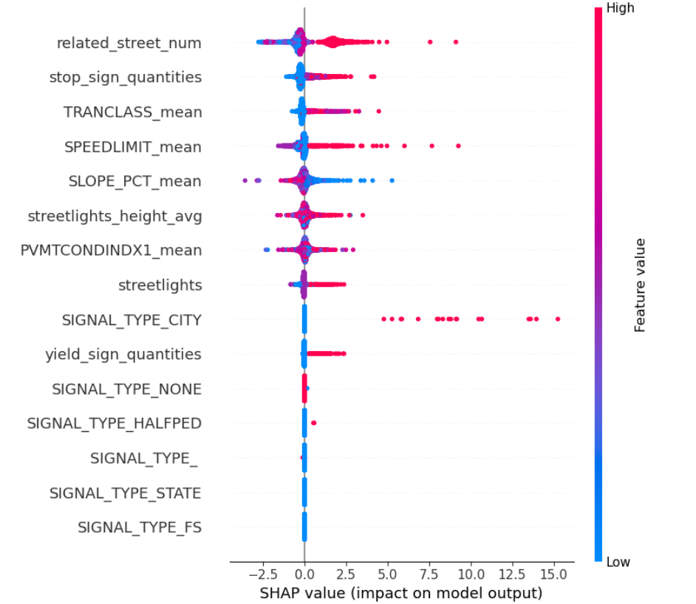
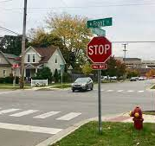
Non-traffic lights intersection, rows: 13813
Mean of collision_rate: 1.5477098868215942
Random Forest：
Cross-validation scores: [ 8.85100644 9.32176777 8.65582848 8.72829925 10.03720718]
Mean squared error on test set: 8.905118645565846

Slide 2
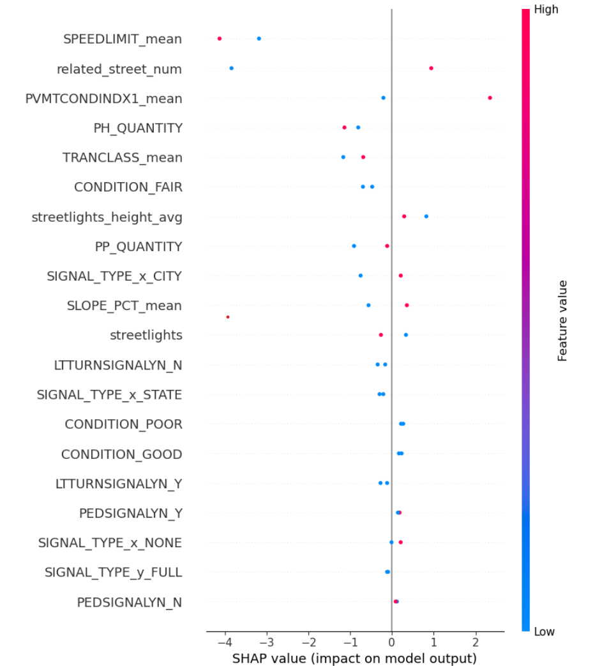
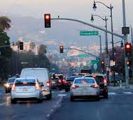
traffic lights intersection, rows: 1102
Mean of collision rate: 17.05255595886268
Random Forest：
Cross-validation scores: [214.09171394 130.87544993 155.27798708 184.00003655 214.75248902]
Mean squared error on test set: 14.182536111111109

Slide 3
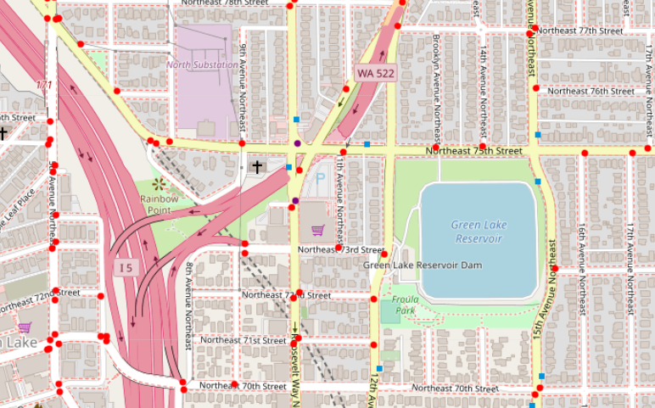
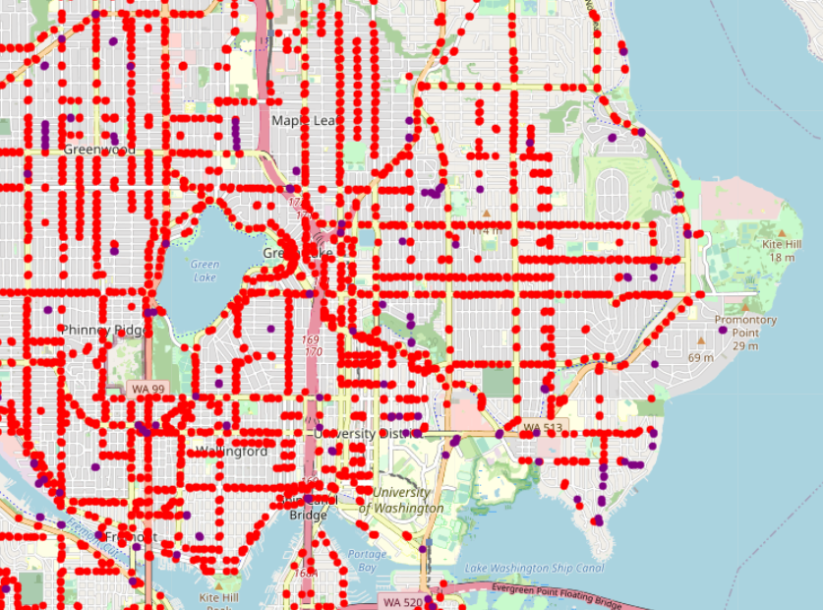
AHA moments

Slide 4
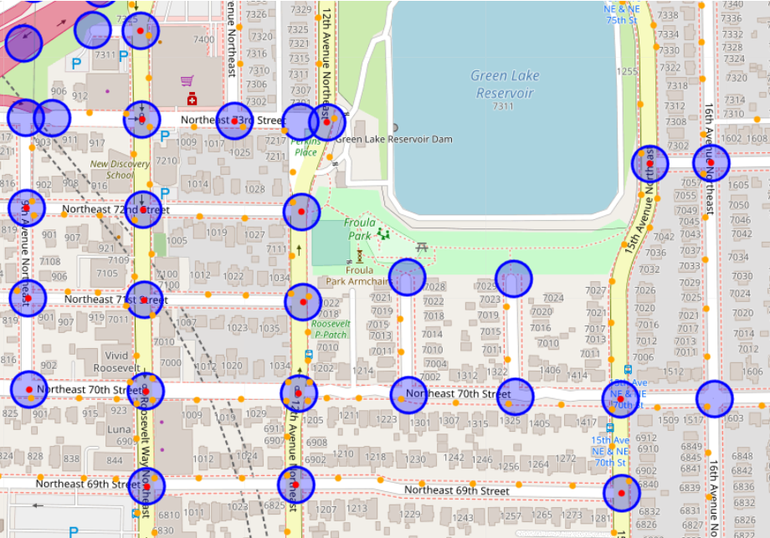
AHA moments

Slide 5
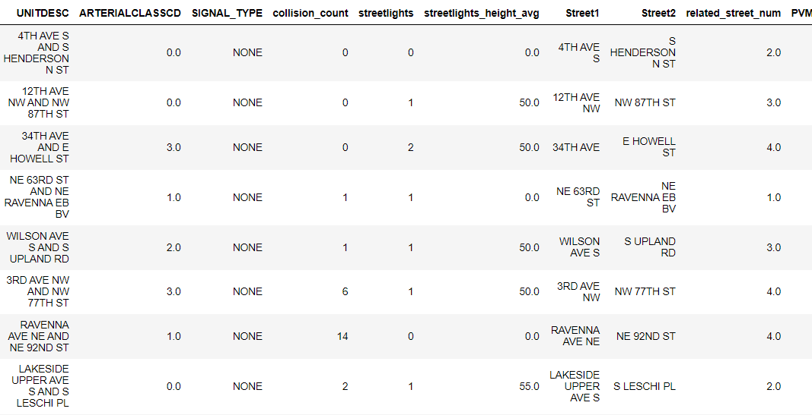
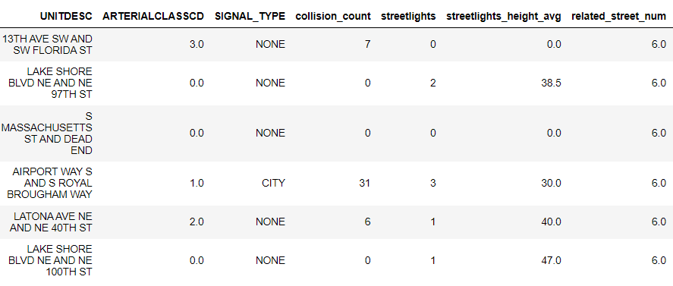
AHA moments

Slide 6
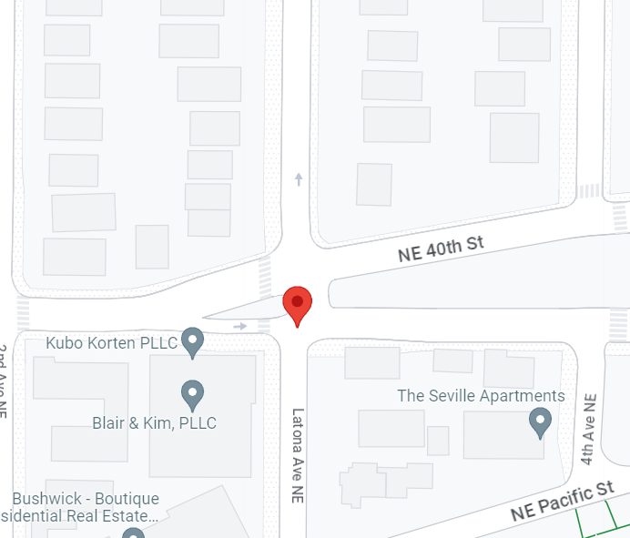
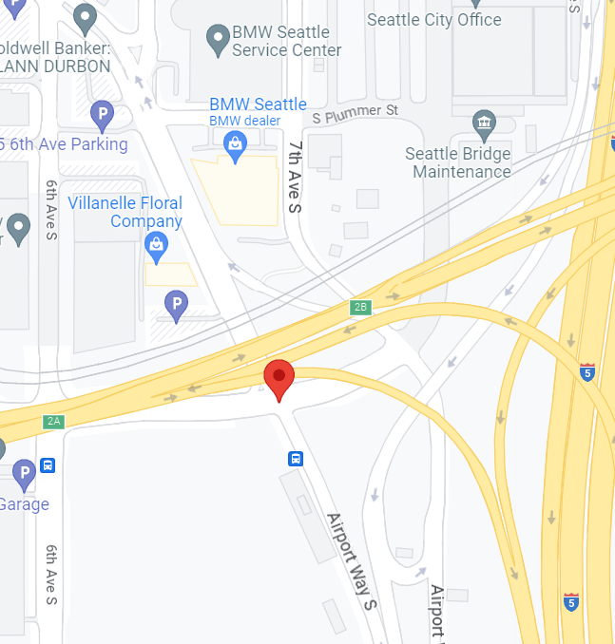
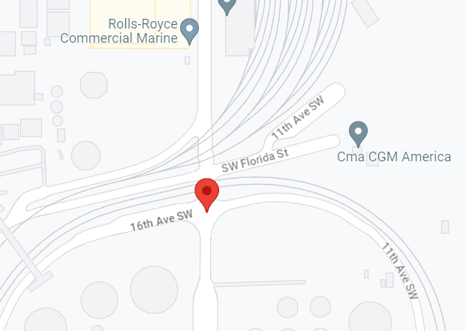
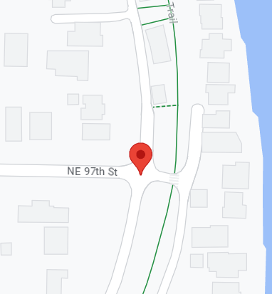
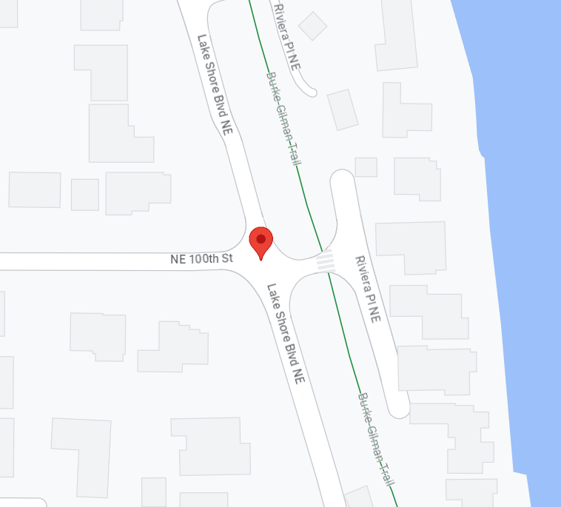
AHA moments

Slide 7
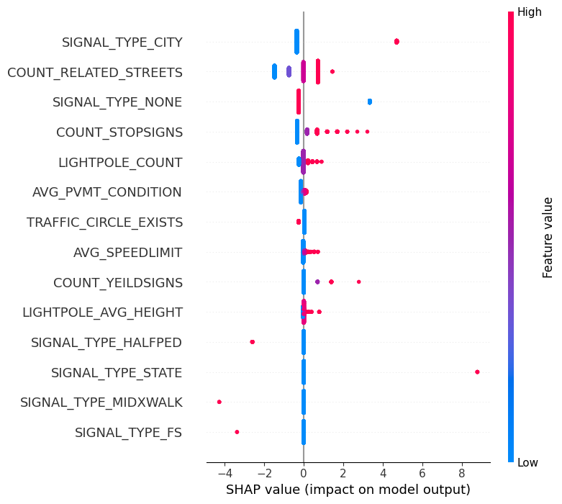
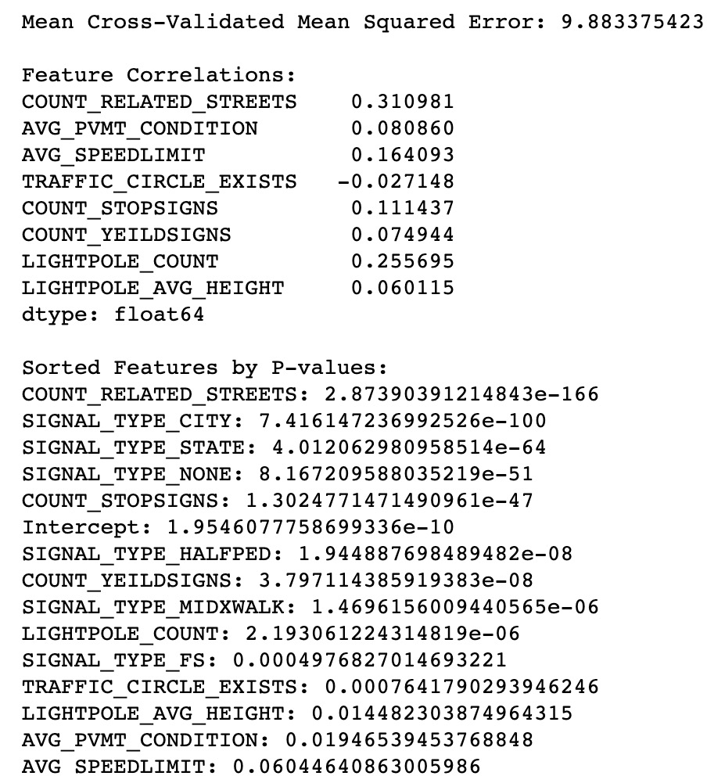
Features vs Collision Rate (collision/re-ordered arterial class) Linear regression

Slide 8
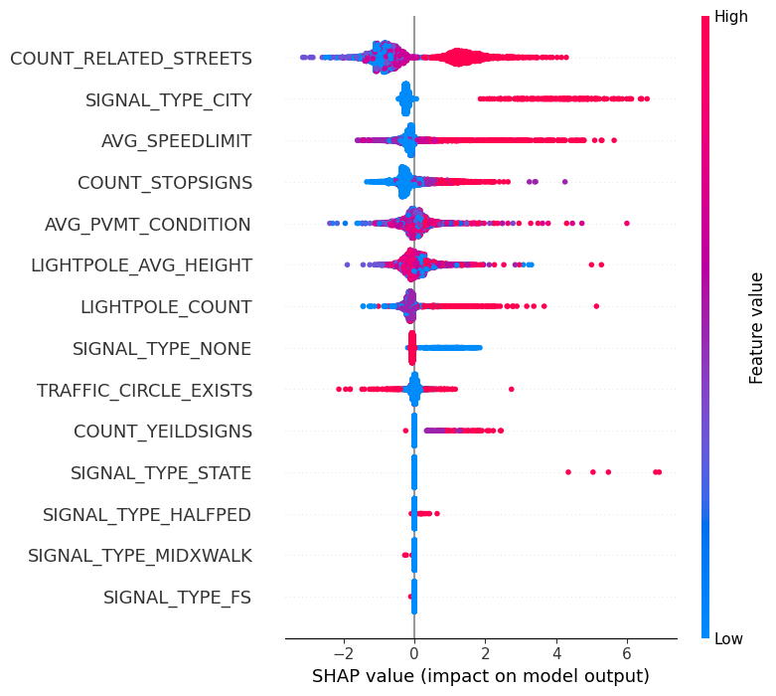
Features vs Collision Rate (collision/re-ordered arterial class) Random Forest
Cross-validation scores: [10.56498874 11.99342862 11.63402024 12.7279217 9.41678166] Mean squared error on test set: 9.771746843696976

Slide 9
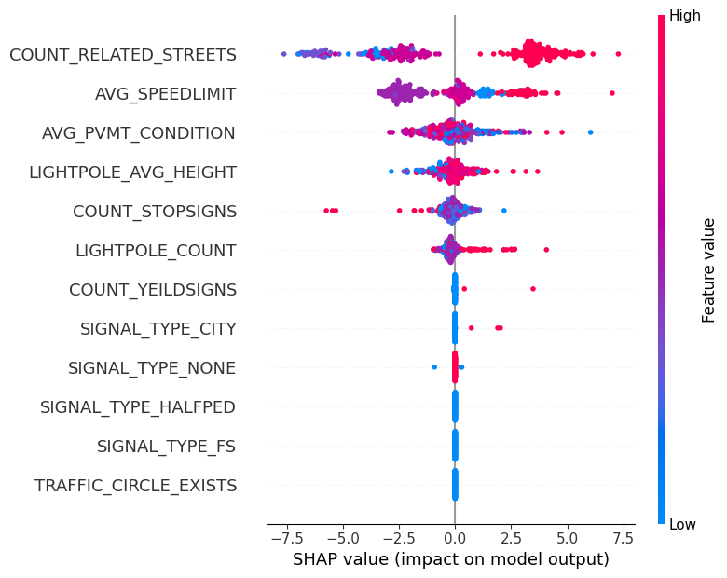
Features vs Collision (Collector_Arterial) Random Forest
Cross-validation scores: [27.03027737 43.34711032 36.45152755 32.42040656 35.67921892] Mean squared error on test set: 36.62236302914919

Slide 10
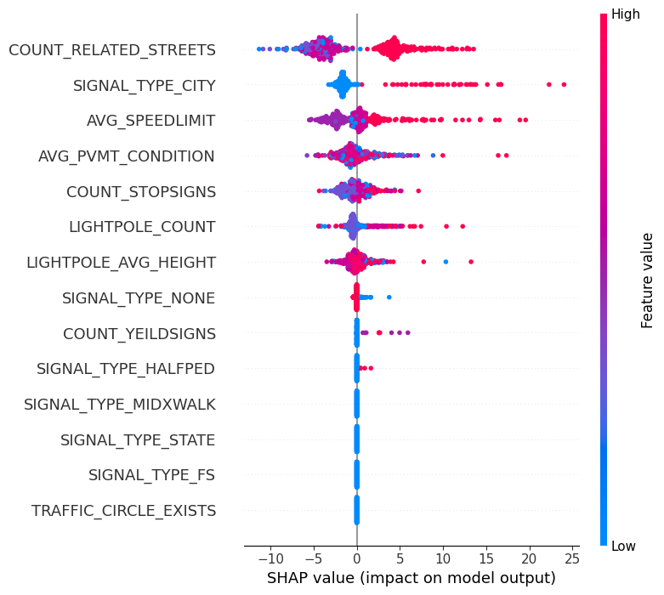
Features vs Collision (Minor_Arterial) Random Forest
Cross-validation scores: [153.95835289 109.01777443 147.56410675 140.36152864 108.83229522] Mean squared error on test set: 227.483640764444

Slide 11
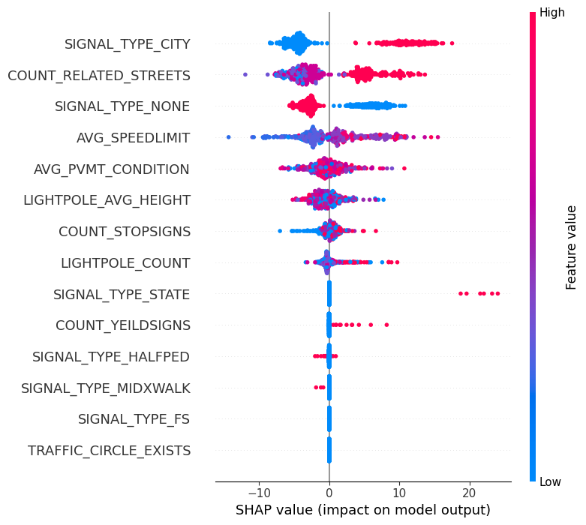
Features vs Collision (Principal_Arterial) Random Forest
Cross-validation scores: [644.29664377 451.21026644 456.88107736 494.90800292 413.73354613] Mean squared error on test set: 519.1158571500497

Slide 12
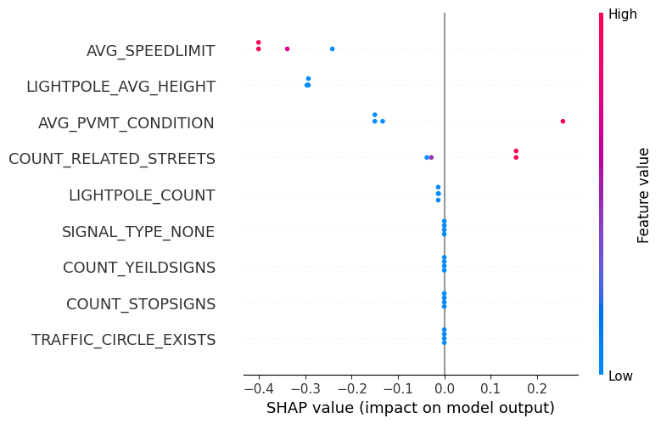
Features vs Collision (State_Highway) Random Forest
Cross-validation scores: [ 0.26980023 0.13437306 6.90745222 11.38698091 0.12219086] Mean squared error on test set: 0.9242603702215219

Slide 13
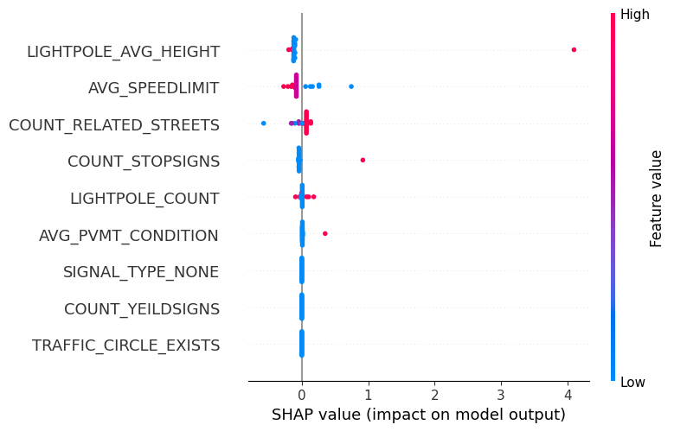
Features vs Collision (Interstate_Freeway) Random Forest
Cross-validation scores: [0.4248105 4.88537611 7.65114528 0.08907943 4.19584804] Mean squared error on test set: 0.5668490219847808

