Slide 1
Doing Data Science Talent Management Analysis– Case Study 2 Tamas Toth

Slide 2

Data and Objective
The dataset is comprised of 870 observations and 36 variables (numerical & categorical)
Tidy data with no missing values
Objective:
Explore and visualize the dataset to provide job role specific trends.
Build classification models to predict if an employee will leave the company or not. Use KNN and Naive Bayes models.
Build regression model to predict salary
Provide recommendations that will help DDSAnalytics to identify factors that lead to attrition.

Slide 3
Facts about DDSAnalytics
870 employees with 36 attributes.
There are 7 job roles.
Overall attrition is 16%.
~75% of the employees are between 18 and 43 years of age.
There are more Male than Females in the company.
The minimum monthly income is $1081, and the maximum is $19999.
Everybody received salary increase. The min increase was 11% and the max salary increase employee received is 25%.
Last year in average employees took training 3 times.
Employees usually stays shorter period with the company.
In average employees gets promoted every two years.
Employees in average stay with their managers for ~4 years.
The median education level of the employees are 3.

Slide 4
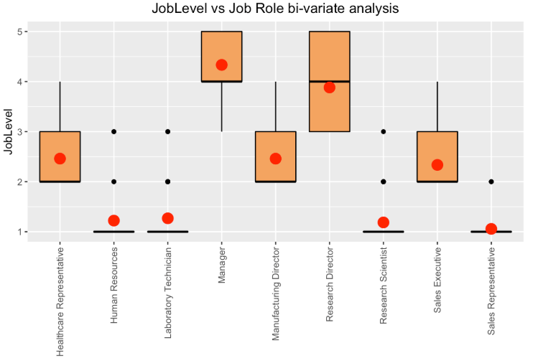
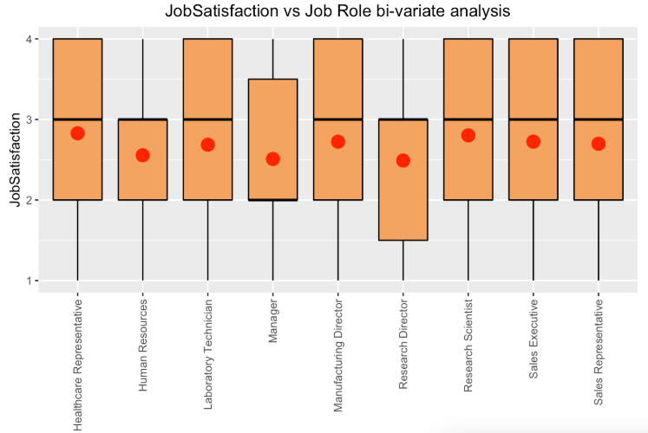
Job Levels and Satisfaction by Job Roles
Low job levels in key positions
Pay attention to Managers’ satisfaction

Slide 5
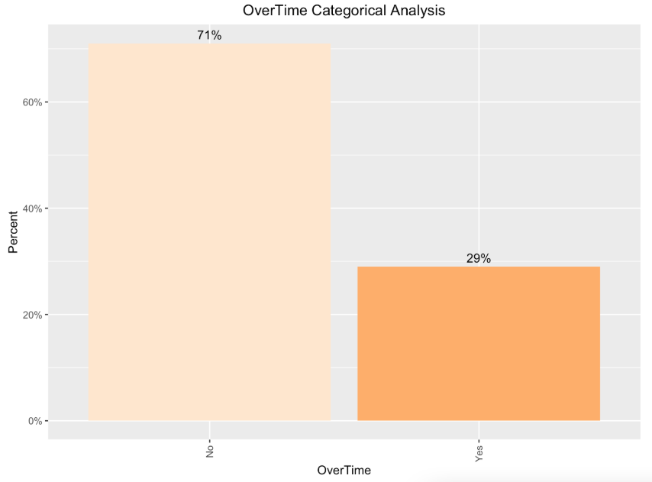
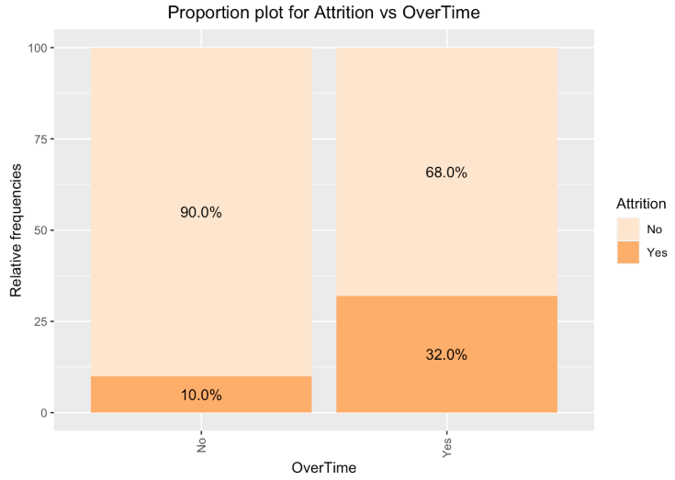
Attrition – Relative proportion for Overtime
Large portion working overtime leaves the company
29% of the total employees work overtime

Slide 6
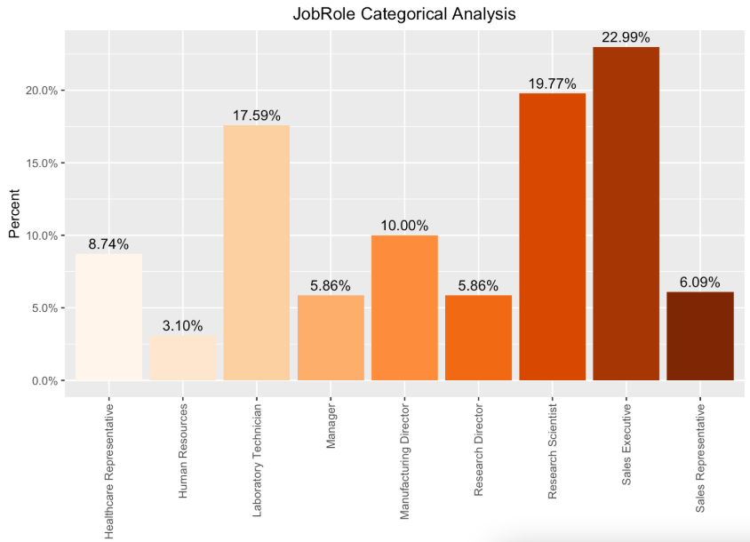
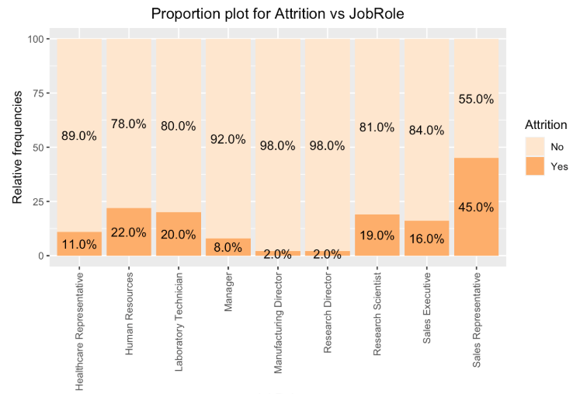
Attrition – Relative proportion for Job Roles
Attrition relative to its proportion at the company
Large portion are on low job levels

Slide 7
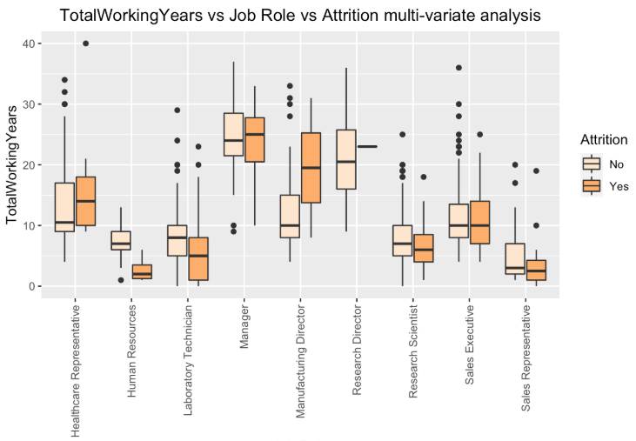
Job role trend for experienced hires
The most experienced employees are the managers and Research directors
Those who have less work experience tend to resign more except management. From the management the more experienced ones are leaving the company.

Slide 8
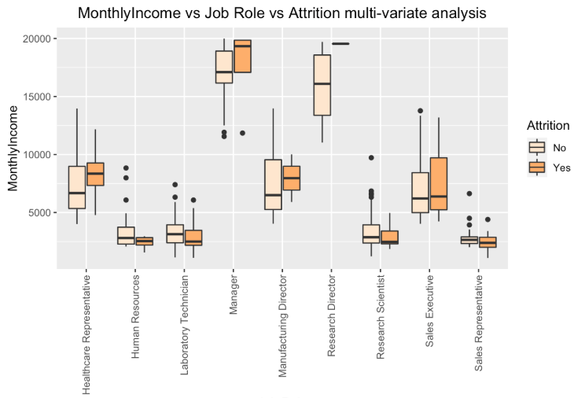
Job role trend by Monthly Income
The median monthly income are in three buckets. Below 5000; Between 5000 and 10000; Above 10000.
Median monthly income is lower for those who left the company except for managers and research director.
The highest paid job roles are Managers and Research Directors.

Slide 9

Profile of employees who resigned
Management resigns at higher age (>40), other job roles are below 40.
Those who resigned lived in a median distance of 20 miles or less from the company.
Most job roles who resigned had a median monthly salary below 10000 except Managers and Research directors. Likely reason for resignation for these two roles is a lower median salary increase and job satisfaction.
Even though research scientists had a salary increase > 15% they resigned.
Resignations happens for those who has less then a median 25 year of work experience.
Most resignation are with a median years with the company of less than 10 years.
The median years of last promotion for those who resigned is less than 3 years.

Slide 10
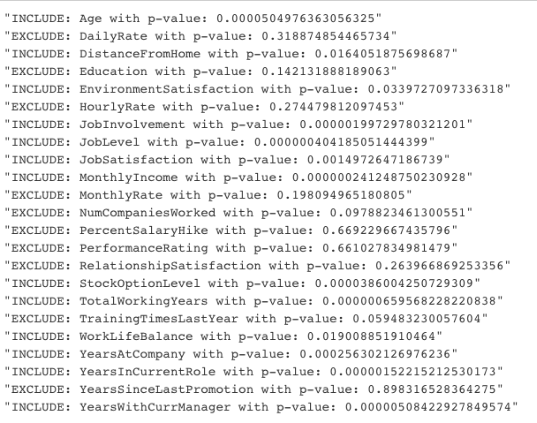
Hypothesis Test for feature selection
Large number of features in the dataset -> needs selection for predictive modeling
Implemented a two-sample t-test
T-test:
Used Welch’s two sample t-test due to violation of equal standard deviations.
H₀:μ_{Attrition}= μ_{No Attrition}
H_{a}: μ_{Attrition} ≠ μ_{No Attrition}
Based on the hypothesis test if the p-value > 0.05 then it means that there is not enough evidence to suggest that the “attrition” and “no attrition” groups are different therefore we should not include those variables into the model.

Slide 11
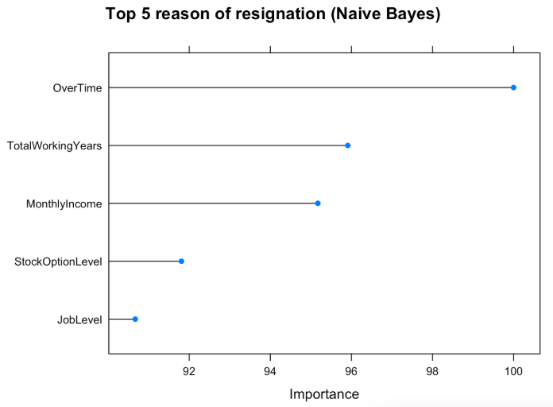
Predicting Attrition with KNN and Naïve Bayes models
Key criteria for the models was to attain at least 60% sensitivity and specificity
Data set | KNN |  | Naïve Bayes
 | Specificity | Sensitivity | Specificity | Sensitivity
Training | 0.8783 | 0.8235 | 0.8598 | 0.8824
Validation | 0.8606 | 0.7000 | 0.8482 | 0.7500
Conclusion:
Both models are performing well however the Naive Bayes model outperforms the KNN model on the validation data set therefore I would recommend using this Naive Bayes model for predicting attrition.

Slide 12
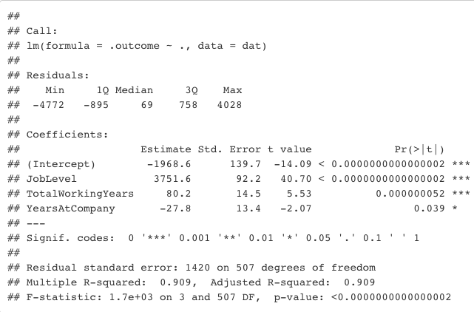
Predicting Salary using a Multiple Linear Regression (MLR) model
Key criteria for the models was to attain a RMSE < $3000 for the training and the validation set
Following variables have linear relationship with MonthlyIncome:
Age - insignificant p-value -> removed
JobLevel, TotalWorkingYears, YearAtCompany
Data set | MLR
 | RMSE | R-sq
Training | 1419.36 | 0.9095
Validation | 1355.90 | 0.9127
Conclusion:
The model met all the Linear Regression assumptions as well as the key performance criteria therefore this model is suitable for predicting monthly salary. The model ONLY considered those employees who are still with the company.

Slide 13
Key takeaways
I suggest to use the Naive Bayes model to predict attrition as the model is performing well.
Pay attention to employees working overtime as they tend to resign more frequently.
Implement a program that will encourage younger employees to stay with the company as people with less then 10 years of work experience tend to leave the company more often.
Salary in many cases is an important factor for attrition. Make sure that the salary of the employees stays competitive, even extending the Stock options will help.
I also recommend using the Regression model for predicting monthly salary. This could help the company to retain employees and stay competitive on the job market by better planning salaries.

Slide 14
Q & A

