Slide 1
CS305 - Social, Ethical, and Legal Issues
Instructor: Nguyen Van Vu

Slide 2
Ethical issues of BitTorrent in Vietnam
Quoc Lap Trieu Advanced Program in Computer Science Faculty of Information Technology University of Science, VNU-HCM Email: tqlap@apcs.vn
Thien Thai Advanced Program in Computer Science Faculty of Information Technology University of Science, VNU-HCM Email: tthien@apcs.vn

Slide 3
I. Introduction

Slide 4
Introduction
Internet has been considered as one of the vital factors for the development of society.
As the society growth, the needs of transferring large data between people through the use of Internet does also increase

Slide 5
Introduction
Due to disadvantages of Client-Server networking, peer-to-peer networking was invented.
Peer-to-peer file sharing protocol such as BitTorrent was used to shared copyright material.

Slide 6
Introduction
Vietnam is one of the countries which are commonplace for this phenomenon
Therefore, we choose Vietnam as a turning point to debate this problem using theories and principles of ethics.

Slide 7
II. Background

Slide 8
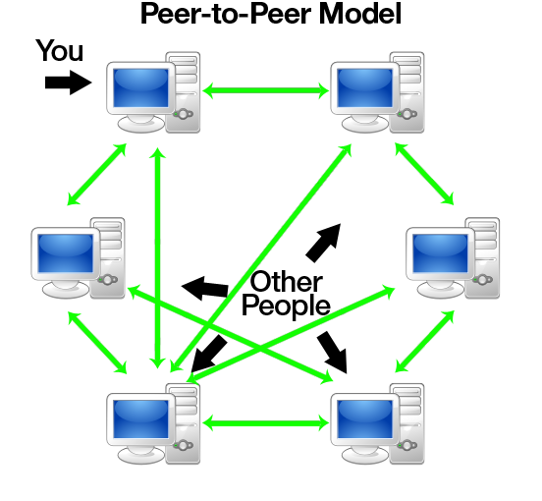
Background
No central server
Peers have equally privileged
Each peers share their resource to network
source: http://www.codeproject.com/KB/WCF/614028/pto1.png

Slide 9
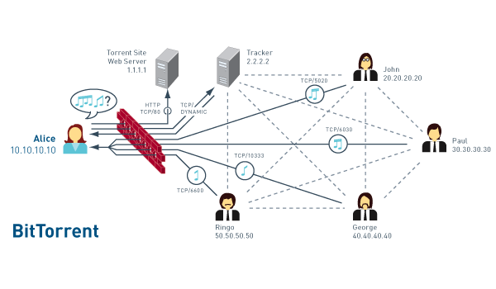
Background

Slide 10
III. METHODOLOGY

Slide 11
Methodology

