Slide 1
CS305 - Social, Ethical, and Legal Issues
Instructor: Nguyen Van Vu

Slide 2
Ethical issues of BitTorrent in Vietnam
Quoc Lap Trieu Advanced Program in Computer Science Faculty of Information Technology University of Science, VNU-HCM Email: tqlap@apcs.vn
Thien Thai Advanced Program in Computer Science Faculty of Information Technology University of Science, VNU-HCM Email: tthien@apcs.vn

Slide 3
I. Introduction

Slide 4
Introduction
Internet has been considered as one of the vital factors for the development of society.
As the society growth, the needs of transferring large data between people through the use of Internet does also increase

Slide 5
Introduction
Due to disadvantages of Client-Server networking, peer-to-peer networking was invented.
Peer-to-peer file sharing protocol such as BitTorrent was used to shared copyright material.

Slide 6
Introduction
We will debate this phenomenon using theories and principles of ethics.

Slide 7
II. Background

Slide 8
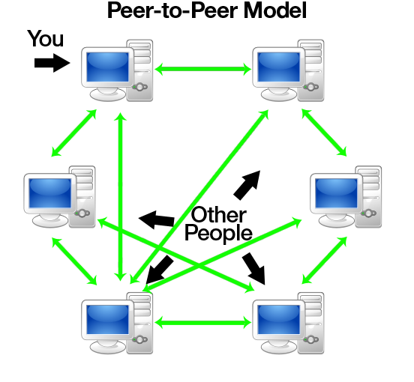
Background
No central server
Peers have equally privileged
Each peers share their resource to network
source: http://www.codeproject.com/KB/WCF/614028/pto1.png

Slide 9
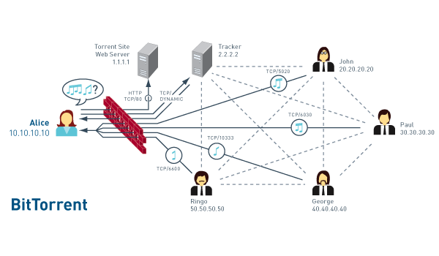
Background

Slide 10
III. METHODOLOGY

Slide 11
Subjective Relativism
+ convenience, easy to use
+ save money (especially for get pirated material)
Copyright owner: hurt their sale.
ISP: consume a lot of bandwidth

Slide 12
Cultural Relativism
+ Switzerland: it is legal for personal use copyrighted material
+ Vietnam: people are used to use copyrighted material for free, not only for personal use but for commerce (such as sell DVD for profit).
- Canada, US, UK :illegal to download copyrighted material

Slide 13
Divine Command theory
Many bible teach us how to treat with others’ property with we can apply to intellectual property
“You shall not steal.” (Exodus 20:15)
“Cursed is the one who moves his neighbor's landmark” (Deuteronomy 27:17)
=>It is wrong to download copyrighted material via BitTorrent.

Slide 14
Kantianism
-People should pay to use copyrighted material.
-If people download it via BitTorrent, they use the creator at the mean to the end (a way to get material for free).

Slide 15
Act Utilitarianism
-Someone share publicly copyrighted material for free via BitTorrent.
-Benefit: People download for free without buy. => save some money
-Harm: Copyrighted owner can’t sell product => some people loss job.
Harm > Benefit => it is wrong

Slide 16
Rule Utilitarianism
-Many people are used to get copyrighted material from BitTorent
-Benefit: Save some money
-Harm: No one want to create intellectual property.
Harm > Benefit => it is wrong

