Slide 1
CS305 - Social, Ethical, and Legal Issues
Instructor: Nguyen Van Vu

Slide 2
Ethical issues of BitTorrent
Quoc Lap Trieu Advanced Program in Computer Science Faculty of Information Technology University of Science, VNU-HCM Email: tqlap@apcs.vn
Thien Thai Advanced Program in Computer Science Faculty of Information Technology University of Science, VNU-HCM Email: tthien@apcs.vn

Slide 3
I. Introduction

Slide 4
Introduction
Internet has been considered as one of the vital factors for the development of society.
The needs of transferring large data between people through the use of Internet increase.

Slide 5
Introduction
Peer-to-peer networking was invented.
Peer-to-peer file sharing protocol such as BitTorrent was used to shared copyrighted materials.

Slide 6
Introduction
We will debate this phenomenon using theories and principles of ethics.

Slide 7
II. Background

Slide 8
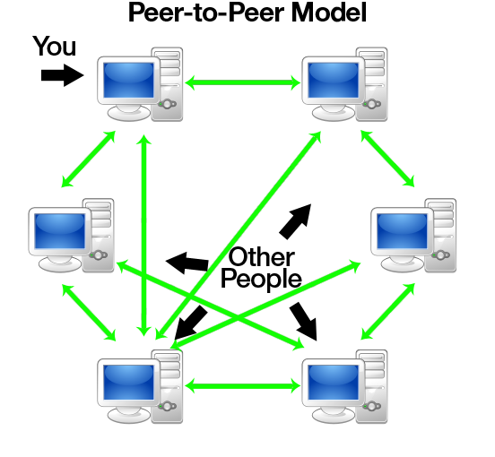
Background
No central server
Peers have equally privileged
Each peers share their resource to network
source: http://www.codeproject.com/KB/WCF/614028/pto1.png

Slide 9
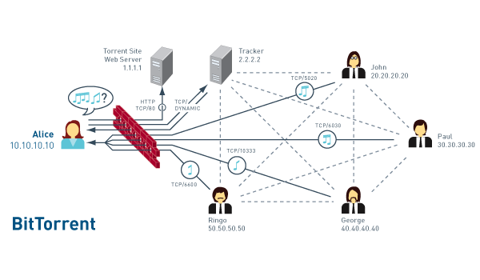
Background
Get .torrent from torrent site
Get peer info from tracker
Connect to peers
File are transfer between peers
https://dougvitale.files.wordpress.com/2012/02/bittorrent-network-flow2.gif?w=700

Slide 10
III. METHODOLOGY

Slide 11
Subjective Relativism
- Users :
+ Convenience, easy to use
+ Save money (especially for get pirated material)
Copyright owners:
+ Hurt their sale.
+ ISP: consume a lot of bandwidth

Slide 12
Cultural Relativism
+ Switzerland: personal use
+ Vietnam: personal use + commerce (such as sell DVD for profit).
+ Canada, US, UK : illegal

Slide 13
Divine Command
“You shall not steal.” (Exodus 20:15)
“Cursed is the one who moves his neighbor's landmark” (Deuteronomy 27:17)
=>It is wrong to download copyrighted materials via BitTorrent.

Slide 14
Kantianism
-People should pay to use copyrighted materials.
-People use the creators at the mean to the end

Slide 15
Act Utilitarianism
-The case: sharing a movie using Bittorrent.
-Benefit: Free
-Harm:
+ Companies, cinemas… lose their profits
+ Unemployment
+ Effects of economy
Harm > Benefit => it is wrong

Slide 16
Rule Utilitarianism
If this action is followed by everyone:
-Benefit: Save some money.
-Harm:
+ Affect creators’ profits.
+ No one wants to create new products.
Harm > Benefit => it is wrong

Slide 17
Social Contract
- A voluntary agreement between individuals for their mutual benefit []
- Consider the case: a novelist
+ what does he have in return?
+ what do readers have to do?
What if they break the rule.

Slide 18
Conclusion
+ Downloading or sharing copyrighted contents -> illegal
=> Bittorrent is legal, the ways people uses it is illegal.

