Slide 1


A comparative analysis of different deep learning models in fall detection on SmartWatch Dataset
COMP 5413-AA (AI for Autonomous Systems)
Department of Computer Science - Lakehead University
Instructor: Dr. Bashier Elkarami
Team Members:
Thi Thuy Tien Tran – 1220872
Azeem Abdul - 1220370
Darcus Angeline Peter - 1212905
Nimasha Warnakulasuriya - 1218119

Slide 2
Content
Introduction
Related Works
Methodology
Dataset
Techniques
Experimental Designs
Evaluation Metrics
Results
Conclusion

Slide 3
Introduction
For elderly people worldwide, fall has become a prevalent issue.
28-35 percent of adults 65 years of age and older fall every year (WHO) [1].
30% to 50% of residents in long-term care facilities experience falls each year, with many recurrences [2].
20% of falls cause fatal injuries such head trauma, hip fractures, etc. [4].
Unintentional injuries brought on by falls is among the most expensive medical procedures [5].
In the US, fall-related hospitalizations cost an average of $17,483 per hospital stay for people 65 and older in 2004 [2].
By 2040, that number is expected to rise to $240 billion [2].
As IoT develops rapidly, using fall detection systems to track everyday activities and identify falls in the elderly has become more promising [7].
Early intervention can potentially reduce healthcare expenses and minimize the demand on caregivers [8].
While fall prevention is not the exclusive objective of a fall detection system, caregivers and medical professionals can benefit greatly from the information it offers [9].

Slide 4
Related Works
Three types of fall detection studies
wearable sensors that monitor posture
computer vision systems that use video to identify falls
environmental sensors that detect falls through vibrations or audio
this study proposes a fall detection framework based on wearable-sensor fall detection dataset using deep learning models.
accelerometers
deep learning techniques
common in smart devices
falls cause a noticeable change in accel
provide a wide range of hyperparameter tuning options

Slide 5
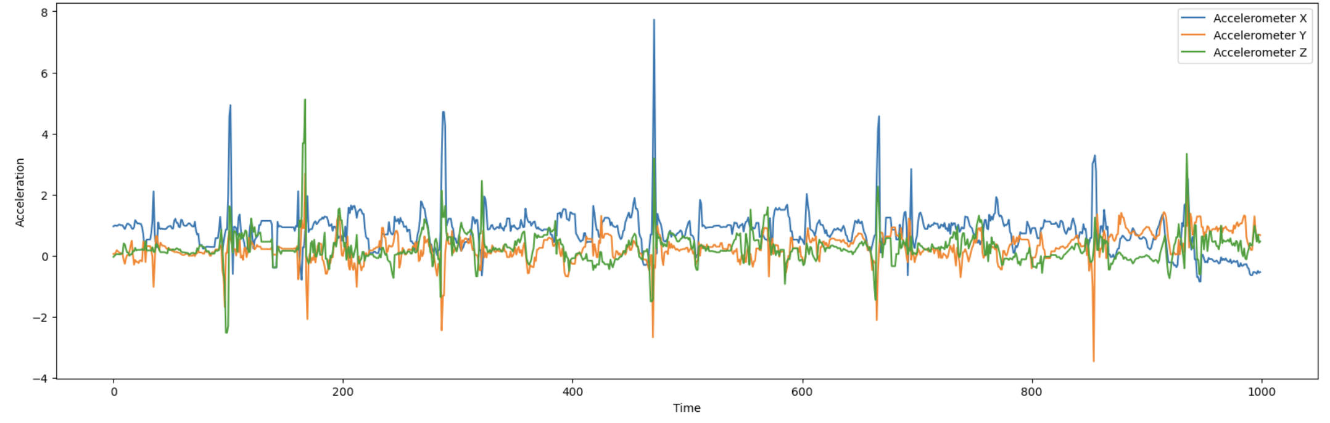
Methodology
SmartWatch Dataset: link
Data collected data from seven healthy participants who wore MS Band watches and engaged in simulated falls and activities of daily living (ADLs) like running and hand waving [1].
Four types of falls were performed onto a mattress, with ten repetitions of each direction [1].
sampling rate 31.25 Hz was the best option [1].
Real-time data labeling as "Fall" or "NotFall" was accomplished through a smartphone app; however, human labeling resulted in some errors that were later fixed by post-processing to guarantee accurate labeling of fall phases [1].
 | Fall | Not Fall | Sum
Training | 4,550 | 29,470 | 34,020
Testing | 2,275 | 14,954 | 17,229
Sum | 6,825 | 44,424 | 51,249
Table I. SmartWatch original dataset description
Figure 1. Signal value extracted from SmartWatch dataset

Slide 6
Methodology
LSTM
a type of a recurrent neural network (RNN), is particularly good at learning long-term dependencies and is suitable for sequential data such as time-series
can prevent the vanishing gradient problem
GRU
a type of Recurrent Neural Network
a simpler structure with no output gate compared to LSTM
BERT
The transformer architecture it uses has 12 encoder layers, 8 attention heads, 768 hidden units, 512 hidden units, and 110 million parameters in total [18].
TFT
is a deep neural network based on attention for multi-horizon forecasting

Slide 7
Methodology
 | Fall | Not Fall | Sum
Training | 2,912 | 31,068 | 33,980
Testing | 1,456 | 15,733 | 17,189
Sum | 4,368 | 46,801 | 51,169
Experimental Designs
Data preprocessing
Generate instances
A 40-point window size was used to process the training and testing dataset
If instance that had 25 or more fall label signal points within the window size → labeled as “Fall”, else labeled as “Not Fall”
Handle imbalance issues
the non-fall data was randomly downsampled to match the number of fall instances in both generated training and testing dataset
Model Training
Table II. SmartWatch generated dataset description
 | Fall | Not Fall | Sum
Training | 2,912 | 2,912 | 5,824
Testing | 1,456 | 1,456 | 2,912
Sum | 4,368 | 4,368 | 8,736
Table III. SmartWatch final dataset description
 | Value
learning rate | 0.0001
batch size | 512
validation split ratio | 0.2
number of epochs | 50
Early stopping | monitor='val_loss', patience=1, restore_best_weights=True
Table IV. Model Parameters

Slide 8
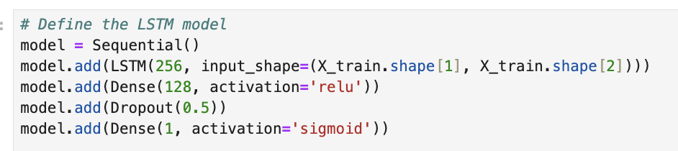
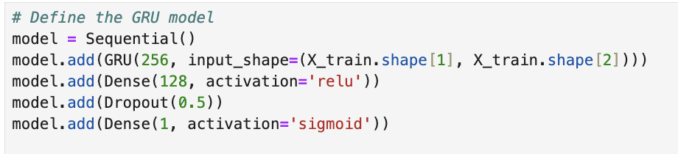
Methodology
Experimental Designs
Model Training:
LSTM: Comment
GRU: Comment

Slide 9
Methodology
Experimental Designs
Model Training: BERT
Comment

Slide 10
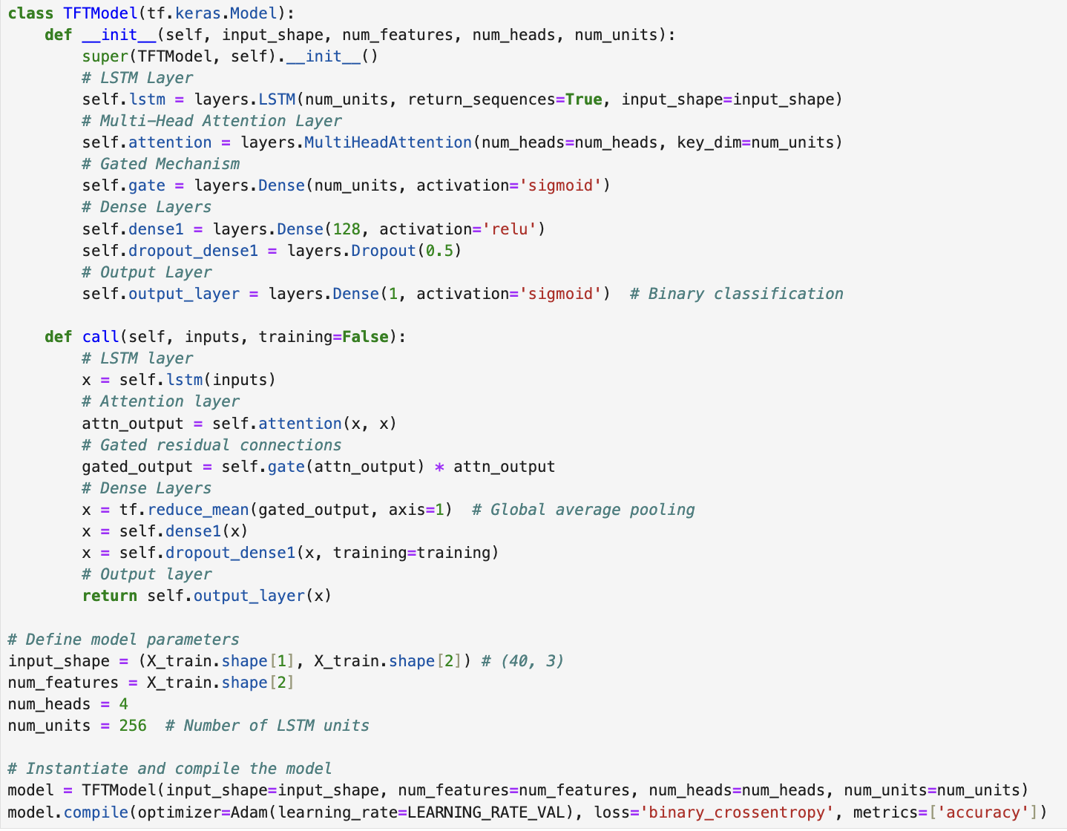
Methodology
Experimental Designs
Model Training: TFT
Comment

Slide 11
Methodology
Experimental Designs
Model Training: Parameters
Comment

Slide 12

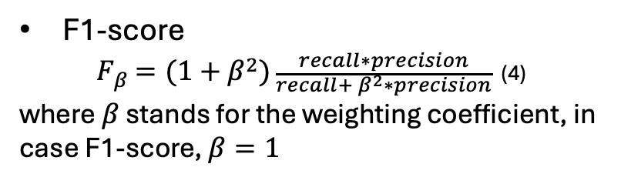
Methodology
Experimental Designs
Evaluation Metrics
Accuracy
$accuracy= \frac{TP+TN}{TP+FP+TN+FN}$ (1)
Precision
$precision= \frac{TP}{TP+FP}$ (2)
Recall
$$recall= \frac{TP}{TP+FN} (3)$$
where FN stands for false negative rate, FP for false positive rate, TN for true negative rate, and TP for true positive rate.
F1-score
$F_{β}=(1+β^{2})\frac{recall∗precision}{recall+ β^{2}∗precision}$ (4)
where $β$ stands for the weighting coefficient, in case F1-score, $β=1$
AUC – ROC
AUC stands for the degree or measure of separability, and ROC is a probability curve [13]. They provide an indication of the model's degree of class distinction [13]. An AUC that is close to 1 indicates that a model is good in terms of separability [13].

Slide 13
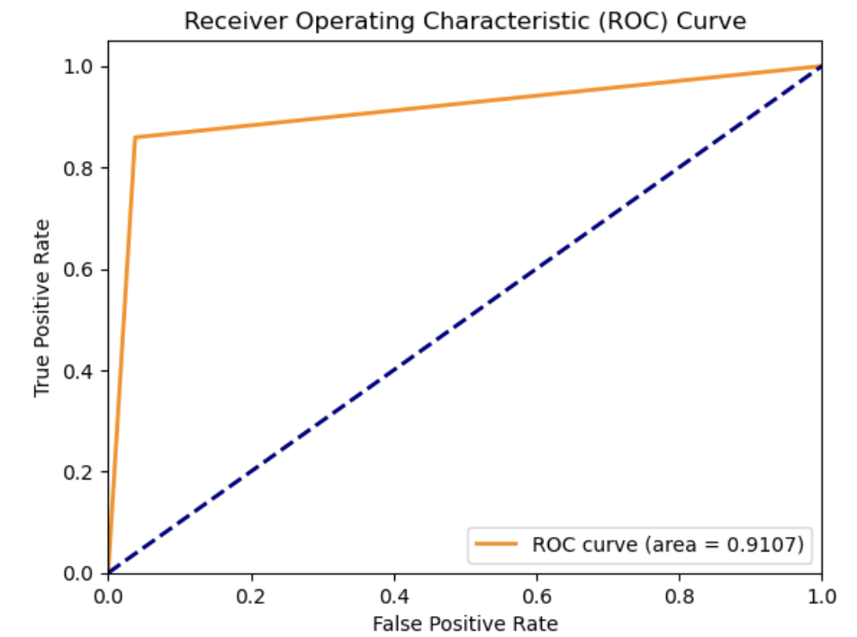
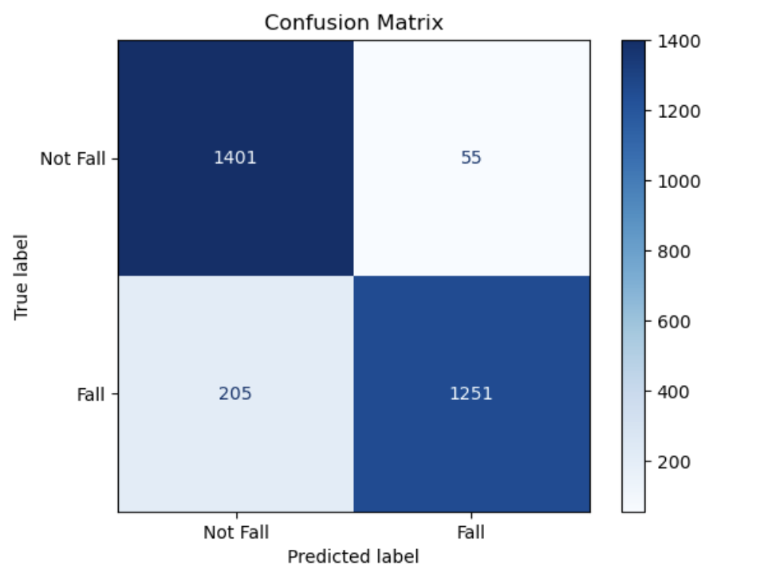
Results
LSTM
Comment
Figure 2. ROC Curve and Confusion Matrix of LSTM

Slide 14
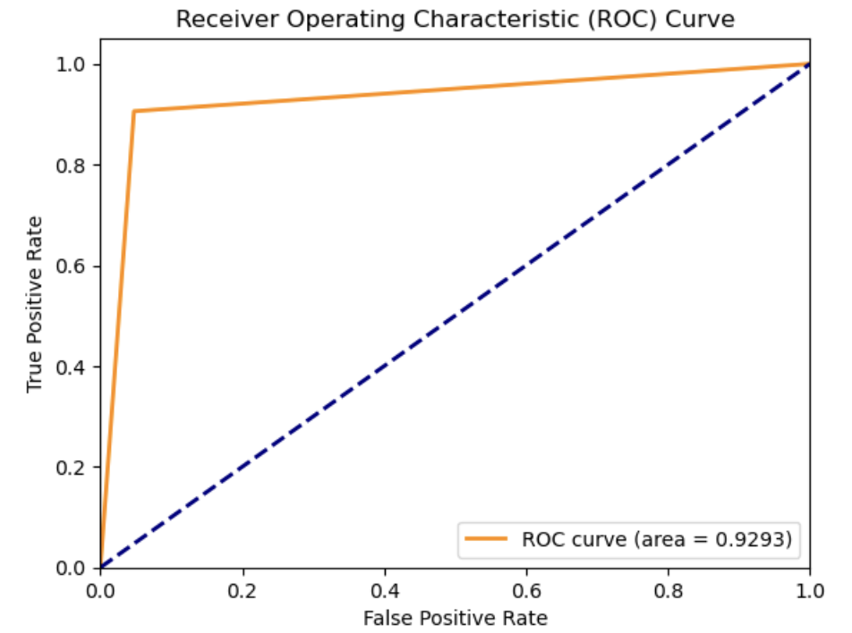
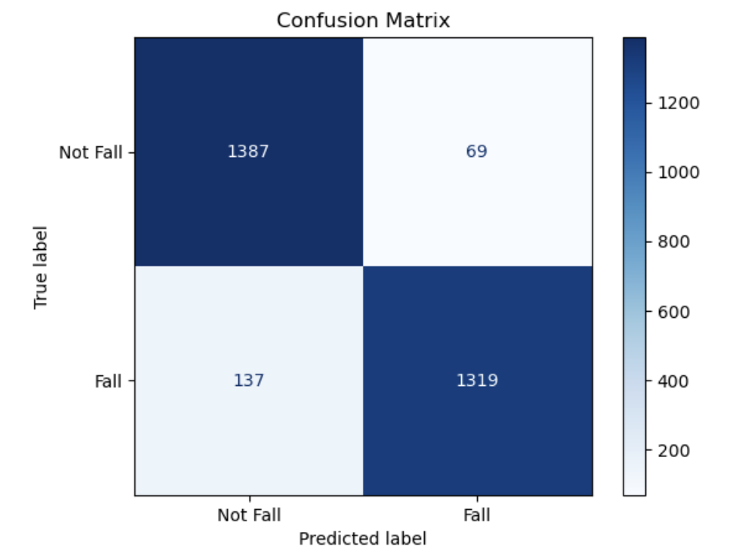
Results
GRU
Comment
Figure 3. ROC Curve and Confusion Matrix of GRU

Slide 15
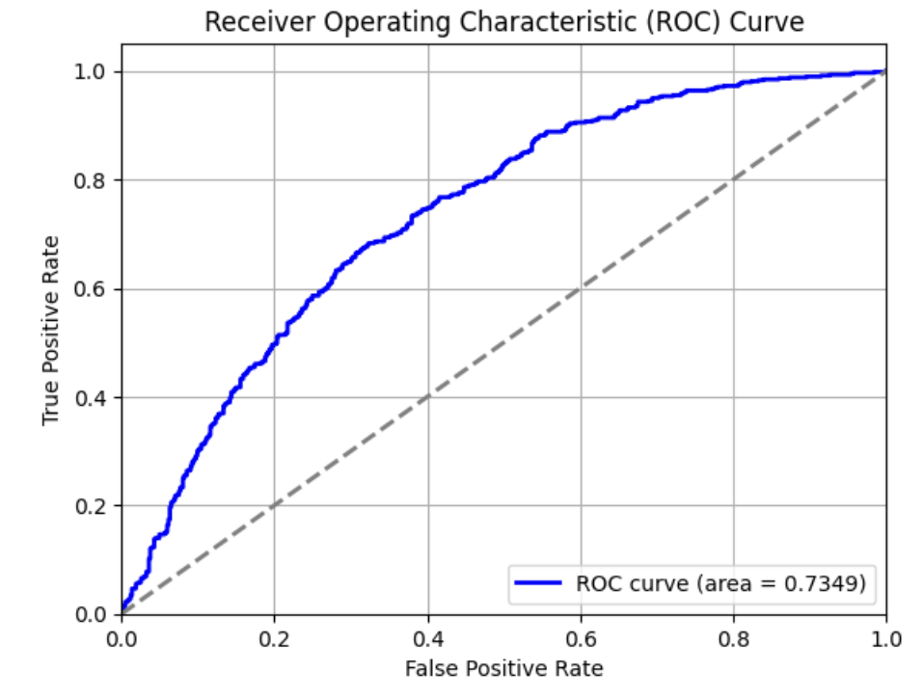
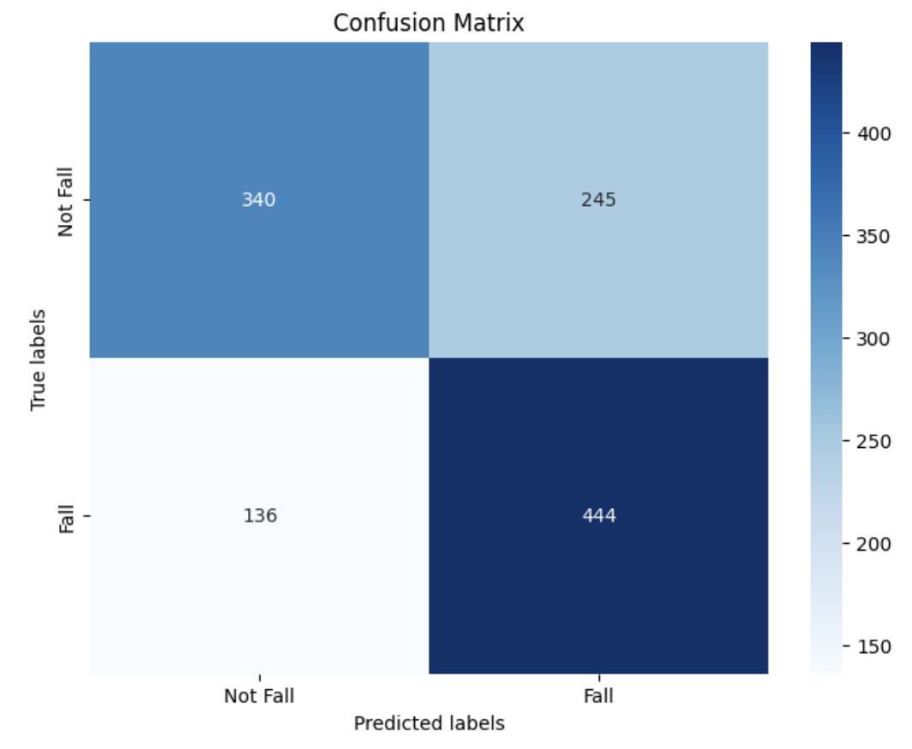
Results
BERT
Comment
Figure 4. ROC Curve and Confusion Matrix of BERT

Slide 16
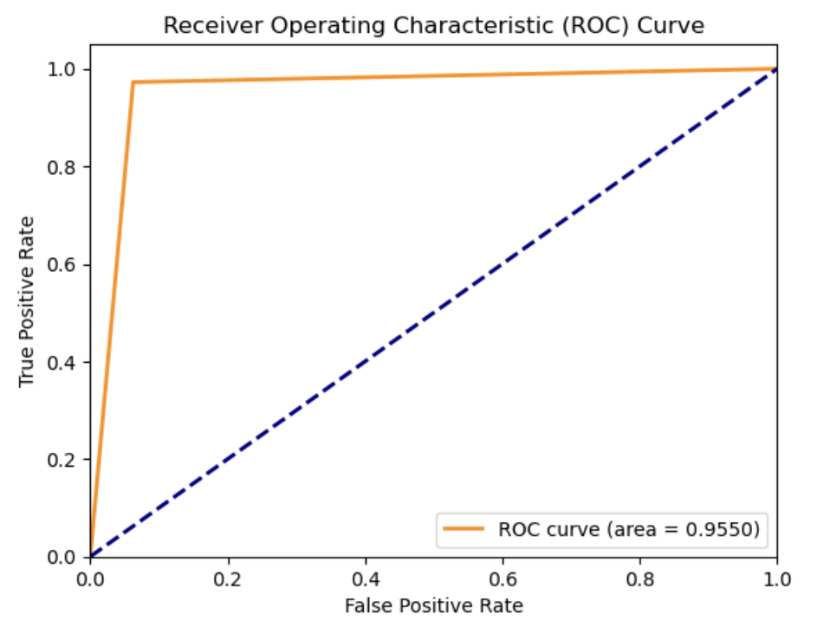
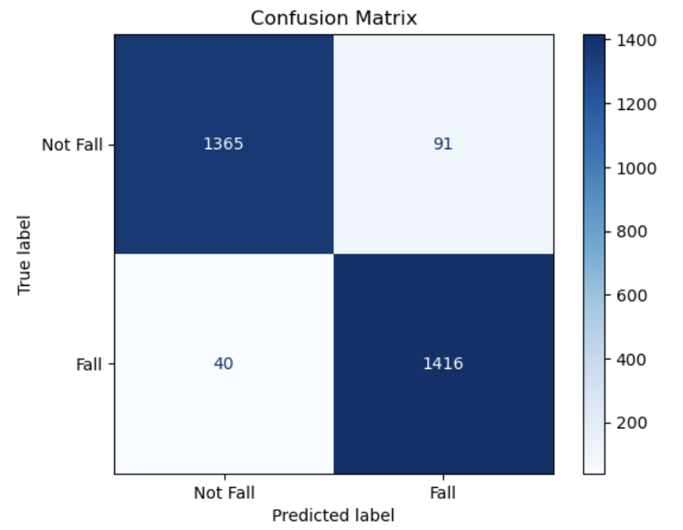
Results
TFT
Comment
Figure 5. ROC Curve and Confusion Matrix of TFT

Slide 17
Results
Compare between models
Comment
Evaluation Metrics | LSTM | GRU | BERT | TFT
Accuracy | 0.9107 | 0.9293 | 0.6730 | 0.9550
Precision | 0.9579 | 0.9503 | 0.6795 | 0.9396
Recall | 0.8592 | 0.9059 | 0.6730 | 0.9725
F1-score | 0.9059 | 0.9276 | 0.6702 | 0.9558
ROC_AUC | 0.9107 | 0.9293 | 0.7349 | 0.9550
Table V. Models’ performance comparison

Slide 18
Conclusion
Contributions:
- developed sophisticated deep learning models to evaluate the SmartWatch dataset, improving classification performance of fall detection.
- conducted a methodical comparison of LSTM, GRU, BERT, TFT to assess each deep learning method's efficiency.
As a result, we discover that that BERT is less effective for time series data compared to other deep learning models. Meanwhile, Temporal Fusion Transformer (TFT) achieved the best performance.
In the future, we would like to apply training set resampling techniques to address the imbalanced classes issue. Instead of depending just on one random downsampling technique, we will run multiple downsampling iterations, then calcualte the average result. This method aims to mitigate bias when selecting dataset for training, leading to increase the reliability of model.

Slide 19
References
[1] T. Mauldin, M. Canby, V. Metsis, A. Ngu, and C. Rivera, “SmartFall: A Smartwatch-Based Fall Detection System Using Deep Learning,” Sensors, vol. 18, no. 10, p. 3363, Oct. 2018, doi: https://doi.org/10.3390/s18103363.
[2] M. Musci, D. De Martini, N. Blago, T. Facchinetti, and M. Piastra, “Online Fall Detection Using Recurrent Neural Networks,” IEEE Transactions on Emerging Topics in Computing, vol. 9, no. 3, pp. 1276–1289, Jul. 2021, doi: https://doi.org/10.1109/tetc.2020.3027454.
[3] M. Farsi, “Application of ensemble RNN deep neural network to the fall detection through IoT environment,” Alexandria Engineering Journal, Jul. 2020, doi: https://doi.org/10.1016/j.aej.2020.06.056.
[4] Md. M. Islam et al., “Deep Learning Based Systems Developed for Fall Detection: A Review,” IEEE Access, vol. 8, pp. 166117–166137, 2020, doi: https://doi.org/10.1109/access.2020.3021943.
[5] Z. Jiang et al., "Fall Detection Systems for Internet of Medical Things Based on Wearable Sensors: A Review," IEEE Internet of Things Journal, doi: 10.1109/JIOT.2024.3421336.
[6] R. Kaur and R. Sharma, “Wearable sensors and datasets for evaluating systems predicting falls and activities of daily living: recent advances and methodology,” Multimedia Tools and Applications, Jun. 2024, doi: https://doi.org/10.1007/s11042-024-19504-1.
[7] X. Wu, Y. Zheng, C.-H. Chu, L. Cheng, and J. Kim, “Applying deep learning technology for automatic fall detection using mobile sensors,” Biomedical Signal Processing and Control, vol. 72, p. 103355, Feb. 2022, doi: https://doi.org/10.1016/j.bspc.2021.103355.
[8] O. Reyad, H. Shehata, and M. Karar, “Developed Fall Detection of Elderly Patients in Internet of Healthcare Things,” Computers, Materials & Continua, vol. 76, no. 2, pp. 1689–1700, 2023, doi: https://doi.org/10.32604/cmc.2023.039084.
[9] T. Theodoridis, V. Solachidis, N. Vretos, and P. Daras, “Human fall detection from acceleration measurements using a recurrent neural network,” Precision Medicine Powered by pHealth and Connected Health, pp. 145–149, Nov. 2017. doi:10.1007/978-981-10-7419-6_25.
[10] C.-B. Lin, Z. Dong, W.-K. Kuan, and Y.-F. Huang, “A Framework for Fall Detection Based on OpenPose Skeleton and LSTM/GRU Models,” Applied Sciences, vol. 11, no. 1, p. 329, Dec. 2020, doi: https://doi.org/10.3390/app11010329.

Slide 20
References
[11] Nader Maray, Anne, J. Ni, M. Debnath, and L. Wang, “Transfer Learning on Small Datasets for Improved Fall Detection,” Sensors, vol. 23, no. 3, pp. 1105–1105, Jan. 2023, doi: https://doi.org/10.3390/s23031105.
[12] J. Santoyo-Ramón, E. Casilari, and J. Cano-García, “Analysis of a Smartphone-Based Architecture with Multiple Mobility Sensors for Fall Detection with Supervised Learning,” Sensors, vol. 18, no. 4, p. 1155, Apr. 2018, doi: https://doi.org/10.3390/s18041155.
[13] J. Clemente, F. Li, M. Valero, and W. Song, “Smart Seismic Sensing for Indoor Fall Detection, Location, and Notification,” IEEE Journal of Biomedical and Health Informatics, vol. 24, no. 2, pp. 524–532, Feb. 2020, doi: https://doi.org/10.1109/jbhi.2019.2907498.
[14] C. Taramasco et al., “A Novel Monitoring System for Fall Detection in Older People,” IEEE Access, vol. 6, pp. 43563–43574, 2018, doi: https://doi.org/10.1109/access.2018.2861331.
[15] A. Lotfi, S. Albawendi, H. Powell, K. Appiah, and C. Langensiepen, “Supporting Independent Living for Older Adults; Employing a Visual Based Fall Detection Through Analysing the Motion and Shape of the Human Body,” IEEE Access, vol. 6, pp. 70272–70282, 2018, doi: https://doi.org/10.1109/access.2018.2881237.
[16] T. R. Mauldin, Anne, Vangelis Metsis, M. E. Canby, and Jelena Tesic, “Experimentation and Analysis of Ensemble Deep Learning in IoT Applications,” The Internet of Things, vol. 5, no. 1, pp. 133–149, Jan. 2019.
[17] P. T. Yamak, L. Yujian, and P. K. Gadosey, “A comparison between Arima, LSTM, and GRU for time series forecasting,” Proceedings of the 2019 2nd International Conference on Algorithms, Computing and Artificial Intelligence, Dec. 2019. doi:10.1145/3377713.3377722.
[18] H. Ramirez, S. A. Velastin, S. Cuellar, E. Fabregas, and G. Farias, “Bert for activity recognition using sequences of skeleton features and data augmentation with gan,” Sensors, vol. 23, no. 3, p. 1400, Jan. 2023. doi:10.3390/s23031400.
[19] B. Lim, S. Ö. Arık, N. Loeff, and T. Pfister, “Temporal Fusion Transformers for interpretable multi-horizon time series forecasting,” International Journal of Forecasting, vol. 37, no. 4, pp. 1748–1764, Oct. 2021, doi: https://doi.org/10.1016/j.ijforecast.2021.03.012.
[20] M. S. Al-Rakhami et al., “FallDeF5: A Fall Detection Framework Using 5G-Based Deep Gated Recurrent Unit Networks,” IEEE Access, vol. 9, pp. 94299–94308, 2021, doi: https://doi.org/10.1109/access.2021.3091838.
‌[21] G. Santos, P. Endo, K. Monteiro, E. Rocha, I. Silva, and T. Lynn, “Accelerometer-Based Human Fall Detection Using Convolutional Neural Networks,” Sensors, vol. 19, no. 7, p. 1644, Apr. 2019, doi: https://doi.org/10.3390/s19071644.

