Slide 1
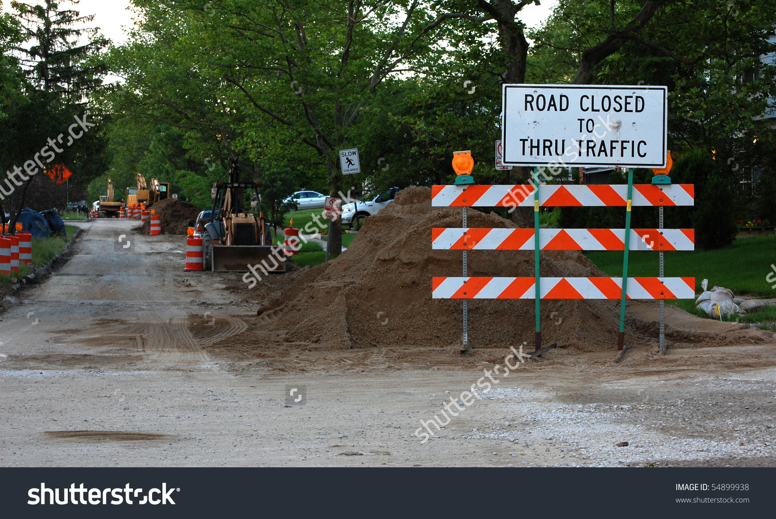
Image
Lines are painted on the road
Lines are being painted on the road

