Slide 1
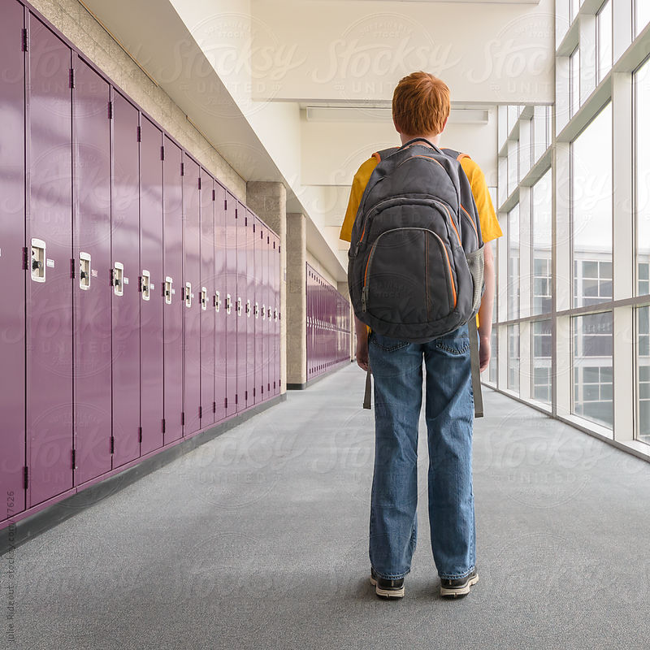
Image
hallway
he is standing in the hallway

