Slide 1
Week 2
Introduction to Kotlin Programming Language

Slide 2
Objectives
Review the basics of Kotlin Programming Language:
Variables
Control Structures
Functions
Classes
Collections
Set up Android Studio to use Kotlin and build apps.

Slide 3
What is Kotlin
Statically typed Object Oriented language.
Targets JVM, Android and JavaScript.
Can do anything which Java can.
Combines Object Oriented and Functional Programming features.
Developed and maintained by JetBrains.
Released under Apache 2 OSS license.
It is Sponsored by Google.
Announced as official language for Android development in 2017.

Slide 4
Kotlin Developers
: 156 K
: 700 K
: 2.2 M
2023 : It remains one of the most promising programming languages, and its popularity is expected to grow even more.

Slide 5
Kotlin and Java
Kotlin is Object Oriented Language, and is better language than Java.
Fully interoperable with Java code.
Can do anything which Java can.
Can be easily mixed with Java code.
You can have Kotlin and Java in one project.

Slide 6
Kotlin: features
Concise : Drastically reduce the amount of boilerplate code. (40% fewer code than Java).
Interoperable: 100% interoperable with Java. Support for Android, Browser and Native.
Tool–friendly : Excellent tooling support from JetBrains.
Advanced features: It provides several advance featues such as Operator overloading, Lambda expressions, String templates etc.

Slide 7
Kotlin "Hello, World!" Program
// Hello World Program
fun main(args : Array<String>) {
println("Hello, World!")
}
When you run the program, the output will be:
Hello, World!

Slide 8
How this program works?
// Hello World Program
Any line starting with // is a comment in Kotlin (similar to Java). Comments are ignored by the compiler. They are intended for person reading the code to better understand the intent and functionality of the program. fun main(args : Array<String>) { ... }
This is the main function, which is mandatory in every Kotlin application. The Kotlin compiler starts executing the code from the main function.
The function takes array of strings as a parameter and returns Unit. You will learn about functions and parameters in later chapters.
For now, just remember that main function is a mandatory function which is the entry point of every Kotlin program.
println("Hello, World!")
The println() function prints the given message inside the quotation marks and newline to the standard output stream. In this program, it prints Hello, World! and new line.

Slide 9
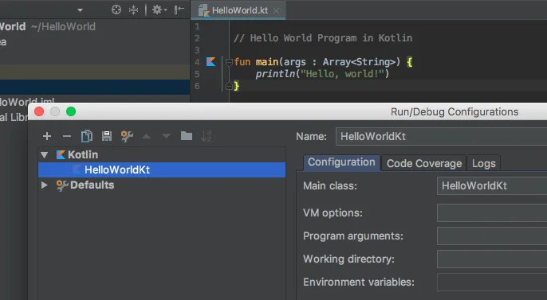
Few Important Notes
1. Unlike Java, it is not mandatory to create a class in every Kotlin program. It's because the Kotlin compiler creates the class for us.
If you are using IntelliJ IDEA, go to Run > Edit Configurations to view this class. If you named your Kotlin file HelloWorld.kt, the compiler creates HelloWorldKt class.

Slide 10
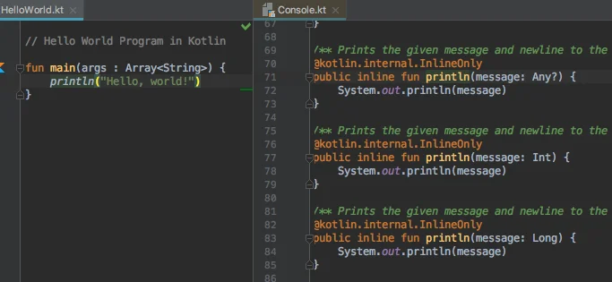
Few Important Notes
2. The println() function calls System.out.println() internally.
If you are using IntelliJ IDEA, put your mouse cursor next to println and go to Navigate > Declaration ( Shortcut: Ctrl + B . For Mac: Cmd + B), this will open Console.kt (declaration file). You can see that println() function is internally calling System.out.println().

Slide 11
Kotlin Comments
In programming, comments are portion of the program intended for you and your fellow programmers to understand the code. They are completely ignored by the Kotlin compiler.
Similar like Java, there are two types of comments in Kotlin
/* ... */
// ....

Slide 12
Traditional comment /* ... */
Traditional comment /* ... */
This is a multiline comment that can span over multiple lines. The Kotlin compiler ignores everything from /* to */. For example,
/* This is a multi-line comment.
* The problem prints "Hello, World!" to the standard output.
*/
fun main(args: Array<String>) {
println("Hello, World!")
}
The tradition comment is also used for documenting Kotlin code (KDoc) with a little variation. The KDoc comments starts with /** and ends with */.

Slide 13
// Single line comment
End of Line Comment //
The compiler ignores everything from // to the end of the line. For example,
// Kotlin Hello World Program
fun main(args: Array<String>) {
println("Hello, World!") // outputs Hello, World! on the screen
}

Slide 14
Kotlin Variables
As you know, a variable is a location in memory (storage area) to hold data.
To indicate the storage area, each variable should be given a unique name (identifier).
How to declare a variable in Kotlin?
To declare a variable in Kotlin, either var or val keyword is used. Here is an example:
var language = "French"
val score = 95

Slide 15
Variable declaration with initialization
var language = "French"
val score = 95
Here, language is a variable of type String, and score is a variable of type Int. You don't have to specify the type of variables; Kotlin implicitly does that for you. The compiler knows this by initializer expression ("French" is a String, and 95 is an integer value in the above program). This is called type inference in programming.

Slide 16
However, you can explicitly specify the type if you want to:
var language: String = "French"
val score: Int = 95

Slide 17
We have initialized variable during declaration in previous examples. However, it's not necessary. You can declare variable and specify its type in one statement, and initialize the variable in another statement later in the program.
var language: String // variable declaration of type String
... .. ...
language = "French" // variable initialization
val score: Int // variable declaration of type Int
... .. ...
score = 95 // variable initialization

Slide 18
Declaration without Initialization
We have initialized variable during declaration in previous examples. However, it's not necessary. You can declare variable and specify its type in one statement, and initialize the variable in another statement later in the program.
var language: String // variable declaration of type String
... .. ...
language = "French" // variable initialization
val score: Int // variable declaration of type Int
... .. ...
score = 95 // variable initialization

Slide 19
Error in Declaration
var language // Error
language = "French"
Here, the type of language variable is not explicitly specified, nor the variable is initialized during declaration.
var language: String
language = 14 // Error
​​​​Here, we are trying to assign 14 (integer value) to variable of different type (String).

Slide 20
Difference Between var and val
val (Immutable reference) - The variable declared using val keyword cannot be changed once the value is assigned. It is similar to final variable in Java.
var (Mutable reference) - The variable declared using var keyword can be changed later in the program. It corresponds to regular Java variable.

Slide 21
Here are few examples:
var language = "French"
language = "German"
Here, language variable is reassigned to German. Since, the variable is declared using var, this code work perfectly.
val language = "French"
language = "German" // Error
You cannot reassign language variable to German in the above example because the variable is declared using val.

Slide 22
Kotlin Basic Types
Kotlin is a statically typed language like Java. That is, the type of a variable is known during the compile time. For example,
val language: Int
val marks = 12.3
Here, the compiler knows that language is of type Int, and marks is of type Double before the compile time.

Slide 23
The built-in types in Kotlin can be categorized as:
Numbers
Characters
Booleans
Arrays

Slide 24
Number Type
Numbers in Kotlin are similar to Java. There are 6 built-in types representing numbers.
Byte
Short
Int
Long
Float
Double

Slide 25
1.Byte
The Byte data type can have values from -128 to 127 (8-bit signed two's complement integer).
It is used instead of Int or other integer data types to save memory if it's certain that the value of a variable will be within [-128, 127]
Example:
fun main(args : Array<String>) {
val range: Byte = 112
println("$range")
}
When you run the program, the output will be:
112

Slide 26
2. Short
The Short data type can have values from -32768 to 32767 (16-bit signed two's complement integer).
It is used instead of other integer data types to save memory if it's certain that the value of the variable will be within [-32768, 32767].
Example:
fun main(args : Array<String>) {
val temperature: Short = -11245
println("$temperature")
}
When you run the program, the output will be:
-11245

Slide 27
3. Int
The Int data type can have values from -2³¹ to 2³¹-1 (32-bit signed two's complement integer).
Example:
fun main(args : Array<String>) {
val score: Int = 100000
println("$score")
}
When you run the program, the output will be:
100000

Slide 28
Implicit Type based on Value
If you assign an integer between -2³¹ to 2³¹-1 to a variable without explicitly specifying its type, the variable will be of Int type. For example,
fun main(args : Array<String>) {
// score is of type Int
val score = 10
println("$score")
}

Slide 29
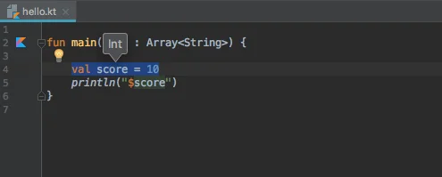
If you are using IntelliJ IDEA, you can place cursor inside the variable and press Ctrl + Shift + P to see its type.
View type of a variable in IntelliJ IDEA

Slide 30
4. Long
The Long data type can have values from -2⁶³ to 2⁶³-1 (64-bit signed two's complement integer).
Example:
fun main(args : Array<String>) {
val highestScore: Long = 9999
println("$highestScore")
}
When you run the program, the output will be:
9999

Slide 31
Implicit Type based on Value
If you assign an integer value greater than 2³¹-1 or less than -2³¹ to a variable (without explicitly specifying its type), the variable will be of Long type. For example,
val distance = 10000000000 // distance variable of type Long
Similarly, you can use capital letter L to specify that the variable is of type Long. For example,
val distance = 100L // distance value of type Long

Slide 32
5. Double
The Double type is a double-precision 64-bit floating point.
Example:
fun main(args : Array<String>) {
// distance is of type Double
val distance = 999.5
println("$distance")
}
When you run the program, the output will be:
999.5

Slide 33
6. Float
The Float data type is a single-precision 32-bit floating point. Example:
fun main(args : Array<String>) {
// distance is of type Float
val distance = 19.5F
println("$distance")
}
When you run the program, the output will be:
19.5

Slide 34
Double Vs Float
Notice that, we have used 19.5F instead of 19.5 in the above program. It is because 19.5 is a Double literal, and you cannot assign Double value to a variable of type Float.
To tell compiler to treat 19.5 as Float, you need to use F at the end.

Slide 35
Number data type: If you are not sure what number value a variable will be assigned in the program, you can specify it as Number type. This allows you to assign both integer and floating-point value to the variable (one at a time).
fun main(args : Array<String>) {
var test: Number = 12.2
println("$test")
test = 12
// Int smart cast from Number
println("$test")
test = 120L
// Long smart cast from Number
println("$test")
}
12.2
12
120

Slide 36
Char
To represent a character in Kotlin, Char types are used. Unlike Java, Char types cannot be treated as numbers.
fun main(args : Array<String>) {
val letter: Char
letter = 'k'
println("$letter")
}
When you run the program, the output will be:
k
In Java, you can do something like:
char letter = 65;
However, the following code gives error in Kotlin.
var letter: Char = 65 // Error

Slide 37
Boolean
The Boolean data type has two possible values, either true or false.
Example:
fun main(args : Array<String>) {
val flag = true
println("$flag")
}
Booleans are used in decision making statements.

Slide 38
Kotlin Type Conversion
In Kotlin, a numeric value of one type is not automatically converted to another type even when the other type is larger. This is different from how Java handles numeric conversions. For example;
In Java,
int number1 = 55;
long number2 = number1; // Valid code
Here, value of number1 of type int is automatically converted to type long, and assigned to variable number2.

Slide 39
Type Conversion
In Kotlin,
val number1: Int = 55
val number2: Long = number1 // Error: type mismatch.
Though the size of Long is larger than Int, Kotlin doesn't automatically convert Int to Long.
Instead, you need to use toLong() explicitly (to convert to type Long). Kotlin does it for type safety to avoid surprises.
val number1: Int = 55
val number2: Long = number1.toLong()

Slide 40
Here's a list of functions in Kotlin used for type conversion:
toByte()
toShort()
toInt()
toLong()
toFloat()
toDouble()
toChar()

Slide 41
Conversion from Larger to Smaller Type
The functions mentioned above can be used in both directions (conversion from larger to smaller type and conversion from smaller to larger type).
However, conversion from larger to smaller type may truncate the value. For example,
fun main(args : Array<String>) {
val number1: Int = 259
val number2: Byte = number1.toByte()
println("number1 = $number1")
println("number2 = $number2")
}
When you run the program, the output will be:
number1 = 259
number2 = 3

Slide 42
Kotlin Operators
Operators are special symbols (characters) that carry out operations on operands (variables and values). For example, + is an operator that performs addition.

Slide 43
1. Arithmetic Operators
Kotlin Arithmetic Operators
Operator | Meaning
+ | Addition (also used for string concatenation)
- | Subtraction Operator
* | Multiplication Operator
/ | Division Operator
% | Modulus Operator

Slide 44
fun main(args: Array<String>) {
val number1 = 12.5
val number2 = 3.5
var result: Double
result = number1 + number2
println("number1 + number2 = $result")
result = number1 - number2
println("number1 - number2 = $result")
result = number1 * number2
println("number1 * number2 = $result")
result = number1 / number2
println("number1 / number2 = $result")
result = number1 % number2
println("number1 % number2 = $result")
}
Output:
number1 + number2 = 16.0
number1 - number2 = 9.0
number1 * number2 = 43.75
number1 / number2 = 3.5714285714285716
number1 % number2 = 2.0

Slide 45
The + operator is also used for the concatenation of String values.
Example: Concatenation of Strings
fun main(args: Array<String>) {
val start = "Talk is cheap. "
val middle = "Show me the code. "
val end = "- Linus Torvalds"
val result = start + middle + end
println(result)
}
Output:
Talk is cheap. Show me the code. - Linus Torvalds

Slide 46
2. Assignment Operators
Assignment operators are used to assign value to a variable. We have already used simple assignment operator = before.
val age = 5
Here, 5 is assigned to variable age using = operator.
Expression | Equivalent to
a +=b | a = a + b
a -= b | a = a - b
a *= b | a = a * b
a /= b | a = a / b
a %= b | a = a % b

Slide 47
Example: Assignment Operators
fun main(args: Array<String>) {
var number = 12
number *= 5 // number = number*5
println("number = $number")
}
Output:
number = 60

Slide 48
3. Unary prefix and Increment / Decrement Operators
Here's a table of unary operators, their meaning, and corresponding functions:
Operator | Meaning | Expression
+ | Unary plus | +a
- | Unary minus | -a
! | Not | !a
++ | Increment | ++a
-- | Decrement | a--

Slide 49
Example: Unary Operators
fun main(args: Array<String>) {
val a = 1
val b = true
var c = 1
var result: Int
var booleanResult: Boolean
result = -a
println("-a = $result")
booleanResult = !b
println("!b = $booleanResult")
--c
println("--c = $c")
}
Output:
-a = -1
!b = false
--c = 0

Slide 50
4. Comparison and Equality Operators
Here's a table of equality and comparison operators, their meaning, and corresponding functions:
Operator | Meaning | Expression
> | greater than | a > b
< | less than | a < b
>= | greater than or equals to | a>=b
<= | less than or equals to | a<=b
== | is equal to | a==b
Comparison and equality operators are used in control flow such as if expression, when expression, and loops.

Slide 51
Example: Comparison and Equality Operators
fun main(args: Array<String>) {
val a = -12
val b = 12
// use of greater than operator
val max = if (a > b) {
println("a is larger than b.")
a
} else {
println("b is larger than a.")
b
}
println("max = $max")
}
Output:
b is larger than a.
max = 12

Slide 52
5. Logical Operators
There are two logical operators in Kotlin: || and &&
Logical operators are used in control flow such as if expression, when expression, and loops.
Operator | Description | Expression
|| | true if either of the Boolean expression is true | (a>b)||(a<c)
&& | true if all Boolean expressions are true | (a>b)&&(a<c)

Slide 53
Example: Logical Operators
fun main(args: Array<String>) {
val a = 10
val b = 9
val c = -1
val result: Boolean
// result is true is a is largest
result = (a>b) && (a>c)
println(result)
}
When you run the program, the output will be:
true

Slide 54
6. in Operator
The in operator is used to check whether an object belongs to a collection.
Operator | Expression | Translates to
in | a in b | b.contains(a)
!in | a !in b | !b.contains(a)

Slide 55
Example: in Operator
fun main(args: Array<String>) {
val numbers = intArrayOf(1, 4, 42, -3)
if (4 in numbers) {
println("numbers array contains 4.")
}
}
When you run the program, the output will be:
numbers array contains 4.

Slide 56
Kotlin Expression, Statements and Blocks
Kotlin Expressions
Expressions consist of variables, operators etc that evaluates to a single value.
Let's take an example,
val score: Int
score = 90 + 25
Here, 90 + 25 is an expression that returns Int value.

Slide 57
In Kotlin, if is an expression unlike Java (In Java, if is a statement). For example,
fun main(args: Array<String>) {
val a = 12
val b = 13
val max: Int
max = if (a > b) a else b
println("$max")
}
Here, if (a > b) a else b is an expression. Then value of the expression is assigned to max variable in the above program.

Slide 58
Kotlin Statements
Statements are everything that make up a complete unit of execution. For example,
val score = 90 + 25
Here, 90 + 25 is an expression that returns 115
and val score = 90 + 25; is a statement.
Expressions are part of statements.
Some examples:
println("Howdy")
var a = 5
++a
max = if (a > b) a else b

Slide 59
Kotlin Blocks
A block is a group of statements (zero or more) that is enclosed in curly braces { }. For example,
fun main(args: Array<String>) { // main function block
val flag = true
if (flag == true) { // start of if block
print("Hey ")
print("jude!")
} // end of if block
} // end of main function block
There are two statements print("Hey ") and print(" jude!") inside if branch block.
Similarly, the main() function also has a block body.

Slide 60
Kotlin Basic Input/Output
Koltin Output
You can use println() and print() functions to send output to the standard output (screen). Let's take an example:
fun main(args : Array<String>) {
println("Kotlin is interesting.")
}
Output:
Kotlin is interesting.
Here, println() outputs the string (inside quotes).

Slide 61
Difference Between println() and print()
print() - prints string inside the quotes.
println() - prints string inside the quotes similar like print() function. Then the cursor moves to the beginning of the next line.
fun main(args : Array<String>) {
println("1. println ");
println("2. println ");
print("1. print ");
print("2. print");
}
Output:
1. println
2. println
1. print 2. print

Slide 62
Example 2: Print Variables and Literals
fun main(args : Array<String>) {
val score = 12.3
println("score")
println("$score")
println("score = $score")
println("${score + score}")
println(12.3)
}
Output:
score
12.3
score = 12.3
24.6
12.3

Slide 63
Kotlin Input
In this section, you will learn to take input from the user..
To read a line of string in Kotlin, you can use readline() function.
Example 3: Print String Entered By the User
fun main(args: Array<String>) {
print("Enter text: ")
val stringInput = readLine()
println("You entered: $stringInput")
}
Output:
Enter text: Hmm, interesting!
You entered: Hmm, interesting!

Slide 64
Getting Input from User
If you want input of other data types, you can use Scanner object.
For that, you need to import Scanner class from Java standard library using:
import java.util.Scanner
Then, you need to create Scannerobject from this class.
val reader = Scanner(System.`in`)
Now, the reader object is used to take input from the user.

Slide 65
Example 4: Getting Integer Input from the User
import java.util.Scanner
fun main(args: Array<String>) {
// Creates an instance which takes input from standard input (keyboard)
val reader = Scanner(System.`in`)
print("Enter a number: ")
// nextInt() reads the next integer from the keyboard
var integer:Int = reader.nextInt()
println("You entered: $integer")
}
Enter a number: -12
You entered: -12

Slide 66
Here, reader object of Scanner class is created. Then, the nextInt() method is called which takes integer input from the user which is stored in variable integer.
To get Long, Float, double and Boolean input from the user, you can use nextLong(), nextFloat(), nextDouble() and nextBoolean() methods respectively.

Slide 67
Kotlin if Expression
Traditional Usage of if...else
The syntax of if...else is:
if (testExpression) {
// codes to run if testExpression is true
}
else {
// codes to run if testExpression is false
}
if executes a certain section of code if the testExpression is evaluated to true. It can have optional else clause. Codes inside else clause are executed if the testExpression is false.

Slide 68
Example: Traditional Usage of if...else
fun main(args: Array<String>) {
val number = -10
if (number > 0) {
print("Positive number")
} else {
print("Negative number")
}
}
Negative number

Slide 69
Kotlin if expression
Unlike Java (and other many programming languages), if can be used an expression in Kotlin; it returns a value.
fun main(args: Array<String>) {
val number = -10
val result = if (number > 0) {
"Positive number"
} else {
"Negative number"
}
println(result)
}
Negative number

Slide 70
The else branch is mandatory when using if as an expression.
The curly braces are optional if the body of if has only one statement.
For example,
fun main(args: Array<String>) {
val number = -10
val result = if (number > 0) "Positive number" else "Negative number"
println(result)
}
This is similar to ternary operator in Java. Hence, there is no ternary operator in Kotlin.

Slide 71
fun main(args: Array<String>) {
val a = -9
val b = -11
val max = if (a > b) {
println("$a is larger than $b.")
println("max variable holds value of a.")
a
} else {
println("$b is larger than $a.")
println("max variable holds value of b.")
b
}
println("max = $max")
}
-9 is larger than -11.
max variable holds value of a.
max = -9

Slide 72
Kotlin if..else..if Ladder
You can return a block of code among many blocks in Kotlin using if..else...if ladder.
Example: if...else...if Ladder
fun main(args: Array<String>) {
val number = 0
val result = if (number > 0)
"positive number"
else if (number < 0)
"negative number"
else
"zero"
println("number is $result")
}
This program checks whether number is positive number, negative number, or zero.

Slide 73
Kotlin Nested if Expression
An if expression can be inside the block of another if expression known as nested if expression.
This program computes the largest number among three numbers.
fun main(args: Array<String>) {
val n1 = 3
val n2 = 5
val n3 = -2
val max = if (n1 > n2) {
if (n1 > n3)
n1
else
n3
} else {
if (n2 > n3)
n2
else
n3
}
println("max = $max")
}
max = 5

Slide 74
Kotlin when Expression
Kotlin when Construct
The when construct in Kotlin can be thought of as a replacement for Java switch Statement. It evaluates a section of code among many alternatives.

Slide 75
Example: Simple when Expression
fun main(args: Array<String>) {
val a = 12
val b = 5
println("Enter operator either +, -, * or /")
val operator = readLine()
val result = when (operator) {
"+" -> a + b
"-" -> a - b
"*" -> a * b
"/" -> a / b
else -> "$operator operator is invalid operator."
}
println("result = $result")
}
Enter operator either +, -, * or /
*
result = 60

Slide 76
The program above takes an input string from the user. Suppose, the user entered *. In this case, the expression a * b is evaluated, and the value is assigned to variable result.
If none of the branch conditions are satisfied (user entered anything except +, -, *, or /) , else branch is evaluated.
In the above example, we used when as an expression. However, it's not mandatory to use when as an expression. For example,

Slide 77
fun main(args: Array<String>) {
val a = 12
val b = 5
println("Enter operator either +, -, * or /")
val operator = readLine()
when (operator) {
"+" -> println("$a + $b = ${a + b}")
"-" -> println("$a - $b = ${a - b}")
"*" -> println("$a * $b = ${a * b}")
"/" -> println("$a / $b = ${a / b}")
else -> println("$operator is invalid")
}
}
Enter operator either +, -, * or /
-
12 - 5 = 7

Slide 78
Combine two or more branch conditions with a comma. For example,
fun main(args: Array<String>) {
val n = -1
when (n) {
1, 2, 3 -> println("n is a positive integer less than 4.")
0 -> println("n is zero")
-1, -2 -> println("n is a negative integer greater than 3.")
}
}
n is a negative integer greater than 3.

Slide 79
Check value in the range. For example,
fun main(args: Array<String>) {
val a = 100
when (a) {
in 1..10 -> println("A positive number less than 11.")
in 10..100 -> println("A positive number between 10 and 100 (inclusive)")
}
}
A positive number between 10 and 100 (inclusive)

Slide 80
Check if a value is of a particular type.
To check whether a value is of a particular type in runtime, we can use is and !is operator. For example,
when (x) {
is Int -> print(x + 1)
is String -> print(x.length + 1)
is IntArray -> print(x.sum())
}

Slide 81
Use expressions as branch condition. For example,
fun main(args: Array<String>) {
val a = 11
val n = "11"
when (n) {
"cat" -> println("Cat? Really?")
12.toString() -> println("Close but not close enough.")
a.toString() -> println("Bingo! It's eleven.")
}
}
Bingo! It's eleven.

Slide 82
Kotlin while and do...while Loop
Loop is used in programming to repeat a specific block of code until certain condition is met (test expression is false).
Loops are what makes computers interesting machines. Imagine you need to print a sentence 50 times on your screen. Well, you can do it by using print statement 50 times (without using loops). How about you need to print a sentence one million times? You need to use loops.
You will learn about two loops while and do..while in this article with the help of examples.
If you are familiar with while and do...while loops in Java, you are already familiar with these loops in Kotlin as well.

Slide 83
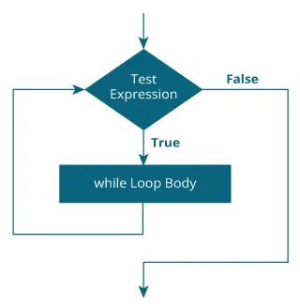
Kotlin while Loop
The syntax of while loop is:
while (testExpression) {
// codes inside body of while loop
}
How while loop works?
The test expression inside the parenthesis is a Boolean expression.
If the test expression is evaluated to true,
statements inside the while loop are executed.
then, the test expression is evaluated again.
This process goes on until the test expression is evaluated to false.
If the test expression is evaluated to false,
while loop is terminated.

Slide 84
Example: Kotlin while Loop
// Program to print line 5 times
fun main(args: Array<String>) {
var i = 1
while (i <= 5) {
println("Line $i")
++i
}
}
Line 1
Line 2
Line 3
Line 4
Line 5

Slide 85
Example: Compute sum of Natural Numbers
// Program to compute the sum of natural numbers from 1 to 100.
fun main(args: Array<String>) {
var sum = 0
var i = 100
while (i != 0) {
sum += i // sum = sum + i;
--i
}
println("sum = $sum")
}
sum = 5050

Slide 86
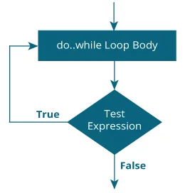
Kotlin do...while Loop
The do...while loop is similar to while loop with one key difference. The body of do...while loop is executed once before the test expression is checked.
Its syntax is:
do {
// codes inside body of do while loop
} while (testExpression)
How do...while loop works?
The codes inside the body of do construct is executed once (without checking the testExpression).
Then, the test expression is checked.
If the test expression is evaluated to true, codes inside the body of the loop are executed, and test expression is evaluated again. This process goes on until the test expression is evaluated to false.
When the test expression is evaluated to false, do..while loop terminates.

Slide 87
Example: Kotlin do...while Loop
The program below calculates the sum of numbers entered by the user until user enters 0.
fun main(args: Array<String>) {
var sum: Int = 0
var input: String
do {
print("Enter an integer: ")
input = readLine()!!
sum += input.toInt()
} while (input != "0")
println("sum = $sum")
}
Enter an integer: 4
Enter an integer: 3
Enter an integer: 2
Enter an integer: -6
Enter an integer: 0
sum = 3

Slide 88
Kotlin for Loop
There is no traditional for loop in Kotlin unlike Java and other languages.
In Kotlin, for loop is used to iterate through ranges, arrays, maps and so on (anything that provides an iterator).
The syntax of for loop in Kotlin is:
for (item in collection) {
// body of loop
}

Slide 89
Example: Iterate Through a Range
fun main(args: Array<String>) {
for (i in 1..5) {
println(i)
}
}
Here, the loop iterates through the range and prints individual item.
1
2
3
4
5

Slide 90
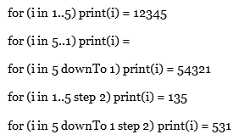
Example: Different Ways to Iterate Through a Range
fun main(args: Array<String>) {
print("for (i in 1..5) print(i) = ")
for (i in 1..5) print(i)
println()
print("for (i in 5..1) print(i) = ")
for (i in 5..1) print(i) // prints nothing
println()
print("for (i in 5 downTo 1) print(i) = ")
for (i in 5 downTo 1) print(i)
println()
print("for (i in 1..5 step 2) print(i) = ")
for (i in 1..5 step 2) print(i)
println()
print("for (i in 5 downTo 1 step 2) print(i) = ")
for (i in 5 downTo 1 step 2) print(i)
}

Slide 91
Iterating Through an Array
Here's an example to iterate through a String array.
fun main(args: Array<String>) {
var language = arrayOf("Ruby", "Kotlin", "Python" "Java")
for (item in language)
println(item)
}
Ruby
Kotlin
Python
Java

Slide 92
It's possible to iterate through an array with an index. For example,
fun main(args: Array<String>) {
var language = arrayOf("Ruby", "Kotlin", "Python", "Java")
for (item in language.indices) {
// printing array elements having even index only
if (item%2 == 0)
println(language[item])
}
}
Ruby
Python
Note: Here, language.indices returns all all indices of each array elements.

Slide 93
Iterating Through a String
fun main(args: Array<String>) {
var text= "Kotlin"
for (letter in text) {
println(letter)
}
}
K
o
t
l
i
n

Slide 94
Similar like arrays, you can iterate through a String with an index. For example,
fun main(args: Array<String>) {
var text= "Kotlin"
for (item in text.indices) {
println(text[item])
}
}
K
o
t
l
i
n

Slide 95
Kotlin break Expression
Suppose you are working with loops. It is sometimes desirable to terminate the loop immediately without checking the test expression.
In such case, break is used. It terminates the nearest enclosing loop when encountered (without checking the test expression). This is similar to how break statement works in Java.

Slide 96
How break works?
It is almost always used with if..else construct. For example,
for (...) {
if (testExpression) {
break
}
}
If testExpression is evaluated to true, break is executed which terminates the for loop.

Slide 97
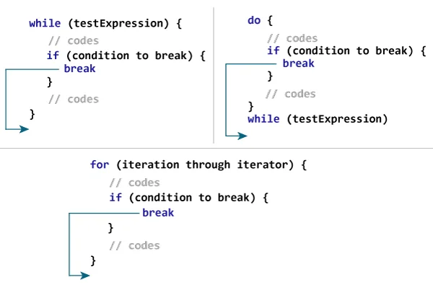

Slide 98
Example: Kotlin break
fun main(args: Array<String>) {
for (i in 1..10) {
if (i == 5) {
break
}
println(i)
}
}
1
2
3
4
When the value of i is equal to 5, expression i == 5 inside if is evaluated to true, and break is executed. This terminates the for loop.

Slide 99
Example: Calculate Sum Until User enters 0
The program below calculates the sum of numbers entered by the user until user enters 0.
fun main(args: Array<String>) {
var sum = 0
var number: Int
while (true) {
print("Enter a number: ")
number = readLine()!!.toInt()
if (number == 0)
break
sum += number
}
print("sum = $sum")
}
Enter a number: 4
Enter a number: 12
Enter a number: 6
Enter a number: -9
Enter a number: 0
sum = 13

Slide 100
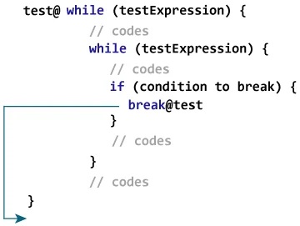
Kotlin Labeled break
What you have learned till now is an unlabeled form of break, which terminates the nearest enclosing loop. There is another way break can be used (labeled form) to terminate the desired loop (can be an outer loop).
How labeled break works?
Kotlin Labeled break

Slide 101
Labeled break
Label in Kotlin starts with an identifier which is followed by @.
Here, test@ is a label marked at the outer while loop. Now, by using break with a label (break@test in this case), you can break the specific loop.

Slide 102
Kotlin continue Expression
Suppose you are working with loops. It is sometimes desirable to skip the current iteration of the loop.
In such case, continue is used. The continue construct skips the current iteration of the enclosing loop, and the control of the program jumps to the end of the loop body.

Slide 103
How continue works?
It is almost always used with if...else construct. For example,
while (testExpression1) {
// codes1
if (testExpression2) {
continue
}
// codes2
}
If the testExpression2 is evaluated to true, continue is executed which skips all the codes inside while loop after it for that iteration.

Slide 104
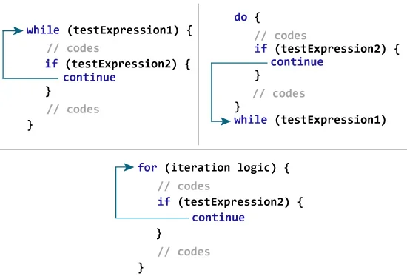

Slide 105
Example: Kotlin continue
fun main(args: Array<String>) {
for (i in 1..5) {
println("$i Always printed.")
if (i > 1 && i < 5) {
continue
}
println("$i Not always printed.")
}
}
1 Always printed.
1 Not always printed.
2 Always printed.
3 Always printed.
4 Always printed.
5 Always printed.
5 Not always printed.

Slide 106
Example: Calculate Sum of Positive Numbers Only
The program below calculates the sum of maximum of 6 positive numbers entered by the user. If the user enters negative number or zero, it is skipped from calculation.
fun main(args: Array<String>) {
var number: Int
var sum = 0
for (i in 1..6) {
print("Enter an integer: ")
number = readLine()!!.toInt()
if (number <= 0)
continue
sum += number
}
println("sum = $sum")
}
Enter an integer: 4
Enter an integer: 5
Enter an integer: -50
Enter an integer: 10
Enter an integer: 0
Enter an integer: 12
sum = 31

Slide 107
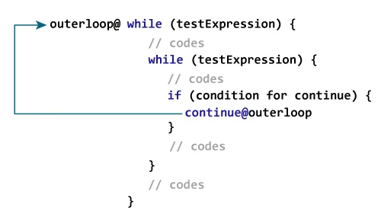
Kotlin Labeled continue
What you have learned till now is unlabeled form of continue, which skips current iteration of the nearest enclosing loop. continue can also be used to skip the iteration of the desired loop (can be outer loop) by using continue labels.
How labeled continue works?

Slide 108
Kotlin Functions
In programming, function is a group of related statements that perform a specific task.
Functions are used to break a large program into smaller and modular chunks. For example, you need to create and color a circle based on input from the user. You can create two functions to solve this problem:
createCircle() Function
colorCircle() Function
Dividing a complex program into smaller components makes our program more organized and manageable.
Furthermore, it avoids repetition and makes code reusable.

Slide 109
Types of Functions
Depending on whether a function is defined by the user, or available in standard library, there are two types of functions:
Kotlin Standard Library Function
User-defined functions

Slide 110
Kotlin Standard Library Function
The standard library functions are built-in functions in Kotlin that are readily available for use. For example,
print() is a library function that prints message to the standard output stream (monitor).
sqrt() returns square root of a number (Double value)
fun main(args: Array<String>) {
var number = 5.5
print("Result = ${Math.sqrt(number)}")
}
Result = 2.345207879911715

Slide 111
User-defined Functions
As mentioned, you can create functions yourself. Such functions are called user-defined functions.
How to create a user-defined function in Kotlin?
Before you can use (call) a function, you need to define it.
Here's how you can define a function in Kotlin:
fun callMe() {
// function body
}
To define a function in Kotlin, fun keyword is used. Then comes the name of the function (identifier). Here, the name of the function is callMe.
In the above program, the parenthesis ( ) is empty. It means, this function doesn't accept any argument. You will learn about arguments later in this article.
The codes inside curly braces { } is the body of the function.

Slide 112
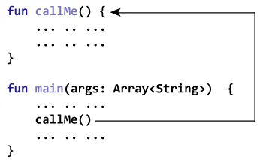
How to call a function?
You have to call the function to run codes inside the body of the function. Here's how:
callme( )
This statement calls the callMe() function declared earlier.

Slide 113
Example: Simple Function Program
fun callMe() {
println("Printing from callMe() function.")
println("This is cool (still printing from inside).")
}
fun main(args: Array<String>) {
callMe()
println("Printing outside from callMe() function.")
}
Printing from callMe() function.
This is cool (still printing from inside).
Printing outside from callMe() function.

Slide 114
Example: Add Two Numbers Using Function
fun addNumbers(n1: Double, n2: Double): Int {
val sum = n1 + n2
val sumInteger = sum.toInt()
return sumInteger
}
fun main(args: Array<String>) {
val number1 = 12.2
val number2 = 3.4
val result: Int
result = addNumbers(number1, number2)
println("result = $result")
}
result = 15

Slide 115
How functions with arguments and return value work?
Here, two arguments number1 and number2 of type Double are passed to the addNumbers() function during function call. These arguments are called actual arguments.
result = addNumbers(number1, number2)
The parameters n1 and n2 accepts the passed arguments (in the function definition). These arguments are called formal arguments (or parameters).

Slide 116
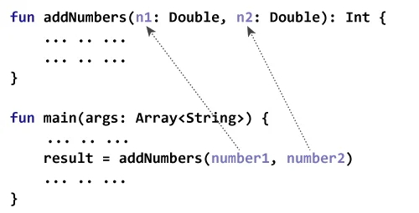
In Kotlin, arguments are separated using commas. Also, the type of the formal argument must be explicitly typed.
Note that, the data type of actual and formal arguments should match, i.e., the data type of first actual argument should match the type of first formal argument. Similarly, the type of second actual argument must match the type of second formal argument and so on.

Slide 117
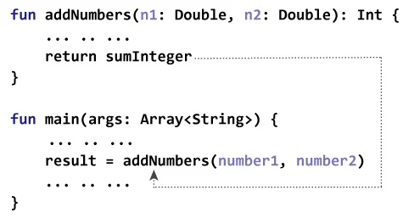
In the program, sumInteger is returned from addNumbers() function. This value is assigned to the variable result.
Notice, both sumInteger and result are of type Int.
the return type of the function is specified in the function definition.
// return type is Int
fun addNumbers(n1: Double, n2: Double): Int {
... .. ...
}

Slide 118
Example: Display Name by Using Function
fun main(args: Array<String>) {
println(getName("John", "Doe"))
}
fun getName(firstName: String, lastName: String): String = "$firstName $lastName"
When you run the program, the output will be:
John Doe
Here, the getName() function takes two String arguments, and returns a String.

Slide 119
You can omit the curly braces { } of the function body and specify the body after = symbol if the function returns a single expression (like above example).
It is optional to explicitly declare the return type in such case because the return type can be inferred by the compiler. In the above example, you can replace
fun getName(firstName: String, lastName: String): String = “$firstName $lastName” with
fun getName(firstName: String, lastName: String) = “$firstName $lastName”

Slide 120
Kotlin Default Argument
In Kotlin, you can provide default values to parameters in function definition.
If the function is called with arguments passed, those arguments are used as parameters. However, if the function is called without passing argument(s), default arguments are used.

Slide 121
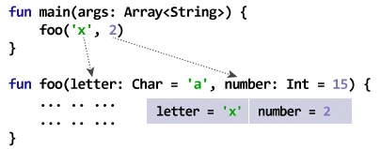
Case I: All arguments passed
The function foo() takes two arguments. The arguments are provided with default values. However, foo() is called by passing both arguments in the above program. Hence, the default arguments are not used.
The value of letter and number will be 'x' and 2 respectively inside the foo() function.

Slide 122
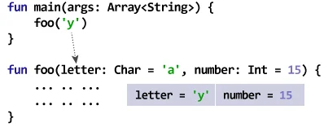
Case II: All arguments are not passed
Here, only one (first) argument is passed to the foo() function. Hence, the first argument uses the value passed to the function. However, second argument number will take the default value since the second argument is not passed during function call.
The value of letter and number will be 'y' and 15 respectively inside the foo() function.

Slide 123
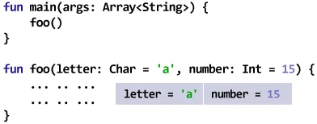
Case III: No argument is passed
Here, the foo() function is called without passing any argument. Hence, both arguments uses its default values.
The value of letter and number will be 'a' and 15 respectively inside the foo() function.

Slide 124
Example: Kotlin Default Argument
fun displayBorder(character: Char = '=', length: Int = 15) {
for (i in 1..length) {
print(character)
}
}
fun main(args: Array<String>) {
println("Output when no argument is passed:")
displayBorder()
println("Output when first argument is passed:")
displayBorder('*’)
println("Output when both arguments are passed:")
displayBorder('*', 5)
}

Slide 125
Output
Output when no argument is passed:
===============
Output when first argument is passed:
***************
Output when both arguments are passed:
*****

Slide 126
Kotlin named argument
Before talking about named argument, let us consider a little modification of the above code:
fun displayBorder(character: Char = '=', length: Int = 15) {
for (i in 1..length) {
print(character)
}
}
fun main(args: Array<String>) {
displayBorder(5)
}
Here, we are trying to pass second argument to the displayBorder() function, and use default argument for first argument. However, this code will give use an error. It's because the compiler thinks we are trying to provide 5 (Int value) to character (Char type).

Slide 127
Example: Kotlin named argument
fun displayBorder(character: Char = '=', length: Int = 15) {
for (i in 1..length) {
print(character)
}
}
fun main(args: Array<String>) {
displayBorder(length = 5)
}
=====

Slide 128
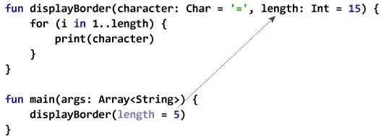
In the above program, we are using named argument (length = 5) specifying that the length parameter in the function definition should take this value (doesn't matter the position of the argument).
The first argument character uses the default value '=' in the program.

Slide 129
Object-oriented Programming (OOP)
In object-oriented style of programming, you can divide a complex problem into smaller sets by creating objects.
These objects share two characteristics:
state
behavior
Let's take few examples:
Lamp is an object
It can be in on or off state.
You can turn on and turn off lamp (behavior).
Bicycle is an object
It has current gear, two wheels, number of gear etc. states.
It has braking, accelerating, changing gears etc. behavior.

Slide 130
Kotlin Class
Before you create objects in Kotlin, you need to define a class.
A class is a blueprint for the object.
We can think of class as a sketch (prototype) of a house. It contains all the details about the floors, doors, windows etc. Based on these descriptions we build the house. House is the object.
Since, many houses can be made from the same description, we can create many objects from a class.

Slide 131
How to define a class in Kotlin?
To define a class in Kotlin, class keyword is used:
class ClassName {
// property
// member function
... .. ...
}

Slide 132
Here's an example:
class Lamp {
// property (data member)
private var isOn: Boolean = false
// member function
fun turnOn() {
isOn = true
}
// member function
fun turnOff() {
isOn = false
}
}

Slide 133
Visibility Modifiers
Classes, objects, properties, member function etc. can have visibility modifiers. For example, the isOn property is private. This means, the isOn property can be changed from only inside the Lamp class.
Other visibility modifiers are:
private - visible (can be accessed) from inside the class only.
public - visible everywhere.
protected - visible to the class and its subclass.
internal - any client inside the module can access them.

Slide 134
Kotlin Objects
When class is defined, only the specification for the object is defined; no memory or storage is allocated.
To access members defined within the class, you need to create objects. Let's create objects of Lamp class.

Slide 135
class Lamp {
// property (data member)
private var isOn: Boolean = false
// member function
fun turnOn() {
isOn = true
}
// member function
fun turnOff() {
isOn = false
}
}
fun main(args: Array<String>) {
val l1 = Lamp() // create l1 object of Lamp class
val l2 = Lamp() // create l2 object of Lamp class
}

Slide 136
How to access members?
You can access properties and member functions of a class by using . notation. For example,
l1.turnOn()
This statement calls turnOn() function for l1 object.

Slide 137
Example1: Kotlin Class and Object
class Lamp {
// property (data member)
private var isOn: Boolean = false
// member function
fun turnOn() {
isOn = true
}
// member function
fun turnOff() {
isOn = false
}
fun displayLightStatus() {
if (isOn == true)
println("lamp is on.")
else
println("lamp is off.")
}
}
fun main(args: Array<String>) {
val lamp = Lamp()
lamp.displayLightStatus()
}
lamp is off.

Slide 138
Example2: Kotlin Class and Object
class Lamp {
// property (data member)
private var isOn: Boolean = false
// member function
fun turnOn() {
isOn = true
}
// member functionl1 Lamp is on.
l2 Lamp is off.
fun turnOff() {
isOn = false
}
fun displayLightStatus(lamp: String) {
if (isOn == true)
println("$lamp lamp is on.")
else
println("$lamp lamp is off.")
}
}
fun main(args: Array<String>) {
val l1 = Lamp() // create l1 object of Lamp class
val l2 = Lamp() // create l2 object of Lamp class
l1.turnOn()
l2.turnOff()
l1.displayLightStatus("l1")
l2.displayLightStatus("l2")
}
l1 Lamp is on.
l2 Lamp is off.

Slide 139
Kotlin Constructors
A constructor is a concise way to initialize class properties.
It is a special member function that is called when an object is instantiated (created). However, how they work in Kotlin is slightly different.
In Kotlin, there are two constructors:
Primary constructor - concise way to initialize a class
Secondary constructor - allows you to put additional initialization logic

Slide 140
Primary Constructor
The primary constructor is part of the class header. Here's an example:
class Person(val firstName: String, var age: Int) {
// class body
}
The block of code surrounded by parentheses is the primary constructor: (val firstName: String, var age: Int).
The constructor declared two properties: firstName (read-only property as it's declared using keyword val) and age (read-write property as it is declared with keyword var).

Slide 141
Example: Primary Constructor
fun main(args: Array<String>) {
val person1 = Person("Joe", 25)
println("First Name = ${person1.firstName}")
println("Age = ${person1.age}")
}
class Person(val firstName: String, var age: Int) {
}
First Name = Joe
Age = 25
When the object of Person class is created, "Joe" and 25 values are passed as if Person is a function.
This initializes firstName and age properties of person1 object to "Joe" and 25 respectively.

Slide 142
Primary Constructor and Initializer Blocks
The primary constructor has a constrained syntax, and cannot contain any code.
To put the initialization code (not only code to initialize properties), initializer block is used. It is prefixed with init keyword. Let's modify the above example with initializer block:
fun main(args: Array<String>) {
val person1 = Person("joe", 25)
}
class Person(fName: String, personAge: Int) {
val firstName: String
var age: Int
// initializer block
init {
firstName = fName.capitalize()
age = personAge
println("First Name = $firstName")
println("Age = $age")
}
}
First Name = Joe
Age = 25

Slide 143
Here, parameters fName and personAge inside the parenthesis accepts values "Joe" and 25 respectively when person1 object is created. However, fName and personAge are used without using var or val, and are not properties of the Person class.
The Person class has two properties firstName, and age are declared.
When person1 object is created, code inside initializer block is executed. The initializer block not only initializes its properties but also prints them.

Slide 144
Here is another way to perform the same task:
fun main(args: Array<String>) {
val person1 = Person("joe", 25)
}
class Person(fName: String, personAge: Int) {
val firstName = fName.capitalize()
var age = personAge
// initializer block
init {
println("First Name = $firstName")
println("Age = $age")
}
}

Slide 145
To distinguish the constructor parameter and property, different names are used (fName and firstName, and personAge and age). It's more common to use _firstName and _age instead of completely different name for constructor parameters. For example:
class Person(_firstName: String, _age: Int) {
val firstName = _firstName.capitalize()
var age = _age
// initializer block
init {
... .. ...
}
}

Slide 146
Default Value in Primary Constructor
You can provide default value to constructor parameters (similar to providing default arguments to functions). For example:
fun main(args: Array<String>) {
println("person1 is instantiated")
val person1 = Person("joe", 25)
println("person2 is instantiated")
val person2 = Person("Jack")
println("person3 is instantiated")
val person3 = Person()
}
class Person(_firstName: String = "UNKNOWN", _age: Int = 0) {
val firstName = _firstName.capitalize()
var age = _age
// initializer block
init {
println("First Name = $firstName")
println("Age = $age\n")
}
}
person1 is instantiated
First Name = Joe
Age = 25
person2 is instantiated
First Name = Jack
Age = 0
person3 is instantiated
First Name = UNKNOWN
Age = 0

Slide 147
Kotlin Secondary Constructor
In Kotlin, a class can also contain one or more secondary constructors. They are created using constructor keyword.
Secondary constructors are not that common in Kotlin. The most common use of secondary constructor comes up when you need to extend a class that provides multiple constructors that initialize the class in different ways.

Slide 148
Here's how you can create a secondary constructor in Kotlin:
class Log {
constructor(data: String) {
// some code
}
constructor(data: String, numberOfData: Int) {
// some code
}
}
Here, the Log class has two secondary constructors, but no primary constructor.

Slide 149
You can extend the class as:
class Log {
constructor(data: String) {
// code
}
constructor(data: String, numberOfData: Int) {
// code
}
}
class AuthLog: Log {
constructor(data: String): super(data) {
// code
}
constructor(data: String, numberOfData: Int): super(data, numberOfData) {
// code
}
}

Slide 150
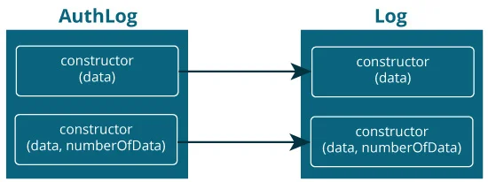
Here, constructors of the derived class AuthLog calls the corresponding constructor of the base class Log. For that, super() is used.

Slide 151
Example: Kotlin Secondary Constructor
fun main(args: Array<String>) {
val p1 = AuthLog("Bad Password")
}
open class Log {
var data: String = ""
var numberOfData = 0
constructor(_data: String) {
}
constructor(_data: String, _numberOfData: Int) {
data = _data
numberOfData = _numberOfData
println("$data: $numberOfData times")
}
}
class AuthLog: Log {
constructor(_data: String): this("From AuthLog -> " + _data, 10) {
}
constructor(_data: String, _numberOfData: Int): super(_data, _numberOfData) {
}
}
From AuthLog -> Bad Password: 10 times

Slide 152
Kotlin Getters and Setters
In programming, getters are used for getting value of the property. Similarly, setters are used for setting value of the property.
In Kotlin, getters and setters are optional and are auto-generated if you do not create them in your program.

Slide 153
How getters and setters work?
class Person {
var name: String = "defaultValue"
}
is equivalent to
class Person {
var name: String = "defaultValue"
// getter
get() = field
// setter
set(value) {
field = value
}
}

Slide 154
When you instantiate object of the Person class and initialize the name property, it is passed to the setters parameter value and sets field to value.
val p = Person()
p.name = "jack"
Now, when you access name property of the object, you will get field because of the code get() = field.
println("${p.name}")
jack

Slide 155
fun main(args: Array<String>) {
val maria = Girl()
maria.actualAge = 15
maria.age = 15
println("Maria: actual age = ${maria.actualAge}")
println("Maria: pretended age = ${maria.age}")
val angela = Girl()
angela.actualAge = 35
angela.age = 35
println("Angela: actual age = ${angela.actualAge}")
println("Angela: pretended age = ${angela.age}")
}
class Girl {
var age: Int = 0
get() = field
set(value) {
field = if (value < 18)
18
else if (value >= 18 && value <= 30)
value
else
value-3
}
var actualAge: Int = 0
}
Maria: actual age = 15
Maria: pretended age = 18
Angela: actual age = 35
Angela: pretended age = 32

Slide 156
Kotlin Inheritance
Inheritance is one of the key features of object-oriented programming. It allows user to create a new class (derived class) from an existing class (base class).
The derived class inherits all the features from the base class and can have additional features of its own.

Slide 157
Why inheritance?
Suppose, in your application, you want three characters - a math teacher, a footballer and a businessman.
Since, all of the characters are persons, they can walk and talk. However, they also have some special skills. A math teacher can teach math, a footballer can play football and a businessman can run a business.
You can individually create three classes who can walk, talk and perform their special skill.

Slide 158

In each of the classes, you would be copying the same code to walk and talk for each character.
If you want to add a new feature - eat, you need to implement the same code for each character. This can easily become error-prone (when copying) and duplicate codes.

Slide 159
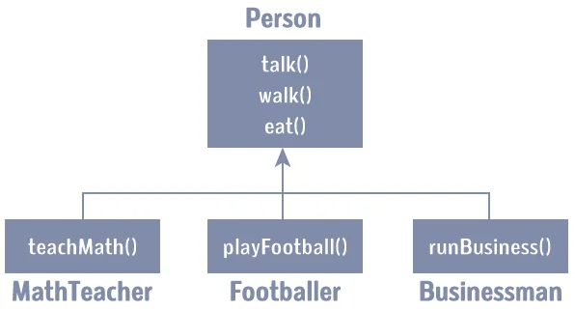
It would be a lot easier if we had a Person class with basic features like talk, walk, eat, sleep, and add special skills to those features as per our characters. This is done using inheritance.

Slide 160
Using inheritance, now you don't implement the same code for walk(), talk() and eat() for each class. You just need to inherit them.
So, for MathTeacher (derived class), you inherit all features of a Person (base class) and add a new feature teachMath(). Likewise, for the Footballer class, you inherit all the features of the Person class and add a new feature playFootball() and so on.
This makes your code cleaner, understandable and extendable.

Slide 161
Kotlin inheritance
Let's try to implement the above discussion in code:
open class Person(age: Int) {
// code for eating, talking, walking
}
class MathTeacher(age: Int): Person(age) {
// other features of math teacher
}
class Footballer(age: Int): Person(age) {
// other features of footballer
}
class Businessman(age: Int): Person(age) {
// other features of businessman
}

Slide 162
Here, Person is a base class, and classes MathTeacher, Footballer, and Businessman are derived from the Person class.
Notice, the keyword open before the base class, Person. It's important.
By default, classes in Kotlin are final. If you are familiar with Java, you know that a final class cannot be subclassed. By using the open annotation on a class, compiler allows you to derive new classes from it.

Slide 163
Example: Kotlin Inheritance
open class Person(age: Int, name: String) {
init {
println("My name is $name.")
println("My age is $age")
}
}
class MathTeacher(age: Int, name: String): Person(age, name) {
fun teachMaths() {
println("I teach in primary school.")
}
}
class Footballer(age: Int, name: String): Person(age, name) {
fun playFootball() {
println("I play for LA Galaxy.")
}
}
fun main(args: Array<String>) {
val t1 = MathTeacher(25, "Jack")
t1.teachMaths()
println()
val f1 = Footballer(29, "Christiano")
f1.playFootball()
}

Slide 164
My name is Jack.
My age is 25
I teach in primary school.
My name is Cristiano.
My age is 29
I play for LA Galaxy.
Here, two classes MathTeacher and Footballer are derived from the Person class.
The primary constructor of the Person class declared two properties: age and name, and it has an initializer block. The initilizer block (and member functions) of the base class Person can be accessed by the objects of derived classes (MathTeacher and Footballer).
Derived classes MathTeacher and Footballer have their own member functions teachMaths() and playFootball() respectively. These functions are accessible only from the objects of their respective class.

Slide 165
When the object t1 of MathTeacher class is created,
val t1 = MathTeacher(25, "Jack")
The parameters are passed to the primary constructor. In Kotlin, init block is called when the object is created. Since, MathTeacher is derived from Person class, it looks for initializer block in the base class (Person) and executes it. If the MathTeacher had init block, the compiler would have also executed the init block of the derived class.
Next, the teachMaths() function for object t1 is called using t1.teachMaths() statement.
The program works similarly when object f1 of Footballer class is created. It executes the init block of the base class. Then, the playFootball() method of Footballer class is called using statement f1.playFootball().

Slide 166
Overriding Member Functions and Properties
If the base class and the derived class contains a member function (or property) with the same name, you can need to override the member function of the derived class using override keyword, and use open keyword for the member function of the base class.

Slide 167
Example: Overriding Member Function
// Empty primary constructor
open class Person() {
open fun displayAge(age: Int) {
println("My age is $age.")
}
}
class Girl: Person() {
override fun displayAge(age: Int) {
println("My fake age is ${age - 5}.")
}
}
fun main(args: Array<String>) {
val girl = Girl()
girl.displayAge(31)
}
My fake age is 26.

Slide 168
Calling Members of Base Class from Derived Class
You can call functions (and access properties) of the base class from a derived class using super keyword. Here's how:
open class Person() {
open fun displayAge(age: Int) {
println("My actual age is $age.")
}
}
class Girl: Person() {
override fun displayAge(age: Int) {
// calling function of base class
super.displayAge(age)
println("My fake age is ${age - 5}.")
}
}
fun main(args: Array<String>) {
val girl = Girl()
girl.displayAge(31)
}
My actual age is 31.
My fake age is 26.

Slide 169
Kotlin Nested and Inner Class
Kotlin Nested Class
Similar like Java, Kotlin allows you to define a class within another class known as nested class.
class Outer {
... .. ...
class Nested {
... .. ...
}
}
Since Nested class is a member of its enclosing class Outer, you can use . notation to access Nested class and its members.

Slide 170
Example: Kotlin Nested Class
class Outer {
val a = "Outside Nested class."
class Nested {
val b = "Inside Nested class."
fun callMe() = "Function call from inside Nested class."
}
}
fun main(args: Array<String>) {
// accessing member of Nested class
println(Outer.Nested().b)
// creating object of Nested class
val nested = Outer.Nested()
println(nested.callMe())
}
Inside Nested class.
Function call from inside Nested class.

Slide 171
Kotlin Inner Class
The nested classes in Kotlin do not have access to the outer class instance. For example,
class Outer {
val foo = "Outside Nested class."
class Nested {
// Error! cannot access member of outer class.
fun callMe() = foo
}
}
fun main(args: Array<String>) {
val outer = Outer()
println(outer.Nested().callMe())
}
The above code won't compile because we tried to access foo property of Outer class from inside Nested class.
In order to solve this issue, you need to mark the nested class with inner to create an inner class. Inner classes carry a reference to an outer class, and can access outer class members.

Slide 172
Example: Kotlin Inner Class
class Outer {
val a = "Outside Nested class."
inner class Inner {
fun callMe() = a
}
}
fun main(args: Array<String>) {
val outer = Outer()
println("Using outer object: ${outer.Inner().callMe()}")
val inner = Outer().Inner()
println("Using inner object: ${inner.callMe()}")
}
Using outer object: Outside Nested class.
Using inner object: Outside Nested class.

Slide 173
Kotlin Data Class
There may arise a situation where you need to create a class solely to hold data. In such cases, you can mark the class as data to create a data class. For example,
data class Person(val name: String, var age: Int)
When you declare a data class, the compiler automatically generates several functions such as toString(), equals(), hashcode() etc behind the scenes. This helps to keep your code concise.

Slide 174
Kotlin Data Class Requirements
The primary constructor must have at least one parameter.
The parameters of the primary constructor must be marked as either val (read-only) or var (read-write).
The class cannot be open, abstract, inner or sealed.
The class may extend other classes or implement interfaces. If you are using Kotlin version before 1.1, the class can only implement interfaces.

Slide 175
Example: Kotlin Data Class
data class User(val name: String, val age: Int)
fun main(args: Array<String>) {
val jack = User("jack", 29)
println("name = ${jack.name}")
println("age = ${jack.age}")
}
name = jack
age = 29

Slide 176
Copying : For a data class, you can create a copy of an object with some of its properties different using copy() function.
data class User(val name: String, val age: Int)
fun main(args: Array<String>) {
val u1 = User("John", 29)
// using copy function to create an object
val u2 = u1.copy(name = "Randy")
println("u1: name = ${u1.name}, name = ${u1.age}")
println("u2: name = ${u2.name}, name = ${u2.age}")
}
u1: name = John, name = 29
u2: name = Randy, name = 29

Slide 177
toString() method
The toString() function returns a string representation of the object.
data class User(val name: String, val age: Int)
fun main(args: Array<String>) {
val u1 = User("John", 29)
println(u1.toString())
}
User(name=John, age=29)

Slide 178
hashCode() and equals()
The hashCode() method returns hash code for the object. If two objects are equal, hashCode() produces the same integer result.
The equals() returns true if two objects are equal (has same hashCode()). If objects are not equal, equals() returns false.

Slide 179
data class User(val name: String, val age: Int)
fun main(args: Array<String>) {
val u1 = User("John", 29)
val u2 = u1.copy()
val u3 = u1.copy(name = "Amanda")
println("u1 hashcode = ${u1.hashCode()}")
println("u2 hashcode = ${u2.hashCode()}")
println("u3 hashcode = ${u3.hashCode()}")
if (u1.equals(u2) == true)
println("u1 is equal to u2.")
else
println("u1 is not equal to u2.")
if (u1.equals(u3) == true)
println("u1 is equal to u3.")
else
println("u1 is not equal to u3.")
}
u1 hashcode = 71750738
u2 hashcode = 71750738
u3 hashcode = 771732263
u1 is equal to u2.
u1 is not equal to u3.

Slide 180
Kotlin | Lambdas Expressions and Anonymous Functions
Lambdas expression and Anonymous function both are function literals means these functions are not declared but passed immediately as an expression.
Lambda Expression –
As we know, syntax of Kotlin lambdas is similar to Java Lambdas. A function without name is called anonymous function. For lambda expression we can say that it is anonymous function.

Slide 181
Lambda Expression: Example
fun main(args: Array<String>) {
val company = { println("GeeksforGeeks")}
// invoking function method1
company()
// invoking function method2
company.invoke()
}
GeeksforGeeks
GeeksforGeeks

Slide 182
Syntax of Lambda expression
val lambda_name : Data_type = { argument_List -> code_body }
A lambda expression is always surrounded by curly braces, argument declarations go inside curly braces and have optional type annotations, the code_body goes after an arrow -> sign. If the inferred return type of the lambda is not Unit, then the last expression inside the lambda body is treated as return value.
val sum = {a: Int , b: Int -> a + b}

Slide 183
// with type annotation in lambda expression
val sum1 = { a: Int, b: Int -> a + b }
// without type annotation in lambda expression
val sum2:(Int,Int)-> Int = { a , b -> a + b}
fun main(args: Array<String>) {
val result1 = sum1(2,3)
val result2 = sum2(3,4)
println("The sum of two numbers is: $result1")
println("The sum of two numbers is: $result2")
// directly print the return value of lambda
// without storing in a variable.
println(sum1(5,7))
}
The sum of two numbers is: 5
The sum of two numbers is: 7
12

Slide 184
Kotlin program to return String value by lambda function
val find =fun(num: Int): String{
if(num % 2==0 && num < 0) {
return "Number is even and negative"
}
else if (num %2 ==0 && num >0){
return "Number is even and positive"
}
else if(num %2 !=0 && num < 0){
return "Number is odd and negative"
}
else {
return "Number is odd and positive"
}
}
fun main(args: Array<String>) {
val result = find(112)
println(result)
}
Number is even and positive

Slide 185
Anonymous Function
An anonymous function is very similar to regular function except for the name of the function which is omitted from the declaration. The body of the anonymous function can be either an expression or block.

Slide 186
Example 1: Function body as an expression
fun(a: Int, b: Int) : Int = a * b
Example 2: Function body as a block
fun(a: Int, b: Int): Int {
val mul = a * b
return mul
}

Slide 187
// anonymous function with body as an expression
val anonymous1 = fun(x: Int, y: Int): Int = x + y
// anonymous function with body as a block
val anonymous2 = fun(a: Int, b: Int): Int {
val mul = a * b
return mul
}
fun main(args: Array<String>) {
//invoking functions
val sum = anonymous1(3,5)
val mul = anonymous2(3,5)
println("The sum of two numbers is: $sum")
println("The multiply of two numbers is: $mul")
}
The sum of two numbers is: 8
The multiply of two numbers is: 15

