Slide 1
Android UI Layouts
In android, Layout is used to define the user interface for an app or activity and it will hold the UI elements that will appear to the user.
The user interface in the android app is made with a collection of View and ViewGroup objects. Generally, the android apps will contain one or more activities and each activity is one screen of the app. The activities will contain multiple UI components and those UI components are the instances of View and ViewGroup subclasses.

Slide 2
View & ViewGroup
The View is a base class for all UI components in android and it is used to create an interactive UI components such as TextView, EditText, Checkbox, Radio Button, etc. and it responsible for event handling and drawing.
The ViewGroup is a subclass of View and it will act as a base class for layouts and layouts parameters. The ViewGroup will provide an invisible containers to hold other Views or ViewGroups and to define the layout properties.

Slide 3
Android View
The View is a base class for all UI components in android. For example, the EditText class is used to accept the input from users in android apps, which is a subclass of View.
Following are the some of common View subclasses that will be used in android applications.
TextView EditText Button
CheckBox RadioButton ImageButton
Progress Bar Spinner
Like these we have many View subclasses available in android.

Slide 4
Android ViewGroup
The ViewGroup is a subclass of View and it will act as a base class for layouts and layouts parameters. The ViewGroup will provide an invisible containers to hold other Views or ViewGroups and to define the layout properties.
For example, Linear Layout is the ViewGroup that contains a UI controls like button, textview, etc. and other layouts also.
Following are the commonly used ViewGroup subclasses in android applications.
Linear Layout Relative Layout Table Layout
Frame Layout Web View List View
Grid View
Both View and ViewGroup subclasses together will play a key role to create a layouts in android applications.

Slide 5
Android LinearLayout
In android, LinearLayout is a ViewGroup subclass which is used to render all child View instances one by one either in Horizontal direction or Vertical direction based on the orientation property.
In android, we can specify the linear layout orientation using android:orientation attribute.
In LinearLayout, the child View instances arranged one by one, so the horizontal list will have only one row of multiple columns and vertical list will have one column of multiple rows.

Slide 6
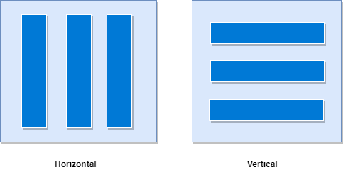
Linear layout
Following is the pictorial representation of linear layout in android applications.

Slide 7
Android LinearLayout Declaration
Following is the way we need to define the LinearLayout in android applications.
<?xml version="1.0" encoding="utf-8"?>
<LinearLayout xmlns:android="http://schemas.android.com/apk/res/android"
android:layout_width="match_parent"
android:layout_height="match_parent"
android:orientation="vertical" >
<!-- Add Child Views Here -->
</LinearLayout>
If you observe above code snippet, here we defined orientation as vertical, so this aligns all its child layout / views vertically.

Slide 8
Android LinearLayout Example
Following is the example of creating a LinearLayout with different controls in android application.
Create a new android application using android studio and give names as LinearLayout.
Now open an activity_main.xml file from \res\layout path and write the code like as shown below

Slide 9
activity_main.xml
<?xml version="1.0" encoding="utf-8"?>
<LinearLayout xmlns:android="http://schemas.android.com/apk/res/android"
android:layout_width="match_parent"
android:layout_height="match_parent"
android:paddingLeft="20dp"
android:paddingRight="20dp"
android:orientation="vertical" >
<EditText
android:id="@+id/txtTo"
android:layout_width="match_parent"
android:layout_height="wrap_content"
android:hint="To"/>
<EditText
android:id="@+id/txtSub"
android:layout_width="match_parent"
android:layout_height="wrap_content"
android:hint="Subject"/>
<EditText
android:id="@+id/txtMsg"
android:layout_width="match_parent"
android:layout_height="0dp"
android:layout_weight="1"
android:gravity="top"
android:hint="Message"/>
<Button
android:layout_width="100dp"
android:layout_height="wrap_content"
android:layout_gravity="right"
android:text="Send"/>
</LinearLayout>

Slide 10
Once we are done with creation of layout, we need to load the XML layout resource from our activity onCreate() callback method, for that open main activity file MainActivity.kt
package com.example.linearlayout; import android…. MainActivity : AppCompatActivity { Override fun onCreate(savedInstanceState:Bundle?) { super.onCreate(savedInstanceState) setContentView(R.layout.activity_main); } }
If you observe above code we are calling our layout using setContentView method in the form of R.layout.layout_file_name. Here our xml file name is activity_main.xml so we used file name activity_main.
Generally, during the launch of our activity, the onCreate() callback method will be called by the android framework to get the required layout for an activity.

Slide 11
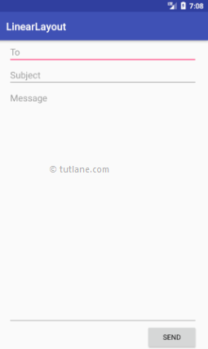

Output of Android LinearLayout Example

Slide 12
Layout Weight Attribute
In the above example we used layout weight attribute (android:layout_weight) in child view. Actually, this attribute is used by child views to specify how much space the View should occupy on the screen. If we assign a larger weight value to the child view, then it will expand to fill any remaining space in the parent view.
We used three text fields and we assigned weight value to only one text field. The two text fields without weight will occupy only the area required for its content and the other text field with weight value will expand to fill the remaining space after all three fields measured.
This is how we can use LinearLayout in android applications to render all View instances one by one either in Horizontal direction or Vertical direction based on the orientation property.

Slide 13
Android RelativeLayout
In android, RelativeLayout is a ViewGroup which is used to specify the position of child View instances relative to each other (Child A to the left of Child B) or relative to the parent (Aligned to the top of parent).
Android Positioning Views in Relative Layout
In RelativeLayout we need to specify the position of child views relative to each other or relative to the parent. In case if we didn’t specify the position of child views, by default all child views are positioned to top-left of the layout.

Slide 14
Layout properties available to views in RelativeLayout
Attribute | Description
layout_alignParentTop | If it specified “true”, the top edge of view will match the top edge of the parent.
layout_alignParentBottom | If it specified “true”, the bottom edge of view will match the bottom edge of parent.
layout_alignParentLeft | If it specified “true”, the left edge of view will match the left edge of parent.
layout_alignParentRight | If it specified “true”, the right edge of view will match the right edge of the parent.
layout_centerInParent | If it specified “true”, the view will be aligned to the centre of parent.
layout_centerHorizontal | If it specified “true”, the view will be horizontally centre aligned within its parent.

Slide 15
Layout properties available to views in RelativeLayout
Attribute | Description
layout_centerVertical | If it specified “true”, the view will be vertically centre aligned within its parent.
layout_above | It accepts another sibling view id and places the view above the specified view id.
layout_below | It accepts another sibling view id and places the view below the specified view id.
layout_toLeftOf | It accepts another sibling view id and places the view left of the specified view id.
layout_toRightOf | It accepts another sibling view id and places the view right of the specified view id.
layout_toStartOf | It accepts another sibling view id and places the view to start of the specified view id.

Slide 16
activity_main.xml
<?xml version="1.0" encoding="utf-8"?>
<RelativeLayout xmlns:android="http://schemas.android.com/apk/res/android"
android:layout_width="match_parent"
android:layout_height="match_parent"
android:paddingLeft="10dp"
android:paddingRight="10dp">
<Button
android:id="@+id/btn1"
android:layout_width="wrap_content"
android:layout_height="wrap_content"
android:layout_alignParentLeft="true"
android:text="Button1" />

Slide 17
<Button
android:id="@+id/btn2"
android:layout_width="wrap_content"
android:layout_height="wrap_content"
android:layout_alignParentRight="true"
android:layout_centerVertical="true"
android:text="Button2" />
<Button
android:id="@+id/btn3"
android:layout_width="wrap_content"
android:layout_height="wrap_content"
android:layout_alignParentLeft="true"
android:layout_centerVertical="true"
android:text="Button3" />

Slide 18
<Button
android:id="@+id/btn4"
android:layout_width="match_parent"
android:layout_height="wrap_content"
android:layout_alignParentBottom="true"
android:text="Button4" />
<Button
android:id="@+id/btn5"
android:layout_width="wrap_content"
android:layout_height="wrap_content"
android:layout_alignBottom="@+id/btn2"
android:layout_centerHorizontal="true"
android:text="Button5" />

Slide 19
<Button
android:id="@+id/btn6"
android:layout_width="wrap_content"
android:layout_height="wrap_content"
android:layout_above="@+id/btn4"
android:layout_centerHorizontal="true"
android:text="Button6" />
<Button
android:id="@+id/btn7"
android:layout_width="wrap_content"
android:layout_height="wrap_content"
android:layout_toEndOf="@+id/btn1"
android:layout_toRightOf="@+id/btn1"
android:layout_alignParentRight="true"
android:text="Button7" />
</RelativeLayout>

Slide 20
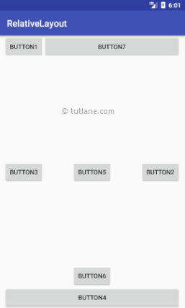
Output of Android RelativeLayout Example

Slide 21
Android TableLayout
In android, TableLayout is a ViewGroup subclass that is used to display the child View elements in rows and columns.
TableLayout will position its children elements into rows and columns and it won’t display any border lines for rows, columns or cells.
The TableLayout in android will work same as the HTML table and the table will have as many columns as the row with the most cells. The TableLayout can be explained as <table> and TableRow is like <tr> element.

Slide 22
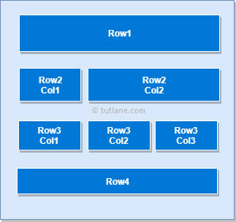
Pictorial representation of table layout

Slide 23
activity_main.xml
<?xml version="1.0" encoding="utf-8"?>
<TableLayout xmlns:android="http://schemas.android.com/apk/res/android"
android:layout_width="match_parent"
android:layout_height="match_parent"
android:layout_marginTop="100dp"
android:paddingLeft="10dp"
android:paddingRight="10dp" >
<TableRow android:background="#0079D6" android:padding="5dp">
<TextView
android:layout_width="wrap_content"
android:layout_height="wrap_content"
android:layout_weight="1"
android:text="UserId" />

Slide 24
<TextView
android:layout_width="wrap_content"
android:layout_height="wrap_content"
android:layout_weight="1"
android:text="User Name" />
<TextView
android:layout_width="wrap_content"
android:layout_height="wrap_content"
android:layout_weight="1"
android:text="Location" />
</TableRow>

Slide 25
<TableRow android:background="#DAE8FC" android:padding="5dp">
<TextView
android:layout_width="wrap_content"
android:layout_height="wrap_content"
android:layout_weight="1"
android:text="1" />
<TextView
android:layout_width="wrap_content"
android:layout_height="wrap_content"
android:layout_weight="1"
android:text="Suresh Dasari" />
<TextView
android:layout_width="wrap_content"
android:layout_height="wrap_content"
android:layout_weight="1"
android:text="Hyderabad" />
</TableRow>

Slide 26
<TableRow android:background="#DAE8FC" android:padding="5dp">
<TextView
android:layout_width="wrap_content"
android:layout_height="wrap_content"
android:layout_weight="1"
android:text="2" />
<TextView
android:layout_width="wrap_content"
android:layout_height="wrap_content"
android:layout_weight="1"
android:text="Rohini Alavala" />
<TextView
android:layout_width="wrap_content"
android:layout_height="wrap_content"
android:layout_weight="1"
android:text="Guntur" />
</TableRow>

Slide 27
<TableRow android:background="#DAE8FC" android:padding="5dp">
<TextView
android:layout_width="wrap_content"
android:layout_height="wrap_content"
android:layout_weight="1"
android:text="3" />
<TextView
android:layout_width="wrap_content"
android:layout_height="wrap_content"
android:layout_weight="1"
android:text="Trishika Dasari" />
<TextView
android:layout_width="wrap_content"
android:layout_height="wrap_content"
android:layout_weight="1"
android:text="Guntur" />
</TableRow>
</TableLayout>

Slide 28
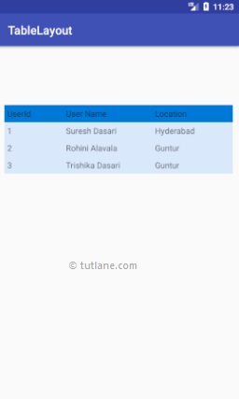
Output of Android TableLayout Example

Slide 29
Android FrameLayout
In android, Framelayout is a ViewGroup subclass that is used to specify the position of View instances it contains on the top of each other to display only single View inside the FrameLayout.
FrameLayout is designed to block out an area on the screen to display a single item.
FrameLayout will act as a placeholder on the screen and it is used to hold a single child view.
In FrameLayout, the child views are added in a stack and the most recently added child will show on the top. We can add multiple children views to FrameLayout and control their position by using gravity attributes in FrameLayout.

Slide 30
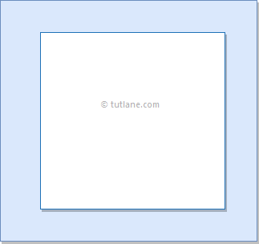
Pictorial representation of Frame layout

Slide 31
activity_main.xml
<?xml version="1.0" encoding="utf-8"?>
<FrameLayout xmlns:android="http://schemas.android.com/apk/res/android"
android:layout_width="match_parent"
android:layout_height="match_parent"
android:orientation="vertical">
<ImageView
android:id="@+id/imgvw1"
android:layout_width="wrap_content"
android:layout_height="wrap_content"
android:scaleType="centerCrop"
android:src="@drawable/flimg" />

Slide 32
<TextView
android:id="@+id/txtvw1"
android:layout_width="match_parent"
android:layout_height="wrap_content"
android:layout_marginTop="40dp"
android:background="#4C374A"
android:padding="10dp"
android:text="Grand Palace, Bangkok"
android:textColor="#FFFFFF"
android:textSize="20sp" />
<TextView
android:id="@+id/txtvw2"
android:layout_width="wrap_content"
android:layout_height="wrap_content"
android:layout_gravity="right|bottom"
android:background="#AA000000"
android:padding="10dp"
android:text="21/Aug/2017"
android:textColor="#FFFFFF"
android:textSize="18sp" />
</FrameLayout>

Slide 33
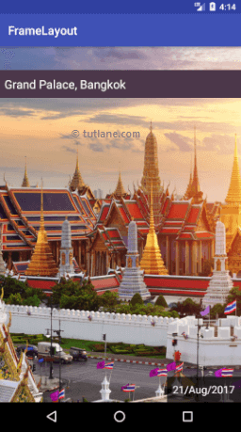
If you observe above code we used ImageView to show the image (flimg) from drawable folder in framelayout. So add your image to drawable folder and replace @drawable/flimg path with your image path.

Slide 34
Android ListView
In android, ListView is a ViewGroup that is used to display the list of scrollable of items in multiple rows and the list items are automatically inserted to the list using an adapter.
Generally, the adapter pulls data from sources such as an array or database and converts each item into a result view and that’s placed into the list.

Slide 35
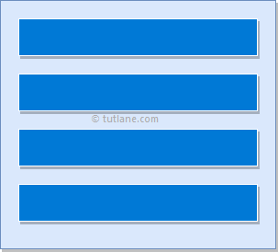
Pictorial representation of listview

Slide 36
Android Adapter
In android, Adapter will act as an intermediate between the data sources and adapter views such as ListView, Gridview to fill the data into adapter views. The adapter will hold the data and iterates through an items in data set and generate the views for each item in the list.
Generally, in android we have a different types of adapters available to fetch the data from different data sources to fill the data into adapter views.

Slide 37
Adapter | Description
ArrayAdapter | It will expects an Array or List as input.
CursorAdapter | It will accepts an instance of cursor as an input.
SimpleAdapter | It will accepts a static data defined in the resources.
BaseAdapter | It is a generic implementation for all three adapter types and it can be used for ListView, Gridview or Spinners based on our requirements

Slide 38
activity_main.xml
<?xml version="1.0" encoding="utf-8"?>
<LinearLayout xmlns:android="http://schemas.android.com/apk/res/android"
xmlns:tools="http://schemas.android.com/tools"
android:layout_width="match_parent"
android:layout_height="match_parent"
android:orientation="vertical">
<ListView
android:id="@+id/userlist"
android:layout_width="match_parent"
android:layout_height="wrap_content" >
</ListView>
</LinearLayout>

Slide 39
Bind data to our ListView using ArrayAdapter in MainActivity
(Sample code in Java)
package com…..
import android……
public class MainActivity extends AppCompatActivity {
private ListView mListView;
private ArrayAdapter aAdapter;
private String[] users = { "Suresh Dasari", "Rohini Alavala", "Trishika Dasari", "Praveen Alavala", "Madav Sai", "Hamsika Yemineni"};
@Override
protected void onCreate(Bundle savedInstanceState) {
super.onCreate(savedInstanceState);
setContentView(R.layout.activity_main);
mListView = (ListView) findViewById(R.id.userlist);
aAdapter = new ArrayAdapter(this, android.R.layout.simple_list_item_1, users);
mListView.setAdapter(aAdapter);
}
}

Slide 40
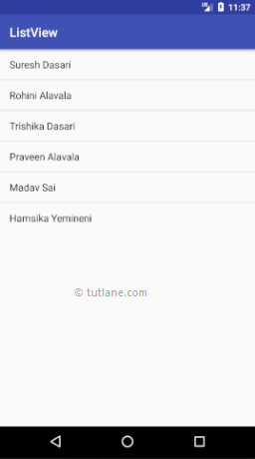
Output:

Slide 41
Android GridView
In android, Grid View is a ViewGroup that is used to display items in a two dimensional, scrollable grid and grid items are automatically inserted to the gridview layout using a list adapter.
Generally, the adapter pulls data from sources such as an array or database and converts each item into a result view and that’s placed into the list.

Slide 42
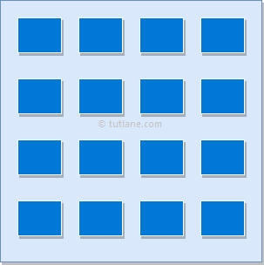
Pictorial representation of GridView

Slide 43
activity_main.xml
<?xml version="1.0" encoding="utf-8"?>
<GridView xmlns:android="http://schemas.android.com/apk/res/android"
android:id="@+id/gridview"
android:layout_width="match_parent"
android:layout_height="match_parent"
android:columnWidth="110dp"
android:numColumns="auto_fit"
android:verticalSpacing="10dp"
android:horizontalSpacing="10dp"
android:stretchMode="columnWidth"
android:gravity="center" />

Slide 44
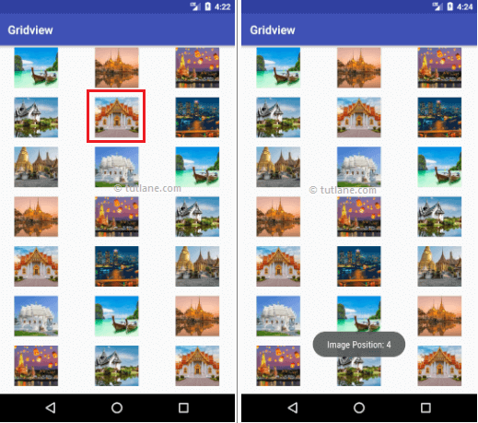
GridView Layout

Slide 45
Android WebView
WebView is an extension of View class and it is used to show the static HTML web pages content or remote web pages content with URL in android applications as a part of our activity layout.
Generally, in android, WebView will act as an embedded browser to include the web pages content in our activity layout and it won’t contain any features of normal browsers, such as address bar, navigation controls, etc.
Generally, in android WebView is useful to include and show the content of other web pages or application content in our required pages, such as an end-user agreements, etc.

Slide 46
activity_main.xml
<?xml version="1.0" encoding="utf-8"?>
<WebView xmlns:android="http://schemas.android.com/apk/res/android"
android:id="@+id/webview"
android:layout_width="fill_parent"
android:layout_height="fill_parent" />

Slide 47
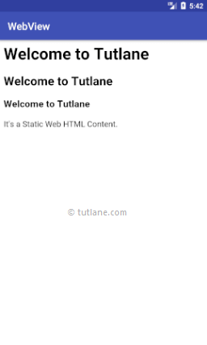
Sample output

