Slide 1
Android UI Controls
In android UI or input controls are the interactive or View components that are used to design the user interface of an application. In android we have a wide variety of UI or input controls available, those are TextView, EditText, Buttons, Checkbox, Progressbar, Spinners, etc.

Slide 2
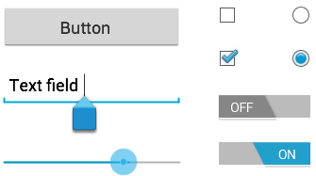

Slide 3
TextView Control
In android, TextView is a user interface control that is used to set and display the text to the user based on our requirements. The TextView control will act as like label control and it won’t allow users to edit the text.
In android, we can create a TextView control in two ways either in XML layout file or create it in Activity file programmatically.

Slide 4
Create a TextView in Layout File
<?xml version="1.0" encoding="utf-8"?>
<LinearLayout xmlns:android="http://schemas.android.com/apk/res/android"
android:layout_width="match_parent"
android:layout_height="match_parent"
android:orientation="vertical">
<TextView
android:id="@+id/textView1"
android:layout_width="match_parent"
android:layout_height="wrap_content"
android:layout_marginBottom="10dp"
android:text="Welcome to Tutlane"
android:textColor="#86AD33"
android:textSize="20dp"
android:textStyle="bold" />
</LinearLayout>

Slide 5
Create a TextView in Activity File
public class MainActivity extends AppCompatActivity {
@Override
protected void onCreate(Bundle savedInstanceState) {
super.onCreate(savedInstanceState);
setContentView(R.layout.activity_main);
LinearLayout linearLayout = (LinearLayout) findViewById(R.id.linearlayout);
TextView textView = new TextView(this);
textView.setText("Welcome to Tutlane");
linearLayout.addView(textView);
}
}

Slide 6
Android TextView Attributes
Attribute | Description
android: id | It is used to uniquely identify the control
android:autoLink | It will automatically found and convert URLs and email addresses as clickable links.
android: ems | It is used to make the textview be exactly this many ems wide.
android:hint | It is used to display the hint text when text is empty
android:width | It makes the TextView be exactly this many pixels wide.
android:height | It makes the TextView be exactly this many pixels tall.
android:text | It is used to display the text.
android:textColor | It is used to change the color of the text.

Slide 7
Android TextView Attributes
Attribute | Description
android:gravity | It is used to specify how to align the text by the view's x and y-axis.
android:maxWidth | It is used to make the TextView be at most this many pixels wide.
android:minWidth | It is used to make the TextView be at least this many pixels wide.
android:textSize | It is used to specify the size of the text.
android:textStyle | It is used to change the style (bold, italic, bolditalic) of text.
android:textAllCaps | It is used to present the text in all CAPS
android:typeface | It is used to specify the Typeface (normal, sans, serif, monospace) for the text.
android:textColor | It is used to change the color of the text.

Slide 8
Android TextView Attributes
Attribute | Description
android:textColorHighlight | It is used to change the color of text selection highlight.
android:textColorLink | It is used to change the text color of links.
android:inputType | It is used to specify the type of text being placed in text fields.
android:fontFamily | It is used to specify the fontFamily for the text.
android:editable | If we set, it specifies that this TextView has an input method.

Slide 9
TextView
TextView is a simple widget that is seen in every android application. This widget is used to display simple text within the android application. We can add custom styling to the text that we have to show. We will take a look at How to create a simple Text View in an android application.

Slide 10
Step by Step Implementation
Step 1: Create a New Project in Android Studio
Step 2: Working with the activity_main.xml file
Navigate to app > res > layout > activity_main.xml and add the code below. Comments are added in the code to get to know in detail.

Slide 11
<?xml version="1.0" encoding="utf-8"?>
<RelativeLayout
xmlns:android="http://schemas.android.com/apk/res/android"
xmlns:tools="http://schemas.android.com/tools"
android:id="@+id/idRLContainer"
android:layout_width="match_parent"
android:layout_height="match_parent"
android:orientation="vertical"
tools:context=".MainActivity">

Slide 12
<!--on below line we are creating a text for our app-->
<TextView
android:id="@+id/idTVHeading"
android:layout_width="match_parent"
android:layout_height="wrap_content"
android:layout_above="@id/idTVMsg"
android:layout_centerInParent="true"
android:layout_margin="20dp"
android:gravity="center"
android:padding="10dp"
android:text="TextView in Android"
android:textAlignment="center"
android:textColor="@color/black"
android:textSize="20sp"
android:textStyle="bold" />

Slide 13
<!--on below line we are creating a text view-->
<TextView
android:id="@+id/idTVMsg"
android:layout_width="match_parent"
android:layout_height="wrap_content"
android:layout_centerInParent="true"
android:layout_margin="20dp"
android:gravity="center"
android:padding="10dp"
android:textAlignment="center"
android:textColor="@color/black"
android:textSize="20sp"
android:textStyle="bold" />
</RelativeLayout>

Slide 14
Step 3: Working with the MainActivity file
Navigate to app > java > your app’s package name > MainActivity file and add the below code to it.

Slide 15
package com.gtappdevelopers.kotlingfgproject
import android.os.Bundle
import android.widget.TextClock
import android.widget.TextView
import androidx.appcompat.app.AppCompatActivity
class MainActivity : AppCompatActivity() {
// on below line we are creating a variable.
lateinit var msgTV: TextView
override fun onCreate(savedInstanceState: Bundle?) {
super.onCreate(savedInstanceState)
setContentView(R.layout.activity_main)
// on below line we are initializing our variables.
msgTV = findViewById(R.id.idTVMsg)
// on below line we are setting message for our text view.
msgTV.text = "Welcome to Geeks for Geeks"
}
}

Slide 16
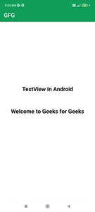
Output

Slide 17
Android EditText
EditText is a user interface control which is used to allow the user to enter or modify the text. While using EditText control in our android applications, we need to specify the type of data the text field can accept using the inputType attribute.
EditText is used to get input from the user. EditText is commonly used in forms and login or registration screens.
In android, EditText control is an extended version of TextView control with additional features and it is used to allow users to enter input values.
In android, we can create EditText control in two ways either in XML layout file or create it in Activity file programmatically.

Slide 18
Different attributes of EditText widgets
XML Attributes | Description
android:id | Used to uniquely identify the control
android:gravity | Used to specify how to align the text like left, right, center, top, etc.
android:hint | Used to display the hint text when text is empty
android:text | Used to set the text of the EditText
android:textSize | Used to set size of the text.
android:textColor | Used to set color of the text.

Slide 19
Different attributes of EditText widgets
XML Attributes | Description
android:textStyle | Used to set style of the text. For example, bold, italic, bolditalic etc.
android:textAllCaps | Used this attribute to show the text in capital letters.
android:width | It makes the TextView be exactly this many pixels wide.
android:height | It makes the TextView be exactly this many pixels tall.
android:maxWidth | Used to make the TextView be at most this many pixels wide.
android:minWidth | Used to make the TextView be at least this many pixels wide.

Slide 20
Different attributes of EditText widgets
XML Attributes | Description
android:background | Used to set background to this View.
android:backgroundTint | Used to set tint to the background of this view.
android:clickable | Used to set true when you want to make this View clickable. Otherwise, set false.
android:drawableBottom | Used to set drawable to bottom of the text in this view.
android:drawableEnd | Used to set drawable to end of the text in this view.
android:drawableLeft | Used to set drawable to left of the text in this view.

Slide 21
Different attributes of EditText widgets
XML Attributes | Description
android:drawablePadding | Used to set padding to drawable of the view.
android:drawableRight | Used to set drawable to right of the text in this view.
android:drawableStart | Used to set drawable to start of the text in this view.
android:drawableTop | Used to set drawable to top of the text in this view.
android:elevation | Used to set elevation to this view.

Slide 22
Step 1: Open activity_main.xml file and create an EditText using id editText.
<?xml version="1.0" encoding="utf-8"?>
<LinearLayout
xmlns:android="http://schemas.android.com/apk/res/android"
xmlns:tools="http://schemas.android.com/tools"
android:orientation="vertical"
android:layout_width="match_parent"
android:layout_height="match_parent"
tools:context=".MainActivity">
<!--EditText with id editText-->
<EditText
android:id="@+id/editText"
android:layout_width="match_parent"
android:layout_height="wrap_content"
android:layout_margin="16dp"
android:hint="Input"
android:inputType="text"/>
</LinearLayout>

Slide 23
Step 2: In activity_main.xml file add code to show a button. Final activity_main.xml file is
<?xml version="1.0" encoding="utf-8"?>
<LinearLayout
xmlns:android="http://schemas.android.com/apk/res/android"
xmlns:tools="http://schemas.android.com/tools"
android:orientation="vertical"
android:layout_width="match_parent"
android:layout_height="match_parent"
tools:context=".MainActivity">
<!--EditText with id editText-->
<EditText
android:id="@+id/editText"
android:layout_width="match_parent"
android:layout_height="wrap_content"
android:layout_margin="16dp"
android:hint="Input"
android:inputType="text"/>
<!--Button with id showInput-->
<Button
android:id="@+id/showInput"
android:layout_width="wrap_content"
android:layout_height="wrap_content"
android:layout_gravity="center_horizontal“
android:text="show"
android:backgroundTint="@color/colorPrimary"
android:textColor="@android:color/white"/>
</LinearLayout>

Slide 24
Step 3: Open MainActivity.kt file and get the reference of Button and EditText defined in the layout file.
package com.geeksforgeeks.myfirstkotlinapp
import androidx.appcompat.app.AppCompatActivity
import android.os.Bundle
import android.widget.Button
import android.widget.EditText
import android.widget.Toast
class MainActivity : AppCompatActivity() {
override fun onCreate(savedInstanceState: Bundle?) {
super.onCreate(savedInstanceState)
setContentView(R.layout.activity_main)
// finding the button
val showButton = findViewById<Button>(R.id.showInput)
// finding the edit text
val editText = findViewById<EditText>(R.id.editText)
// Setting On Click Listener
showButton.setOnClickListener {
// Getting the user input
val text = editText.text
// Showing the user input
Toast.makeText(this, text,Toast.LENGTH_SHORT).show()
}
}
}

Slide 25
AndroidManifest.xml file
<?xml version="1.0" encoding="utf-8"?>
<manifest xmlns:android="http://schemas.android.com/apk/res/android"
package="com.geeksforgeeks.myfirstkotlinapp">
<application
android:allowBackup="true"
android:icon="@mipmap/ic_launcher"
android:label="@string/app_name"
android:roundIcon="@mipmap/ic_launcher_round"
android:supportsRtl="true"
android:theme="@style/AppTheme">
<activity android:name=".MainActivity">
<intent-filter>
<action android:name="android.intent.action.MAIN" />
<category android:name="android.intent.category.LAUNCHER" />
</intent-filter>
</activity>
</application>
</manifest>

Slide 26
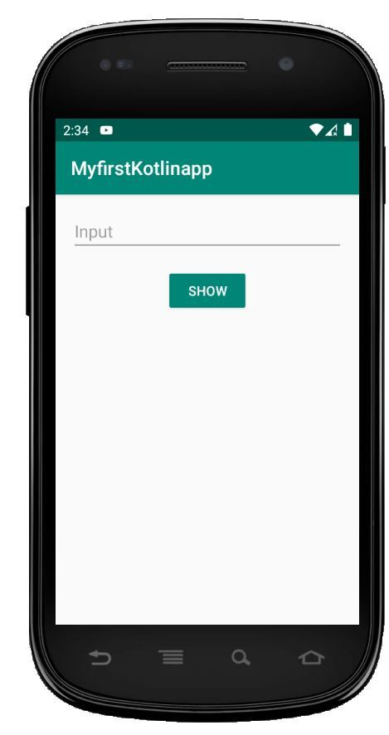
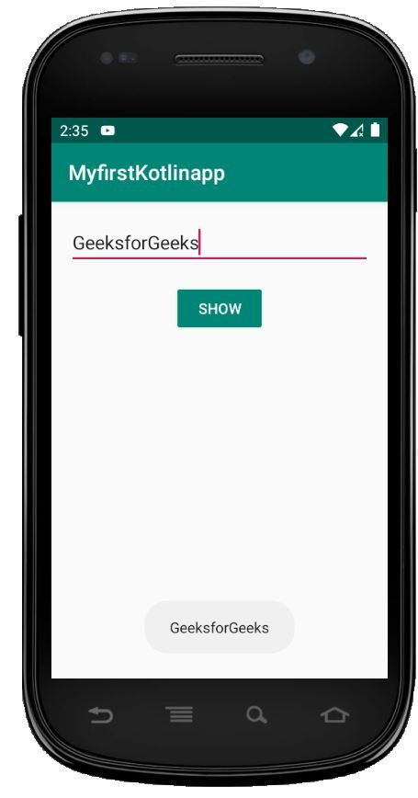
Output

Slide 27
Button in Android
In Android applications, a Button is a user interface that is used to perform some action when clicked or tapped. It is a very common widget in Android and developers often use it. This article demonstrates how to create a button in Android Studio.

Slide 28
XML Attributes of Button Widget
XML Attributes | Description
android:id | Used to specify the id of the view.
android:text | Used to the display text of the button.
android:textColor | Used to the display color of the text.
android:textSize | Used to the display size of the text.
android:textStyle | Used to the display style of the text like Bold, Italic, etc.

Slide 29
XML Attributes of Button Widget
XML Attributes | Description
android:textAllCaps | Used to display text in Capital letters.
android:background | Used to set the background of the view.
android:padding | Used to set the padding of the view.
android:visibility | Used to set the visibility of the view.
android:gravity | Used to specify the gravity of the view like center, top, bottom, etc

Slide 30
Example
In this example step by step demonstration of creating a Button will be covered. The application will consist of a button that displays a toast message when the user taps on it.
Step 1: Create a new project
Click on File, then New => New Project.
Choose “Empty Activity” for the project template.
Select language as Kotlin.
Select the minimum SDK as per your need.

Slide 31
Step 2: Modify the strings.xml file
Navigate to the strings.xml file under the “values” directory of the resource folder. This file will contain all strings that are used in the Application. Below is the appropriate code.
strings.xml
<resources>
<string name="app_name">GfG | Button In Kotlin</string>
<string name="btn">Button</string>
<string name="message">Hello Geeks!! This is a Button.</string>
</resources>

Slide 32
Step 3: Modify the activity_main.xml file
Add a button widget in the layout of the activity. Below is the code of the activity_main.xml
<?xml version="1.0" encoding="utf-8"?>
<androidx.constraintlayout.widget.ConstraintLayout
xmlns:android="http://schemas.android.com/apk/res/android"
xmlns:app="http://schemas.android.com/apk/res-auto"
xmlns:tools="http://schemas.android.com/tools"
android:layout_width="match_parent"
android:layout_height="match_parent"
android:background="#168BC34A"
tools:context=".MainActivity">

Slide 33
<!-- Button added in the activity -->
<Button
android:id="@+id/button"
android:layout_width="wrap_content"
android:layout_height="wrap_content"
android:background="#4CAF50"
android:paddingStart="10dp"
android:paddingEnd="10dp"
android:text="@string/btn"
android:textColor="@android:color/background_light"
android:textSize="24sp"
app:layout_constraintBottom_toBottomOf="parent"
app:layout_constraintEnd_toEndOf="parent"
app:layout_constraintStart_toStartOf="parent"
app:layout_constraintTop_toTopOf="parent" />
</androidx.constraintlayout.widget.ConstraintLayout>

Slide 34
Step 4: Accessing the button in the MainActivity file
import androidx.appcompat.app.AppCompatActivity
import android.os.Bundle
import android.widget.Button
import android.widget.Toast
class MainActivity : AppCompatActivity() {
override fun onCreate(savedInstanceState: Bundle?) {
super.onCreate(savedInstanceState)
setContentView(R.layout.activity_main)
// storing ID of the button in a variable
val button = findViewById<Button>(R.id.button)
// operations to be performed when user tap on the button
button?.setOnClickListener()
{
// displaying a toast message
Toast.makeText(this@MainActivity, R.string.message, Toast.LENGTH_LONG).show() }
}
}

Slide 35
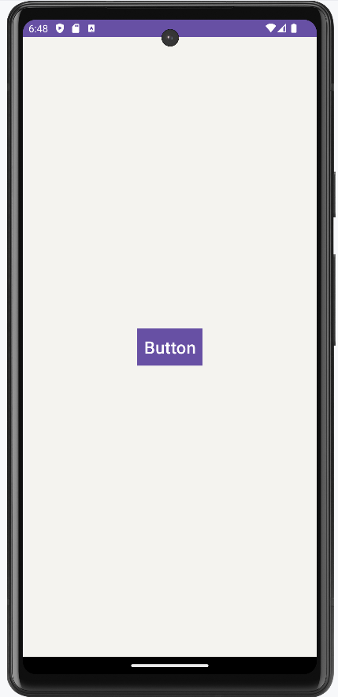
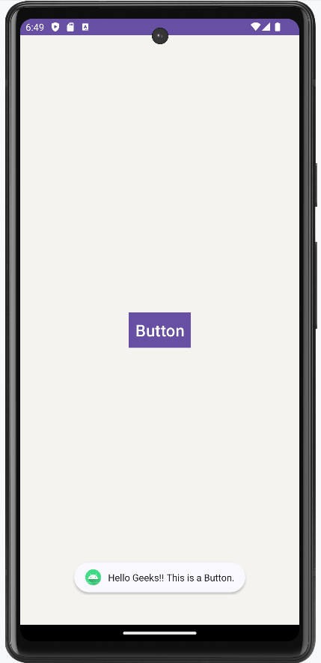
Output

Slide 36
RecyclerView
A RecyclerView is an advanced version of ListView with improved performance. When you have a long list of items to show you can use RecyclerView. It has the ability to reuse its views. In RecyclerView when the View goes out of the screen or not visible to the user it won’t destroy it, it will reuse these views. This feature helps in reducing power consumption and providing more responsiveness to the application. Now let’s see how to implement RecyclerView using Kotlin.

Slide 37
Step by Step Implementation
Step 1: Create a New Project
On the Welcome screen of Android Studio, click on Create New Project. If you have a project already opened, Go to File > New > New Project. Then select a Project Template window, select Empty Activity and click Next. Enter your App Name in the Name field. Select Kotlin from the Language drop-down menu.

Slide 38
Step 2: Add the Dependencies
Go to app < Gradle Scripts < gradle.build(Module: app) and add the following dependencies.
dependencies{
// for adding recyclerview
implementation 'androidx.recyclerview:recyclerview:1.2.0'
// for adding cardview
implementation 'androidx.cardview:cardview:1.0.0'
}

Slide 39
Step 3: Go to activity_main.xml and add the following code
Add RecyclerView to activity_main.xml you can add it from the drag and drop from the design section or you can add it manually by writing some initial characters of RecyclerView then the IDE will give you suggestions for RecyclerView then select RecyclerView it will automatically add it to your layout file.

Slide 40
<?xml version="1.0" encoding="utf-8"?>
<LinearLayout
xmlns:android="http://schemas.android.com/apk/res/android"
xmlns:tools="http://schemas.android.com/tools"
android:layout_width="match_parent"
android:layout_height="match_parent"
android:orientation="vertical"
tools:context=".MainActivity">
<androidx.recyclerview.widget.RecyclerView
android:id="@+id/recyclerview"
android:layout_width="match_parent"
android:layout_height="match_parent"
tools:itemCount="5"
tools:listitem="@layout/card_view_design" />
</LinearLayout>

Slide 41
Step 4: Create a New Layout Resource File
Now create a new Layout Resource File which will be used to design our CardView layout. Go to app > res > layout > right-click on layout > New > Layout Resource File and name that file as card_view_design and add the code provided below. In this file, you can design the layout to show it into the RecyclerView.
<?xml version="1.0" encoding="utf-8"?>
<androidx.cardview.widget.CardView
xmlns:android="http://schemas.android.com/apk/res/android"
xmlns:app="http://schemas.android.com/apk/res-auto"
android:layout_width="match_parent"
android:layout_height="50dp"
android:layout_margin="10dp"
app:cardElevation="6dp">

Slide 42
<LinearLayout
android:layout_width="match_parent"
android:layout_height="wrap_content"
android:orientation="horizontal"
android:padding="5dp">
<ImageView
android:id="@+id/imageview"
android:layout_width="40dp"
android:layout_height="40dp" />
<TextView
android:id="@+id/textView"
android:layout_width="wrap_content"
android:layout_height="wrap_content"
android:layout_marginStart="10dp"
android:layout_marginLeft="15dp"
android:text="Item"
android:textSize="20sp"
android:textStyle="bold" />
</LinearLayout>
</androidx.cardview.widget.CardView>

Slide 43
Step 5: Create a new Kotlin class
Go to app > java > package name > right-click > New > Kotlin class/file and choose Data class from the list. Name that file as ItemsViewModel and then click on OK. This file will hold the information of every item which you want to show in your RecyclerView.
data class ItemsViewModel(val image: Int, val text: String) {
}

Slide 44
Step 6: Create Adapter Class
Go to app > java > package name > right-click > New > Kotlin class/file and name that file as CustomAdapter and then click on OK. After this add the code provided below. Comments are added inside the code to understand the code in more detail.
This class contains some important functions to work with the RecyclerView these are as follows:
onCreateViewHolder(): This function sets the views to display the items.
onBindViewHolder(): This function is used to bind the list items to our widgets such as TextView, ImageView, etc.
getItemCount(): It returns the count of items present in the list.

Slide 45
import android.view.LayoutInflater
import android.view.View
import android.view.ViewGroup
import android.widget.ImageView
import android.widget.TextView
import androidx.recyclerview.widget.RecyclerView
class CustomAdapter(private val mList: List<ItemsViewModel>) : RecyclerView.Adapter<CustomAdapter.ViewHolder>() {
// create new views
override fun onCreateViewHolder(parent: ViewGroup, viewType: Int): ViewHolder {
// inflates the card_view_design view that is used to hold list item
val view = LayoutInflater.from(parent.context) .inflate(R.layout.card_view_design, parent, false)
return ViewHolder(view)
}
}

Slide 46
// binds the list items to a view
override fun onBindViewHolder(holder: ViewHolder, position: Int) {
val ItemsViewModel = mList[position]
// sets the image to the imageview from our itemHolder class
holder.imageView.setImageResource(ItemsViewModel.image)
// sets the text to the textview from our itemHolder class
holder.textView.text = ItemsViewModel.text
}
// return the number of the items in the list
override fun getItemCount(): Int {
return mList.size
}
// Holds the views for adding it to image and text
class ViewHolder(ItemView: View) : RecyclerView.ViewHolder(ItemView) {
val imageView: ImageView = itemView.findViewById(R.id.imageview)
val textView: TextView = itemView.findViewById(R.id.textView)
}

Slide 47
Step 7: Working with the MainActivity.kt
import android.os.Bundle
import androidx.appcompat.app.AppCompatActivity
import androidx.recyclerview.widget.LinearLayoutManager
import androidx.recyclerview.widget.RecyclerView
class MainActivity : AppCompatActivity() {
override fun onCreate(savedInstanceState: Bundle?) {
super.onCreate(savedInstanceState)
setContentView(R.layout.activity_main)
// getting the recyclerview by its id
val recyclerview = findViewById<RecyclerView>(R.id.recyclerview)
// this creates a vertical layout Manager
recyclerview.layoutManager = LinearLayoutManager(this)
// ArrayList of class ItemsViewModel
val data = ArrayList<ItemsViewModel>()

Slide 48
// This loop will create 20 Views containing
// the image with the count of view
for (i in 1..20) {
data.add(ItemsViewModel(R.drawable.ic_baseline_folder_24, "Item " + i))
}
// This will pass the ArrayList to our Adapter
val adapter = CustomAdapter(data)
// Setting the Adapter with the recyclerview
recyclerview.adapter = adapter
}
}

Slide 49
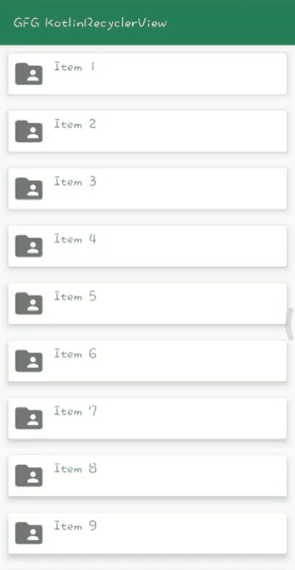
Output

