Slide 1
Week 5
Designing UI with standard views – The Android Widhet Tool – Optional: Custom views.
Examine Android Views.
Implement Menus in Android Apps
Implement Check boxes, RadioGroup & RadioButton, ToggleButton, ImageButton, Spinner, Progress Indicators
Defining UI elements
Event Handling
Handling threads

Slide 2
CheckBox
A CheckBox is a special kind of button in Android which has two states either checked or unchecked. There are many uses of the CheckBox widget like offering a list of options to the user to choose from and the options are mutually exclusive i.e., the user can select more than one option. This feature of the CheckBox makes it a better option to be used in designing multiple-choice questions application or survey application in android.

Slide 3
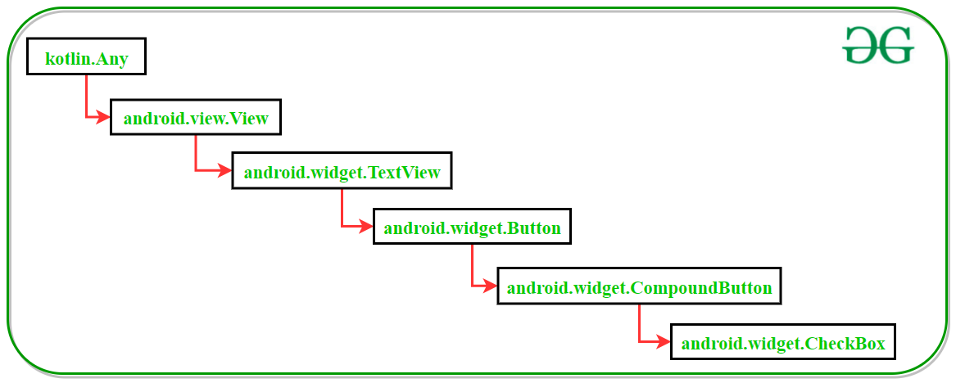
Class hierarchy of CheckBox class in Kotlin

Slide 4
XML attributes of CheckBox widget
XML Attributes | Description
android:id | Used to uniquely identify a CheckBox
android:checked | To set the default state of a CheckBox as checked or unchechek
android:background | To set the background color of a CheckBox
android:text | Used to store a text inside the CheckBox
android:fontFamily | To set the font of the text of the CheckBox

Slide 5
XML attributes of CheckBox widget
XML Attributes | Description
android:textSize | To set the CheckBox text size
android:layout_width | To set the CheckBox width
android:layout_height | To set the CheckBox height
android:gravity | Used to adjust the CheckBox text alignment
android:padding | Used to adjust the left, right, top and bottom padding of the CheckBox

Slide 6
MainActivity.kt
package com.example.mycheckbox
import androidx.appcompat.app.AppCompatActivity
import android.os.Bundle
import android.widget.Button
import android.widget.Toast
class MainActivity : AppCompatActivity() {
override fun onCreate(savedInstanceState: Bundle?) {
super.onCreate(savedInstanceState)
setContentView(R.layout.activity_main)
val button : Button = findViewById(R.id.submitButton)
// Actions to be performed when Submit button is clicked
button.setOnClickListener{
Toast.makeText(this, "Your response has been recorded", Toast.LENGTH_LONG).show()
}
}
}

Slide 7
activity_main.xml
<?xml version="1.0" encoding="utf-8"?>
<androidx.constraintlayout.widget.ConstraintLayout
xmlns:android="http://schemas.android.com/apk/res/android"
xmlns:app="http://schemas.android.com/apk/res-auto"
xmlns:tools="http://schemas.android.com/tools"
android:layout_width="match_parent"
android:layout_height="match_parent"
android:background="#168BC34A"
tools:context=".MainActivity" >

Slide 8
<TextView
android:id="@+id/textView"
android:layout_width="wrap_content"
android:layout_height="wrap_content"
android:text="@string/Heading"
android:textAlignment="center"
android:textColor="@android:color/holo_green_dark"
android:textSize="36sp"
android:textStyle="bold"
app:layout_constraintBottom_toBottomOf="parent"
app:layout_constraintEnd_toEndOf="parent"
app:layout_constraintStart_toStartOf="parent"
app:layout_constraintTop_toTopOf="parent"
app:layout_constraintVertical_bias="0.17000002" />

Slide 9
<LinearLayout
android:id="@+id/checkBox_container"
android:layout_width="0dp"
android:layout_height="wrap_content"
android:orientation="vertical"
app:layout_constraintBottom_toBottomOf="parent"
app:layout_constraintEnd_toEndOf="parent"
app:layout_constraintStart_toStartOf="parent"
app:layout_constraintTop_toBottomOf="@+id/textView"
app:layout_constraintVertical_bias="0.18">
<CheckBox
android:id="@+id/checkBox"
android:layout_width="match_parent"
android:layout_height="wrap_content"
android:text="@string/checkBox1_text"
android:textSize="18sp"
android:padding="7dp"/>

Slide 10
<CheckBox
android:id="@+id/checkBox2"
android:layout_width="match_parent"
android:layout_height="wrap_content"
android:text="@string/checkBox2_text"
android:textSize="18sp"
android:padding="7dp"/>
<CheckBox
android:id="@+id/checkBox3"
android:layout_width="match_parent"
android:layout_height="wrap_content"
android:text="@string/checkBox3_text"
android:textSize="18sp"
android:padding="7dp"/>

Slide 11
</LinearLayout>
<Button
android:id="@+id/submitButton"
android:layout_width="wrap_content"
android:layout_height="wrap_content"
android:background="#AB4CAF50"
android:text="@string/submitButton"
android:textSize="18sp"
android:textStyle="bold"
app:layout_constraintBottom_toBottomOf="parent"
app:layout_constraintEnd_toEndOf="parent"
app:layout_constraintStart_toStartOf="parent"
app:layout_constraintTop_toBottomOf="@+id/checkBox_container"
app:layout_constraintVertical_bias="0.23000002" />
</androidx.constraintlayout.widget.ConstraintLayout>

Slide 12
strings.xml
<resources>
<string name="app_name">CheckBox in Kotlin</string>
<string name="Heading">Services provided by GeeksforGeeks</string>
<string name="checkBox1">Coding contests</string>
<string name="checkBox2_text">Civil Engineering Courses</string>
<string name="checkBox1_text">Coding Contests</string>
<string name="checkBox3_text">Computer Science Courses</string>
<string name="submitButton">SUBMIT</string>
</resources>

Slide 13
AndroidManifest.xml
<?xml version="1.0" encoding="utf-8"?>
<manifest xmlns:android="http://schemas.android.com/apk/res/android"
xmlns:tools="http://schemas.android.com/tools"
package="com.example.mycheckbox">
<application
android:allowBackup="true"
android:exported="true"
android:icon="@mipmap/ic_launcher"
android:label="@string/app_name"
android:roundIcon="@mipmap/ic_launcher_round"
android:supportsRtl="true"
android:theme="@style/Theme.AppCompat"
tools:ignore="WrongManifestParent">
<activity android:name="MainActivity"
android:exported="true">
<intent-filter>
<action android:name="android.intent.action.MAIN" />
<category android:name="android.intent.category.LAUNCHER" />
</intent-filter>
</activity>
</application>
</manifest>

Slide 14
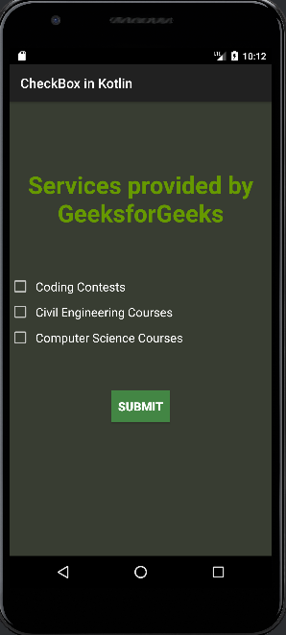
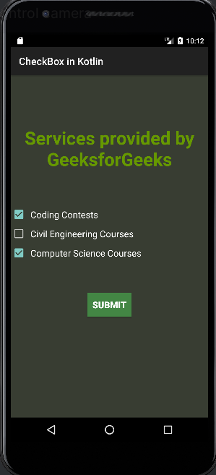
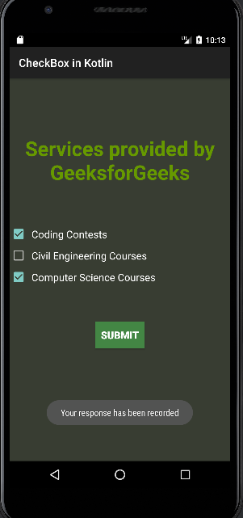

Slide 15
RadioButton
Android Radio Button is bi-state button which can either be checked or unchecked.
Generally, we use RadioButton controls to allow users to select one option from multiple options.
By default, the RadioButton in OFF(Unchecked) state but we can change the default state of RadioButton by using android:checked attribute.

Slide 16
XML attributes of RadioButton widget
XML Attributes | Description
android:id | Used to uniquely identify the control
android:gravity | Used to specify how to align the text like left, right, center, top, etc.
android:checked | Used to specify the current state of radio button
android:onClick | It’s a name of the method to invoke when the radio button clicked.
android:textSize | Used to set size of the text.

Slide 17
XML attributes of RadioButton widget
XML Attributes | Description
android:textColor | Used to set color of the text.
android:textStyle | Used to set style of the text. For example, bold, italic, bolditalic etc.
android:maxWidth | Used to make the view be at most this many pixels wide.
android:minWidth | Used to make the view be at least this many pixels wide.
android:background | Used to set the background of the radio button control.
android:visibility | Used to control the visibility.

Slide 18
activity_main.xml
<?xml version="1.0" encoding="utf-8"?>
<LinearLayout xmlns:android="http://schemas.android.com/apk/res/android"
xmlns:tools="http://schemas.android.com/tools"
android:layout_width="match_parent"
android:layout_height="match_parent"
android:orientation="vertical"
android:padding="16dp"
tools:context=".MainActivity">

Slide 19
<RadioGroup
android:id="@+id/radioGroup"
android:layout_width="wrap_content"
android:layout_height="wrap_content"
android:orientation="vertical">
<RadioButton
android:id="@+id/radioOption1"
android:layout_width="wrap_content"
android:layout_height="wrap_content"
android:text="Option 1" />
<RadioButton
android:id="@+id/radioOption2"
android:layout_width="wrap_content"
android:layout_height="wrap_content"
android:text="Option 2" />
<RadioButton
android:id="@+id/radioOption3"
android:layout_width="wrap_content"
android:layout_height="wrap_content"
android:text="Option 3" />
</RadioGroup>
<Button
android:id="@+id/submitBtn"
android:layout_width="wrap_content"
android:layout_height="wrap_content"
android:text="Submit" />
</LinearLayout>

Slide 20
MainActivity.kt
package com.example.myradiobutton
import android.os.Bundle
import android.widget.Button
import android.widget.RadioButton
import android.widget.RadioGroup
import android.widget.Toast
import androidx.appcompat.app.AppCompatActivity
class MainActivity : AppCompatActivity() {
private lateinit var radioGroup: RadioGroup
private lateinit var submitBtn: Button
override fun onCreate(savedInstanceState: Bundle?) {
super.onCreate(savedInstanceState)
setContentView(R.layout.activity_main)
radioGroup = findViewById(R.id.radioGroup)
submitBtn = findViewById(R.id.submitBtn)
submitBtn.setOnClickListener {
val selectedOptionId = radioGroup.checkedRadioButtonId
if (selectedOptionId == -1) {
Toast.makeText(this@MainActivity, "Please select an option", Toast.LENGTH_SHORT).show()
} else {
val selectedRadioButton = findViewById<RadioButton>(selectedOptionId)
val selectedOption = selectedRadioButton.text
Toast.makeText(this@MainActivity, "Selected option: $selectedOption", Toast.LENGTH_SHORT).show()
}
}
}
}

Slide 21
AndroidManifest.xml
<?xml version="1.0" encoding="utf-8"?>
<manifest xmlns:android="http://schemas.android.com/apk/res/android"
package="com.example.myradiobutton">
<application
android:allowBackup="true"
android:exported="true"
android:icon="@mipmap/ic_launcher"
android:label="@string/app_name"
android:roundIcon="@mipmap/ic_launcher_round"
android:supportsRtl="true"
android:theme="@style/Theme.AppCompat">
<activity
android:name="MainActivity"
android:exported="true">
<intent-filter>
<action android:name="android.intent.action.MAIN" />
<category android:name="android.intent.category.LAUNCHER" />
</intent-filter>
</activity>
</application>
</manifest>

Slide 22
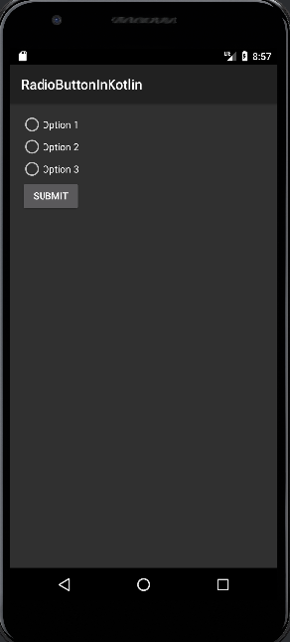
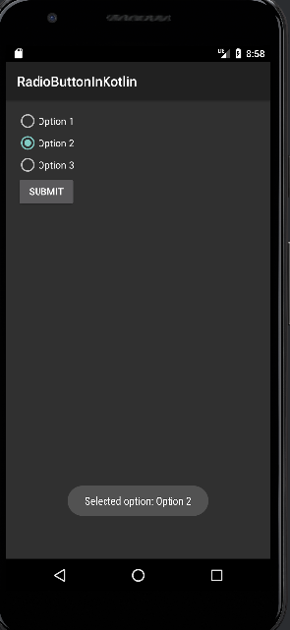

Slide 23
ToggleButton
In Android, the ToggleButton is just like a switch containing two states either ON or OFF which are represented using boolean values true and false respectively. ToggleButton unlike switch does not have a slider interface i.e. we cannot slide to change the states. It is just like a button.

Slide 24
Android ToggleButton XML Attributes
Attribute | Description
android:id | The ID assigned to the toggle button
android:textOff | The text is shown on the button when it is not checked
android:textOn | The text is shown on the button when it is checked
android:disabledAlpha | The alpha (opacity) to apply to the when disabled.

Slide 25
MainActivity.kt
package com.example.mytogglebutton
import androidx.appcompat.app.AppCompatActivity
import android.os.Bundle
import android.widget.Toast
import android.widget.ToggleButton
class MainActivity : AppCompatActivity() {
override fun onCreate(savedInstanceState: Bundle?) {
super.onCreate(savedInstanceState)
setContentView(R.layout.activity_main)
val toggle: ToggleButton = findViewById(R.id.toggleButton)
toggle.setOnCheckedChangeListener { _, isChecked ->
Toast.makeText(this, if(isChecked) "Geek Mode ON" else "Geek Mode OFF", Toast.LENGTH_SHORT).show()
}
}
}

Slide 26
activity_main.xml
<?xml version="1.0" encoding="utf-8"?>
<androidx.constraintlayout.widget.ConstraintLayout
xmlns:android="http://schemas.android.com/apk/res/android"
xmlns:app="http://schemas.android.com/apk/res-auto"
xmlns:tools="http://schemas.android.com/tools"
android:layout_width="match_parent"
android:layout_height="match_parent"
tools:context=".MainActivity">
<ToggleButton
android:id="@+id/toggleButton"
android:layout_width="wrap_content"
android:layout_height="wrap_content"
app:layout_constraintBottom_toBottomOf="parent"
app:layout_constraintEnd_toEndOf="parent"
app:layout_constraintStart_toStartOf="parent"
app:layout_constraintTop_toTopOf="parent" />
</androidx.constraintlayout.widget.ConstraintLayout>

Slide 27
AndroidManifest.xml
<?xml version="1.0" encoding="utf-8"?>
<manifest xmlns:android="http://schemas.android.com/apk/res/android"
xmlns:tools="http://schemas.android.com/tools">
<application
android:allowBackup="true"
android:dataExtractionRules="@xml/data_extraction_rules"
android:fullBackupContent="@xml/backup_rules"
android:icon="@mipmap/ic_launcher"
android:label="@string/app_name"
android:roundIcon="@mipmap/ic_launcher_round"
android:supportsRtl="true"
android:theme="@style/Theme.AppCompat"
tools:targetApi="31">
<activity
android:name="MainActivity"
android:exported="true"
android:label="@string/app_name"
android:theme="@style/Theme.AppCompat">
<intent-filter>
<action android:name="android.intent.action.MAIN" />
<category android:name="android.intent.category.LAUNCHER" />
</intent-filter>
</activity>
</application>
</manifest>

Slide 28
Click here to See The Output

Slide 29
ImageButton
Android ImageButton is a user interface widget which is used to display a button having image and to perform exactly like button when we click on it but here, we add an image on Image button instead of text. There are different types of buttons available in android like ImageButton, ToggleButton etc.
We can add an image to the button simply by using attribute android:src in activity_main.xml file or by using setImageResource() method.

Slide 30
XML Attributes | Description
android:id | Used to uniquely identify the control.
android:src | Used to specify the source file of the image.
android:onClick | Used to Specifies what to do when this button is clicked.
android:visibility | Used to set visibility of the image button.
android:background | Used to set background color of the Image button.
android:maxHeight | Used to set maximum height of the Image button view.
android:maxWidth | Used to set maximum width of the Image button view.
android:padding | Used to set the padding from left, right, top and bottom.

Slide 31
MainActivity.kt
package com.example.myimagebutton
import android.os.Bundle
import androidx.appcompat.app.AppCompatActivity
import android.widget.EditText
import android.widget.ImageButton
import android.widget.Toast
class MainActivity : AppCompatActivity() {
override fun onCreate(savedInstanceState: Bundle?) {
super.onCreate(savedInstanceState)
setContentView(R.layout.activity_main)
val num1 = findViewById<EditText>(R.id.Num1)
val num2 = findViewById<EditText>(R.id.Num2)
val imgbtn = findViewById<ImageButton>(R.id.imageBtn)
imgbtn.setOnClickListener {
if (num1.text.toString().isEmpty() || num2.text.toString().isEmpty()) {
Toast.makeText(this,
"Enter both numbers", Toast.LENGTH_SHORT).show()
}
else {
val num1 = Integer.parseInt(num1.text.toString())
val num2 = Integer.parseInt(num2.text.toString())
Toast.makeText(this,
"Sum of the numbers = " + (num1 + num2),
Toast.LENGTH_SHORT).show()
}
}
}
}

Slide 32
activity_main.xml
<?xml version="1.0" encoding="utf-8"?>
<LinearLayout xmlns:android="http://schemas.android.com/apk/res/android"
android:orientation="vertical"
android:layout_width="match_parent"
android:layout_height="match_parent"
android:id="@+id/linear_layout">
<EditText
android:id="@+id/Num1"
android:layout_width="wrap_content"
android:layout_height="wrap_content"
android:layout_marginLeft="50dp"
android:ems="10"
android:hint= "Enter first number"/>
<EditText
android:id="@+id/Num2"
android:layout_width="wrap_content"
android:layout_height="wrap_content"
android:layout_marginLeft="50dp"
android:ems="10"
android:hint= "Enter second number"/>
<ImageButton
android:id="@+id/imageBtn"
android:layout_width="wrap_content"
android:layout_height="wrap_content"
android:layout_marginLeft="100dp"
android:src="@android:drawable/btn_plus" />
</LinearLayout>

Slide 33
AndroidManifest.xml
<?xml version="1.0" encoding="utf-8"?>
<manifest xmlns:android="http://schemas.android.com/apk/res/android"
xmlns:tools="http://schemas.android.com/tools">
<application
android:allowBackup="true"
android:exported="true"
android:dataExtractionRules="@xml/data_extraction_rules"
android:fullBackupContent="@xml/backup_rules"
android:icon="@mipmap/ic_launcher"
android:label="@string/app_name"
android:roundIcon="@mipmap/ic_launcher_round"
android:supportsRtl="true"
android:theme="@style/Theme.AppCompat"
tools:targetApi="31">
<activity
android:name="MainActivity"
android:exported="true"
android:label="@string/app_name"
android:theme="@style/Theme.AppCompat">
<intent-filter>
<action android:name="android.intent.action.MAIN" />
<category android:name="android.intent.category.LAUNCHER" />
</intent-filter>
</activity>
</application>
</manifest>

Slide 34
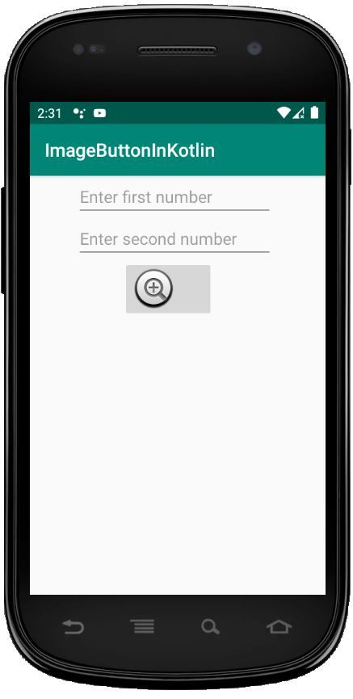
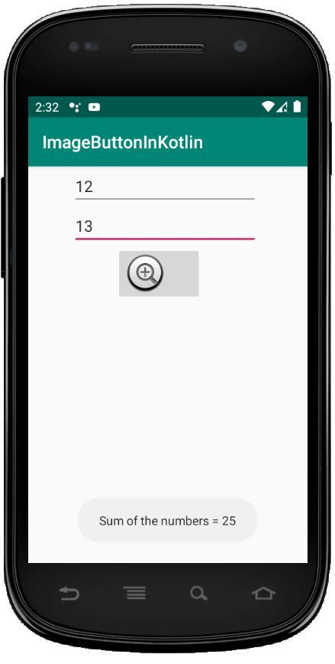

Slide 35
Spinner
Android Spinner is a view similar to a dropdown list which is used to select one option from the list of options. It provides an easy way to select one item from the list of items and it shows a dropdown list of all values when we click on it.
The default value of the android spinner will be the currently selected value and by using the Adapter we can easily bind the items to the spinner objects. Generally, we populate our Spinner control with a list of items by using an ArrayAdapter in our Kotlin file.

Slide 36
XML attributes | Description
android:id | Used to specify the id of the view.
android:textAlignment | Used to the text alignment in the dropdown list.
android:background | Used to set the background of the view.
android:padding | Used to set the padding of the view.
android:visibility | Used to set the visibility of the view.
android:gravity | Used to specify the gravity of the view like center, top, bottom etc

Slide 37
activity_main.xml
<?xml version="1.0" encoding="utf-8"?>
<LinearLayout xmlns:android="http://schemas.android.com/apk/res/android"
android:orientation="vertical"
android:layout_width="match_parent"
android:layout_height="match_parent"
android:id="@+id/linear_layout"
android:gravity = "center">
<TextView
android:id="@+id/txtView"
android:layout_width="wrap_content"
android:layout_height="wrap_content"
android:text="Select language:"
android:textSize = "20dp" />
<Spinner
android:id="@+id/spinner"
android:layout_width="wrap_content"
android:layout_height="wrap_content"
android:layout_alignBottom="@id/txtView"/>
</LinearLayout>

Slide 38
strings.xml
<resources>
<string name="app_name">SpinnerInKotlin</string>
<string name="selected_item">Selected item:</string>
<string-array name="Languages">
<item>Java</item>
<item>Kotlin</item>
<item>Swift</item>
<item>Python</item>
<item>Scala</item>
<item>Perl</item>
</string-array>
</resources>

Slide 39
MainActivity.kt
package com.example.myspinner
import androidx.appcompat.app.AppCompatActivity
import android.os.Bundle
import android.view.View
import android.widget.*
class MainActivity : AppCompatActivity() {
override fun onCreate(savedInstanceState: Bundle?) {
super.onCreate(savedInstanceState)
setContentView(R.layout.activity_main)
val languages = resources.getStringArray(R.array.Languages)
val spinner = findViewById<Spinner>(R.id.spinner)
if (spinner != null) {
val adapter = ArrayAdapter(this, android.R.layout.simple_spinner_item, languages)
spinner.adapter = adapter
spinner.onItemSelectedListener = object : AdapterView.OnItemSelectedListener {
override fun onItemSelected(parent: AdapterView<*>, view: View, position: Int, id: Long) {
Toast.makeText(this@MainActivity, getString(R.string.selected_item) + " " + "" + languages[position],
Toast.LENGTH_SHORT).show()
}
}
}
}
}

Slide 40
AndroidManifest.xml
<?xml version="1.0" encoding="utf-8"?>
<manifest xmlns:android="http://schemas.android.com/apk/res/android"
package="com.example.myspinner">
<application
android:allowBackup="true"
android:exported="true"
android:icon="@mipmap/ic_launcher"
android:label="@string/app_name"
android:roundIcon="@mipmap/ic_launcher_round"
android:supportsRtl="true"
android:theme="@style/Theme.AppCompat">
<activity android:name="MainActivity"
android:exported="true">
<intent-filter>
<action android:name="android.intent.action.MAIN" />
<category android:name="android.intent.category.LAUNCHER" />
</intent-filter>
</activity>
</application>
</manifest>

Slide 41
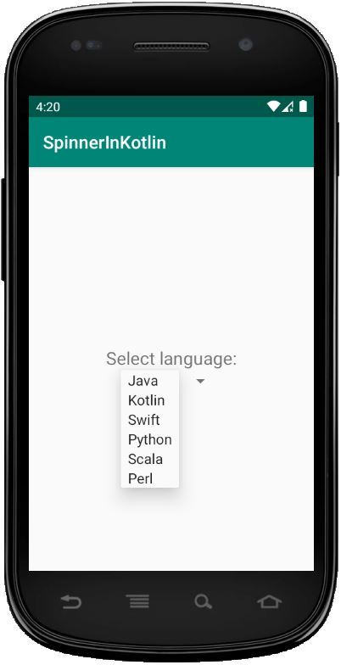
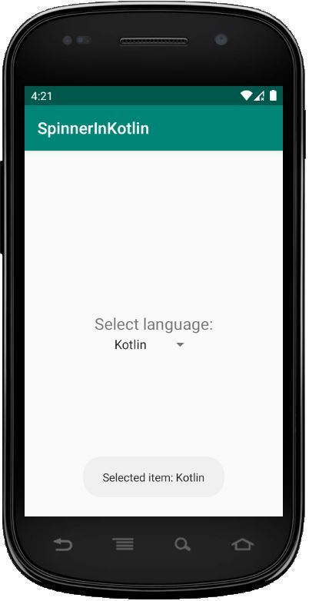

Slide 42
Progress indicators (ProgressBar)
Android ProgressBar is a user interface control that indicates the progress of an operation. For example, downloading a file, uploading a file on the internet we can see the progress bar to estimate the time remaining in operation.
There are two modes of ProgressBar:
Determinate ProgressBar
Indeterminate ProgressBar

Slide 43
Determinate ProgressBar
In common, we use the Determinate progress mode in ProgressBar because it shows the quantity of progress that has occurred like the (%) percentage of the file downloaded, how much data was uploaded or downloaded on the internet, etc. If we have to use determinate we set the style of the progress bar as below:
<ProgressBar
android:id="@+id/pBar"
style="?android:attr/progressBarStyleHorizontal"
android:layout_width="wrap_content"
android:layout_height="wrap_content" />

Slide 44
Indeterminate ProgressBar
Here, we don’t get the idea of the progress of work means how much it has been completed or How long it will take to complete.
We can use indeterminate progressBar like below by setting the indeterminate attribute as true.
<ProgressBar
android:id="@+id/pBar"
style="?android:attr/progressBarStyleHorizontal"
android:layout_width="wrap_content"
android:layout_height="wrap_content"
android:indeterminate="true"/>

Slide 45
XML Attributes | Description
android:id | Used to uniquely identify the control
android:min | Used to set minimum value
android:max | Used to set the maximum value
android:progress | Used to set the default progress integer value between 0 and max.
android:minHeight | Used to set the height of the progress bar.
android:minWidth | Used to set the width of the progress bar.
android:background | Used to set the background color for progress bar
android:indeterminate | Used to enable indeterminate progress mode.

Slide 46
package com.example.myprogressbar
import androidx.appcompat.app.AppCompatActivity
import android.os.Bundle
import android.widget.Button
import android.widget.ProgressBar
import android.widget.TextView
import android.os.Handler
import android.view.View
class MainActivity : AppCompatActivity() {
private var progressBar: ProgressBar? = null
private var i = 0
private var txtView: TextView? = null
private val handler = Handler()
override fun onCreate(savedInstanceState: Bundle?) {
super.onCreate(savedInstanceState)
setContentView(R.layout.activity_main)
// finding progressbar by its id
val progressBar = findViewById<ProgressBar>(R.id.progress_Bar) as ProgressBar
// finding textview by its id
val txtView = findViewById<TextView>(R.id.text_view)
// finding button by its id
val btn = findViewById<Button>(R.id.show_button)

Slide 47
// handling click on button
btn.setOnClickListener {
// setting the progressbar visibility to visible
progressBar.visibility = View.VISIBLE
i = progressBar.progress
Thread(Runnable {
// loop will run until the value of i becomes 99
while (i < 100) {
i += 1
// Update the progress bar and display the current value
handler.post(Runnable {
progressBar.progress = i
// setting current progress to the textview
txtView!!.text = i.toString() + "/" + progressBar.max
})
try {
Thread.sleep(100)
} catch (e: InterruptedException) {
e.printStackTrace()
}
}
// setting the visibility of the progressbar to invisible
// or you can use View.GONE instead of invisible
// View.GONE will remove the progressbar
progressBar.visibility = View.INVISIBLE
}).start()
}
}
}

Slide 48
activity_main.xml
<?xml version="1.0" encoding="utf-8"?>
<RelativeLayout
xmlns:android="http://schemas.android.com/apk/res/android"
xmlns:app="http://schemas.android.com/apk/res-auto"
xmlns:tools="http://schemas.android.com/tools"
android:layout_width="match_parent"
android:layout_height="match_parent"
tools:context=".MainActivity">
<!-- adding progress bar -->
<ProgressBar
android:id="@+id/progress_Bar"
style="?android:attr/progressBarStyle"
android:layout_width="200dp"
android:layout_height="wrap_content"
android:layout_marginLeft="70dp"
android:layout_marginTop="150dp"
android:indeterminate = "true"
android:max="100"
android:minWidth="200dp"
android:minHeight="50dp"
android:visibility="invisible"
android:layout_centerInParent="true"
android:progress="0"
android:layout_marginStart="70dp" />

Slide 49
<!-- adding textview which will show the progress -->
<TextView
android:id="@+id/text_view"
android:layout_width="wrap_content"
android:layout_height="wrap_content"
android:layout_below="@+id/progress_Bar"
android:layout_centerHorizontal="true" />
<!-- adding button to start the progress -->
<Button
android:id="@+id/show_button"
android:layout_width="191dp"
android:layout_height="wrap_content"
android:layout_below="@+id/text_view"
android:layout_marginLeft="70dp"
android:layout_marginTop="20dp"
android:text="Progress Bar"
android:layout_centerHorizontal="true"
android:layout_marginStart="70dp" />
</RelativeLayout>

Slide 50
AndroidManiest.xml
<?xml version="1.0" encoding="utf-8"?>
<manifest xmlns:android="http://schemas.android.com/apk/res/android"
package="com.example.myprogressbar">
<application
android:allowBackup="true"
android:exported="true"
android:icon="@mipmap/ic_launcher"
android:label="@string/app_name"
android:roundIcon="@mipmap/ic_launcher_round"
android:supportsRtl="true"
android:theme="@style/Theme.AppCompat">
<activity android:name="MainActivity"
android:exported="true">
<intent-filter>
<action android:name="android.intent.action.MAIN" />
<category android:name="android.intent.category.LAUNCHER" />
</intent-filter>
</activity>
</application>
</manifest>

Slide 51
Output of ProgressBar

Slide 52
Defining UI Elements
We can define the UI elements (Controls/Views) either in MainActivity.kt programmatically or in activity_main.xml.
When defining in Kotlin code the instance values will be initialized through the object instantiated from the View classes.
When defining using activity_main.xml they are assigned with the attribute values of the UI elements.

Slide 53
Event Handling in Android
Events are the actions performed by the user in order to interact with the application, for e.g. pressing a button or touching the screen.
The events are managed by the android framework in the FIFO manner i.e. First In – First Out.
Handling such actions or events by performing the desired task is called Event Handling.

Slide 54
Overview of the input event management
Event Listeners
Event Handlers
Event Listeners Registration
Touch Mode

Slide 55
Overview of the input event management
Event Listeners: It is an interface in the View class. It contains a single callback method. Once the view to which the listener is associated is triggered due to user interaction, the callback methods are called.
Event Handlers: It is responsible for dealing with the event that the event listeners registered for and performing the desired action for that respective event.

Slide 56
Overview of the input event management
Event Listeners Registration: Event Registration is the process in which an Event Handler gets associated with an Event Listener so that this handler is called when the respective Event Listener fires the event.
Touch Mode: When using an app with physical keys it becomes necessary to give focus to buttons on which the user wants to perform the action but if the device is touch-enabled and the user interacts with the interface by touching it, then it is no longer necessary to highlight items or give focus to particular View. In such cases, the device enters touch mode and in such scenarios, only those views for which the isFocusableInTouchMode() is true will be focusable, e.g. plain text widget.

Slide 57
Event Listeners and their respective event handlers
OnClickListener() – This method is called when the user clicks, touches, or focuses on any view (widget) like Button, ImageButton, Image, etc. Event handler used for this is onClick().
OnLongClickListener() – This method is called when the user presses and holds a particular widget for one or more seconds. Event handler used for this is onLongClick().
OnMenuItemClickListener() – This method is called when the user selects a menu item. Event handler used for this is onMenuItemClick().
OnTouch() – This method is called either for a movement gesture on the screen or a press and release of an on-screen key. Event handler used for this is onTouch().

Slide 58
Menu
In android, the Menu is an important part of the UI component which is used to provide some common functionality around the application. With the help of the menu, users can experience smooth and consistent experiences throughout the application. In Android, we have three types of Menus available to define a set of options and actions in our android applications.
Options Menu
Context Menu
Popup menu

Slide 59
Android Options Menu: Android Options Menu is a primary collection of menu items in an android application and is useful for actions that have a global impact on the search application.
Android Context Menu: Android Context Menu is a floating menu that only appears when the user clicks for a long time on an element and is useful for elements that affect the selected content or context frame.
Android Popup Menu: Android Popup Menu displays a list of items in a vertical list which presents the view that invoked the menu and is useful to provide an overflow of actions related to specific content.

Slide 60
MainActivity.kt
package com.example.mymenu
import android.os.Bundle
import android.view.Menu
import android.view.MenuItem
import androidx.appcompat.widget.Toolbar
import android.widget.Button
import android.widget.PopupMenu
import android.widget.Toast
import androidx.appcompat.app.AppCompatActivity
class MainActivity : AppCompatActivity() {
override fun onCreate(savedInstanceState: Bundle?) {
super.onCreate(savedInstanceState)
setContentView(R.layout.activity_main)
val toolbar:Toolbar=findViewById(R.id.toolbar)
setSupportActionBar(toolbar)
}
override fun onCreateOptionsMenu(menu: android.view.Menu?): kotlin.Boolean {
menuInflater.inflate(R.menu.option_menu_item,menu)
return true
}
override fun onOptionsItemSelected(item: android.view.MenuItem): kotlin.Boolean {
when(item!!.itemId){
R.id.item1 -> Toast.makeText(this@MainActivity,"Item1",Toast.LENGTH_LONG).show()
R.id.item2 -> Toast.makeText(this@MainActivity,"Item2",Toast.LENGTH_LONG).show()
R.id.item3 -> Toast.makeText(this@MainActivity,"Item3",Toast.LENGTH_LONG).show()
}
return true
}
}

Slide 61
activity_main.xml
<?xml version="1.0" encoding="utf-8"?>
<androidx.constraintlayout.widget.ConstraintLayout xmlns:android="http://schemas.android.com/apk/res/android"
xmlns:tools="http://schemas.android.com/tools"
xmlns:app="http://schemas.android.com/apk/res-auto"
android:exported="true"
android:layout_width="match_parent"
android:layout_height="match_parent"
android:orientation="horizontal"
tools:context=".MainActivity">
<TextView
android:id="@+id/textView"
android:layout_width="wrap_content"
android:layout_height="wrap_content"
android:layout_centerInParent="true"
android:text="Options Menu Demo!"
app:layout_constraintBottom_toBottomOf="parent"
app:layout_constraintEnd_toEndOf="parent"
app:layout_constraintStart_toStartOf="parent"
app:layout_constraintTop_toTopOf="parent" />
<com.google.android.material.appbar.AppBarLayout
android:layout_width="match_parent"
android:layout_height="wrap_content"
tools:ignore="MissingConstraints">
</com.google.android.material.appbar.AppBarLayout>
<androidx.appcompat.widget.Toolbar
android:id="@+id/toolbar"
android:layout_width="129dp"
android:layout_height="67dp"
android:background="@color/white"
app:layout_scrollFlags="enterAlways|scroll"
tools:layout_editor_absoluteX="282dp"
tools:layout_editor_absoluteY="42dp" />
</androidx.constraintlayout.widget.ConstraintLayout>

Slide 62
option_menu_item.xml
<?xml version="1.0" encoding="utf-8"?>
<menu xmlns:android="http://schemas.android.com/apk/res/android"
xmlns:app="http://schemas.android.com/apk/res-auto">
<item android:id="@+id/item1"
android:title="Item 1"/>
<item android:id="@+id/item2"
android:title="Item 2"/>
<item android:id="@+id/item3"
android:title="Item 3"/>
</menu>

Slide 63
AndroidManifest.xml
<?xml version="1.0" encoding="utf-8"?>
<manifest xmlns:android="http://schemas.android.com/apk/res/android"
xmlns:tools="http://schemas.android.com/tools">
<application
android:allowBackup="true"
android:exported="true"
android:dataExtractionRules="@xml/data_extraction_rules"
android:fullBackupContent="@xml/backup_rules"
android:icon="@mipmap/ic_launcher"
android:label="@string/app_name"
android:roundIcon="@mipmap/ic_launcher_round"
android:supportsRtl="true"
android:theme="@style/Theme.OptionsMenu"
tools:targetApi="31">
<activity
android:name="MainActivity"
android:exported="true"
android:label="@string/app_name"
android:theme="@style/Theme.OptionsMenu">
<intent-filter>
<action android:name="android.intent.action.MAIN" />
<category android:name="android.intent.category.LAUNCHER" />
</intent-filter>
</activity>
</application>
</manifest>

Slide 64
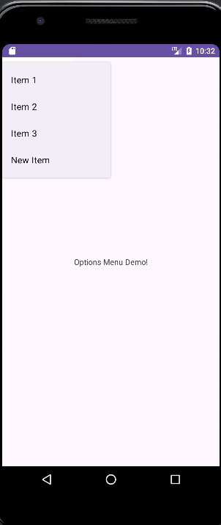
Output

Slide 65
What is the context menu in android ?
Context menu is a short floating menu option which appears when the user long presses on a specific widget on the mobile application. This menu is just like a right click option in windows which is used to perform some quick actions within an android application for a specific widget.

Slide 66
activity_main.xml
<?xml version="1.0" encoding="utf-8"?>
<RelativeLayout xmlns:android="http://schemas.android.com/apk/res/android"
android:layout_width="match_parent"
android:layout_height="match_parent">
<ListView
android:layout_width="match_parent"
android:layout_height="wrap_content"
android:id="@+id/context_list_view"/>
</RelativeLayout>

Slide 67
main_menu.xml
<?xml version="1.0" encoding="utf-8"?>
<menu xmlns:android="http://schemas.android.com/apk/res/android"
xmlns:app="http://schemas.android.com/apk/res-auto">
<item
android:id="@+id/menu_call"
android:showAsAction="always"
android:title="Call" />
<item
android:id="@+id/menu_phone"
android:showAsAction="always"
android:title="Phone" />
<item
android:id="@+id/menu_message"
android:showAsAction="always"
android:title="Message" />
</menu>

Slide 68
package com.example.mycontextmenuexample
import android.os.Bundle
import android.view.ContextMenu
import android.view.MenuItem
import android.view.View
import android.widget.ArrayAdapter
import android.widget.ListView
import android.widget.Toast
import androidx.activity.ComponentActivity
import androidx.activity.compose.setContent
import androidx.activity.enableEdgeToEdge
import androidx.compose.foundation.layout.fillMaxSize
import androidx.compose.foundation.layout.padding
import androidx.compose.material3.Scaffold
import androidx.compose.material3.Text
import androidx.compose.runtime.Composable
import androidx.compose.ui.Modifier
import androidx.compose.ui.tooling.preview.Preview
import com.example.mycontextmenuexample.ui.theme.MyContextMenuExampleTheme
class MainActivity : ComponentActivity() {
private var itemList: Array<String> = arrayOf("Item 1", "Item 2", "Item 3")
private var listView: ListView? = null
private var arrayAdapter: ArrayAdapter<String>? = null
override fun onCreate(savedInstanceState: Bundle?) {
super.onCreate(savedInstanceState)
setContentView(R.layout.activity_main)
listView = findViewById(R.id.context_list_view)
arrayAdapter =
ArrayAdapter(applicationContext, android.R.layout.simple_list_item_1, itemList)
listView?.adapter = arrayAdapter
registerForContextMenu(listView)
}

Slide 69
override fun onCreateContextMenu(
menu: ContextMenu?,
v: View?,
menuInfo: ContextMenu.ContextMenuInfo?
) {
menuInflater.inflate(R.menu.main_menu, menu)
super.onCreateContextMenu(menu, v, menuInfo)
}
override fun onContextItemSelected(item: MenuItem): Boolean {
return when (item.itemId) {
R.id.menu_call -> {
Toast.makeText(applicationContext, "Call Menu", Toast.LENGTH_LONG).show()
return true
}

Slide 70
R.id.menu_phone -> {
Toast.makeText(applicationContext, "Phone Menu", Toast.LENGTH_LONG).show()
return true
}
R.id.menu_message -> {
Toast.makeText(applicationContext, "Message Menu", Toast.LENGTH_LONG).show()
return true
}
else -> return super.onContextItemSelected(item)
}
}
}

Slide 71
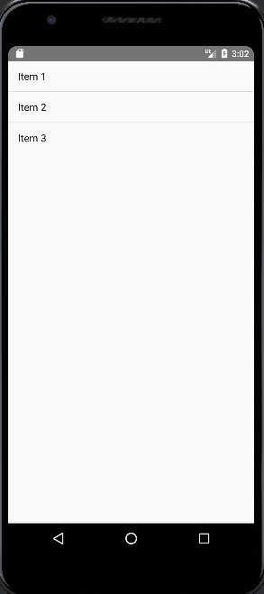
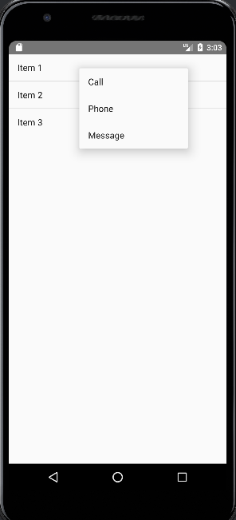
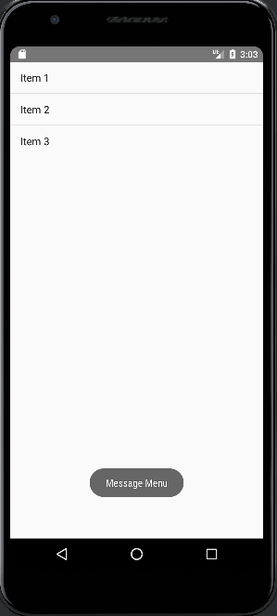

Slide 72
Pop up Menu
A PopupMenu displays a Menu in a popup window anchored to a View. The popup will be shown below the anchored View if there is room(space) otherwise above the View. If any IME(Input Method Editor) is visible the popup will not overlap it until the View(to which the popup is anchored) is touched. Touching outside the popup window will dismiss it.

Slide 73
Activity_main.xml
<?xml version="1.0" encoding="utf-8"?>
<androidx.constraintlayout.widget.ConstraintLayout xmlns:android="http://schemas.android.com/apk/res/android"
xmlns:app="http://schemas.android.com/apk/res-auto"
xmlns:tools="http://schemas.android.com/tools"
android:layout_width="match_parent"
android:layout_height="match_parent"
tools:context=".MainActivity">
<Button
android:id="@+id/clickBtn"
android:layout_width="wrap_content"
android:layout_height="wrap_content"
android:background="#0F9D58"
android:text="Click Me"
android:textColor="#ffffff"
app:layout_constraintBottom_toBottomOf="parent"
app:layout_constraintLeft_toLeftOf="parent"
app:layout_constraintRight_toRightOf="parent"
app:layout_constraintTop_toTopOf="parent" />
</androidx.constraintlayout.widget.ConstraintLayout>

Slide 74
Colors.xml
<?xml version="1.0" encoding="utf-8"?>
<resources>
<color name="purple_200">#FFBB86FC</color>
<color name="purple_500">#FF6200EE</color>
<color name="purple_700">#FF3700B3</color>
<color name="teal_200">#FF03DAC5</color>
<color name="teal_700">#FF018786</color>
<color name="black">#FF000000</color>
<color name="white">#FFFFFFFF</color>
<color name="colorPrimary">#0F9D58</color>
<color name="colorPrimaryDark">#16E37F</color>
<color name="colorAccent">#03DAC5</color>
</resources>

Slide 75
Popup_menu.xml
<?xml version="1.0" encoding="utf-8"?>
<menu xmlns:android="http://schemas.android.com/apk/res/android">
<item
android:id="@+id/java"
android:title="Java" />
<item
android:id="@+id/kotlin"
android:title="Kotlin" />
<item
android:id="@+id/android"
android:title="Android" />
<item
android:id="@+id/react_native"
android:title="React Native" />
</menu>

Slide 76
MainActivity.kt
package com.example.mypopupmenu
import android.os.Bundle
import android.widget.Button
import android.widget.PopupMenu
import android.widget.Toast
import androidx.appcompat.app.AppCompatActivity
class MainActivity : AppCompatActivity() {
lateinit var button: Button
override fun onCreate(savedInstanceState: Bundle?) {
super.onCreate(savedInstanceState)
setContentView(R.layout.activity_main)
// Referencing and Initializing the button
button = findViewById(R.id.clickBtn)
// Setting onClick behavior to the button
button.setOnClickListener {
// Initializing the popup menu and giving the reference as current context
val popupMenu = PopupMenu(this@MainActivity, button)
// Inflating popup menu from popup_menu.xml file
popupMenu.menuInflater.inflate(R.menu.popup_menu, popupMenu.menu)
popupMenu.setOnMenuItemClickListener { menuItem ->
// Toast message on menu item clicked
Toast.makeText(this@MainActivity, "You Clicked " + menuItem.title, Toast.LENGTH_SHORT).show()
true
}
// Showing the popup menu
popupMenu.show()
}
}
}

Slide 77
AndroidManifest.xml
<?xml version="1.0" encoding="utf-8"?>
<manifest xmlns:android="http://schemas.android.com/apk/res/android"
xmlns:tools="http://schemas.android.com/tools">
<application
android:allowBackup="true"
android:dataExtractionRules="@xml/data_extraction_rules"
android:fullBackupContent="@xml/backup_rules"
android:icon="@mipmap/ic_launcher"
android:label="@string/app_name"
android:roundIcon="@mipmap/ic_launcher_round"
android:supportsRtl="true"
android:theme="@style/Theme.AppCompat"
tools:targetApi="31">
<activity
android:name="MainActivity"
android:exported="true"
android:label="@string/app_name"
android:theme="@style/Theme.AppCompat">
<intent-filter>
<action android:name="android.intent.action.MAIN" />
<category android:name="android.intent.category.LAUNCHER" />
</intent-filter>
</activity>
</application>
</manifest>

Slide 78
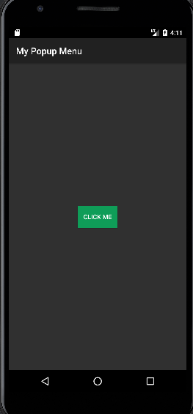
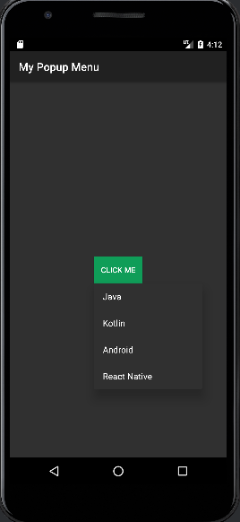
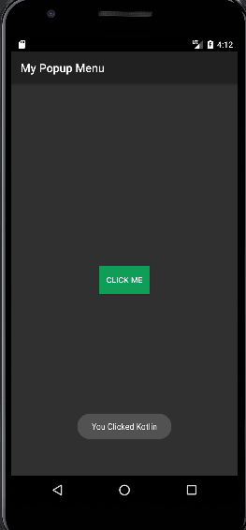

Slide 79
MultiThreading in Android
Working on multiple tasks at the same time is Multitasking. In the same way, multiple threads running at the same time in a machine is called Multi-Threading. Technically, a thread is a unit of a process. Multiple such threads combine to form a process. This means when a process is broken, the equivalent number of threads are available.
For example, Autocorrect is the process where the software looks for the mistakes in the current word being typed. Endlessly checking for the mistake and providing suggestions at the same time is an example of a Multi-Threaded process.

Slide 80
activity_main.xml
<?xml version="1.0" encoding="utf-8"?>
<RelativeLayout
xmlns:android="http://schemas.android.com/apk/res/android"
xmlns:app="http://schemas.android.com/apk/res-auto"
xmlns:tools="http://schemas.android.com/tools"
android:layout_width="match_parent"
android:layout_height="match_parent"
tools:context=".MainActivity">
<TextView
android:id="@+id/tv1"
android:layout_width="75sp"
android:layout_height="75sp"
android:gravity="center"
android:textSize="10sp"
android:layout_centerVertical="true"
android:layout_toLeftOf="@id/tv2"
/>
<TextView
android:id="@+id/tv2"
android:layout_width="75sp"
android:layout_height="75sp"
android:gravity="center"
android:textSize="10sp"
android:layout_centerInParent="true"
/>
<TextView
android:id="@+id/tv3"
android:layout_width="75sp"
android:layout_height="75sp"
android:gravity="center"
android:textSize="10sp"
android:layout_centerVertical="true"
android:layout_toRightOf="@id/tv2"
/>
<Button
android:id="@+id/btnStart"
android:layout_width="wrap_content"
android:layout_height="wrap_content"
android:text="Start"
android:layout_centerHorizontal="true"
android:layout_below="@id/tv2"
/>
</RelativeLayout>

Slide 81
MainActivity.kt
package com.example.mythread
import android.annotation.SuppressLint
import android.os.Bundle
import android.widget.TextView
import android.widget.Button
import androidx.appcompat.app.AppCompatActivity
import androidx.compose.material3.Button
class MainActivity : AppCompatActivity() {
@SuppressLint("SetTextI18n")
override fun onCreate(savedInstanceState: Bundle?)
{
super.onCreate(savedInstanceState)
setContentView(R.layout.activity_main)
// Assigning Layout elements
val tv1 = findViewById<TextView>(R.id.tv1)
val tv2 = findViewById<TextView>(R.id.tv2)
val tv3 = findViewById<TextView>(R.id.tv3)
val btn = findViewById<Button>(R.id.btnStart)

Slide 82
// Boolean for Button (initially False)
var boolbtn = false
// Button onClick action
btn.setOnClickListener{
boolbtn = !boolbtn
// Case where Button is False
if (!boolbtn)
{
tv1.text = "Stopped1"
tv2.text = "Stopped2"
tv3.text = "Stopped3"
btn.text= "Start"
}
// Case where Threads are running
else
{
// Setting the button text as "Stop"
btn.text = "Stop"

Slide 83
// Thread 1
Thread(Runnable {
// Runs only when Button is True
while (boolbtn) {
runOnUiThread{
tv1.text = "Started1"
}
Thread.sleep(1000)
runOnUiThread{
tv1.text = "Activity1"
}
Thread.sleep(1000)
}
}).start()

Slide 84
// Thread 2
Thread(Runnable {
// Runs only when Button is
// True
while (boolbtn) {
runOnUiThread{
tv2.text = "Started2"
}
Thread.sleep(1000)
runOnUiThread{
tv2.text = "Activity2"
}
Thread.sleep(1000)
}
}).start()

Slide 85
// Thread 3
Thread(Runnable {
// Runs only when Button is
// True
while (boolbtn) {
runOnUiThread{
tv3.text = "Started3"
}
Thread.sleep(1000)
runOnUiThread{
tv3.text = "Activity3"
}
Thread.sleep(1000)
}
})
.start()
}
}
}
}

Slide 86
AndroidManifest.xml
<?xml version="1.0" encoding="utf-8"?>
<manifest xmlns:android="http://schemas.android.com/apk/res/android"
xmlns:tools="http://schemas.android.com/tools">
<application
android:allowBackup="true"
android:dataExtractionRules="@xml/data_extraction_rules"
android:fullBackupContent="@xml/backup_rules"
android:icon="@mipmap/ic_launcher"
android:label="@string/app_name"
android:roundIcon="@mipmap/ic_launcher_round"
android:supportsRtl="true"
android:theme="@style/Theme.AppCompat"
tools:targetApi="31">
<activity
android:name="MainActivity"
android:exported="true"
android:label="@string/app_name"
android:theme="@style/Theme.AppCompat">
<intent-filter>
<action android:name="android.intent.action.MAIN" />
<category android:name="android.intent.category.LAUNCHER" />
</intent-filter>
</activity>
</application>
</manifest>

