Slide 1
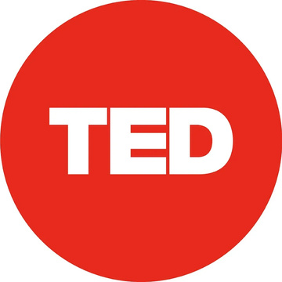
TED Talks
A47042 - Nguyễn Thị Bích Loan
A48872 - Lê Thị Thu Trang
A49542 - Phạm Phương Nhung

Slide 2
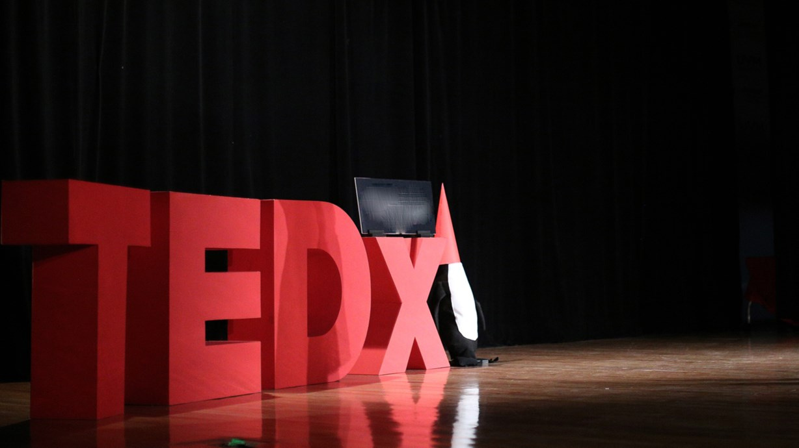

ANALYTICS FLOW
Introductions
What’s the Problem
Viewers’ Insights
Recommendations

Slide 3

About TED
TED stands for Technology, Entertainment and Design.
TED was founded in 1984 in California by Richard Saul Wurman and Harry Marks. They are known as inspiring figures behind short, compelling, and human-centered presentations.

Slide 4
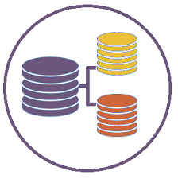
DATASETS
This dataset includes all information from TED talks that were recorded and published on TED’s official website up to September 21, 2017
The TED main dataset contains information about all talks including number of views, number of comments, descriptions, speakers and titles. The TED transcripts dataset contains the transcripts for all talks available on TED.com

Slide 5

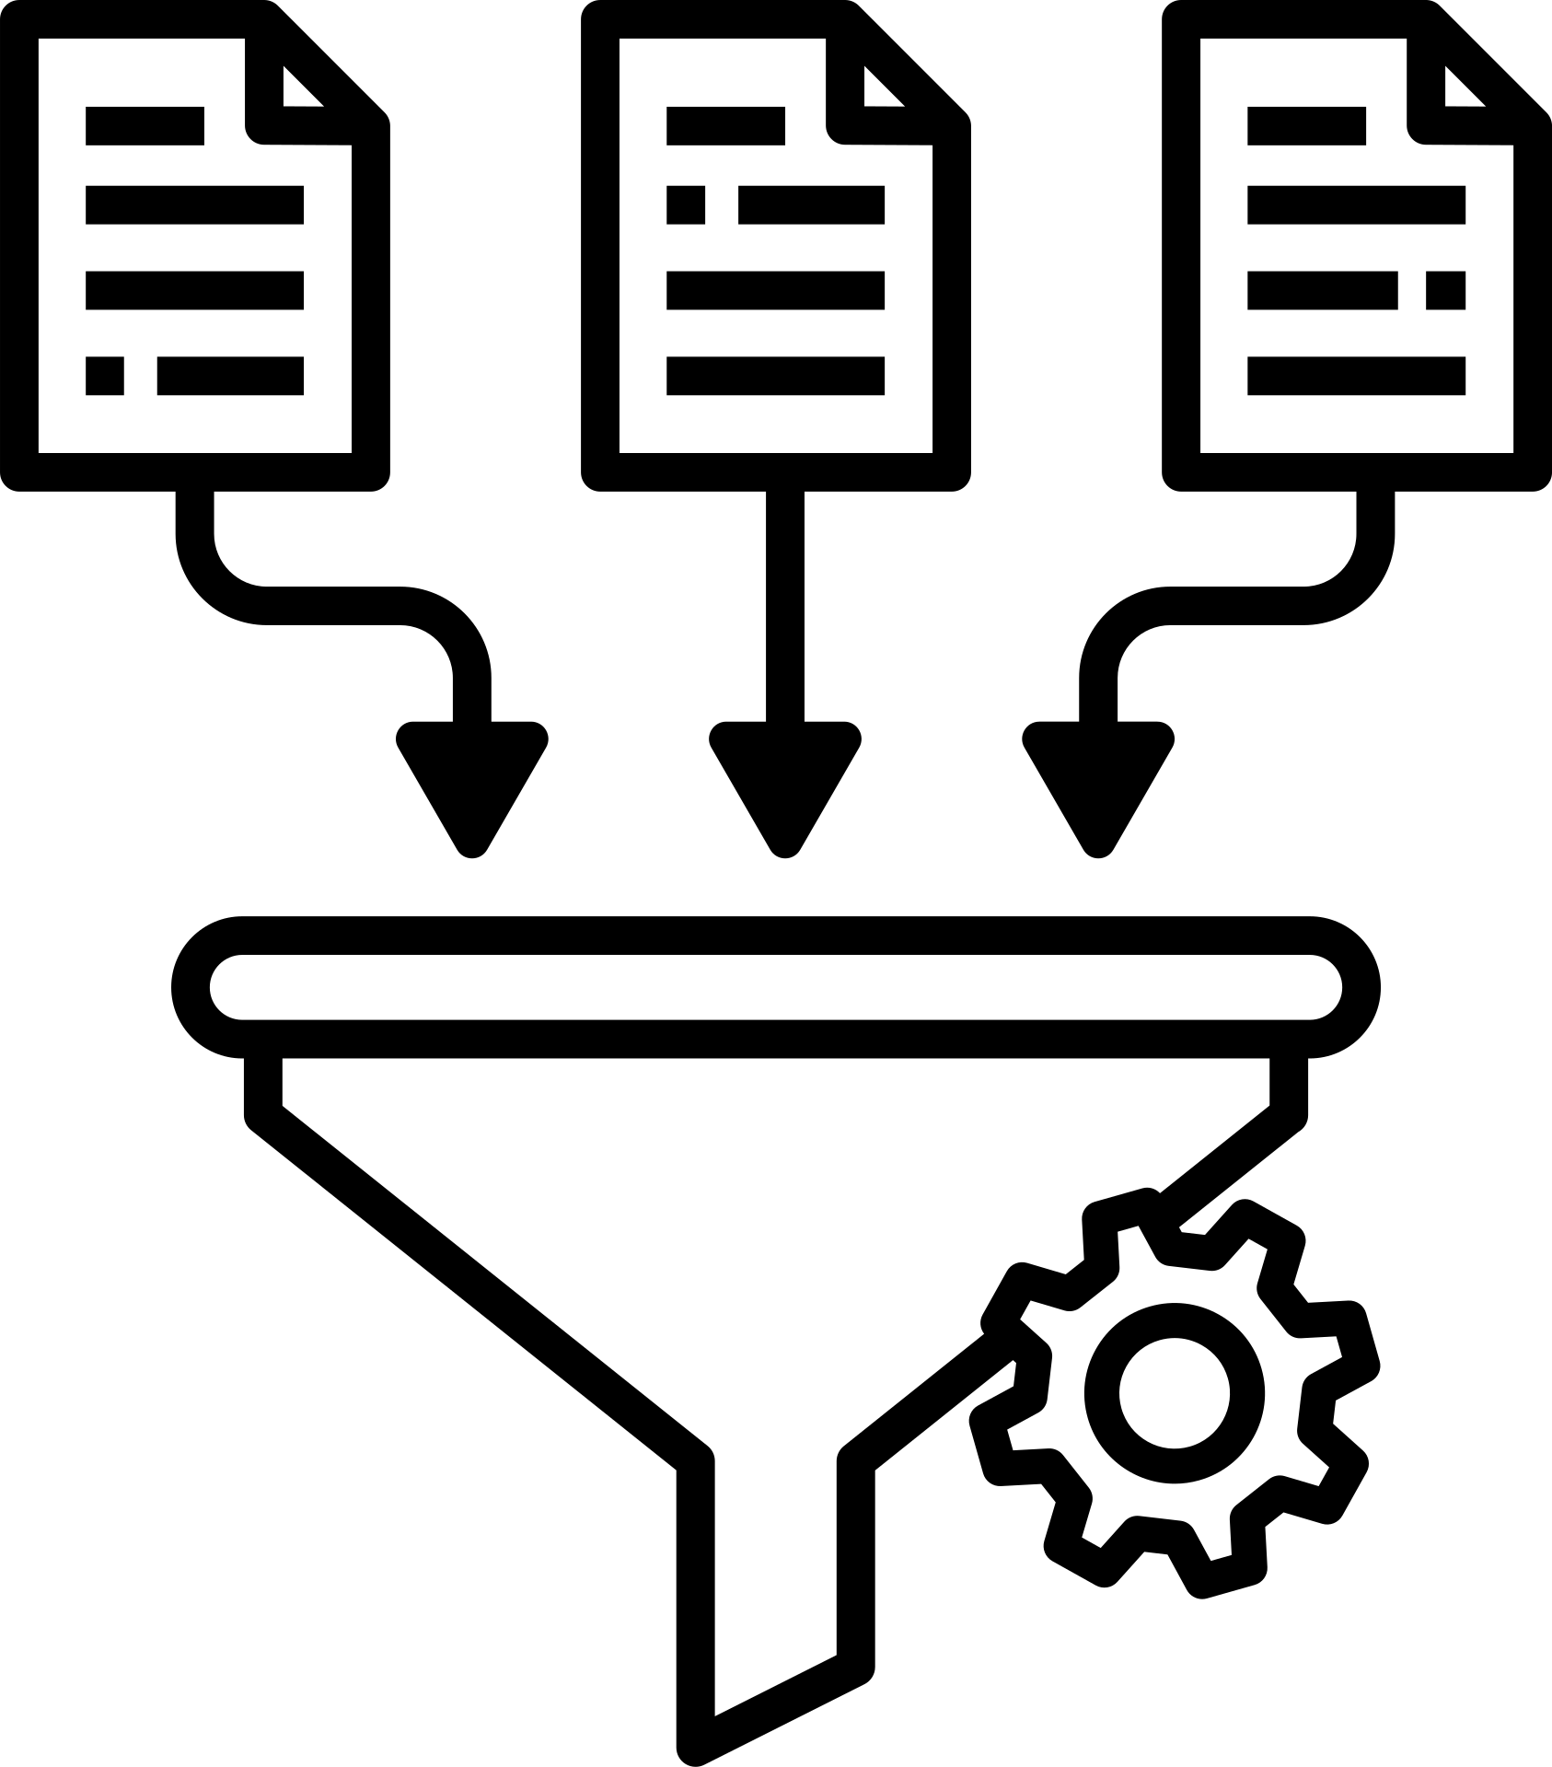



How TED works?
Speakers apply by filling out a registration form.
The producers select suitable candidates to present at TED.
The talks are published on social media platforms
Speakers represent at TED

Slide 6

Target Customer
This analysis can provide insights into audience needs and preferences by examining view counts and content interests.
This allows TED to produce more appealing content, attract speakers who resonate with the audience, and strengthen positive audience perception.
TED’s Producers

Slide 7
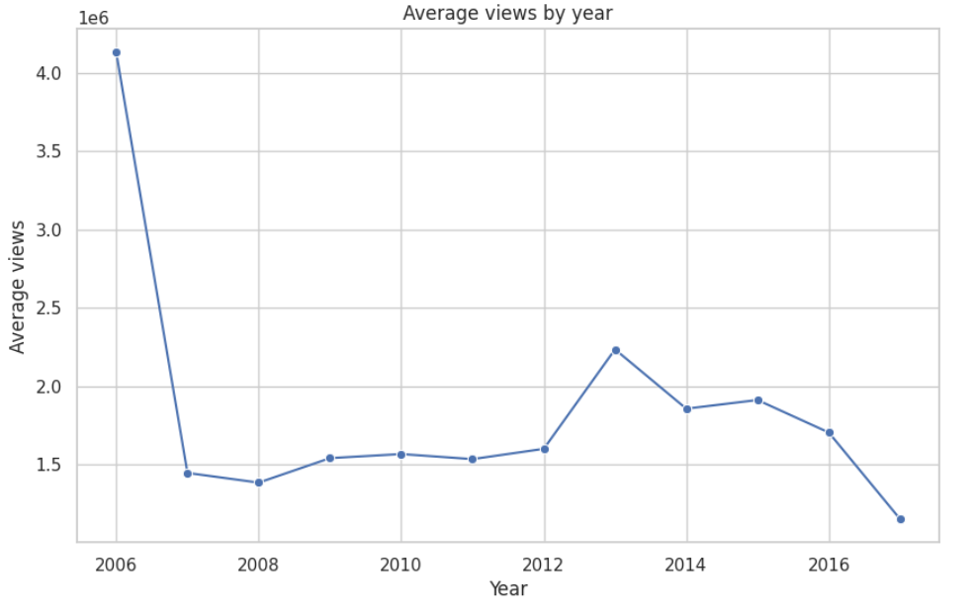

What’s the Problem
The number of views changes over the years, with the chart clearly showing a significant decrease from 2006 to 2007.
Since 2012, there has been a recovery in view counts; however, it has not shown a significant breakthrough.
What factors influence the popularity of a TED Talk and the reasons why audiences choose to watch it?

Slide 8
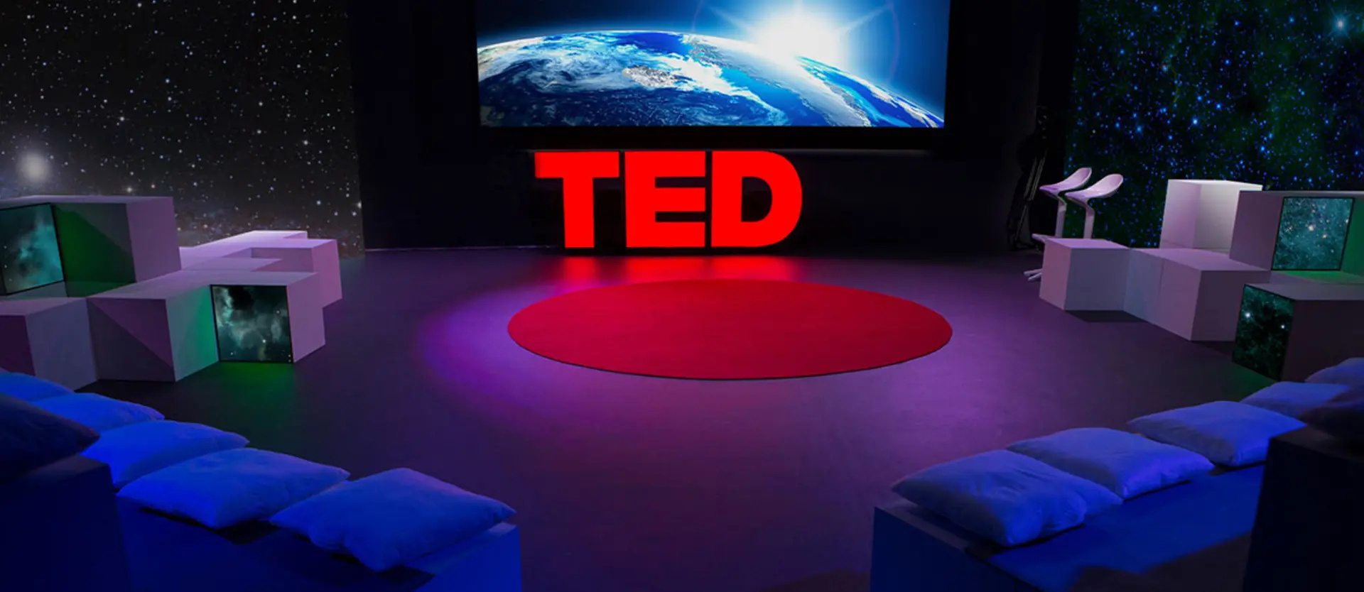
VIEWERS’ INSIGHTS

Slide 9


Slide 10
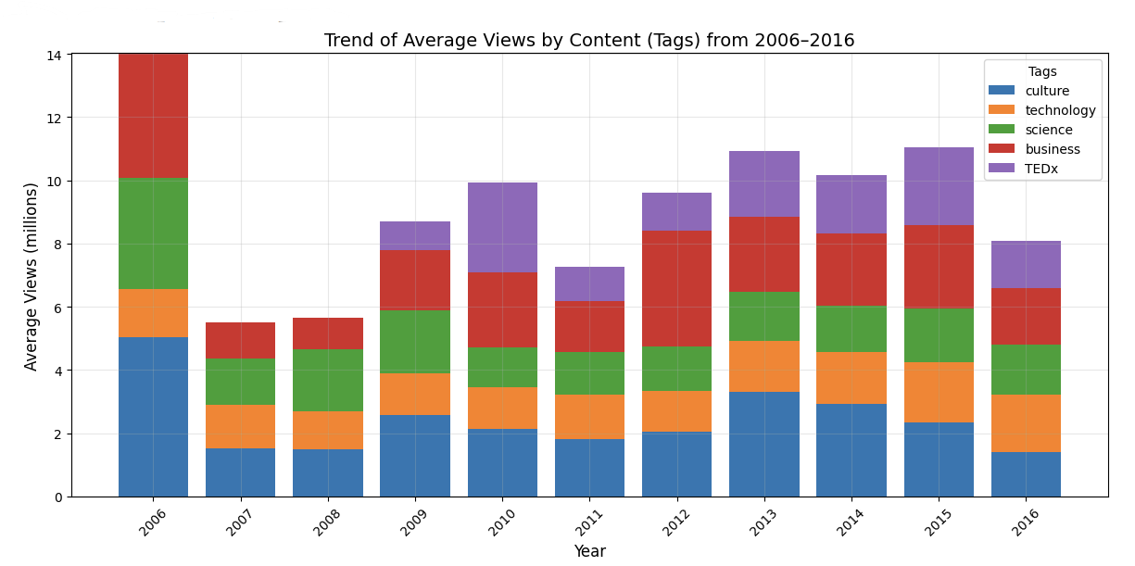
Viewers’ behaviour change
The chart illustrates the changes in TED Talk content and audience preferences over the years.
Topics such as culture, business, and technology have maintained high and stable engagement levels.
The TEDx topic reflects the growing influence of the TED platform through independently organized events since 2010.
The peak in average views in 2006 was likely due to TED’s novelty at the time, the smaller number of talks, and the strong viral spread.
In the following years, audience content consumption behavior became more stable and evenly distributed.

Slide 11
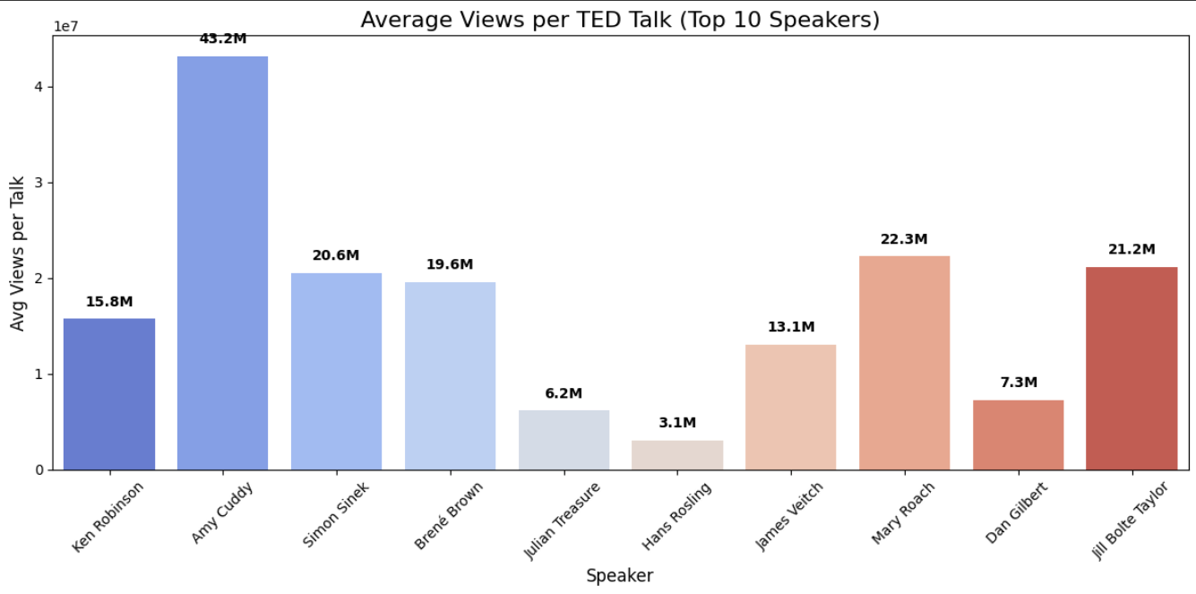

The popularity of the speaker has a direct impact on view counts
Speaker popularity directly impacts viewership.
Even fewer talks by well-known speakers can result in very high engagement.
Choosing impactful speakers boosts visibility, shares, and engagement across platforms.

Slide 12
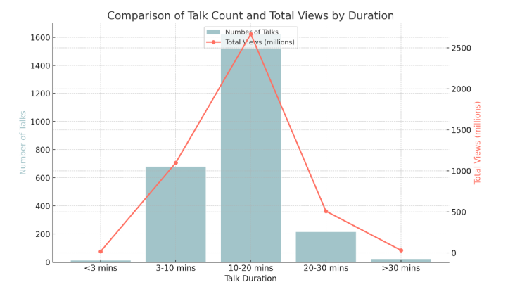
Durations also have an impact on Views
The most striking feature is that a majority of TED Talks fall within the 10–20 minute range.
Viewers seem to avoid ultra-short and extended formats.
This suggests that the 10–20 minute range is ideal for delivering messages that are both concise and meaningful, aligning well with today’s fast content consumption habits.

Slide 13
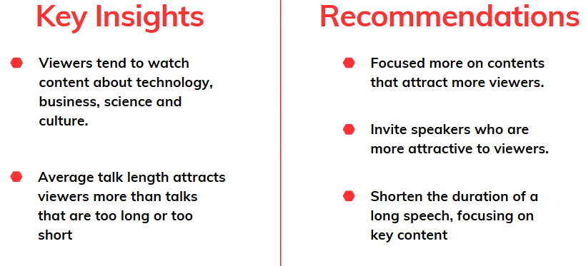

Slide 14
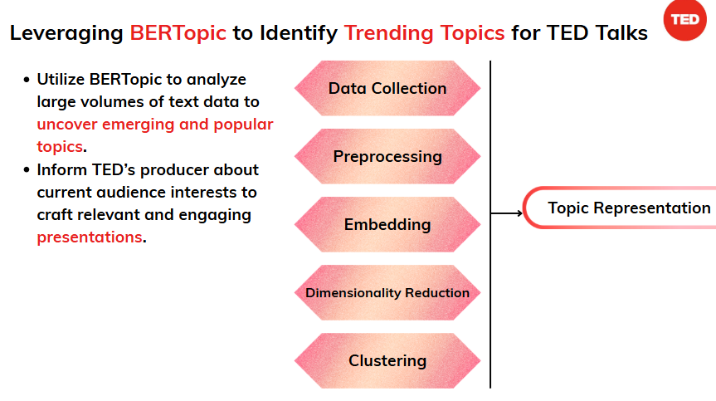

Slide 15

THANK YOU

