Slide 1
Composite Testbed Presentation
Synthetic PPTX for MetaRCI structural evaluation
Contains text, notes, an embedded image, a native table, a native chart with underlying data, and embedded video.
Notes:
Parent-level note: This deck is intentionally synthetic. It is designed to provide a bounded, known-good composite source for MetaRCI testing.

Slide 2
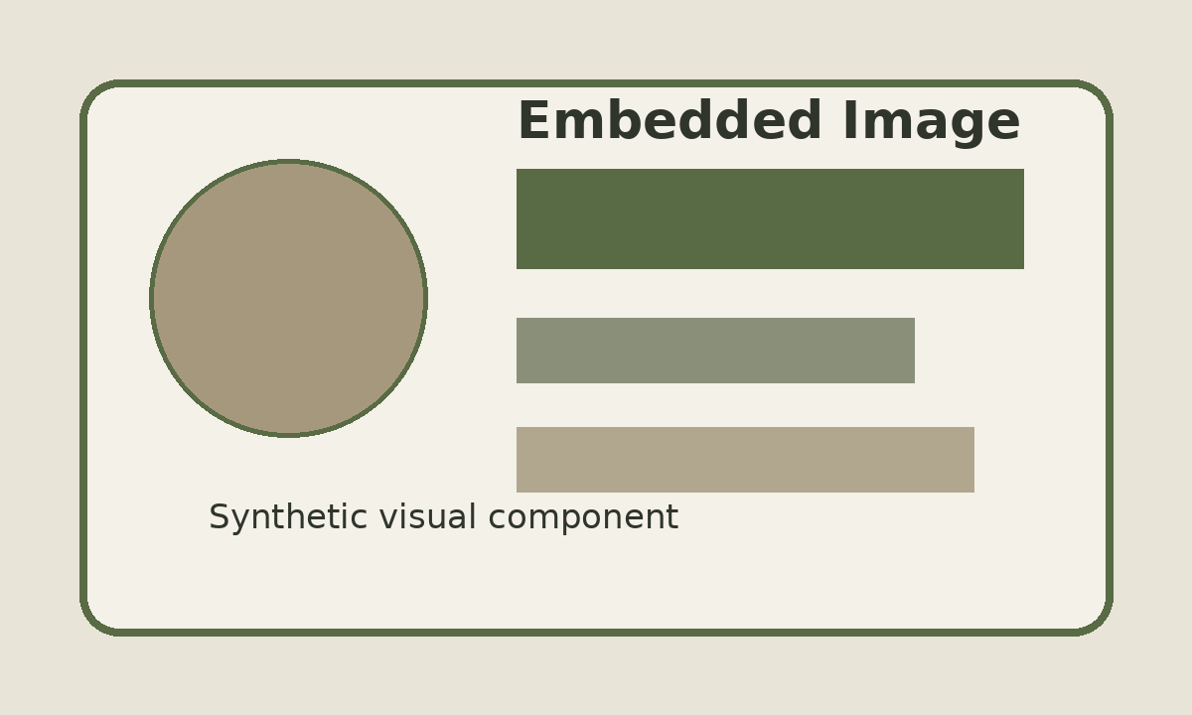
Text + Image + Speaker Notes
A single slide with multiple meaningful component types.
Document-like content
This text block is intentionally ordinary narrative content. It can be treated independently from the embedded image while both remain components of the same slide and presentation.
Example bullets:
Ordered slide context
Narrative text
Embedded media
Speaker notes
Embedded PNG image
Notes:
Speaker note component: This note is intentionally distinct from the visible slide text. It can be extracted separately and should not be assumed to have the same metadata scope as the slide body.

Slide 3
Native Table
Structured data represented directly inside the presentation.
Quarter | Units | Revenue ($k) | Status
Q1 | 120 | 245 | Complete
Q2 | 135 | 278 | Complete
Q3 | 149 | 301 | Complete
Q4 | 162 | 337 | Projected
The table is a first-class PowerPoint table object, not a screenshot.
Composite pressure: presentation context + table structure + slide ordering

Slide 4
Native Chart with Underlying Data
Chart semantics and source data coexist inside the PPTX package.
Why this matters
The chart has visible graphical meaning.
It also carries structured series/category data.
Both remain components of the parent slide/deck.
Notes:
Chart note: The chart data is intentionally similar to the prior slide table so that the same conceptual data appears in two different presentation structures.

Slide 5

Embedded Video
Temporal media as a component of the same coherent presentation.
Component inventory
Parent: PPTX presentation
Slide: ordered component
Video: temporal Media component
Notes: Document-like component
Synthetic 3-second MP4
Notes:
Embedded-video note: The video is synthetic and intentionally short. Its purpose is only to create a real temporal-media component inside the PPTX package.

