Slide 1
Multiprocessing GO vs SCALA
An overview of the performance differences between the GO and SCALA programming languages when processing large datasets using multiprocess/multicomputer systems.

Slide 2
Introduction

Slide 3
Motivation
Computers are Getting Faster
Programmers need to keep up
As computers become faster and more capable of doing multiple things concurrently, it behooves developers to know which languages are able to harness them easily and effectively.

Slide 4
The Project
Using the GO and SCALA programming languages, write a program to sort a large dataset of numbers using a configurable set of resources.
Log the processing time for both applications and compare the results.

Slide 5
Resources
Cluster
Multicore Single Computer
UNF’s URANUS 14-Computer Beowulf Cluster
Each computer has 4 CPUs and 4GB RAM
For Uranus, the resources used will be the number of computers used during processing. Each computer will use all 4 CPUs for processing
UNF’s ATLAS 64-CPU Virtual Computer
128GB RAM
For Atlas, the resources used will be the number of CPUs used for processing.

Slide 6
Languages

Slide 7
GO
Created by 3 Engineers at Google as an alternative to C.
Compiled, Garbage-collected Systems Programming Language.
C-like syntax
Func(), type struct, nested types (as a form of object-orientation)
Direct Memory Model using pointers.
Focus on making fast, non-complicated, scalable applications.

Slide 8
Go – Multiprocessing
Multiprocessing is accomplished using goroutines.
Goroutines – blocks of code executed on individual threads via “chan” communicaiton channels MPI interface.
Using goroutines
Func p(){
chan ch = go somefunc(val a, val b) //instantiates a gourutine for //somefunc and opens a channel to //communicate
someVal <- ch // sends someVal to chan
ch <- returnData //waits for channel to return some //value
}

Slide 9
Scala
Designed by Martin Odersky
Interpreted, Statically-Typed, Functional/Object-Oriented, Application Software Language
Compiles into intermediate Java Bytecode
Designed to fix design problems with Java
Unified Type architecture
Everything is an object that inerits from Scala.Any()
Focus on creating elegant, concise solutions to problems with processing big data.

Slide 10
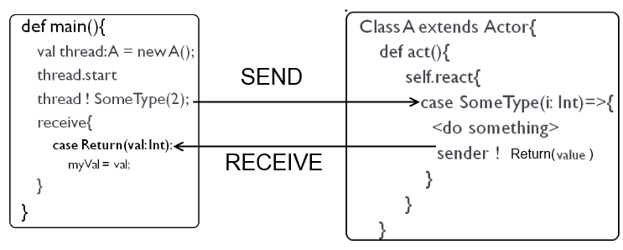
Scala - Multiprocessing
Uses “Actor” Model.
Converts Actor MP code to Java MP ByteCode.
Using Scala Actors

Slide 11
Language Comparison
GO
SCALA
Direct Compilation
Byref Function Calls
Simple type structure
Lighweight goroutines and channel architecture.
Multiprocessing must be explicitly coded by the programmer.
Execution via JVM
ByVal function Calls
Everything is an object.
Default multiprocessing capabilities of Scala’s Functional programming model.

Slide 12
Hypothesis – Individual Languages
When sorting small sets of data, a language’s application will perform worse when using more resources (cores/computers) to sort data when compared to using the methods built into each language used to sort data. This can be attributed to the overhead incurred when manually splitting the data into multiple datasets, sorting it and recombining it.
When the data to be sorted becomes large enough, the language’s applications should outperform the stock applications on account of the overhead incurred by splitting and joining the data becoming less and less significant.

Slide 13
Hypothesis – GO vs SCALA
GO applications will outperform SCALA applications in both the cluster and multicore configurations due to the reasons below.
---------------------------------------------------------------------------
GO is fully-compiled before execution. SCALA is compiled as it is executed.
GO functions can be called byref. Scala functions can only be called byval, meaning that sending objects to and from Scala functions duplicates them in memory.
GO uses much smaller variable types than SCALA does.

Slide 14
Project Outline

Slide 15
The Project
Start the App
Read parameters specifying T number of resources to use and N size of dataset to generate
Generate dataset of size N
Split dataset into T smaller sets
Send to T resources and wait for a response
Recombine the responses into one sorted set.
Verify List is sorted.
Save Sort Time, Combination Time and Total Time to file.

Slide 16
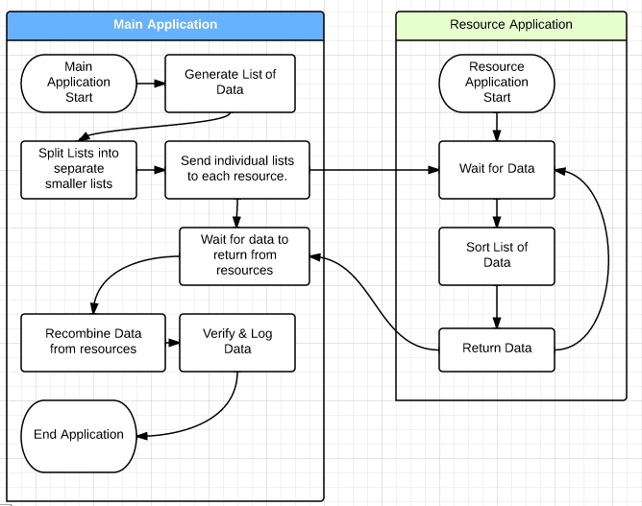
The Project

Slide 17
Testing Parameters
For Multicore, test using {2,4,8,26,43,64,128,256} CPUs
For Cluster, test using {1,2,4,6,8,10,12} Servers.
For Stock applications, test using the default number of resources for each language’s built-in functions.
For all applications test using the following dataset sizes:
10k-100k: Increments of 10k
100k-1M: Increments of 100k
1M-10M: Increments of 1M
10M-100M: Increments of 10M

Slide 18
Results - Go

Slide 19
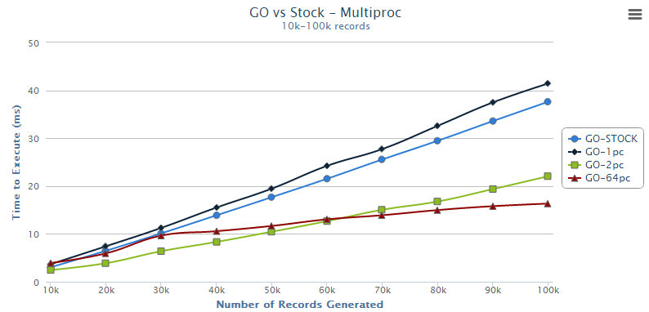
Results GO – Multicore – Small Data
All Multicore configurations outperform stock on even small data sets.

Slide 20
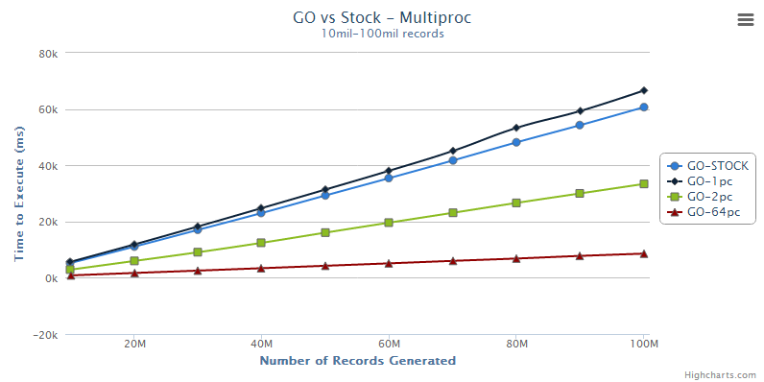
Results GO – Multicore – Very Large Data
Go Performs much better on large data with more CPU Cores

Slide 21
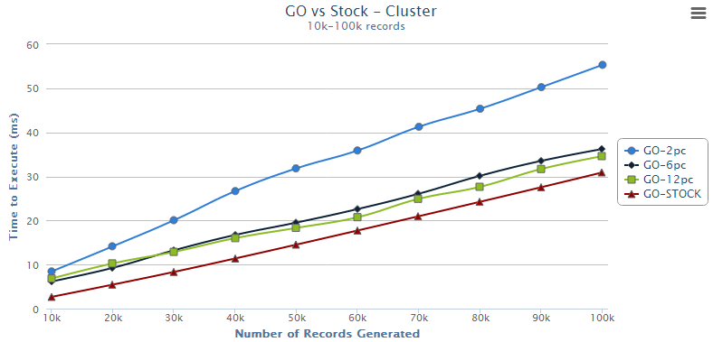
Results Go – Cluster – Small Data
Stock is faster than 12-PC cluster on small data sets

Slide 22
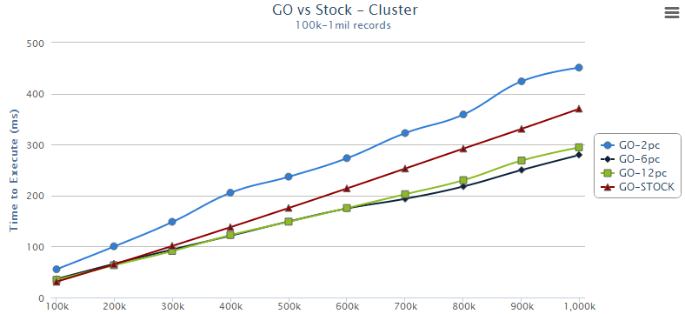
Results Go – Cluster – Larger Data
On larger Datasets, larger clusters performs better than Stock

Slide 23
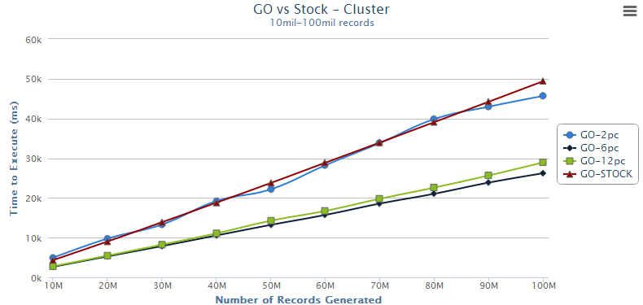
Results Go – Cluster – Very Large Data
On very large Datasets, Stock is equivalent to a 2-Client Cluster

Slide 24
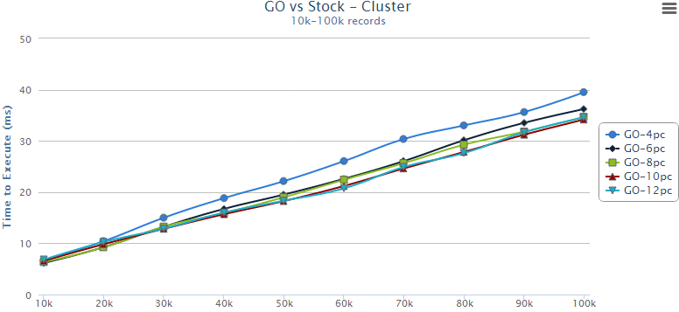
Results Go – Cluster – 4 PCs vs 12 PCs
Clusters larger than 4 PCs see no performance gains -

Slide 25
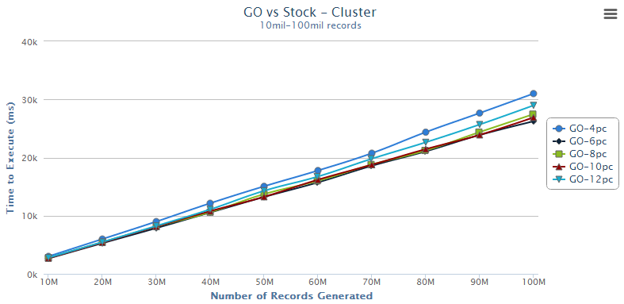
Results Go – Cluster – 4 PCs vs 12 PCs
- not even on very large data sets.

Slide 26
Results - Scala

Slide 27
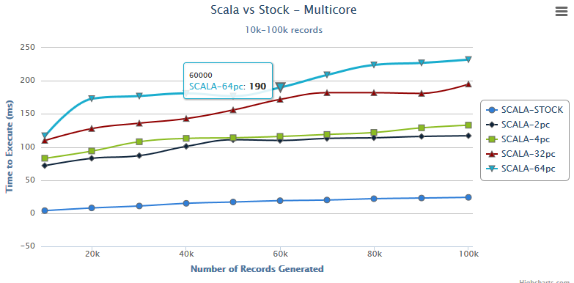
Results Scala – Multicore – Small Data
Stock Beats out threading for small datasets

Slide 28
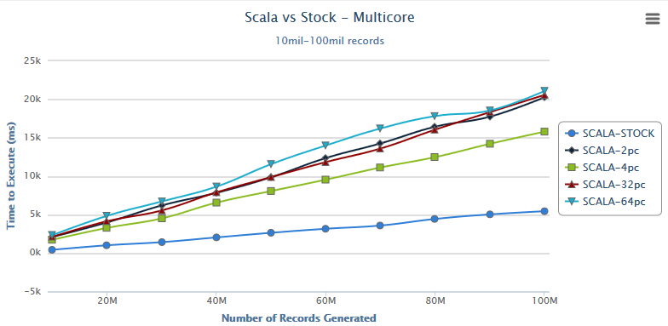
Results Scala – Multicore – Very Large Data
Stock Beats out threading even for very large Data

Slide 29
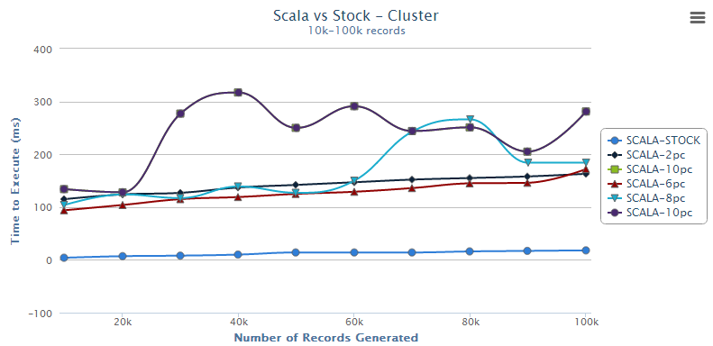
Result Scala – Cluster – Small Data
Larger Number of resources are more sensitive to overhead hickups
Stock outperforms all Cluster Configurations.

Slide 30
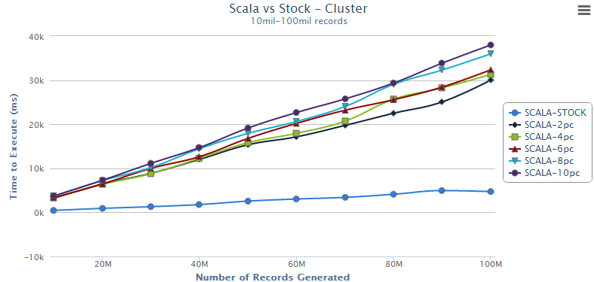
Result Scala – Cluster – Very Large Data
Stock significantly outperformed all Cluster Configurations.

Slide 31
Results – Go vs Scala

Slide 32
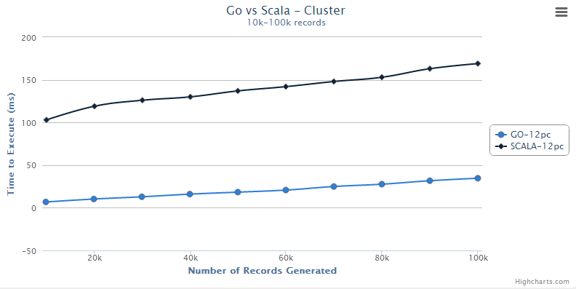
Results Go Vs Scala – Cluster – Small data
Go performs much faster than Scala on smaller data sets

Slide 33
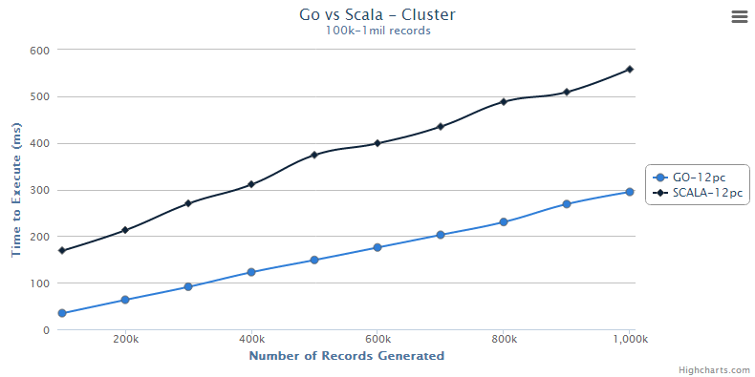
Results Go Vs Scala – Cluster – Medium Data
Go performs still performs twice as fast as Scala

Slide 34
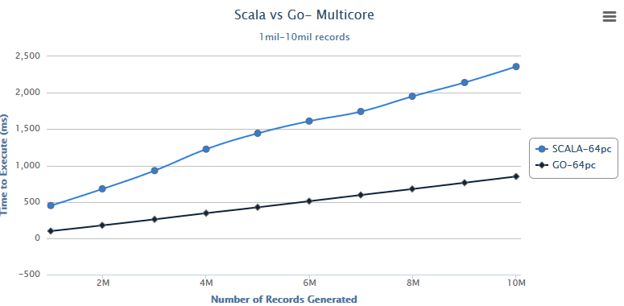
Results Go Vs Scala – Cluster – Large Data
Go’s performance lead is stark

Slide 35
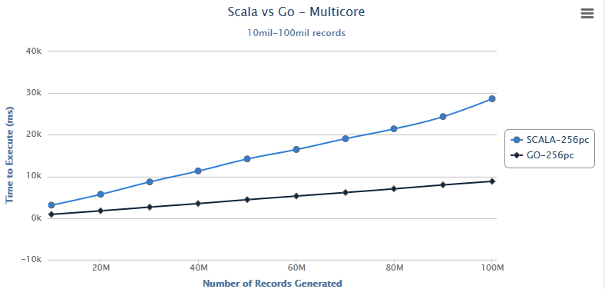
Results Go Vs Scala – Multicore – Very Large Data
Go outperforms Scala on all dataset sizes.

Slide 36
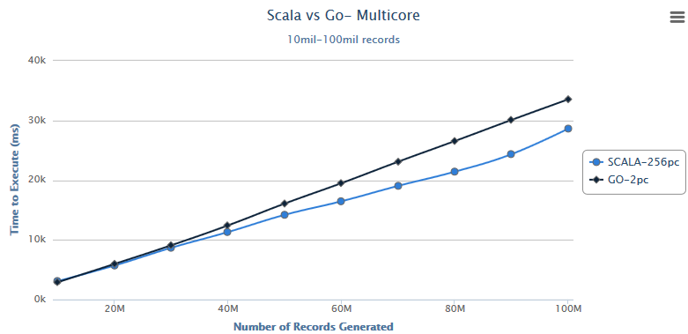
Results Go Vs Scala – Multicore – Very Large Data
In fact, Scala performance with 256 cores is equivelent to Go performance with 2 cores.

Slide 37
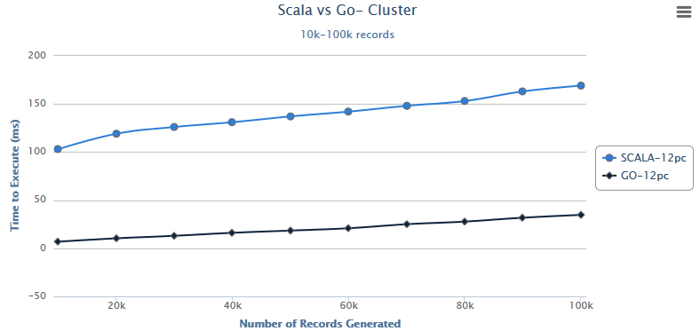
Results Go Vs Scala – Cluster – Small Data
On small data sets, Go is significantly faster than Scala

Slide 38
Results Go Vs Scala – Cluster – Very Large Data
On small data sets, Go is significantly faster than Scala, when comparing the same number of resources.

Slide 39
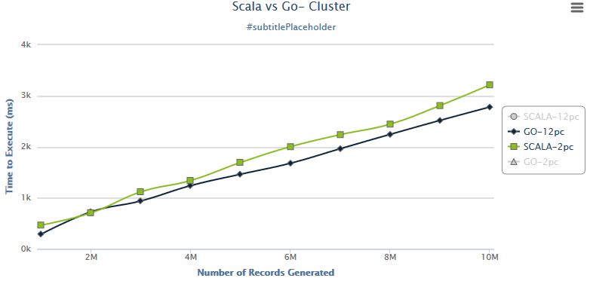
Results Go Vs Scala – Cluster – Very Large Data
Since Scala’s Cluster performance degrades as resources increases, it is more fair to compare smaller Scala resources to larger Go resources.

Slide 40
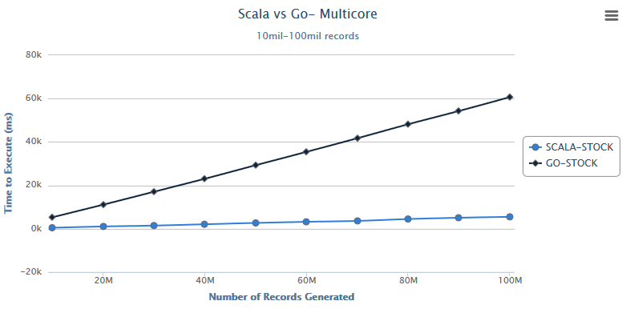
Results Go Vs Scala – Stock
Because Scala does such a good job at sorting data, it beats Go’s stock sorting implementation handily.

Slide 41
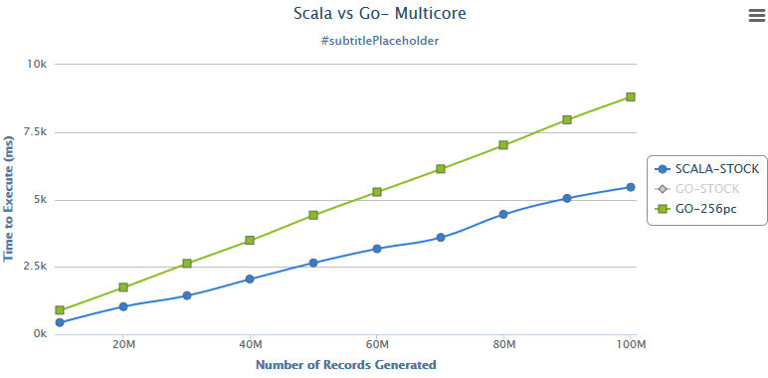
Results Scala Stock vs Go 256 CPU
Scala’s stock solution even beats out Go’s 256-CPU performance on the Multicore system.

Slide 42
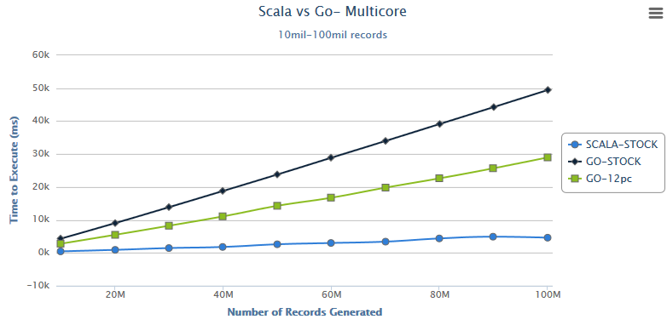
Results Scala Stock vs Go 12-CPU Cluster
Scala’s stock solution performs significantly better than Go’s 12-computer cluster system.

Slide 43
Conclusion

Slide 44
Conclusion – Cluster Applications
In the case of GO, adding resources beyond 4 cluster clients did not result in significant performance gains. This is probably due to the overhead of recombining more and more lists negating the performance gains of using multiple Computers.
In the case of Scala, all applications performed poorer than both their GO counterparts and the SCALA stock application. The reason why is explained later.

Slide 45
Conclusion – Multicore Applications
In the case of GO, adding more CPU resources to the application always resulted in better performance. The stock application had comparable performance to a Go multicore application using 2 CPUs.
In the case of Scala, all applications showed around the same performance, regardless of the number of CPU resources available to them. They all performed more poorly than the Stock Scala sort algorithm.

Slide 46
Conclusion – Scala’s Stock Sort performance
Scala’s stock sort algorithm is coded so that all resources available to the application are conscribed in the processing. That, combined with the stock sort code being fully optimized by the scala designers, is probably what caused the Scala applications to do so comparatively poorly.
It beat out not only all Scala application configurations, but all GO applications as well.
In other words, the stock Scala sorting algorithm is pretty awesome and should be used instead of splitting your data manually.

Slide 47
Conclusion – Go vs Scala
On both platforms, GO performed significantly better than its Scala counterpart in almost all situations.
Scala’s stock sorting solution outperformed all other sorting algorithms.
In contrast, Go’s sorting performance improves marginally to significantly the more resources that are available to it.

Slide 48
Conclusion When to use Go vs Scala
Due to the scalability evident in the results, GO would be useful when more computer resources were available to scale. True to word, Go is best used for concurrent, parallel systems.
Due to the performance hit Scala applications take when scaling up, it is advised that programmers use Scala’s stock sorting algorithm when sorting data.

Slide 49
Further Research

Slide 50
Further Research
Execute the Go & Scala applications on a larger multicore system to see if the GO application can outperform Scala’s stock sorting algorithm.
Generate Sorting data for a multi-client single-server system for both GO and SCALA.
Conduct fault-tolerance testing on Cluster configuration on both Go and Scala applications.

