Slide 1
David and goliath
Team:
Monkey
Members:
Tim Tribby
Kyle Dickson
Will Penfold
Seth Bonser

Slide 2
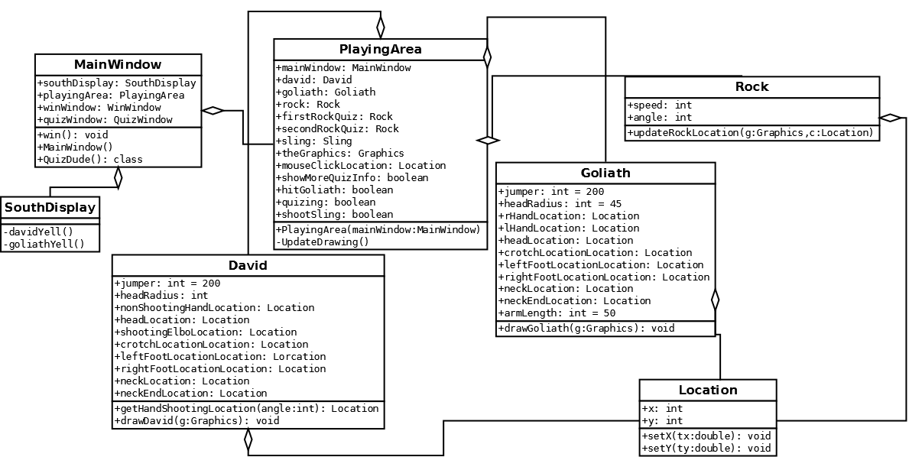
UML

Slide 3
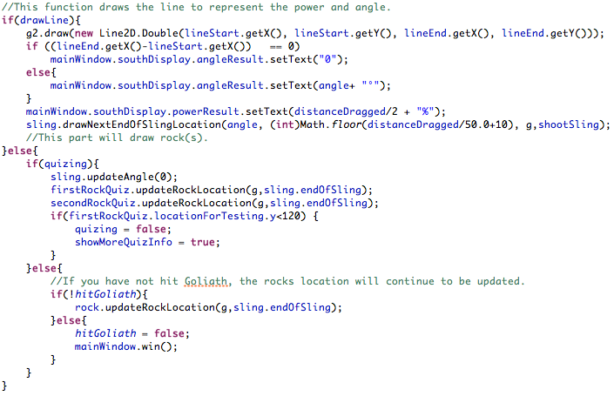
The Code

Slide 4
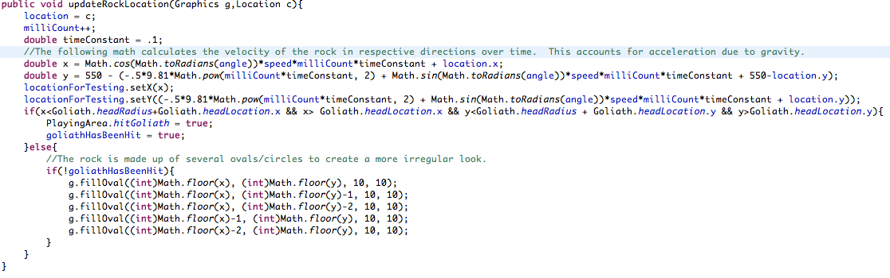
The Code

Slide 5
The Code

Slide 6
Quiz
Used to reinforce student learning.
Age Group: 5th – 12th grade.
1 question Quiz with multiple answers.
Simulated throws at different powers to teach kids Newton’s 2nd Law.

Slide 7
Lessons Learned
Git is helpful
Refreshing can be difficult
Keeping the timer lower(30ms) is better
Use good consistent variable names
Better comments for collaborators to understand

Slide 8
Questions?

