Slide 1
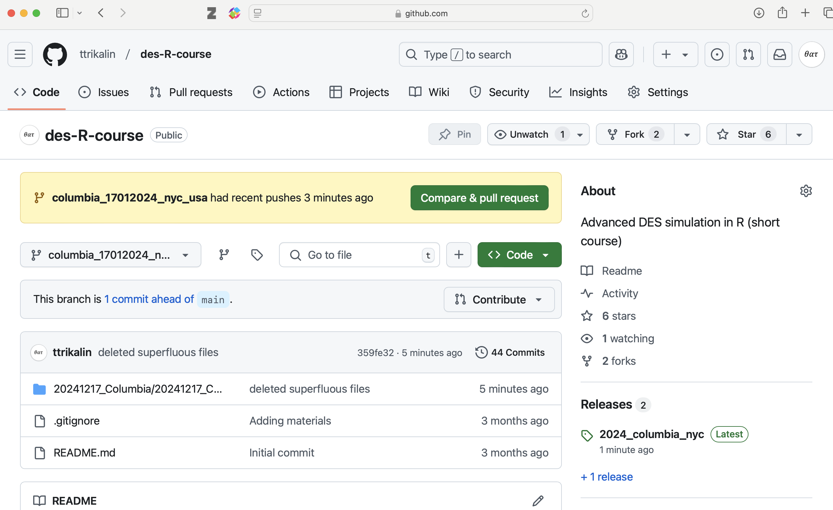
Choose this branch in the drop-down to get to your course’s branch.
Click here to download a zip file with the materials

