Slide 1
Sunday 27th of October 8:30 to 12:00
Time | Description | Discussant
[15 min] | (0) Introductions and administrivia | Trikalinos
[25 min] | (1) DES as a composition of point processes | Alarid-Escudero
[30 min] | (2) NHPPPs – key properties | Trikalinos
[30 min] | (3) Sampling from NHPPPs | Sereda
[15 min] | Break
[80 min] | (4) Guided exercise: Implement a simple cancer natural history DES for one person The many-person case Packaging | [All] Chrysanthopoulou Sereda/Alarid-Escudero Trikalinos
[10 min] | (5) Advanced Topic Teaser on self-excitatory processes: point processes that are not NHPPPs and when you may need them | Trikalinos
[15 min] | General Q & A | All

Slide 2
Section 1: Big picture

Slide 3
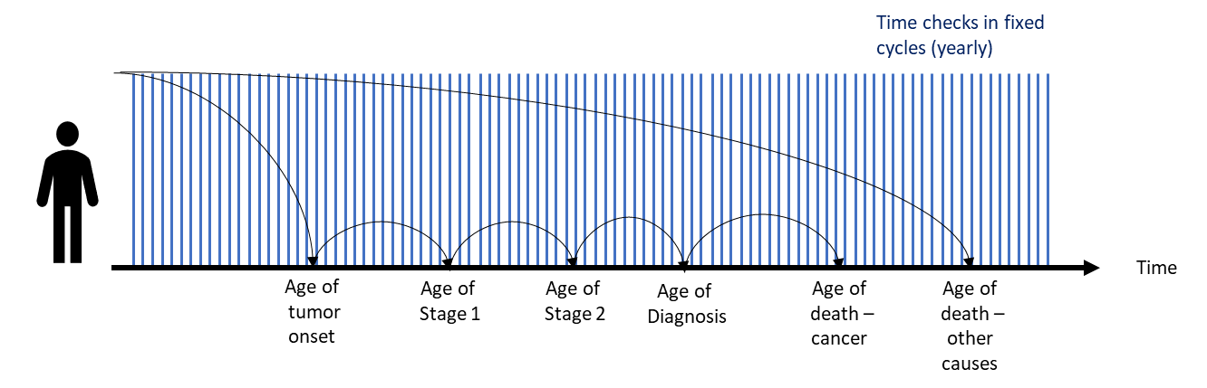
Background
Individual-level discrete-time simulation models usually require sampling of which event happens each cycle.
Discrete-time simulation
Figure courtesy of Carlos Pineda
Notes:
or even the time when they died

Slide 4
Background
Individual-level discrete-event simulation (DES) models usually require sampling times at which specific transitions or events could occur.
Animation courtesy of Carlos Pineda
Notes:
or even the time when they died

Slide 5
Background
Individual-level discrete-time simulation models usually require sampling of which event happens each cycle.
Discrete-time simulation
Figure courtesy of Carlos Pineda
Notes:
or even the time when they died

Slide 6
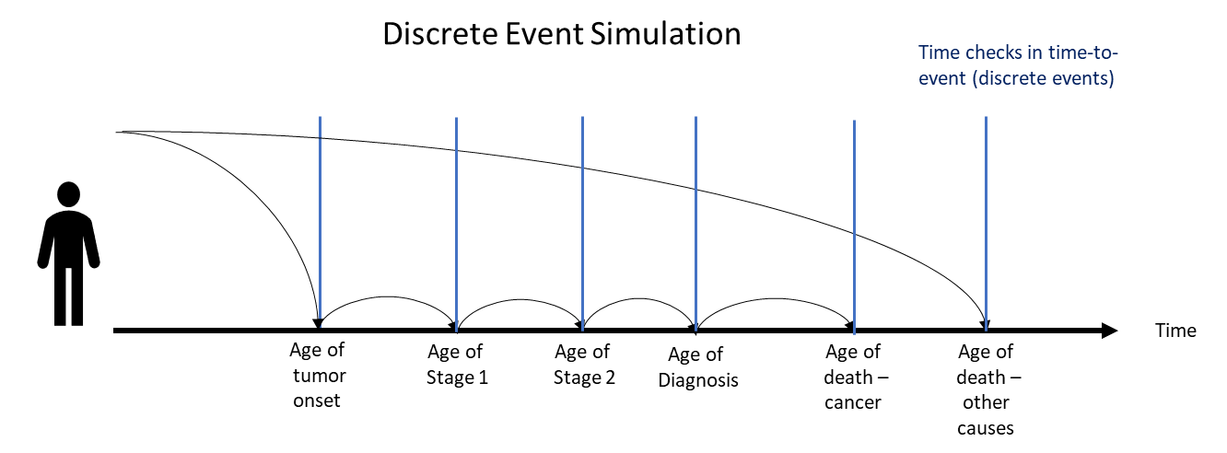
Background
Individual-level discrete-event simulation (DES) models usually require sampling times at which specific transitions or events could occur.
Discrete-time simulation
Figure courtesy of Carlos Pineda
Notes:
or even the time when they died

Slide 7


Background
One individual at a time
-> inefficient in high-level languages like R or Python
Event 1
Event 2
…
Death
Event 1
Event 2
…
Death
…
…
…
…
…
Event 1
Event 2
…
Death
Notes:
or even the time when they died

Slide 8
Background
One event at a time
-> efficient in high-level languages like R or Python
Event 1
Event 2
…
Death
Event 1
Event 2
…
Death
…
…
…
…
…
Event 1
Event 2
…
Death
Notes:
or even the time when they died

Slide 9
Graphical notation
The time horizon of the simulation
Stop the simulation at 110
All times in years

Slide 10
Graphical notation
We are interested in the interval from 40 to 110
Spawn cancer-free at 40
Stop the simulation at 110
All our cancer-related events may occur in the shaded window.
Simulation window

Slide 11
Graphical notation: Type of events
Exactly one event
At most one event
Zero, one, or more events
Simulation window

Slide 12
Graphical notation: Exactly one event
Some events shall happen exactly once in the interval of interest.
We use black color for such processes.
Example:
death from all causes
start being
at risk
stop being
at risk
event

Slide 13
Graphical notation: At most one event
Some events shall happen at most once in the interval of interest.
Note, color red.
Example:
Death from cardiovascular disease (CVD) occurred at age 78

Slide 14
Graphical notation: At most one event
Some events shall happen at most once in the interval of interest.
Note, color red.
Example:
No death throughout the at-risk interval

Slide 15
Graphical notation: Zero, one, or more events
Some events may happen zero, one or more times in the interval of interest.
Note, color blue.
Example:
Occurrence of lesions at 55 and 68 years
time’s out, no more events realized

Slide 16
Graphical notation: Chained events (in series)
For chained processes, the next one starts once the preceding one realizes an event.
Example:
Clinical cancer diagnosis happens at 80, but the process starts only after cancer has emerged at 62
imagine simulating the first row first, etc.

Slide 17
Graphical notation: Competing events (parallel)
Competing event processes run parallel to each other.
Example:
Death from CVD at 100, death from non-CVD causes at 68
The age of all cause death is the earliest occurring event, if any (no guaranteed death in interval)

Slide 18
A simple DES model
A DES model comprises the black, red, and blue processes, connected in series or in parallel, with proper accounting of start and stop ages.
What does the modeler assume in this example?

Slide 19
Another simple DES model
What does the modeler assume in this example?

Slide 20
The two examples side by side
Notes:
Left: some people may never die.
Right: all people will die.

Slide 21
Cancer death: what at-risk interval was chosen?
Notes:
The at risk interval for death cancer ends at the end of the simulation window on the left panel or the “death (other)” on the right panel.

Slide 22
What would a model with multiple tumors look like?

Slide 23
A model with multiple tumors
Many architectures are possible.
What are the risk intervals for each event process?

Slide 24



The building blocks of a DES
Events that happen exactly once
Events that happen 0 or 1 times
Events that happen 0, 1, … times

Slide 25
Cancer of the Bladder in R Analytic Simulator (COBRAS) model
Nodal involvement (N) = 0, 1, 2
Metastasis (M) = 0, 1
Normal
Tis
preclinical
Ta-lg
preclinical
Ta-hg
preclinical
T1
preclinical
T2
preclinical
T3
preclinical
T4
preclinical
Tis
clinical
Ta-lg
clinical
Ta-hg
clinical
T1
clinical
T2
clinical
T3
clinical
T4
clinical
NMIBC
MIBC

Slide 26
Next … Section 2: Theory

Slide 27
Sunday 27th of October 8:30 to 12:00
Time | Description | Discussant
[15 min] | (0) Introductions and administrivia | Trikalinos
[25 min] | (1) DES as a composition of point processes | Alarid-Escudero
[30 min] | (2) NHPPPs – key properties | Trikalinos
[30 min] | (3) Sampling from NHPPPs | Sereda
[15 min] | Break
[80 min] | (4) Guided exercise: Implement a simple cancer natural history DES for one person The many-person case Packaging | [All] Chrysanthopoulou Sereda/Alarid-Escudero Trikalinos
[10 min] | (5) Advanced Topic Teaser on self-excitatory processes: point processes that are not NHPPPs and when you may need them | Trikalinos
[15 min] | General Q & A | All

