Slide 1
Sunday 15th of June, 9:00 to 12:30
Time | Description | Discussant
[15 min] | (0) Introductions and administrivia | Trikalinos
[25 min] | (1) DES as a composition of point processes | Alarid-Escudero
[30 min] | (2) NHPPPs – key properties | Trikalinos
[30 min] | (3) Sampling from NHPPPs | Sereda
[15 min] | Break
[80 min] | (4) Guided exercise: Implement a simple cancer natural history DES for one person The many-person case Packaging | [All] Chrysanthopoulou Sereda/Alarid-Escudero Trikalinos
[10 min] | (5) Advanced Topic Teaser on self-excitatory processes: point processes that are not NHPPPs and when you may need them | Trikalinos
[15 min] | General Q & A | All

Slide 2
Section 3: Sampling

Slide 3
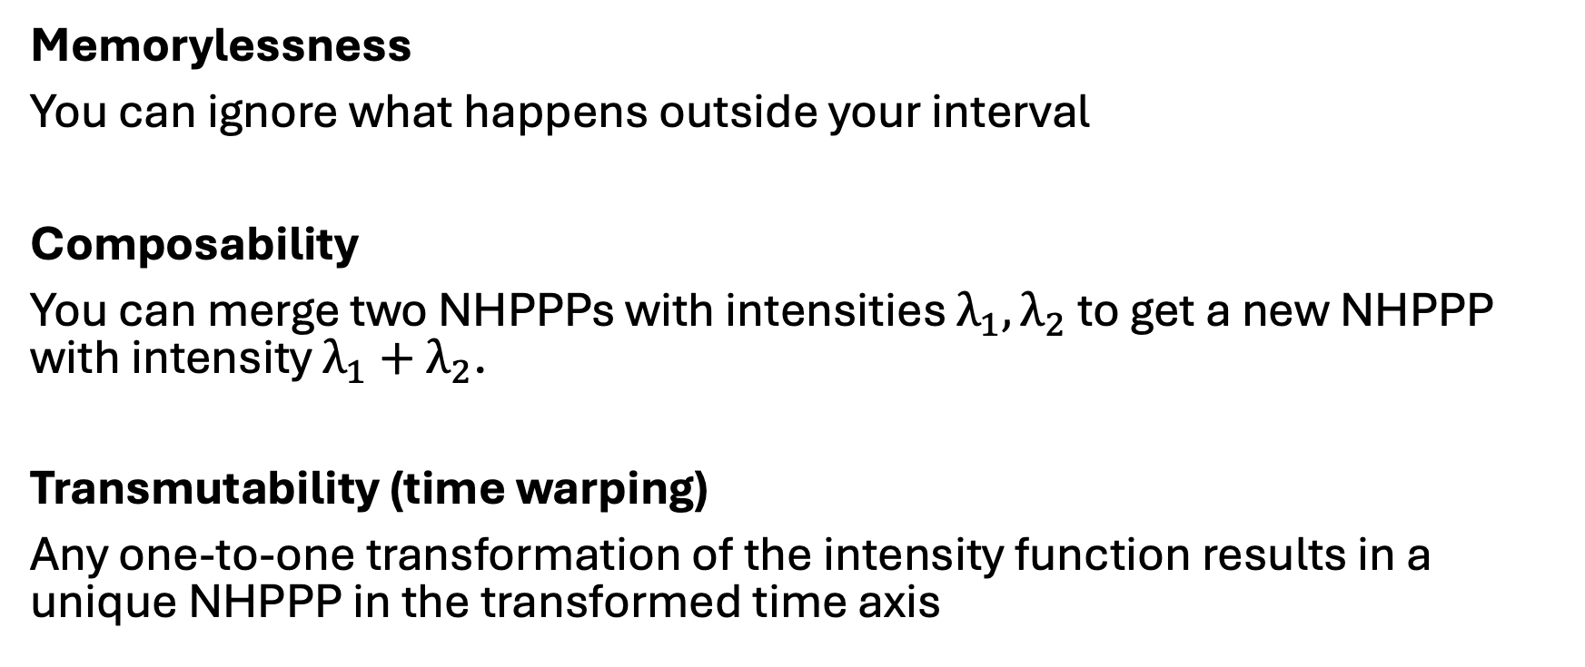
Three important properties for sampling
Memorylessness
You can ignore what happens outside your interval
Composability
You can merge two NHPPPs with intensities $λ_{1}, λ_{2}$ to get a new NHPPP with intensity $λ_{1}+λ_{2}$.
Transmutability (time warping)
Any one-to-one transformation of the intensity function results in a unique NHPPP in the transformed time axis

Slide 4
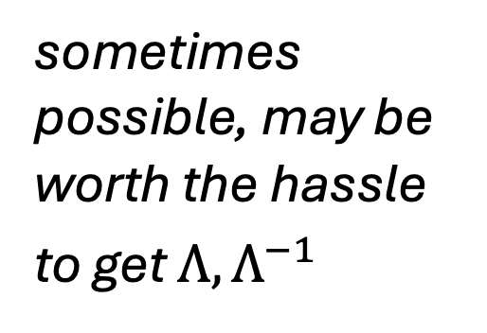
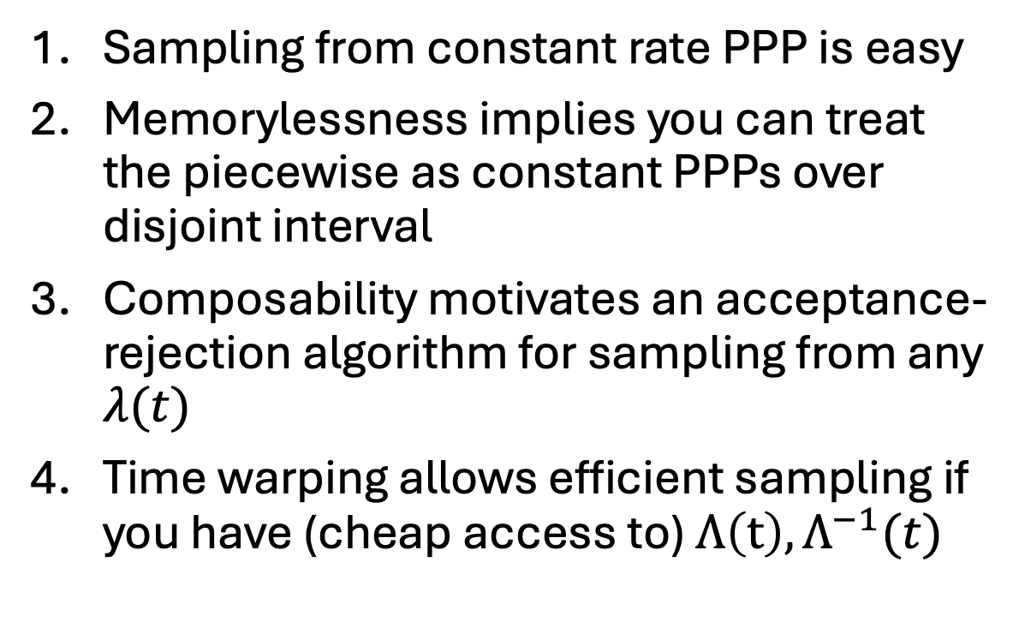
Overview of the sampling strategy
Sampling from constant rate PPP is easy
Memorylessness implies you can treat the piecewise as constant PPPs over disjoint interval
Composability motivates an acceptance-rejection algorithm for sampling from any $λ(t)$
Time warping allows efficient sampling if you have (cheap access to) $Λ\left(t\right), Λ^{−1}(t)$
easy
peasy
almost always practical
sometimes
possible, may be worth the hassle
to get $Λ, Λ^{−1}$

Slide 5
1. Sampling from a PPP is easy

Slide 6






Constant intensity function (homogeneous PPP)
Sampling from a constant intensity function is easy.
The interarrival times have an exponential distribution.
$λ$ constant
$$Z_{(i)}−Z_{\left(i−1\right)}\sim Exponential(λ)$$
$$Z_{(0)}$$
$$Z_{(1)}$$
$$Z_{(2)}$$
$$Z_{(4)}$$

Slide 7
2. Memorylessness: Sampling from piecewise constant NHPPP is peasy

Slide 8
Piecewise constant intensity function (NHPPP)
Look at each piecewise constant interval separately
In each interval you have a constant intensity (easy)
Return the union of all events
Sampling from piecewise constant intensities is easy (memorylessness)

Slide 9
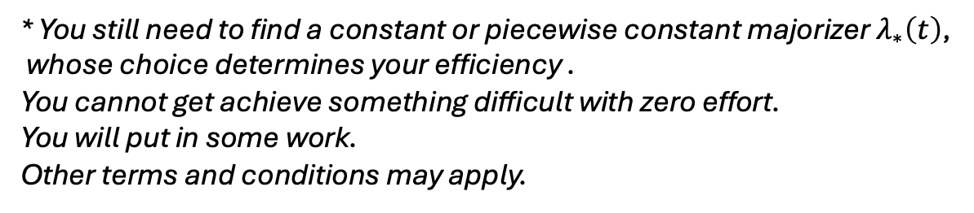
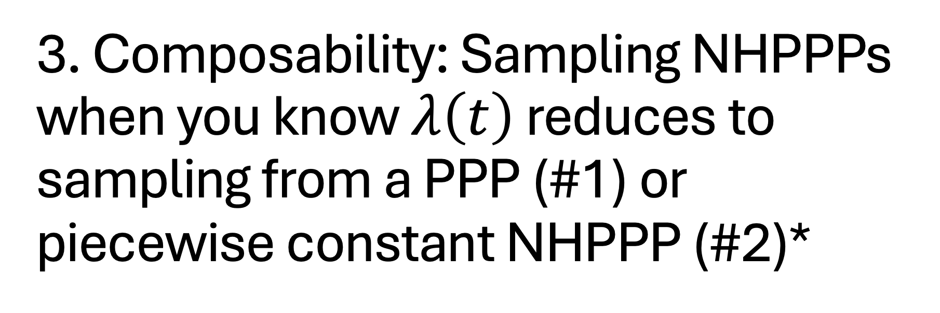
3. Composability: Sampling NHPPPs when you know $λ\left(t\right)$ reduces to sampling from a PPP (#1) or piecewise constant NHPPP (#2)*
* You still need to find a constant or piecewise constant majorizer $λ_{∗}\left(t\right)$, whose choice determines your efficiency .
You cannot get achieve something difficult with zero effort.
You will put in some work.
Other terms and conditions may apply.

Slide 10
Composability
+
=

Slide 11


NHPPP, where you know $λ\left(t\right)$ : Thinning
The general case is more challenging
$$λ\left(t\right)=e^{−1+0.5t}$$

Slide 12
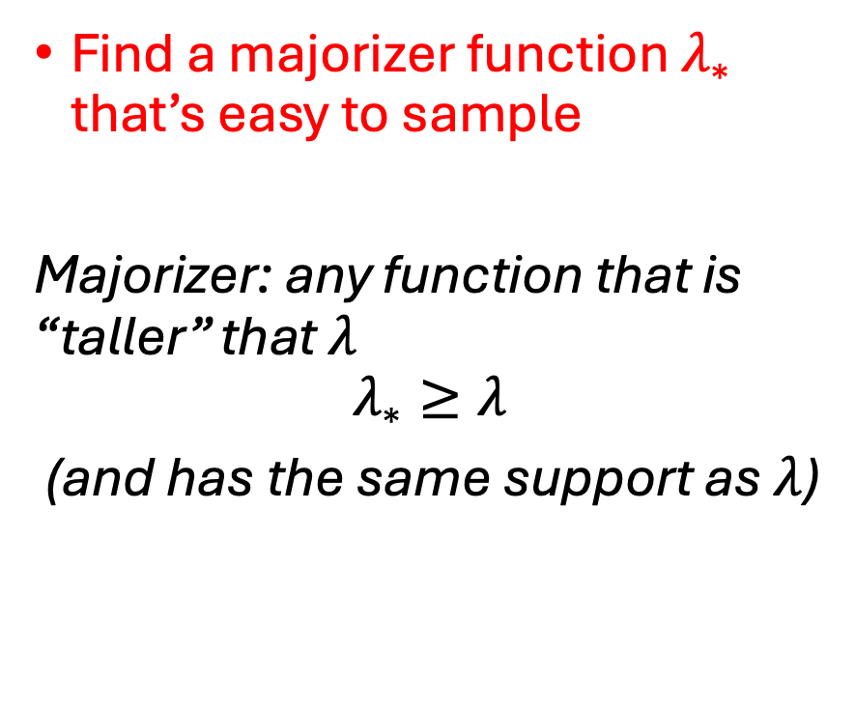

NHPPP, where you know $λ\left(t\right)$ : Thinning
Find a majorizer function $λ_{∗}$ that’s easy to sample
Majorizer: any function that is “taller” that $λ$
$$λ_{∗}≥λ$$
(and has the same support as $λ$)
$$λ_{∗}\left(t\right)=5$$
$$λ\left(t\right)=e^{−1+0.5t}$$

Slide 13

NHPPP, where you know $λ\left(t\right)$ : Thinning
Find a majorizer function $λ_{∗}$ that’s easy to sample
$$λ_{∗}\left(t\right)=λ\left(t\right)+ \left[λ_{∗}\left(t\right)−λ(t)\right]$$
$$λ_{∗}\left(t\right)=5$$
$$λ\left(t\right)=e^{−1+0.5t}$$
Sample proposals from here
Keep proposals conforming to this part
Reject the rest

Slide 14

NHPPP, where you know $λ\left(t\right)$ : Thinning
Find a majorizer function $λ_{∗}$ that’s easy to sample
Draw events $\left\{Z_{∗1},…\right\}$ from $λ_{∗}$

Slide 15


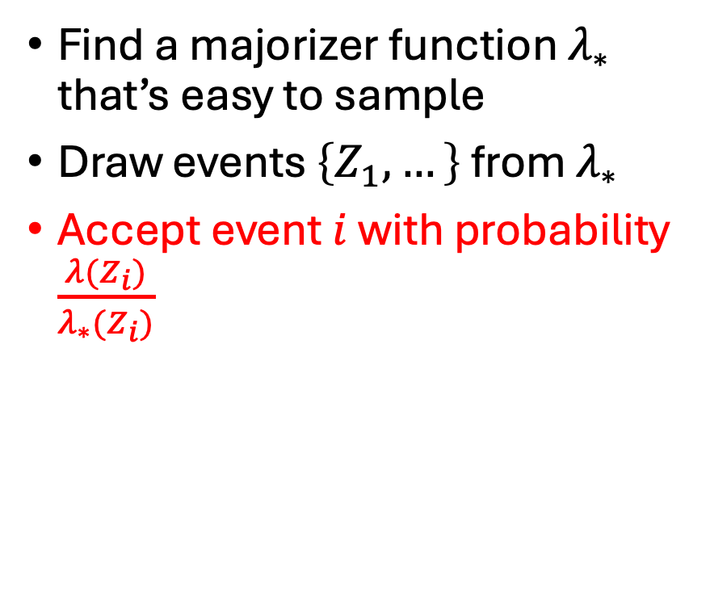
NHPPP, where you know $λ\left(t\right)$ : Thinning
Find a majorizer function $λ_{∗}$ that’s easy to sample
Draw events $\left\{Z_{1},…\right\}$ from $λ_{∗}$
Accept event $i$ with probability $\frac{λ(Z_{i})}{λ_{∗}(Z_{i})}$
$${λ_{∗}(Z}_{\left[1\right]})$$
$${λ(Z}_{\left[1\right]})$$

Slide 16
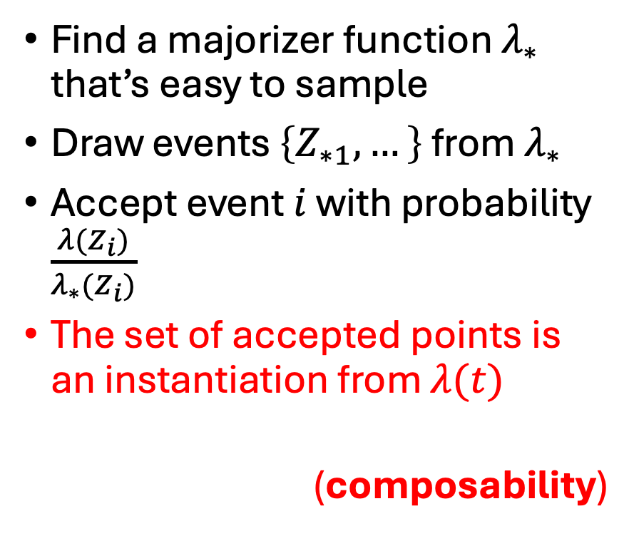

NHPPP, where you know $λ\left(t\right)$: Thinning
Find a majorizer function $λ_{∗}$ that’s easy to sample
Draw events $\left\{Z_{∗1},…\right\}$ from $λ_{∗}$
Accept event $i$ with probability $\frac{λ(Z_{i})}{λ_{∗}(Z_{i})}$
The set of accepted points is an instantiation from $λ(t)$
(composability)

Slide 17
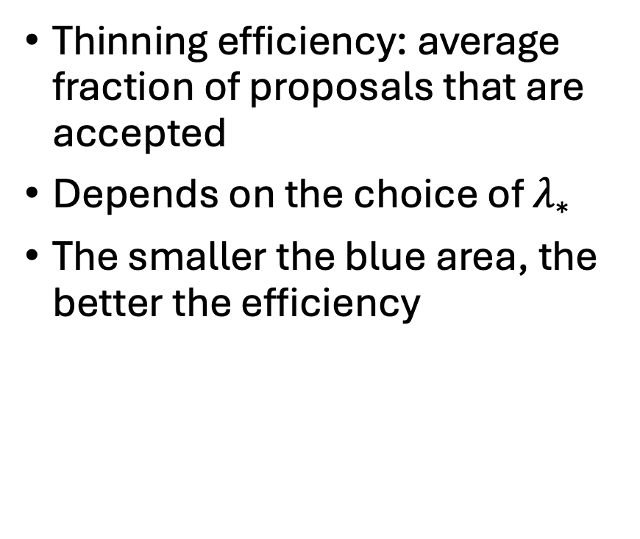
Thinning, efficiency
Thinning efficiency: average fraction of proposals that are accepted
Depends on the choice of $λ_{∗}$
The smaller the blue area, the better the efficiency
Efficiency = 32.9%

Slide 18
Thinning, efficiency
Thinning efficiency: average fraction of proposals that are accepted
Depends on the choice of $λ_{∗}$
The smaller the blue area, the better the efficiency
Efficiency = 36.7%

Slide 19
Thinning, efficiency
Thinning efficiency: average fraction of proposals that are accepted
Depends on the choice of $λ_{∗}$
The smaller the blue area, the better the efficiency
Efficiency = 78.7%

Slide 20
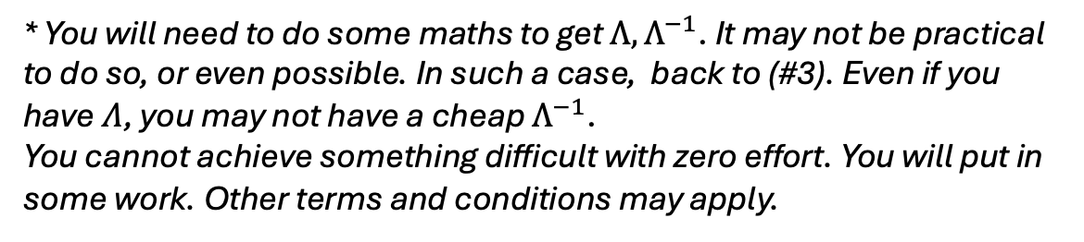
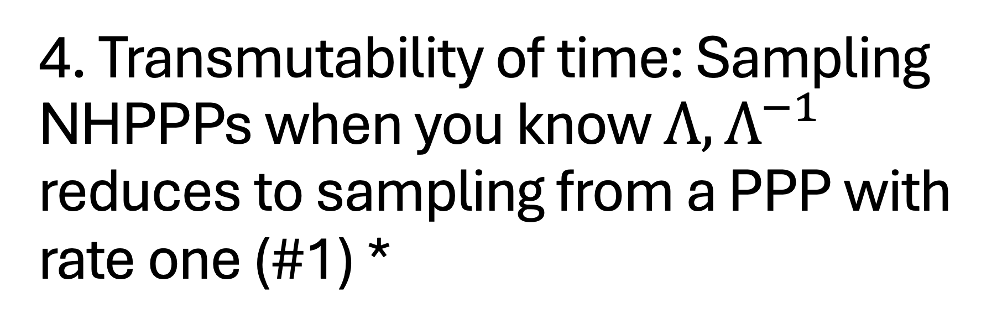
4. Transmutability of time: Sampling NHPPPs when you know $Λ, Λ^{−1}$ reduces to sampling from a PPP with rate one (#1) *
* You will need to do some maths to get $Λ,Λ^{−1}$. It may not be practical to do so, or even possible. In such a case, back to (#3). Even if you have $Λ$, you may not have a cheap $Λ^{−1}$. You cannot achieve something difficult with zero effort. You will put in some work. Other terms and conditions may apply.

Slide 21






Transmutability
$$u$$
$$u^{−1}$$
$$u(1)$$
$$u(2)$$
$$u(3)$$
$$u(3.5)$$

Slide 22
Transmutability
$$u$$
$$u^{−1}$$

Slide 23
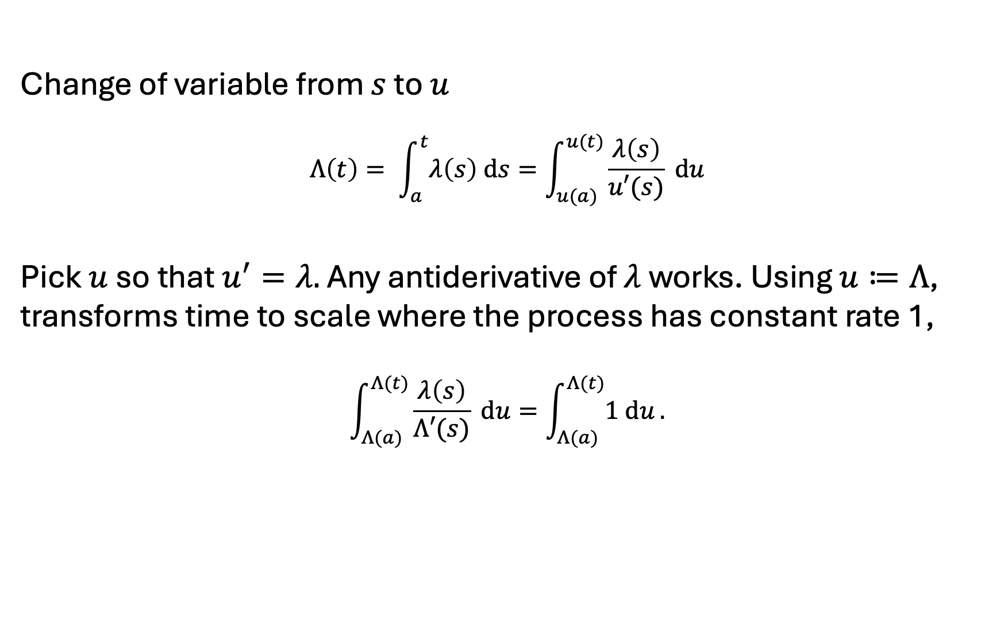

A nice $u$ is $Λ$ (and then $u^{−1}$ is $Λ^{−1}$)
Change of variable from $s$ to $u$
$$Λ\left(t\right)= \int_{a}^{t}{λ\left(s\right) ds}=\int_{u(a)}^{u(t)}{\frac{λ\left(s\right)}{u′(s)} du}$$
Pick $u$ so that $u^{′}=λ.$ Any antiderivative of $λ$ works. Using $u≔Λ$, transforms time to scale where the process has constant rate 1,
$$\int_{Λ(a)}^{Λ(t)}{\frac{λ\left(s\right)}{Λ′(s)} du=\int_{Λ(a)}^{Λ(t)}{1 du}.}$$
This is a sketch of the formal proof – omitting the rigorous bits

Slide 24
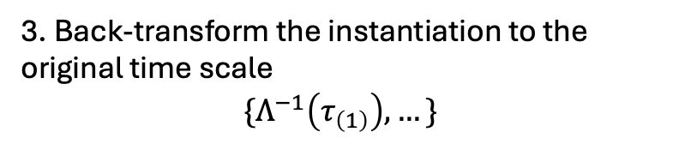

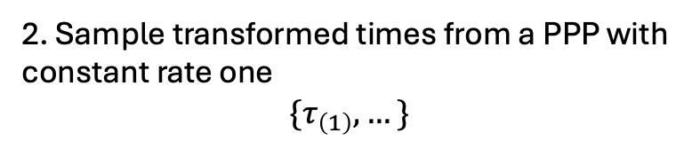

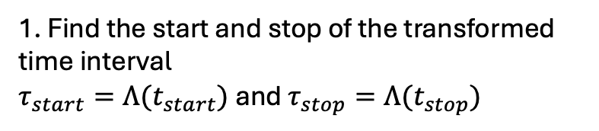
Transmutability
1. Find the start and stop of the transformed time interval
$τ_{start}=Λ(t_{start})$ and $τ_{stop}=Λ(t_{stop})$
$$Λ$$
2. Sample transformed times from a PPP with constant rate one
$$\{τ_{\left(1\right)}, …\}$$
3. Back-transform the instantiation to the original time scale
$$\{Λ^{−1}\left(τ_{\left(1\right)}\right),…\}$$
$$Λ^{−1}$$

Slide 25

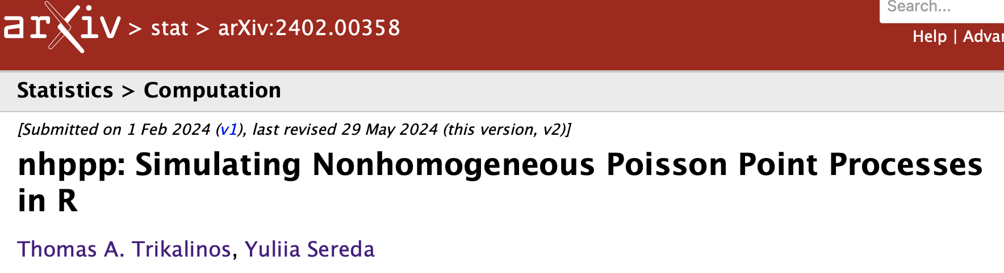


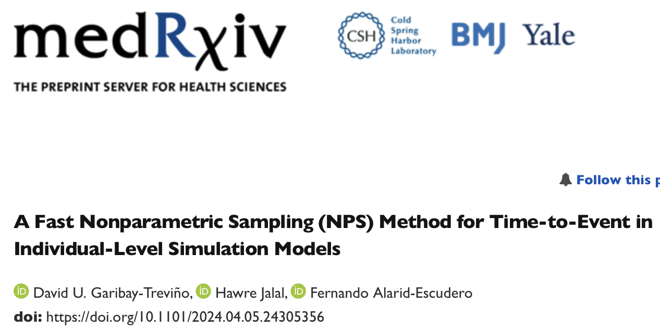

More in these works…

Slide 26
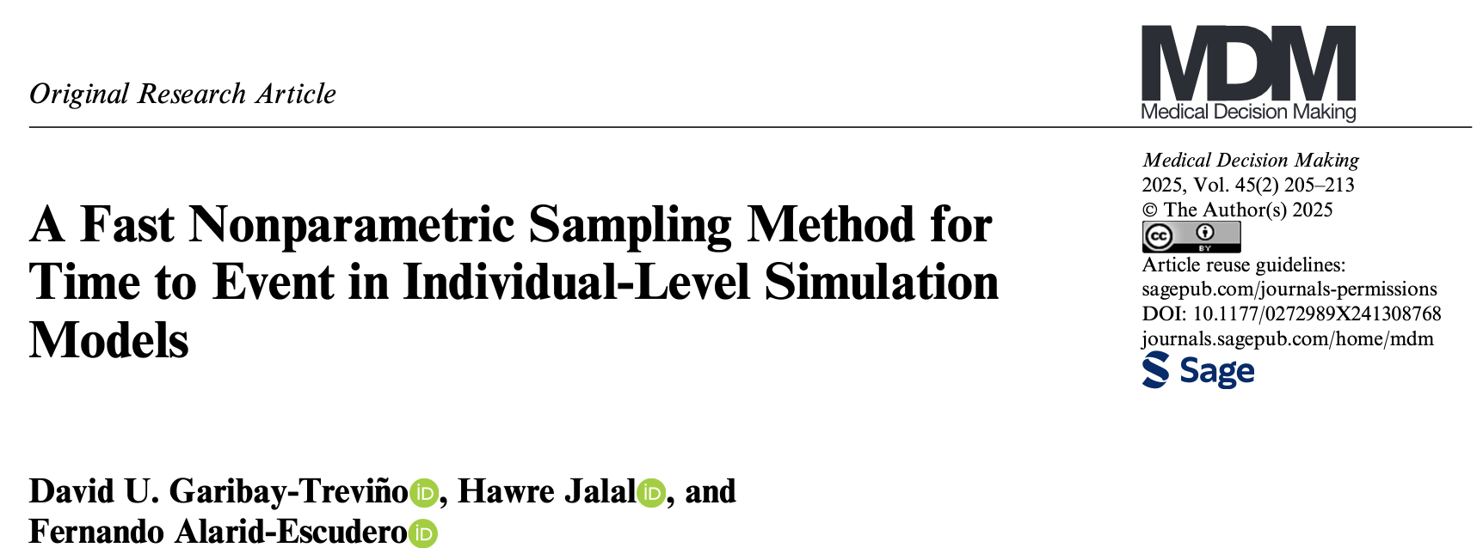

More in these works…

Slide 27
Next … Section 4: Hands-on example (simple case)

Slide 28
Sunday 15th of June, 9:00 to 12:30
Time | Description | Discussant
[15 min] | (0) Introductions and administrivia | Trikalinos
[25 min] | (1) DES as a composition of point processes | Alarid-Escudero
[30 min] | (2) NHPPPs – key properties | Trikalinos
[30 min] | (3) Sampling from NHPPPs | Sereda
[15 min] | Break
[80 min] | (4) Guided exercise: Implement a simple cancer natural history DES for one person The many-person case Packaging | [All] Chrysanthopoulou Sereda/Alarid-Escudero Trikalinos
[10 min] | (5) Advanced Topic Teaser on self-excitatory processes: point processes that are not NHPPPs and when you may need them | Trikalinos
[15 min] | General Q & A | All

