Slide 1
Advanced Discrete Event Simulation in R
TA Trikalinos, F Alarid-Escudero, Y Sereda, SA Chrysanthopoulou
SMDM 2026 (Oslo, Norway)

Slide 2
Disclosures
We have no financial or other conflicts to declare
Supported by the NCI CISNET Incubator and CISNET programs:
All by U01 CA265750-02 (CISNET bladder cancer)
Alarid-Escudero also by U01 CA265729 (CISNET gastric cancer); and U01 CA253913 (colorectal cancer)
Trikalinos and Sereda developed and maintain the nhppp R package

Slide 3
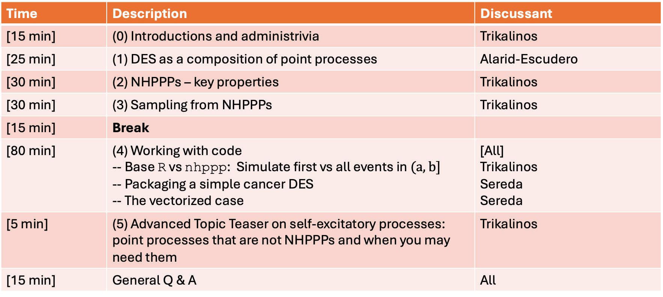
Sunday 28th of June, 8:35 to 12:00
Time | Description | Discussant
[15 min] | (0) Introductions and administrivia | Trikalinos
[25 min] | (1) DES as a composition of point processes | Alarid-Escudero
[30 min] | (2) NHPPPs – key properties | Trikalinos
[30 min] | (3) Sampling from NHPPPs | Trikalinos
[15 min] | Break
[80 min] | (4) Working with code -- Base R vs nhppp: Simulate first vs all events in $(a,b]$ -- Packaging a simple cancer DES -- The vectorized case | [All] Trikalinos Sereda Sereda
[5 min] | (5) Advanced Topic Teaser on self-excitatory processes: point processes that are not NHPPPs and when you may need them | Trikalinos
[15 min] | General Q & A | All

Slide 4
Administrivia
Professional conduct
https://smdm.org/hub/page/smdm-conduct-policy
Bathroom locations
WiFi (strip the quotation marks; keep whitespace in password)
SSID: “conferences”
Password: “Leonhard Euler”
Format of the course

Slide 5
For the hands-on part,
You need R, preferably with an IDE such as R Studio.
Install packages data.table and nhppp (>=1.0.0). To install them from CRAN,
> install.packages("data.table")
> install.packages("nhppp")
All materials are available at
Through this Dropbox link (full link in the email) through 28/07/2026. Password "smdm_oslo",
https://github.com/ttrikalin/des-R-course
(smdm_2026 release)

Slide 6
Learning objectives
Be able to discuss:
How a basic DES is organized
Three properties of NHPPPs (memorylessness, composability, and transmutation by transforming the time axis) that are important for simulation
Sampling algorithms and their use via R’s nhppp package

