Slide 1
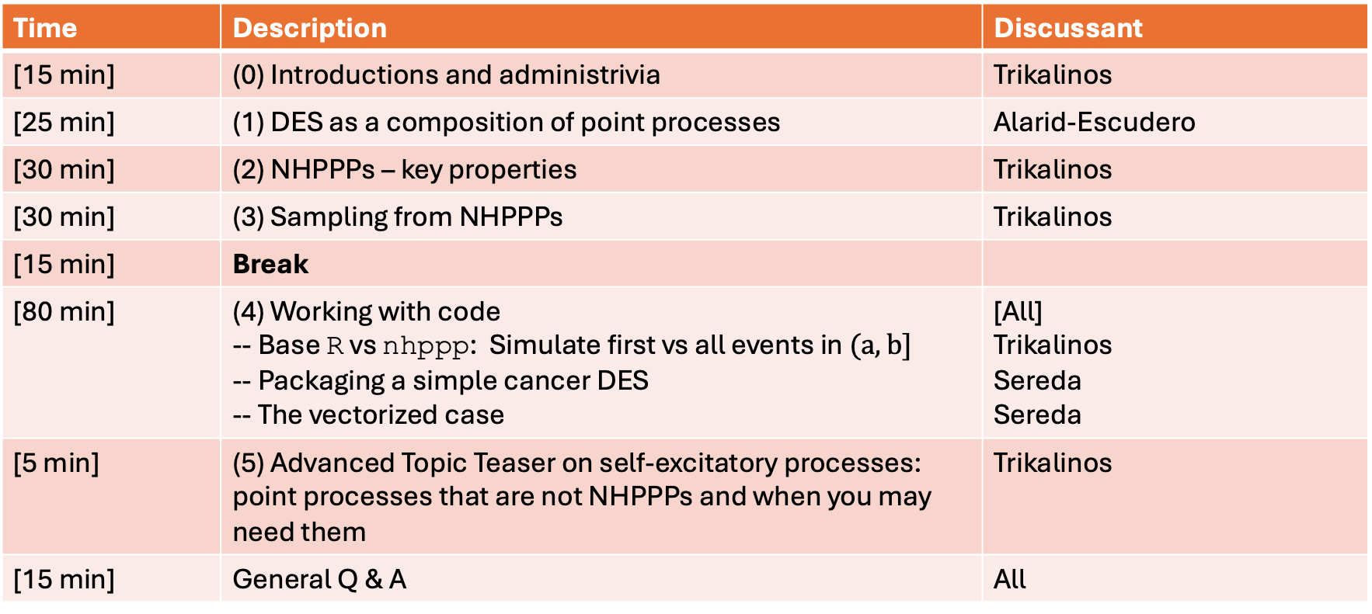
Sunday 28th of June, 8:35 to 12:00
Time | Description | Discussant
[15 min] | (0) Introductions and administrivia | Trikalinos
[25 min] | (1) DES as a composition of point processes | Alarid-Escudero
[30 min] | (2) NHPPPs – key properties | Trikalinos
[30 min] | (3) Sampling from NHPPPs | Trikalinos
[15 min] | Break
[80 min] | (4) Working with code -- Base R vs nhppp: Simulate first vs all events in $(a,b]$ -- Packaging a simple cancer DES -- The vectorized case | [All] Trikalinos Sereda Sereda
[5 min] | (5) Advanced Topic Teaser on self-excitatory processes: point processes that are not NHPPPs and when you may need them | Trikalinos
[15 min] | General Q & A | All

Slide 2
Section 4: Simple DES (in code)

Slide 3
Next … Section 5: Processes that are not NHPPPs

Slide 4
Sunday 28th of June, 8:35 to 12:00
Time | Description | Discussant
[15 min] | (0) Introductions and administrivia | Trikalinos
[25 min] | (1) DES as a composition of point processes | Alarid-Escudero
[30 min] | (2) NHPPPs – key properties | Trikalinos
[30 min] | (3) Sampling from NHPPPs | Trikalinos
[15 min] | Break
[80 min] | (4) Working with code -- Base R vs nhppp: Simulate first vs all events in $(a,b]$ -- Packaging a simple cancer DES -- The vectorized case | [All] Trikalinos Sereda Sereda
[5 min] | (5) Advanced Topic Teaser on self-excitatory processes: point processes that are not NHPPPs and when you may need them | Trikalinos
[15 min] | General Q & A | All

