Slide 1
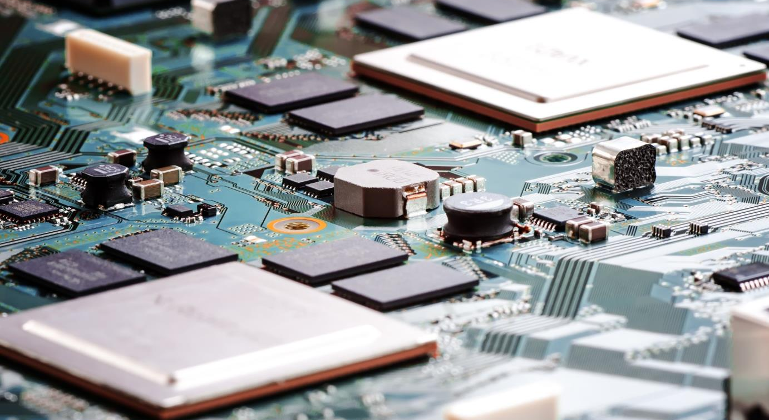
26G MENTOR-MENTEE
Midterm presentation
dec 2017 – dec 2019
Mentee: Hieu tran (2040)
Mentor: phuong nguyen (1632)
WeDnesday, Dec 19, 2018
Tool development 2 team
Broad base tool 2 group
Software engineering department
Renesas design vietnam co., ltd.
Renesas Electronics Corporation

Slide 2
Agenda
Training target - Result Page 03
Activities - Achivements Page 05
Plan Page 07
Commitment Page 08

Slide 3
Training target - result (1/2) 26g mentor – mentee training plan
Training target – result(1/2)
Activities – Achivements
Issues - countermeasure
Plan
Commitment
Achieve “Software Design Engineer” with role level 2 by Dec, 2019
⇨ Do IDE Design Task without support, if it is within certain degree of difficult.
Role | Skill | Description | Target Level | Current Status | Current level
Engineer for software design | Software Functional Design | Decide the structure of software according to given software requirement definitions. | 2 | Can create Function spec base on the requirement with support | 1.5
 | Software Detailed Design | Conduct a detailed software design according to given software structure definitions. | 2 | Can create Detail spec base on the Function spec with support | 1.5
Coding engineer (Software) | Software Coding | Have sufficient knowledge of programming language and create a program based on the detail design document. Conduct a code review of created code. | 2 | Can do coding for new feature and fixing bug with support | 1.5
 | Readability | Have knowledge of techniques for improving the source code readability and perform coding accordingly. | 2 | Source code follows the coding rules, coding style and be easy for read and maintenance | 1.5

Slide 4
Training target - result (2/2) 26g mentor – mentee training plan
Training target – result(2/2)
Activities – Achivements
Issues - countermeasure
Plan
Commitment
Achieve “Software Design Engineer” with role level 2 by Dec, 2019
⇨ Do IDE Design Task without support, if it is within certain degree of difficult.
Skill | Target | Current
Development Process | Know and can follow Development process. Can evaluate the results to find and improve weak phase of the process. | Understand and can follow Development process. Can evaluate the results to find weak and improve it.
Communication skill | Can express idea to others. Can report status/issues/solutions to teammates. | Can report and express ideas to teammates
Management Ability | Can schedule works and follow the schedule. Can manage common risk for assigned tasks: private issues (health,…), technical issues (lack of experience in assigned fields),… | Can self-managed works and schedule, also common risk for assigned tasks
English | TOEIC 750 | Basically, There is no TOEIC certification

Slide 5
Activities - achievements (1/2) 26g mentor – mentee training plan
Training target - result
Activities – Achivements(1/2)
Issues - countermeasure
Plan
Commitment
Skill | Mentor’s Action | Mentee’s Action | Achievements
Software Functional Design | Provide input documents, confirm understanding of Mentee. Follow progress, give feedback/direction | Investigate existing requirement and F.D document to know the relationship between them. Confirm with Mentor about unclear points to understand F.D document clearly. Refer to writing style of existed document | Can create Function spec base on requirement with support from Mentor Product: Measuring Consumption Current, Trace, Memory Usage
Software Detailed Design | Share design tips, techniques. Follow progress, give feedback & direction | Investigate existing F.D and D.D document to know the relationship between them. Investigate work flow and design structure and internal processing flow base on request Create Detail spec base on existing source code | Can create DS base on FS Create and update DS for bug fixing of Trace, Measuring Consumption Current, Memory Usage, ADM
Software Coding & Readability | Provide prototype, sample implementation, coding style & coding rules guideline. Follow progress, give feedback & direction | Do coding for e2 studio’s components by following Design document from simple to complex tasks Apply coding rule, coding style for source code. All new source code had comments for maintenance Using some tools which can check coding rule to check the source code | Can do coding base on Design document Can analyze source code to find and fix bugs Product: Trace, Memory Usage, Measuring Consumption Current.

Slide 6
Activities - achievements (2/2) 26g mentor – mentee training plan
Training target - result
Activities – Achivements(2/2)
Issues - countermeasure
Plan
Commitment
Common Skills | Mentor’s Action | Mentee’s Action | Achievements
Development Process | Share tips and experience Give direction, tips and document source. Check output and give feedback | Investigate Development process to understand its role and follow it. Plan for each development before starting Express issue about process in daily meeting to get advice from mentor/supporter | Can understand and apply Development Process to real task Can analyze the result to find out issue of development to improve in other development
Communication skill |  | Confirm with Mentor/supporter before sending email to customer Express task and issue in daily meeting | Can discuss and confirm with customer about requirement via email and F2F meeting
Management Ability |  | Make plan of tasks, confirm it to Mentor and modify it from feedback. Make list of risk, find solution if risk occurs, show list to Mentor and modify from feedback | Can self-manage task with support and improve it through review or comments from mentor.
English |  | Improve English in output (FS, DS, email, meeting,…) | Can create documents/ meeting note and discuss requirement with customer by English

Slide 7
Issues - countermeasure (1/1) 26g mentor – mentee training plan
Training target - result
Activities – Achivements(2/2)
Issues - countermeasure(1/1)
Plan
Commitment
Issue | Root causes | Countermeasure
 |  | Mentee | Mentor
It’s difficult and takes many times to develop a new feature from design to code to test phase and present it to customer | Lack of experience and user viewpoint for design phase. | Confirm expectation of plugin with Mentor/REL. Analyze the requirement and refer other features. Create document to confirm spec with mentor. | Explain to make clear requirement to adapt user viewpoint Give the ideas/comments after checking documents of mentee.

Slide 8
Plan (1/1) 26g mentor – mentee training plan
Training target – result
Activities – Achivements
Plan(1/1)
Issues - countermeasure
Commitment
1.5
2
Level
Role & Skill Evaluation
1.5
2
2
Software Functional Design
Software Detailed Design
Software coding
Readability
Common skills
Dec 18
May 19
Jul 19
Dec 19

Slide 9
COMMITMENT(1/1) 26g mentor – mentee training plan
Training target – result
Activities – Achivements
Plan
Issues - countermeasure
Commitment(1/1)
By Dec 2019, I will achieve “Software Design Engineer” level 2.
For technical skills:
I can do IDE design task for all phase (F.D, D.D, C.D, U.T.P, U.T, I.T.P, I.T) without help from my Mentor.
All output documents (F.S, D.S, T.S) will follow document templates and can be used to refer in the next phases.
For common skills:
I can understand and follow Development Process.
I can express ideas, status, issues with other well.
I can manage all common risks for my task.
TOEIC 750.

Slide 10
Thank you for your attention!

