Slide 1

A study on the prediction of Asian’s demography using deep neural network
Defense for Master of Science
School of Electrical Engineering and Computer Science
Tran Trung Tin / 20194070 / Advisor: Prof. Moongu Jeon
Template from Yechan Kim
Notes:
Hello, I am Yechan Kim. I really appreciate you for judging my thesis defense.
Now I will give you a presentation for my thesis defense.
The topic is [].

Slide 2
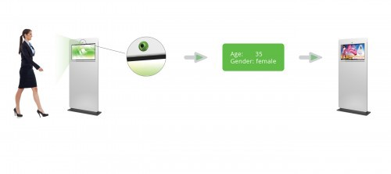
I. Introduction
Age and Gender are two important key features on human face.
Combine with a face detection system, Age & Gender prediction has some applications such as recommendation system or human-computer interaction.
With the help of convolutional neural network, and public large-scale face dataset, the Age & Gender prediction accuracy improve significantly.
Source: https://www.kiwi-digital.com/produkty/age-gender-detection
Notes:
In fact, many real world datasets suffer form imbalanced class distributions like the below fig. And these distributions largely limit the capacity of the DNN models in terms of generalization.

Slide 3
I. Introduction – Problem 1
Recent large-scale public datasets for Face detection and Age, Gender prediction are available. Such as:
IMDB (~460.000 images).
Wiki (~62.000 images).
CACD, Cross age celebrity data (~163.000 images).
UTKFace, Facial, FG-NET.
All mentioned datasets above are mixed of all human facial characteristic from different country (e.g. America, Europe, Asia,...)
Notes:
In fact, many real world datasets suffer form imbalanced class distributions like the below fig. And these distributions largely limit the capacity of the DNN models in terms of generalization.

Slide 4
I. Introduction – Problem 1
Two datasets available for Asian (mostly Chinese):
AFAD, Asian Face Age (~165.000 images).
AAF, All Age Face (~13.000 images).
→ Problem 1: Lack of method that focused on predicting Age & Gender from Asian’s face characteristic.
Notes:
In fact, many real world datasets suffer form imbalanced class distributions like the below fig. And these distributions largely limit the capacity of the DNN models in terms of generalization.

Slide 5
I. Introduction – Problem 2
Most of applications using Age & Gender prediction tent to be used on small and handheld device such as:
A Raspberry Pi board embedded with a screen at the entrance to detect and predict user Age & Gender for content recommendation.
A fun Age prediction app on mobile using on-device resourses to process instead of server for privacy concern.
Hence, using a bulky model like FaceNet (~140M params) or VGG16 (~138M params) is not ideal on such devices.
→ Problem 2: Having a light-weight model that useable on small devices.
Notes:
In fact, many real world datasets suffer form imbalanced class distributions like the below fig. And these distributions largely limit the capacity of the DNN models in terms of generalization.

Slide 6
I. Introduction – Contribution
(I) Proposed a light-weight model for Age & Gender prediction trained on Asian’s face specifically.
(II) Making a study to improve the real Age prediction accuracy by proposed a Soft-label Representation of Age mechanism.
Notes:
To solve this issue, there are several research lines for imbalanced recognition. I’ll introduce each research line in brief.
One of the easiest way is “Data Re-sampling.” The goal of re-sampling is to restore the true distributions from the imbalanced training data by under-sampling (like this 포인터) or over-sampling (like this 포인터).
Also we can also consider “cost-sensitive learning” where the goal is to assign a weight to the loss of each class. For example, to make each gradient for each category be equal, we can reweight class-wise loss by inverse class frequency.
These A and B are traditional methods used for imbalanced learning since the past.

Slide 7
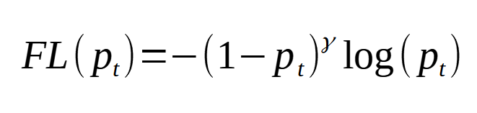
II. Related methods – Focal Loss
Proposed by Lin et al. [12] in 2018.
This loss designed to address class imbalance during training tasks e.g. object classification.
Focal loss add a modulating factor to cross entropy loss. With as a tunable focusing parameter which reduce the relative loss from well-classified examples . The loss defined as:
${\left(1−p_{t}\right)}^{γ}$
$γ≥0$
$\left(p_{t}>0.5\right)$
[12] T. Lin, P. Goyal, R. B. Girshick, K. He, and P. Doll ́ar, “Focal loss for dense object detection,” CoRR, vol. abs/1708.02002, 2017.
Notes:
To solve this issue, there are several research lines for imbalanced recognition. I’ll introduce each research line in brief.
One of the easiest way is “Data Re-sampling.” The goal of re-sampling is to restore the true distributions from the imbalanced training data by under-sampling (like this 포인터) or over-sampling (like this 포인터).
Also we can also consider “cost-sensitive learning” where the goal is to assign a weight to the loss of each class. For example, to make each gradient for each category be equal, we can reweight class-wise loss by inverse class frequency.
These A and B are traditional methods used for imbalanced learning since the past.

Slide 8
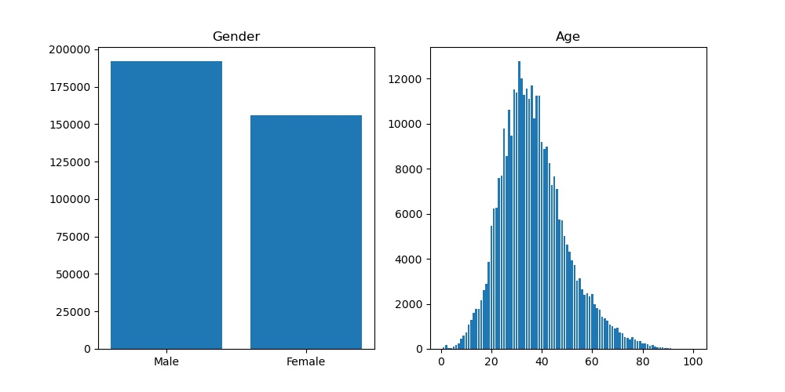
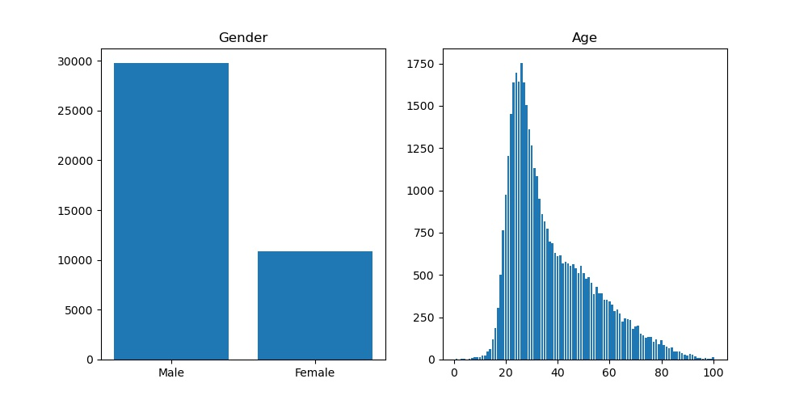
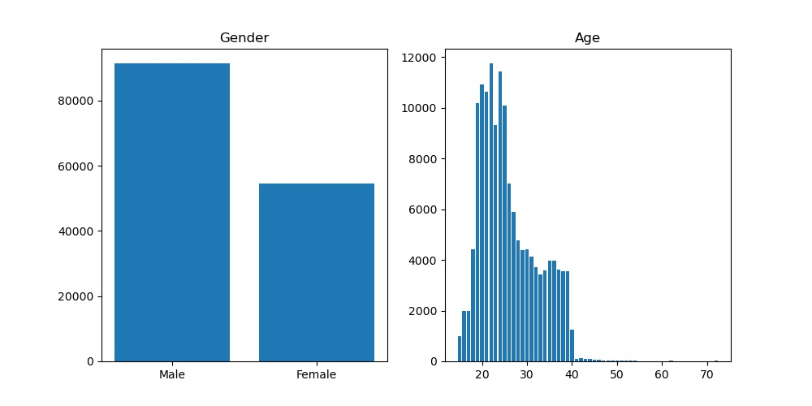
II. Related methods – Why Focal Loss ?
Since most of the available dataset for Age & Gender prediction are having one similar problem: Skew to the younger age.
IMDB
WIKI
AFAD
Notes:
To solve this issue, there are several research lines for imbalanced recognition. I’ll introduce each research line in brief.
One of the easiest way is “Data Re-sampling.” The goal of re-sampling is to restore the true distributions from the imbalanced training data by under-sampling (like this 포인터) or over-sampling (like this 포인터).
Also we can also consider “cost-sensitive learning” where the goal is to assign a weight to the loss of each class. For example, to make each gradient for each category be equal, we can reweight class-wise loss by inverse class frequency.
These A and B are traditional methods used for imbalanced learning since the past.

Slide 9
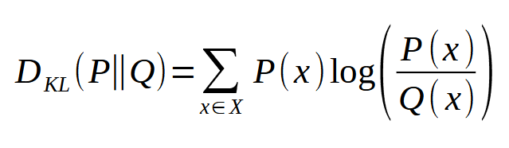
II. Related methods – Kullback-Leibler (KL) Divergence
Measure for the differences between two probability distribution.
KL-Divergence is defined as:
With is true distribution and is predicted distribution in space .
$P\left(X\right)$
$Q\left(X\right)$
$X$
Notes:
Recently, researchers tried to solve the issue of imbalanced class distribution by meta-learning.
Meta-learning has two subcategories called metric learning and knowledge distillation.
Metric Learning is to facilitate the model to better discriminate features by trying to increase the distance between non-related categories while reduce the distance between similar categories during training.
This method is widely used on the face recognition task or binary classification task.
And knowledge distillation tries to teach the smaller version of the original network. It might be useful because in general, the smaller network tends to be less over-fit to training dataset.

Slide 10
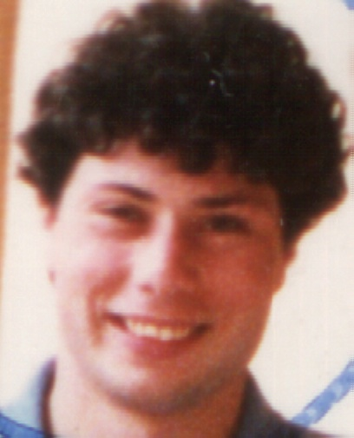
III. Methodology – Soft-label Represenation of Age
Age : 22
Guessing: maybe around 20-25 ?
Notes:
Recently, researchers tried to solve the issue of imbalanced class distribution by meta-learning.
Meta-learning has two subcategories called metric learning and knowledge distillation.
Metric Learning is to facilitate the model to better discriminate features by trying to increase the distance between non-related categories while reduce the distance between similar categories during training.
This method is widely used on the face recognition task or binary classification task.
And knowledge distillation tries to teach the smaller version of the original network. It might be useful because in general, the smaller network tends to be less over-fit to training dataset.

Slide 11
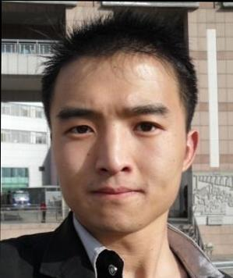
III. Methodology – Soft-label Represenation of Age
The regression label (real-age) will be presented as a convex shape with highest probability at the truth label and lower in both size with a gap value.
1 | 0
... | 0
20 | 0.33
21 | 0.66
22 | 0.99
23 | 0.66
24 | 0.33
... | 0
100 | 0
Real Age: 22
gap = 3
Notes:
Recently, researchers tried to solve the issue of imbalanced class distribution by meta-learning.
Meta-learning has two subcategories called metric learning and knowledge distillation.
Metric Learning is to facilitate the model to better discriminate features by trying to increase the distance between non-related categories while reduce the distance between similar categories during training.
This method is widely used on the face recognition task or binary classification task.
And knowledge distillation tries to teach the smaller version of the original network. It might be useful because in general, the smaller network tends to be less over-fit to training dataset.

Slide 12
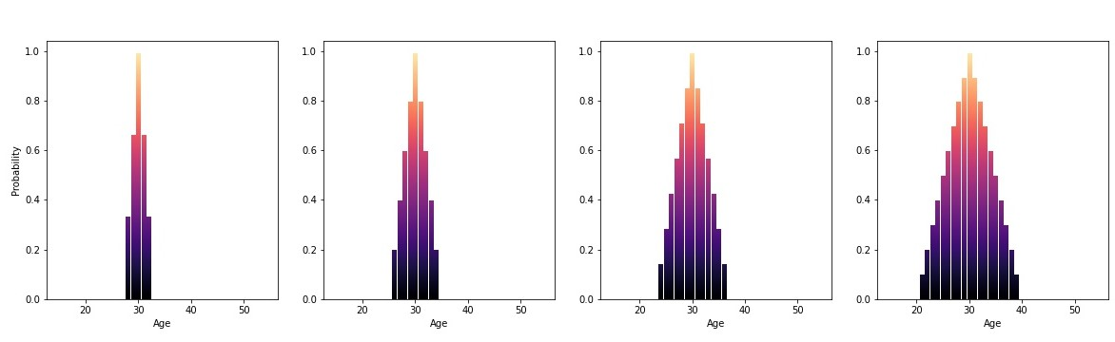
III. Methodology – Soft-label Represenation of Age
Probability change with different gap values (3, 5, 7, 10 respectively), age = 30
Notes:
Recently, researchers tried to solve the issue of imbalanced class distribution by meta-learning.
Meta-learning has two subcategories called metric learning and knowledge distillation.
Metric Learning is to facilitate the model to better discriminate features by trying to increase the distance between non-related categories while reduce the distance between similar categories during training.
This method is widely used on the face recognition task or binary classification task.
And knowledge distillation tries to teach the smaller version of the original network. It might be useful because in general, the smaller network tends to be less over-fit to training dataset.

Slide 13
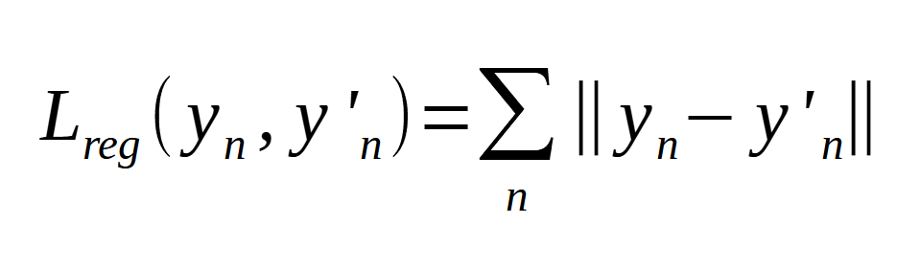
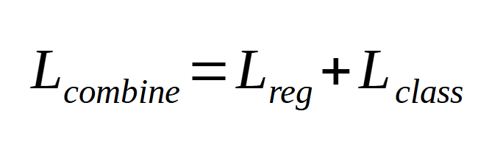
III. Methodology – Combine Classification and Regression
From the above mechanism, a cascade style of training also implemented.
With classification label, Focal Loss and KL-Divergence Loss will be applied.
With regression label, used Mean Absolute Error (MAE Loss). Defined as:
In training process, two losses will be combined as a total loss:
Notes:
To solve this issue, there are several research lines for imbalanced recognition. I’ll introduce each research line in brief.
One of the easiest way is “Data Re-sampling.” The goal of re-sampling is to restore the true distributions from the imbalanced training data by under-sampling (like this 포인터) or over-sampling (like this 포인터).
Also we can also consider “cost-sensitive learning” where the goal is to assign a weight to the loss of each class. For example, to make each gradient for each category be equal, we can reweight class-wise loss by inverse class frequency.
These A and B are traditional methods used for imbalanced learning since the past.

Slide 14

III. Methodology – Base CNN
Gender Output
Male
160 x 160 x 3
Conv
(3x3x32)
ReLU
Batch Norm
Flatten
Age Classification
Dense (10)
Age Regression
29
Notes:
To solve this issue, there are several research lines for imbalanced recognition. I’ll introduce each research line in brief.
One of the easiest way is “Data Re-sampling.” The goal of re-sampling is to restore the true distributions from the imbalanced training data by under-sampling (like this 포인터) or over-sampling (like this 포인터).
Also we can also consider “cost-sensitive learning” where the goal is to assign a weight to the loss of each class. For example, to make each gradient for each category be equal, we can reweight class-wise loss by inverse class frequency.
These A and B are traditional methods used for imbalanced learning since the past.

Slide 15
III. Methodology – Deeper CNN (D-CNN)
160 x 160 x 3
Conv
(3x3x32)
Batch Norm
ReLU
Conv
(1x1x32)
ReLU
Avg Pooling
Batch Norm
Max Pooling
Flatten
Age Regression
Age Classification
Dropout - BN
Dense (64)
Dropout - BN
29
Dense (1024)
Gender Output
Male
Notes:
To solve this issue, there are several research lines for imbalanced recognition. I’ll introduce each research line in brief.
One of the easiest way is “Data Re-sampling.” The goal of re-sampling is to restore the true distributions from the imbalanced training data by under-sampling (like this 포인터) or over-sampling (like this 포인터).
Also we can also consider “cost-sensitive learning” where the goal is to assign a weight to the loss of each class. For example, to make each gradient for each category be equal, we can reweight class-wise loss by inverse class frequency.
These A and B are traditional methods used for imbalanced learning since the past.

Slide 16
III. Methodology – Multiple Input CNN (M-CNN)
CNN Block
Conv
(3x3x32)
ReLU
Batch Norm
Conv
(1x1x32)
ReLU
Avg Pooling
Batch Norm
Max Pooling
Flatten
64 x 64 x 3
CNN BLock
64 x 64 x 3
CNN BLock
Concatenate Extracted Features
Age Classification
Age Regression
29
64 x 64 x 3
CNN BLock
Gender Output
Male
Notes:
To solve this issue, there are several research lines for imbalanced recognition. I’ll introduce each research line in brief.
One of the easiest way is “Data Re-sampling.” The goal of re-sampling is to restore the true distributions from the imbalanced training data by under-sampling (like this 포인터) or over-sampling (like this 포인터).
Also we can also consider “cost-sensitive learning” where the goal is to assign a weight to the loss of each class. For example, to make each gradient for each category be equal, we can reweight class-wise loss by inverse class frequency.
These A and B are traditional methods used for imbalanced learning since the past.

Slide 17
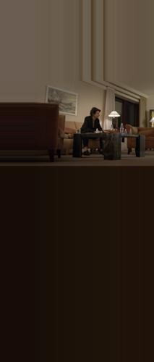
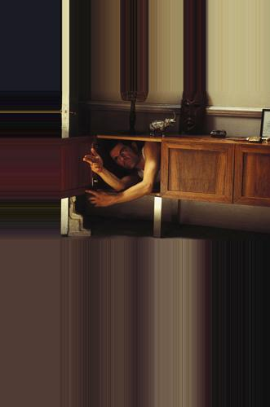
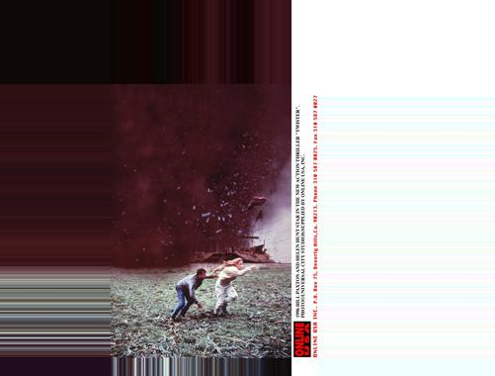
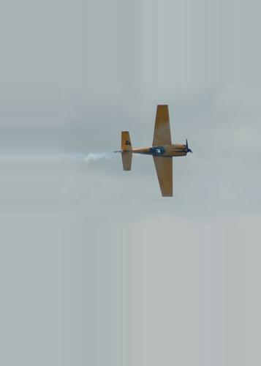

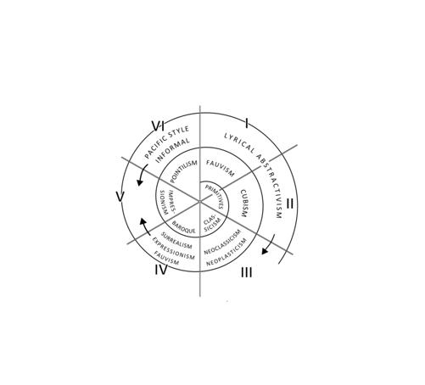
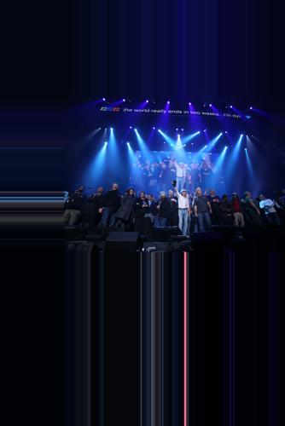
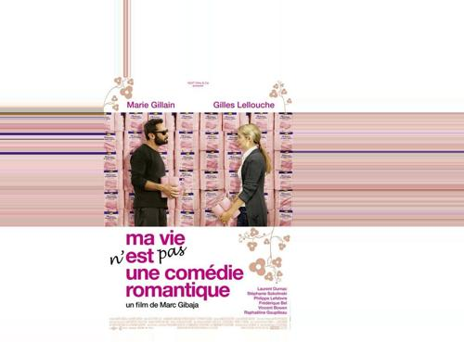
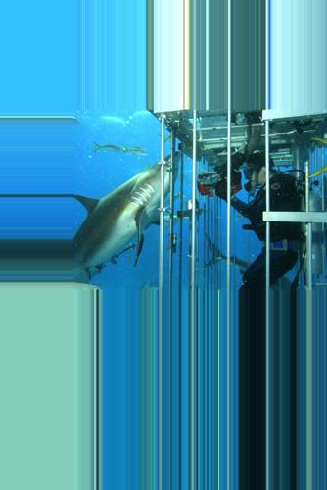
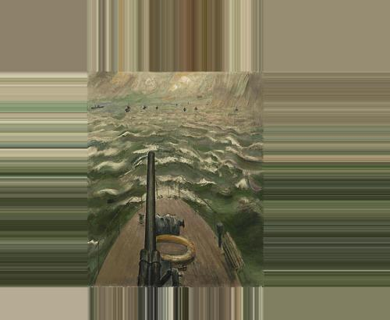
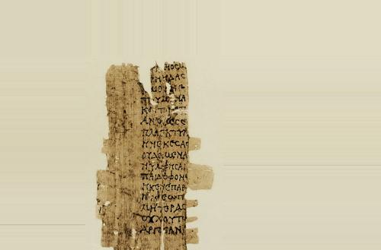
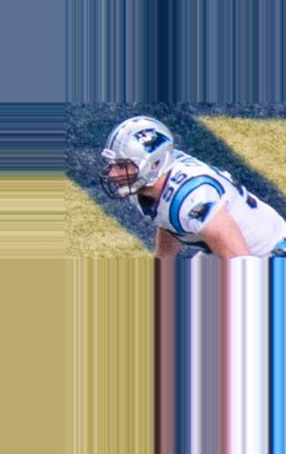

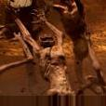
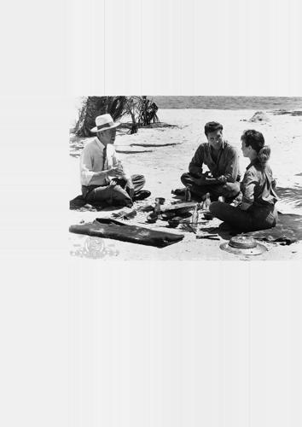
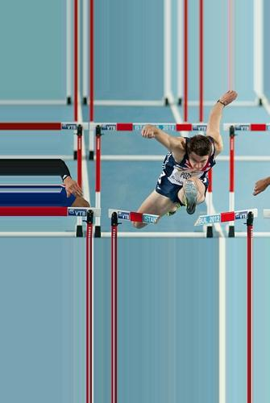
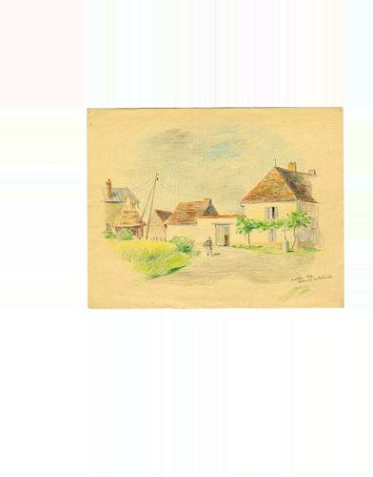
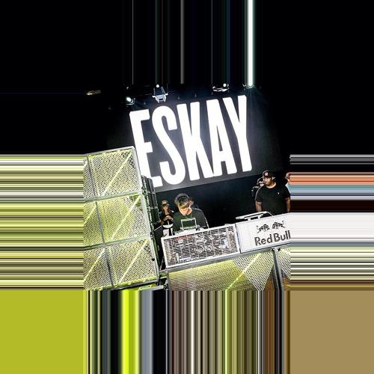
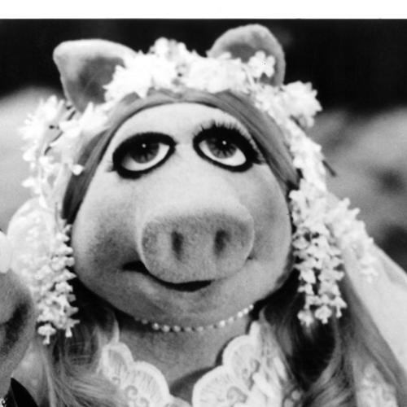

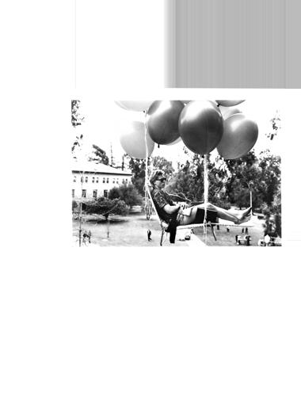
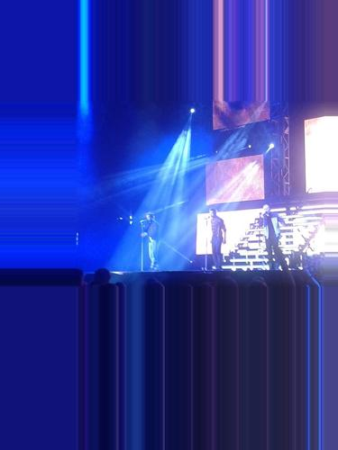
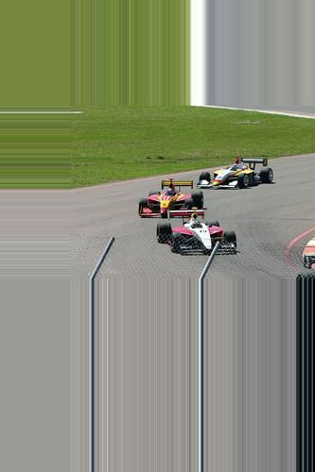

IV. Experiments – Datasets
IMDB: Contains 460.723 face images from 20.284 celebrites crawled from IMDB with the age range from 1-100.
WIKI: Contains 62.328 celebrity’s face images from Wikipedia.
→ Since these two datasets are collected large-scale on Internet, there are lots of noise images such as non-person, low-quality images.
→ These datasets will used for pre-train the model.
Examples of noise images from IMDB (Left) & WIKI (Right).
Notes:
To solve this issue, there are several research lines for imbalanced recognition. I’ll introduce each research line in brief.
One of the easiest way is “Data Re-sampling.” The goal of re-sampling is to restore the true distributions from the imbalanced training data by under-sampling (like this 포인터) or over-sampling (like this 포인터).
Also we can also consider “cost-sensitive learning” where the goal is to assign a weight to the loss of each class. For example, to make each gradient for each category be equal, we can reweight class-wise loss by inverse class frequency.
These A and B are traditional methods used for imbalanced learning since the past.

Slide 18
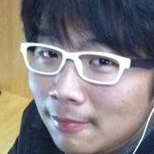
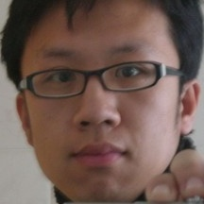
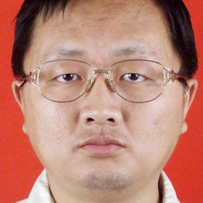
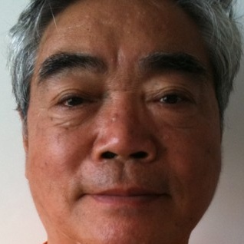

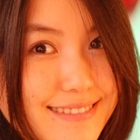
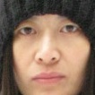
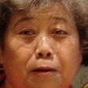
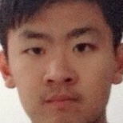
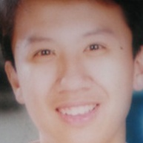
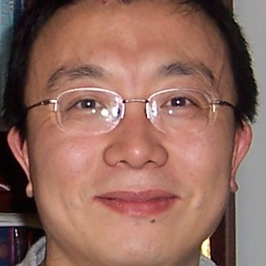
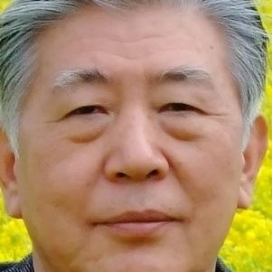
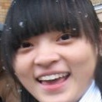
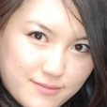





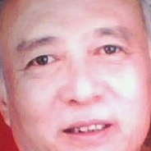
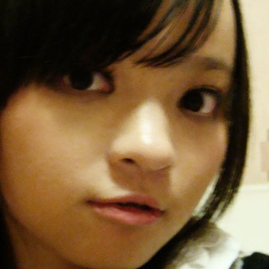
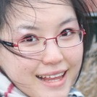


IV. Experiments – Datasets
AFAD (Asian Face Age Dataset): Contains 160.000 images with age and gender label. This dataset collected from Chineses Social Network, which contained uploaded photos from students and more. The author of [8] manually filtered out the noise data.
→ This dataset will use for fine-tuning the model.
Example images from AFAD dataset with the age of 18, 24, 40, 67
[8] Z. Niu, M. Zhou, L. Wang, X. Gao, and G. Hua, “Ordinal regression with multiple output cnn for age estimation,” in Proceedings of the IEEE Conference on Computer Vision and Pattern Recognition (CVPR), June 2016.
Notes:
To solve this issue, there are several research lines for imbalanced recognition. I’ll introduce each research line in brief.
One of the easiest way is “Data Re-sampling.” The goal of re-sampling is to restore the true distributions from the imbalanced training data by under-sampling (like this 포인터) or over-sampling (like this 포인터).
Also we can also consider “cost-sensitive learning” where the goal is to assign a weight to the loss of each class. For example, to make each gradient for each category be equal, we can reweight class-wise loss by inverse class frequency.
These A and B are traditional methods used for imbalanced learning since the past.

Slide 19
IV. Experiments – Pipeline
(I) All images went thought a face detection to filtered out most of noise images.
(II) Resized to [160x160x3] & [64x64x3] includeding corresponding Age & Gender label.
(III) All datasets used for training will be splited into train/test as [80:20].
(IV) Run and collect the results from all proposed models with different losses.
Notes:
To solve this issue, there are several research lines for imbalanced recognition. I’ll introduce each research line in brief.
One of the easiest way is “Data Re-sampling.” The goal of re-sampling is to restore the true distributions from the imbalanced training data by under-sampling (like this 포인터) or over-sampling (like this 포인터).
Also we can also consider “cost-sensitive learning” where the goal is to assign a weight to the loss of each class. For example, to make each gradient for each category be equal, we can reweight class-wise loss by inverse class frequency.
These A and B are traditional methods used for imbalanced learning since the past.

Slide 20
IV. Experiments – Training Configuration
(I) batch_size=512 will keep the same in every experiments.
(II) epochs=100.
(III) learning_rate=0.001, decreased by factor of 0.1 with patience epochs=10 to min=0.00001.
(IV) gap value g=3 as default.
(V) Adam Optimizer was applied.
Notes:
To solve this issue, there are several research lines for imbalanced recognition. I’ll introduce each research line in brief.
One of the easiest way is “Data Re-sampling.” The goal of re-sampling is to restore the true distributions from the imbalanced training data by under-sampling (like this 포인터) or over-sampling (like this 포인터).
Also we can also consider “cost-sensitive learning” where the goal is to assign a weight to the loss of each class. For example, to make each gradient for each category be equal, we can reweight class-wise loss by inverse class frequency.
These A and B are traditional methods used for imbalanced learning since the past.

Slide 21
IV. Experiments – List of experiments
(I) Collect the results across all the proposed models.
(II) Select the best performance model and tuning its parameters.
Notes:
To solve this issue, there are several research lines for imbalanced recognition. I’ll introduce each research line in brief.
One of the easiest way is “Data Re-sampling.” The goal of re-sampling is to restore the true distributions from the imbalanced training data by under-sampling (like this 포인터) or over-sampling (like this 포인터).
Also we can also consider “cost-sensitive learning” where the goal is to assign a weight to the loss of each class. For example, to make each gradient for each category be equal, we can reweight class-wise loss by inverse class frequency.
These A and B are traditional methods used for imbalanced learning since the past.

Slide 22
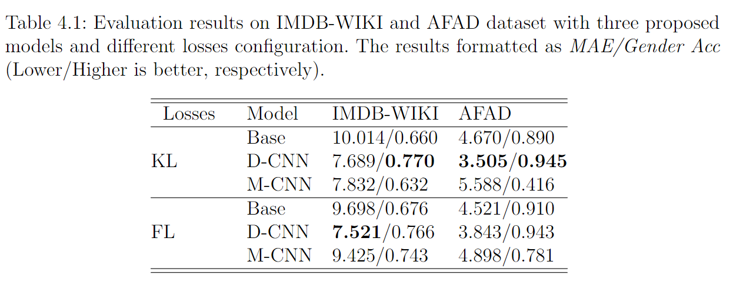
IV. Experiments – 1st experiment
KL: Kullback-leibler divergence
FL: Focal Loss
D-CNN: Deeper-CNN
M-CNN: Multiple-CNN
MAE: Mean Absolute Error
Notes:
To solve this issue, there are several research lines for imbalanced recognition. I’ll introduce each research line in brief.
One of the easiest way is “Data Re-sampling.” The goal of re-sampling is to restore the true distributions from the imbalanced training data by under-sampling (like this 포인터) or over-sampling (like this 포인터).
Also we can also consider “cost-sensitive learning” where the goal is to assign a weight to the loss of each class. For example, to make each gradient for each category be equal, we can reweight class-wise loss by inverse class frequency.
These A and B are traditional methods used for imbalanced learning since the past.

Slide 23
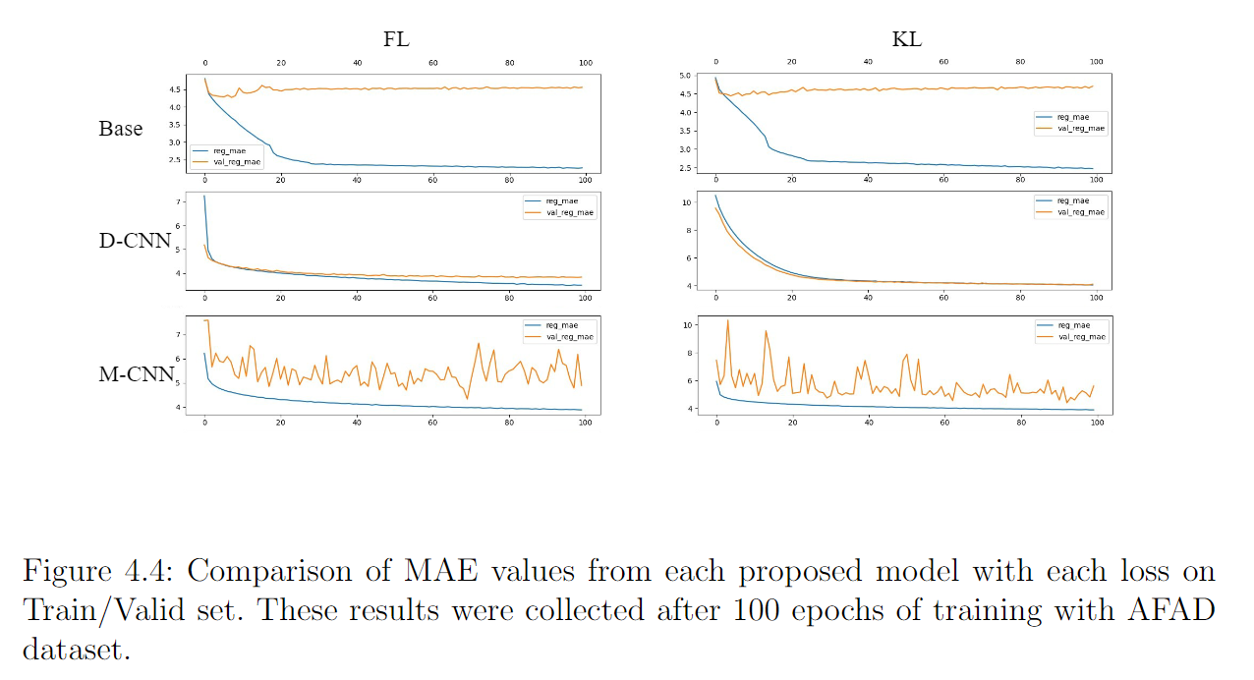
III. Experiments – 1st experiment
Notes:
To solve this issue, there are several research lines for imbalanced recognition. I’ll introduce each research line in brief.
One of the easiest way is “Data Re-sampling.” The goal of re-sampling is to restore the true distributions from the imbalanced training data by under-sampling (like this 포인터) or over-sampling (like this 포인터).
Also we can also consider “cost-sensitive learning” where the goal is to assign a weight to the loss of each class. For example, to make each gradient for each category be equal, we can reweight class-wise loss by inverse class frequency.
These A and B are traditional methods used for imbalanced learning since the past.

Slide 24
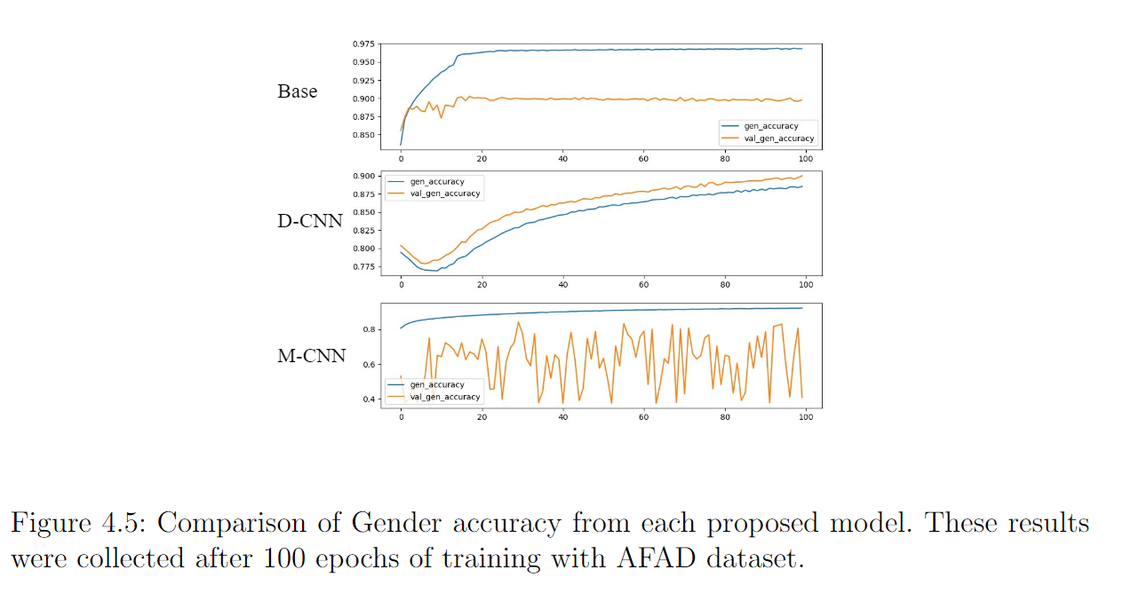
III. Experiments – 1st experiment
Notes:
To solve this issue, there are several research lines for imbalanced recognition. I’ll introduce each research line in brief.
One of the easiest way is “Data Re-sampling.” The goal of re-sampling is to restore the true distributions from the imbalanced training data by under-sampling (like this 포인터) or over-sampling (like this 포인터).
Also we can also consider “cost-sensitive learning” where the goal is to assign a weight to the loss of each class. For example, to make each gradient for each category be equal, we can reweight class-wise loss by inverse class frequency.
These A and B are traditional methods used for imbalanced learning since the past.

Slide 25

III. Experiments – 1st experiment
Notes:
To solve this issue, there are several research lines for imbalanced recognition. I’ll introduce each research line in brief.
One of the easiest way is “Data Re-sampling.” The goal of re-sampling is to restore the true distributions from the imbalanced training data by under-sampling (like this 포인터) or over-sampling (like this 포인터).
Also we can also consider “cost-sensitive learning” where the goal is to assign a weight to the loss of each class. For example, to make each gradient for each category be equal, we can reweight class-wise loss by inverse class frequency.
These A and B are traditional methods used for imbalanced learning since the past.

Slide 26

III. Experiments – 2nd experiment
Notes:
To solve this issue, there are several research lines for imbalanced recognition. I’ll introduce each research line in brief.
One of the easiest way is “Data Re-sampling.” The goal of re-sampling is to restore the true distributions from the imbalanced training data by under-sampling (like this 포인터) or over-sampling (like this 포인터).
Also we can also consider “cost-sensitive learning” where the goal is to assign a weight to the loss of each class. For example, to make each gradient for each category be equal, we can reweight class-wise loss by inverse class frequency.
These A and B are traditional methods used for imbalanced learning since the past.

Slide 27

III. Experiments – 2nd experiment
Notes:
To solve this issue, there are several research lines for imbalanced recognition. I’ll introduce each research line in brief.
One of the easiest way is “Data Re-sampling.” The goal of re-sampling is to restore the true distributions from the imbalanced training data by under-sampling (like this 포인터) or over-sampling (like this 포인터).
Also we can also consider “cost-sensitive learning” where the goal is to assign a weight to the loss of each class. For example, to make each gradient for each category be equal, we can reweight class-wise loss by inverse class frequency.
These A and B are traditional methods used for imbalanced learning since the past.

Slide 28

III. Experiments – 2nd experiment
Notes:
To solve this issue, there are several research lines for imbalanced recognition. I’ll introduce each research line in brief.
One of the easiest way is “Data Re-sampling.” The goal of re-sampling is to restore the true distributions from the imbalanced training data by under-sampling (like this 포인터) or over-sampling (like this 포인터).
Also we can also consider “cost-sensitive learning” where the goal is to assign a weight to the loss of each class. For example, to make each gradient for each category be equal, we can reweight class-wise loss by inverse class frequency.
These A and B are traditional methods used for imbalanced learning since the past.

Slide 29
IV. Conclusion
The combination of Classification and Regression in Age prediction did show its affect to the final real-age prediction.
In this particular case of Age Classification, Focal Loss did not show the affect of counter skew dataset.
Higher resolution image can lead to better result instead of multiple small images.
Notes:
To solve this issue, there are several research lines for imbalanced recognition. I’ll introduce each research line in brief.
One of the easiest way is “Data Re-sampling.” The goal of re-sampling is to restore the true distributions from the imbalanced training data by under-sampling (like this 포인터) or over-sampling (like this 포인터).
Also we can also consider “cost-sensitive learning” where the goal is to assign a weight to the loss of each class. For example, to make each gradient for each category be equal, we can reweight class-wise loss by inverse class frequency.
These A and B are traditional methods used for imbalanced learning since the past.

Slide 30
V. Disscussion
Facial Plastic Surgery problem → Collect more sources of data instead of just Face image(e.g. heart rate, short movement capture) ?
An image interceded by beauty filters, photoshop ?
Notes:
To solve this issue, there are several research lines for imbalanced recognition. I’ll introduce each research line in brief.
One of the easiest way is “Data Re-sampling.” The goal of re-sampling is to restore the true distributions from the imbalanced training data by under-sampling (like this 포인터) or over-sampling (like this 포인터).
Also we can also consider “cost-sensitive learning” where the goal is to assign a weight to the loss of each class. For example, to make each gradient for each category be equal, we can reweight class-wise loss by inverse class frequency.
These A and B are traditional methods used for imbalanced learning since the past.

Slide 31
Summary
This work proposes a new Soft-Label Representaion of Age that help as a classification information for final real-age result.
This work studies the effect of Focal Loss on imbalance IMDB/Wiki dataset, the effect of combining Classification and Regression Label.
This work proposed a new light-weight CNN based model for Real-Age & Gender prediction.
Notes:
Okay. Thank you for listening my defense and if you have any questions let me know.

Slide 32
Thank you for listening
Q&A
Notes:
Okay. Thank you for listening my defense and if you have any questions let me know.

