Slide 1

PokeDex WebApp
Done by Jason, Ralph, Tyler

Slide 2
Project Description
Pokedex web application to view general information about the game of Pokemon.
Includes aspects of the Pokemon video game. Allows user to learn about pokemon and inspect interactions of pokemon

Slide 3
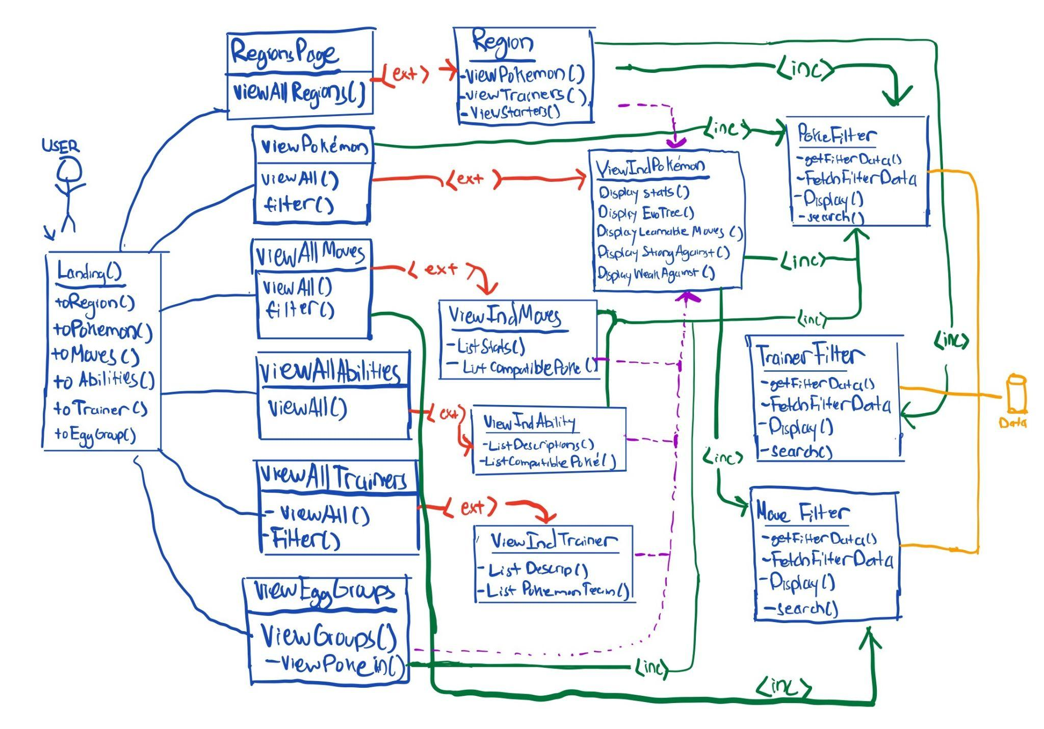
UML Diagram

Slide 4
UML Diagram
The main use case is giving the user detailed information about any Pokemon or move.
From the landing page the user is able to explore information based off a number filters including regions, pokemon, moves, abilities, trainers, and egg groups.
The user selects a main category to explore and then applies additional filters to the given results
The user is then able to select and individual item (eg. A specific pokemon, move,trainer) and receive detailed information about the given item.
The system displays attributes such as stats, evolutions, element interactions and other items.

Slide 5
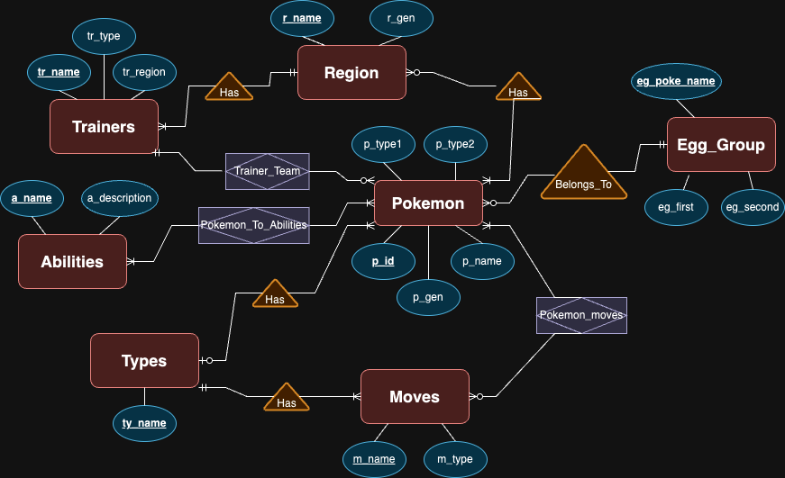
ER Diagram

Slide 6
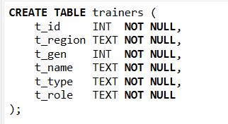
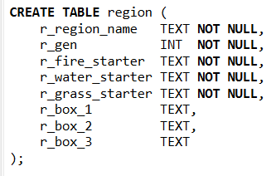
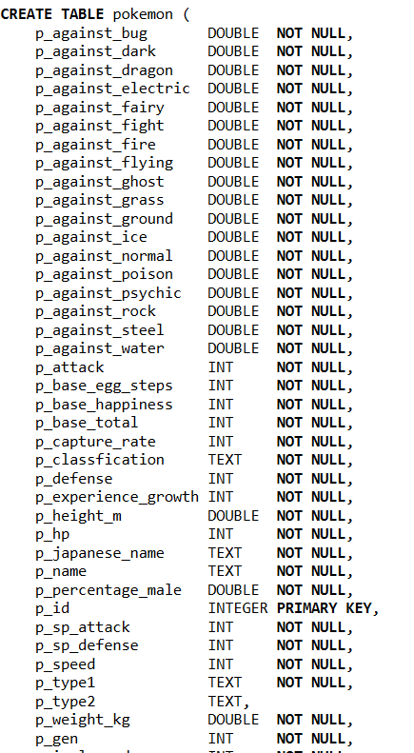

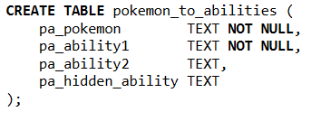
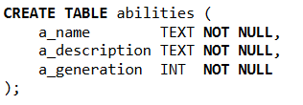
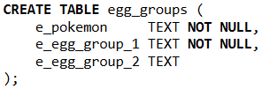
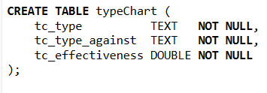
Relational Schema
Relational Schema

Slide 7


Implementation Details
Flask Application
Connected DB through sqlite3 commands
Executed queries from flask route
Send query data to frontend HTML and parse with Jinja2
Each html page can link to other flask routes to access other pages

