Slide 1

Towards a Model-Driven Engineering
Software Development Framework
Julien Delange
Maxime Perrotin
Samir Bennani
Julien Delange
Maxime Perrotin
Samir Bennani

Slide 2
Consequences of Software Development issues
Increasing cost
  Development + certification
Late release and impact on other projects
  Re-engineering efforts due to testing efforts
Remaining bugs leading to potential failures

Slide 3
Software Development
Traps & Pitfalls – tech concerns
Heterogeneous notations
  Models using different representation
  Collocation of languages with potential incompatibilities
Lack of formalization
  Assumptions made by development teams
Heterogeneous execution environment
  Impact on system execution and software behavior

Slide 4
Software Development
Traps & Pitfalls – org. concerns
Lack of coordination among teams
  Different understanding of system requirements
  Assumptions based on team experience
Human-factor
  Introduction of bugs
  Heterogeneous background

Slide 5
Software Development
Traps & Pitfalls – org. concerns
Lack of coordination among teams
  Different understanding of system requirements
  Assumptions based on team experience
Human-factor
  Introduction of bugs
  Heterogeneous background

Slide 6
Proposed Approach
Formalize system specifications using models
  System functions, interfaces & execution environment
  Avoid unspecified aspects
Automate development aspects
  Focus on specialized engineering domain
  Avoid integration efforts

Slide 7
The ASSERT Set of Tools for Engineering
System description using three views
  Data View: interfaces, data types
  Interface View: system functions and connections
  Deployment View: functions allocation on execution system
Automatic production of implementation
  Transform models into executable code
  Integration with established tools and standards

Slide 8
TASTE Development Process
User-defined
Data View
(ASN.1)
Interface View
(AADL)
Functions code
(C, Ada, Simulink, etc.)
Deployment View
(AADL)
Interfaces generation
Code skeletons
(C, Ada, etc.)
Code integration
Automatically Generated
System implementation
(binary)

Slide 9
TASTE ecosystem
Languages
Tools
ASN.1
  Interfaces & data types
AADL
  Functional specification
  Deployment definition
Functional modeling languages
ASN1Scc (Semantix)
Ocarina (ISAE)
TASTE GUI (Ellidiss)
RTDS (Pragmadev)

Slide 10
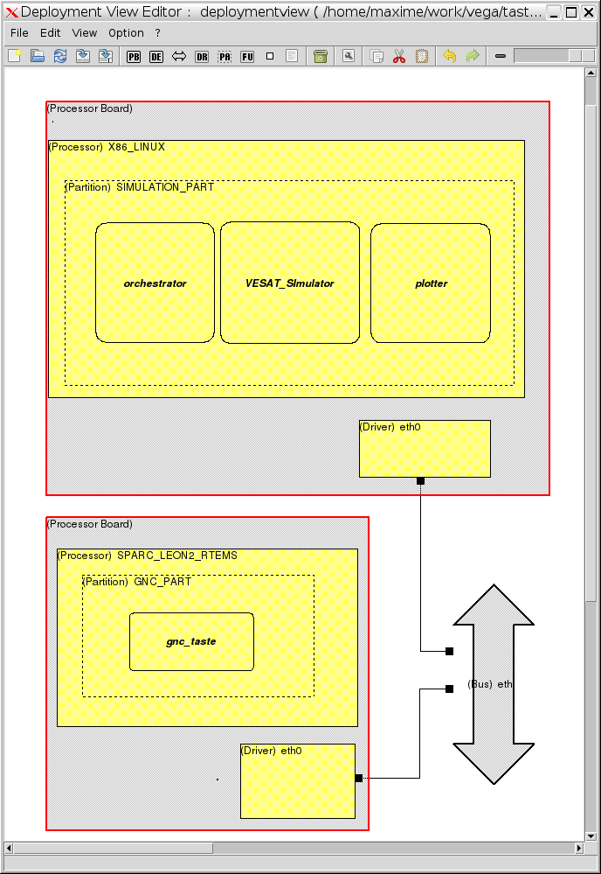
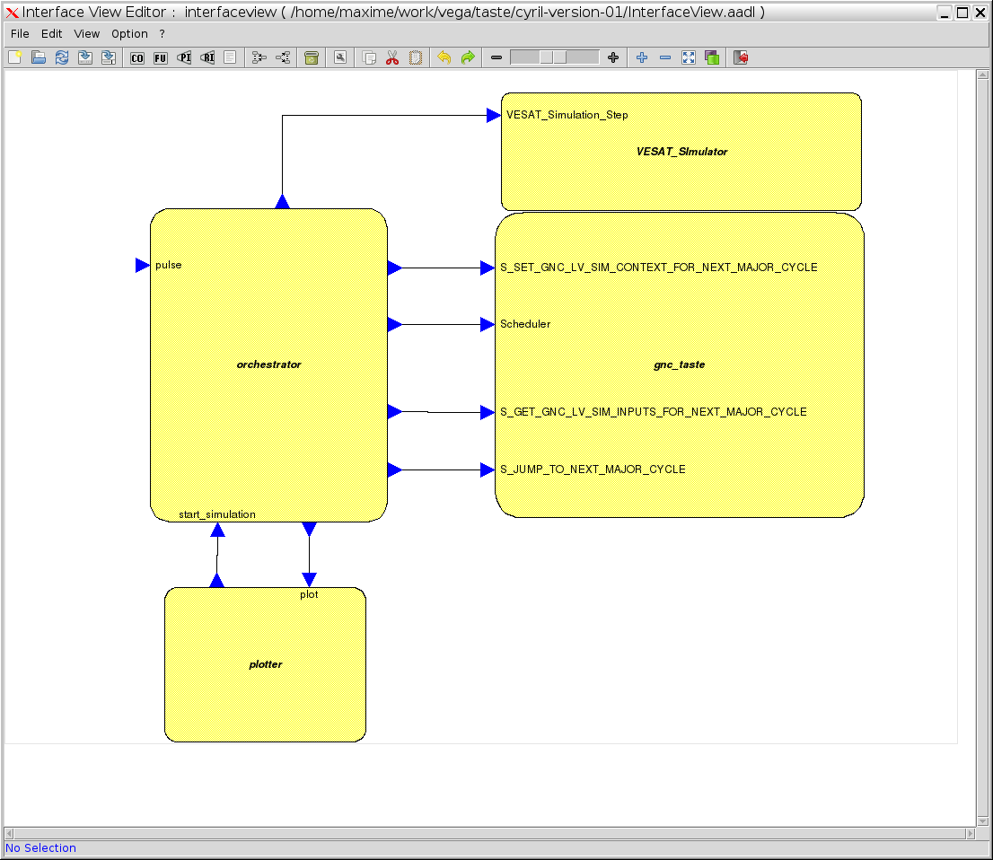
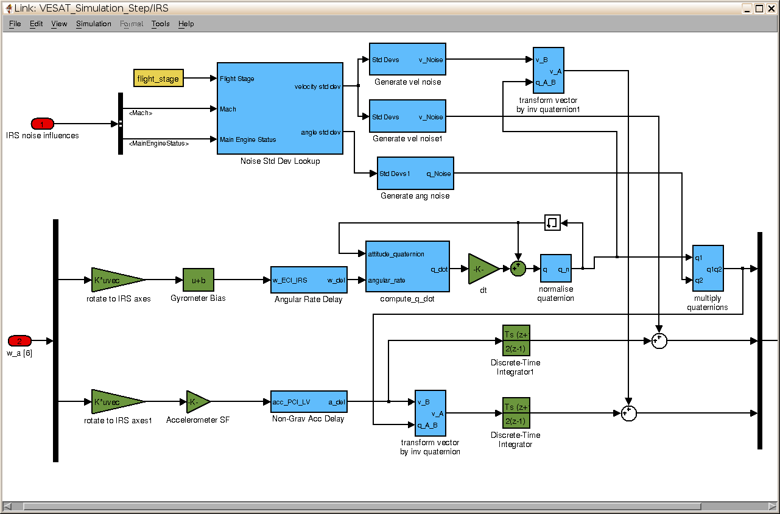

The VEGA case-study
Interface View
Functional code
(Guidance and Navigation Control)
Deployment View
Simulink models
Heterogeneous languages
Deployment on systems with different architectures
Implementation

Slide 11
Existing projects & feedback
Initial use in the European Space Agency
  Supporting projects development
  Abstraction ease system development
Extension to other domain
  Use in both academic and industrial contexts
  Demonstrate toolset maturity

Slide 12
Conclusion
Pragmatic approach addressing current traps & pitfalls
  Strict & formalized system description
  Automate system production, avoid manual efforts
Support for more validation & other domains
  Support for validation/certification efforts
  Extension for other safety-critical systems (e.g. avionics)

Slide 13
Questions ?

