Slide 1



opengeode
A tiny free, open-source state-machine editor and code generator based on the SDL and ASN.1 languages
Maxime.Perrotin@esa.int
Software Engineering Division - TEC-SWE

Slide 2
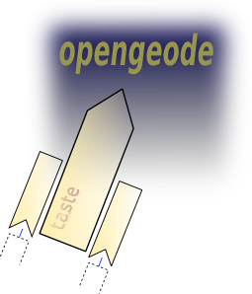

Opengeode is an SDL editor that was created to support the design and quick prototyping of state machines in the scope of the TASTE project.
TASTE is a modelling environment that targets embedded, real-time systems ; it is based on formal languages.
Check it ! http://taste.tuxfamily.org

Slide 3
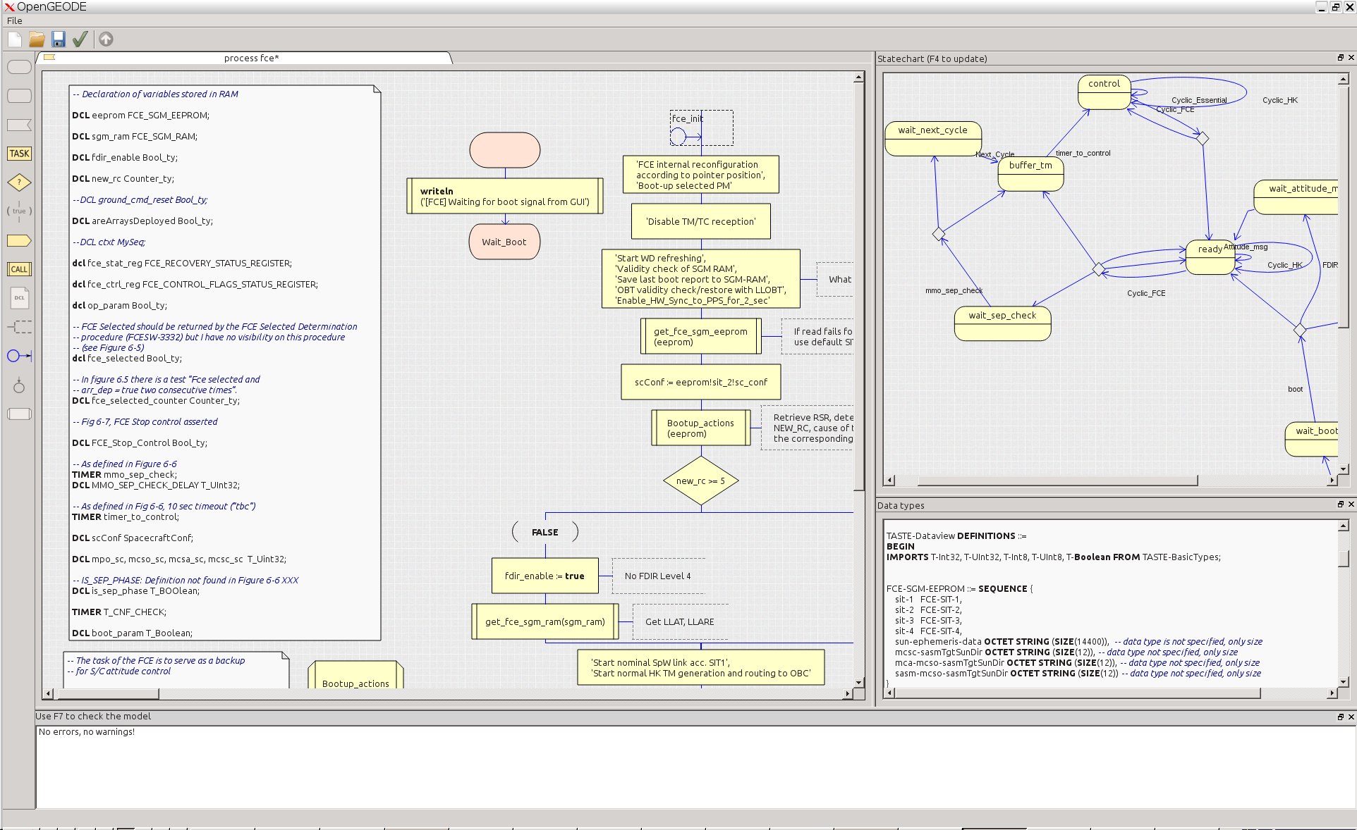

Slide 4
Download and installation
Opengeode can run on many platforms (tested on Linux, Windows, FreeBSD and Mac)
It is pre-installed in the TASTE virtual machine
Manual download and installation instructions on www.opengeode.net or https://github.com/maxime-esa/opengeode or https://pypi.python.org/pypi/opengeode

Slide 5

What is SDL good for
Specify or design the behaviour of communicating software, such as
  Embedded software,
  Communication protocols
  State machines
Reformulate and understand existing software specifications, design, or code
Simulate, verify and generate low-level code (C, Ada) from a formal language that is simple, complete, unambiguous, easy to learn and clear to read.
Check http://www.sdl-forum.org

Slide 6
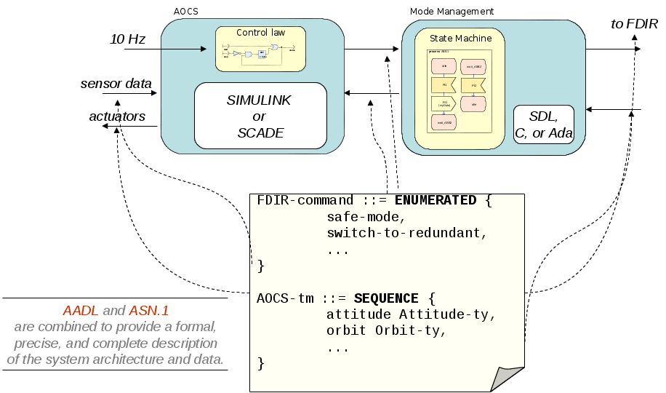
Architecture and data → use TASTE

Slide 7
ASN.1
International standard (ISO and ITU-T)
Simple text notation for precise and complete data type description
Real added values compared to other notations
  Value notation : the syntax allows to specify types but also the value of an instance of a type – however complex it is ;
  the physical encoding rules (compact binary encoding, endianness-neutral, but also XML encoding, legacy encoding specifications).
  Separate the encoding rules from the types specification
  Not proprietary – many implementations, massive use in existing applications (air trafic control, cryptography, bank transfers...)
  ASN.1 is fully integrated in the SDL language and can be used natively
Opengeode uses ESA ASN.1 compiler :
https://github.com/ttsiodras/asn1scc
  Generates C and SPARK/Ada code with identical memory mappings

Slide 8
ASN.1 – basic types
INTEGER
  → My-int ::= INTEGER (0..7)
    Value notation : value My-int ::= 5
REAL
  → My-real ::= REAL (10.0 .. 42.0)
BOOLEAN
ENUMERATED
  → My-enum ::= ENUMERATED { hello, world }
  Value notation : value My-enum ::= hello
OCTET STRING
  → My-string ::= OCTET STRING (SIZE (0..255))
    Value notation : value My-string::= 'DEADBEEF'H
BIT STRING
  → My-bitstring ::= BIT STRING (SIZE (10..12))
    Value notation : value My-bitstring ::= '00111000110'B

Slide 9
ASN.1 – complex types
SEQUENCE
  → My-seq ::= SEQUENCE {
  x My-int,
  y My-enum OPTIONAL
  }
    Value notation : value My-seq::= { x 5 }
CHOICE
  → My-choice ::= CHOICE {
  choiceA My-real,
  choiceB My-bitstring
  }
    Value notation : value My-choice ::= choiceA : 42.0
SEQUENCE OF
  → My-seq ::= SEQUENCE (SIZE (0..5)) OF BOOLEAN
    Value notation : value My-seq:= { 1, 2 ,3 }
SET / SET OF

Slide 10


Major SDL elements for behavioural design
Running
Action
A state
Procedure call
Input
Input (triggers a transition)
Procedure definition
Output
Output (sends a message)
Variables declaration
Decision
Label/Join

Slide 11
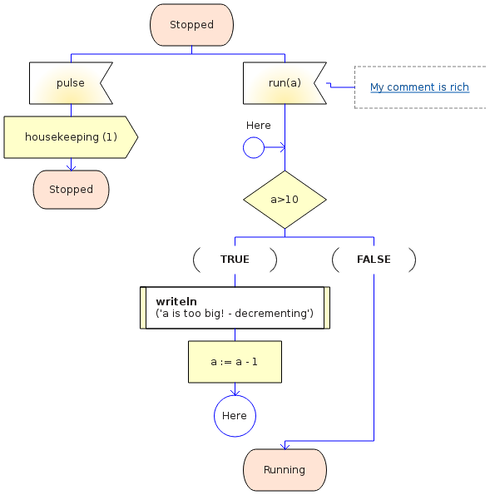
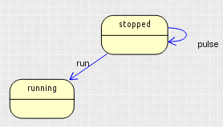
Typical transition diagram
State
Possible inputs
(and comments)
Transition body
(actions)
Next State

Slide 12
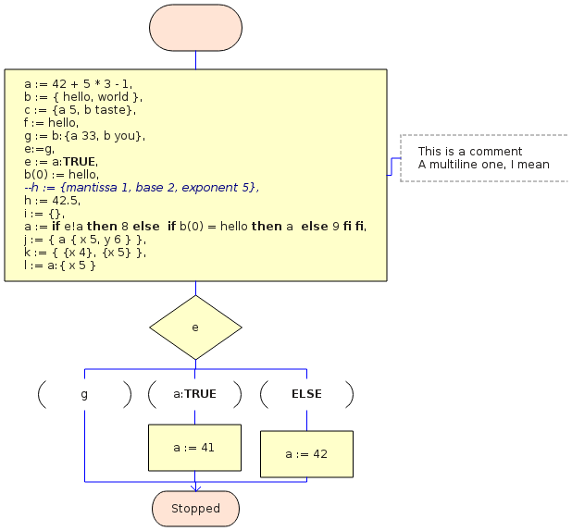
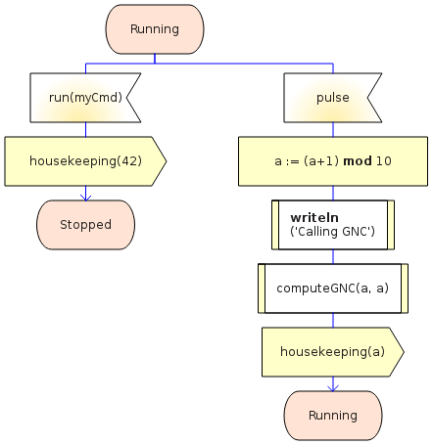
Data manipulation (overview)
Uses ASN.1
value notation
Native operators

Slide 13
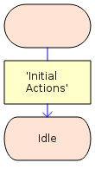
Start : initialization transition
A state machine has exactly
one start transition
The start transition is executed
at process creation (do not call
required interfaces there)
The start transition
  - Sets the initial state
  - May execute initial actions
  (initialization of variables)
Start
Start
transition
First state

Slide 14




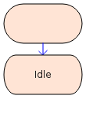
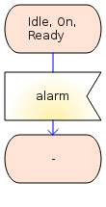
State / Nextstate
Each state has a name
In a given state, the process is
expecting to receive messages
A state can be composite
Shortcuts
Multiple
states
Any state
Any state
except Idle
Shortcut
Arrival state
Unique
Is the initial state of other
transitions
Most recent
state

Slide 15
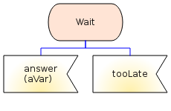
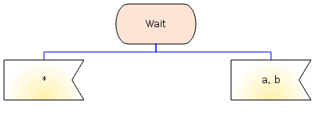
Input
Fires a transition : the transition is
executed when the process
consumes the signal
In a given state, the process can
expect several signals
May have parameters (use
variables to store their values)
Shortcuts
Inputs at level N have priority
over inputs at level N-1 (composite
states)
As a consequence, be careful with
« asterisk » inputs : if the state is
composite, all inner inputs are
ignored.
All signals not
explicitely
mentioned
a or b

Slide 16

Output
Transmission of a signal
  in TASTE terms : invocation
  of a sporadic required interface
May have a parameter

Slide 17

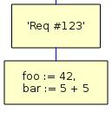
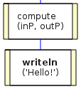
Task, Procedure call
Elementary action
of process transition
Informal task
Task setting a variable to a
given value
For loops
formal
informal
Call an external procedure
In TASTE terms, call a
synchronous required interface
(protected or unprotected)
Can have input and output
parameters
Writeln : built-in print function

Slide 18
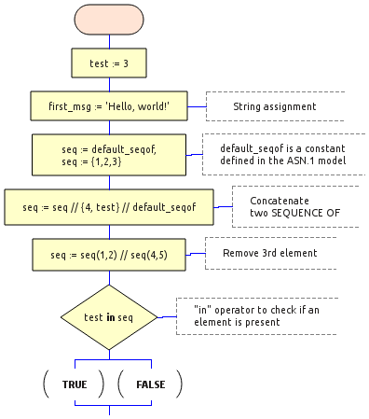
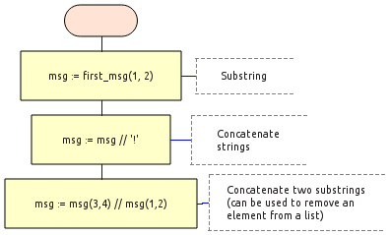
Advanced data manipulation (1)

Slide 19
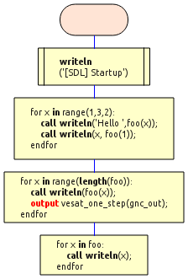
Advanced data manipulation (2)
FOR loop
Range([start], stop, [step])
or iterator (SEQUENCE OF)
Transition can use any SDL construct

Slide 20
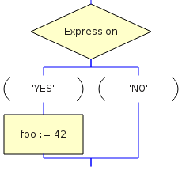
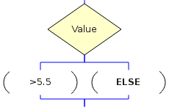
Decision
Control structure
To represent conditional action
sequences
A decision can have more than
two answers
  - Multiple answers must be
  mutually exclusive
  -The last answer can be ELSE
Useful to build loops

Slide 21
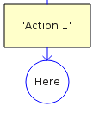
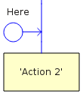
Labels and branches
Allow rerouting
Loop description
« Don't repeat yourself » (DRY)
But do not use to describe
complex algorithms..

Slide 22
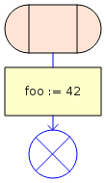
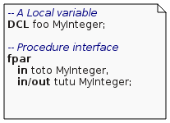
Procedures
Sequential sub-functions
Can have parameters (in and in/out)
Have visibility on the parent variables
Same constructs as a process
Local variables
But no internal states
Start
Transition
Return

Slide 23
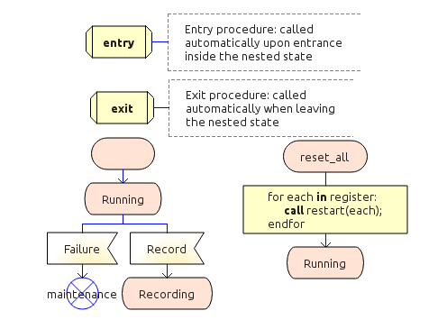
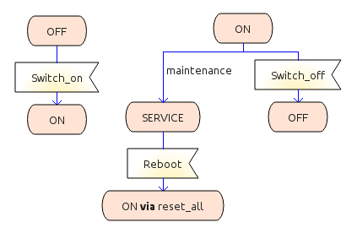
Composite states
Hierarchical state machines
Entry and exit procedures
Multiple entry and exit points

Slide 24
Quality criteria for state machines
State oriented
  Use variables for storing data, not object states
Complexity
  Number of states
  Number of transitions per state
  Avoid decisions in waterfall wat
  Minimum of data
Graphical justification comments
Use hyperlinks for better traceability

Slide 25
Summary
SDL includes a complete data model
  Declare and use variables within transition symbols
Design is complete
  Designers without expertise in programming languages can build complete executable models
  TASTE allows communication with external code
Best approach : model behaviour with SDL, algorithms with Simulink, and drivers with Ada or C
Opengeode can generate Ada code for a complete state machine
  For full SDL support, C code and model simulation use Pragmadev RTDS tool :www.pragmadev.com

