Slide 1



opengeode
A tiny free, open-source state-machine editor and code generator,
based on the SDL and ASN.1 languages.
Maxime Perrotin
Software Engineering division - ESTEC
TEC-SWE

Slide 2
Introduction - overview
How to describe the behaviour of a system ?
System engineers define their systems modes and transitions with « state machines »
State machines have simple concepts and solid foundations – they hide implementation details and allow to focus first on the dynamics
Unfortunately most programming languages (like C or Ada) do not have a grammar that natively handle these concepts
...Except SDL, a 25+ years-old language that is dedicated to state machines, and widely used in telecom applications – why not trying it in space ?

Slide 3
State machines are useful...really ?
Embedded systems react to their environment
Spot the bug ?
There is nothing to prevent the continuous power cycle....
void handle_event(Event evt) { if (evt == unit_failure) bus_power_cycle() ; }
Note : this example was inspired by the description of the State design pattern found at http://gameprogrammingpatterns.com/state.html

Slide 4
State machines are useful
A simple fix : add a flag
Next, we want to calibrate some sensors...
void handle_event(Event evt) { if (evt == unit_failure) { if (!power_cycling) { power_cycling = true; // Power cycle... } } }

Slide 5
State machines are useful
void handle_event(Event evt) { if (evt == unit_failure) { // Power cycle if not power cycling... } else if (evt == calibrate) { if (!power_cycling) start_calibration() ; } else if (evt == calibration_end) { tm_up_and_running() ; } }
Spot the bug this time ?
  Start calibration, receive a failure, end calibration..
  The system will report it is up and running while in fact power cycling.
Time for another flag !

Slide 6
State machines are useful
void handle_event(Event evt) { if (evt == unit_failure) { if (!power_cycling && !calibrating) // Power cycle... } else if (evt == calibrate) { if (!power_cycling) { calibrating = true; … } } else if (evt == calibration_end) { if(calibrating) { calibrating = false ; ...} } }
Next, it would be nice to switch to redundant if a calibration is requested while power cycling

Slide 7
State machines are useful
void handle_event(Event evt) { if (evt == unit_failure) { if (!power_cycling && !calibrating) // Power cycle... } else if (evt == calibrate) { if (!power_cycling) { calibrating = true; … } else { power_cycling = false ; switch_on_redundant() ; } } else if (evt == calibration_end) { if(calibrating) { calibrating = false ; ...} } }
Bug hunting time again. Find it ?
We check that we can't power cycle while calibrating but not while switching on redundant. Yet another flag....
Etc, etc..
Something is clearly wrong with this approach : every time we touch this handful of code, we break something.

Slide 8
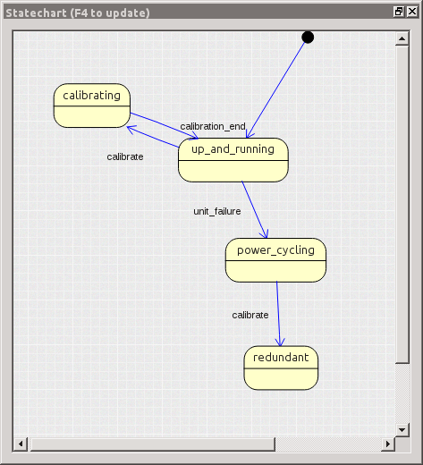
State machines are useful...really !

Slide 9
OpenGEODE
OpenGEODE graphical editor and compiler based on the SDL language
It is free and open-source, small and easy to maintain
Development is active and 3rd party support is available
The tool is a prototype and does not aim at competing with full-featured, commercial options (RTDS)
The target is restricted to embedded/safe systems – using ASN.1, generating Ada code, … with a special focus put on providing a great user experience

Slide 10
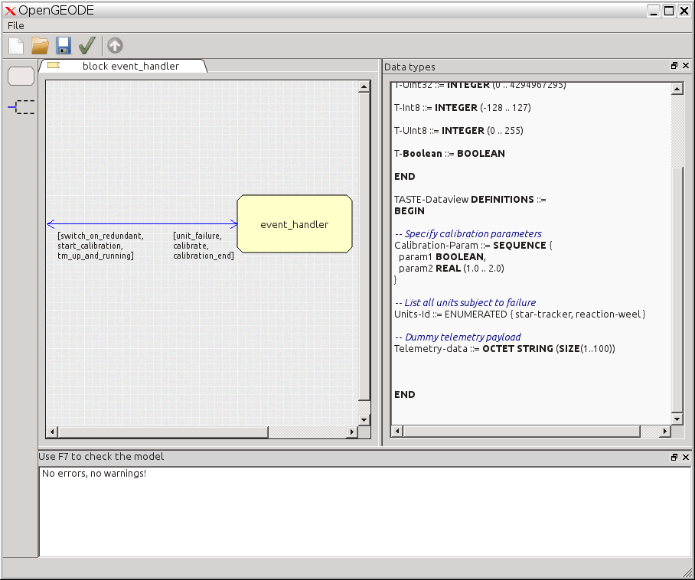
OpenGEODE
Everything is formally specified : interface, data, and behaviour.

Slide 11
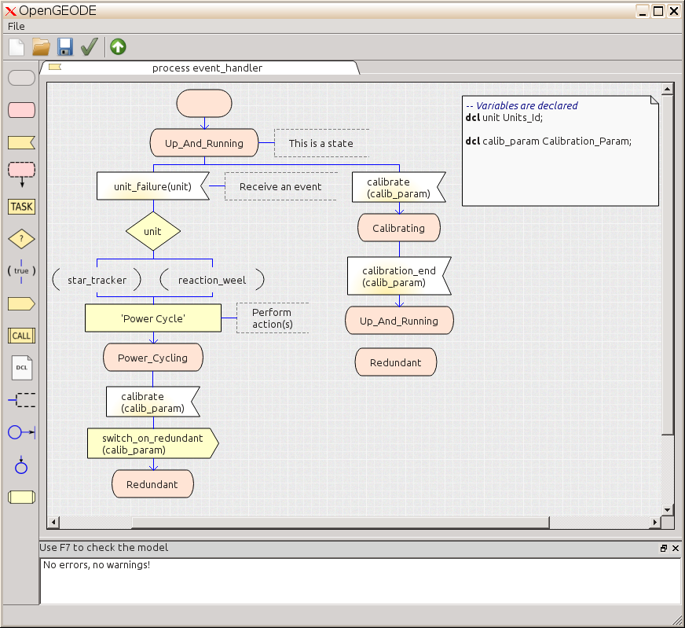
OpenGEODE

Slide 12
OpenGEODE
PROCESS event_handler; -- Variables are declared dcl unit Units_Id; dcl calib_param Calibration_Param; START; NEXTSTATE Up_And_Running ; STATE Redundant; ENDSTATE; STATE Calibrating; INPUT calibration_end(calib_param); NEXTSTATE Up_And_Running; ENDSTATE; STATE Power_Cycling; INPUT calibrate(calib_param); OUTPUT switch_on_redundant(calib_param); NEXTSTATE Redundant; ENDSTATE; STATE Up_And_Running COMMENT 'This is a state'; INPUT unit_failure(unit) COMMENT 'Receive an event'; DECISION unit; (reaction_weel): (star_tracker): ENDDECISION; TASK 'Power Cycle' COMMENT 'Perform action(s)'; NEXTSTATE Power_Cycling; INPUT calibrate(calib_param); NEXTSTATE Calibrating; ENDSTATE; ENDPROCESS event_handler;
Graphical and textual notations are equivalent
The save format is the textual notation
The syntax is simple and the parser is available
Writing a backend is easy
Two backends exist : Ada and LLVM code generators

Slide 13
SDL and ASN.1 – two complementary languages
SDL : Specification and Description Language (ITU-T standard)
ASN.1 : Abstract Syntax Notation One

Slide 14
ASN.1
International, widely used standard (ISO)
Simple text notation for precise and complete data type description
Real added value : the physical encoding rules – read about that !
ASN.1 types and value notation can be used in SDL – they are part of the language
Point ::= SEQUENCE { x REAL (-10.0, 10.0), y REAL (-10.0, 10.0) } myPoint Point ::= { x 5.0, y 1.0 } Point [encoding IEEE754-1985-64, endianness little]

Slide 15
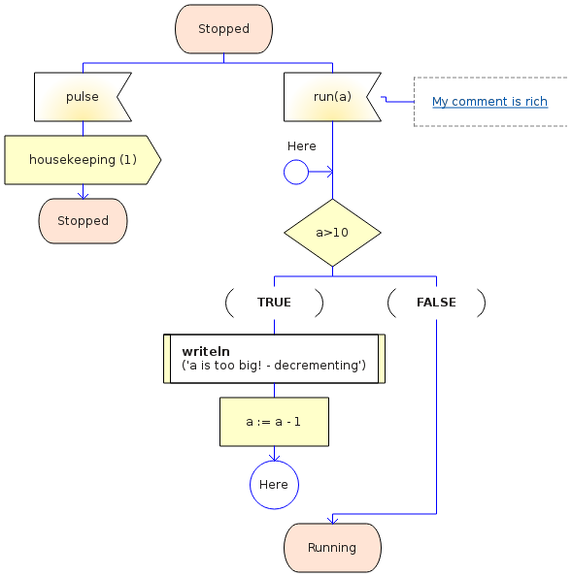
Typical SDL diagram
State
Possible inputs
(and comments)
Transition body
Next State

Slide 16
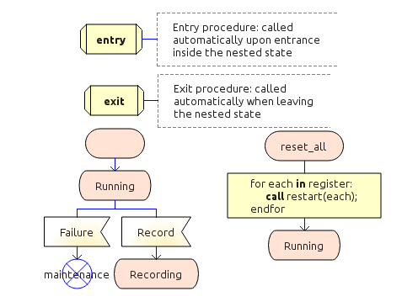
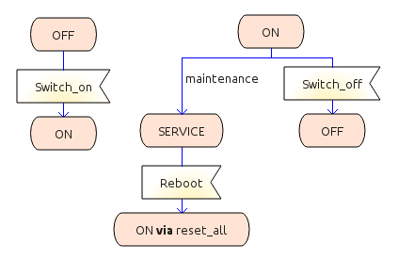
Composite states
Hierarchical state machines
Entry and exit procedures
Multiple entry and exit points

Slide 17
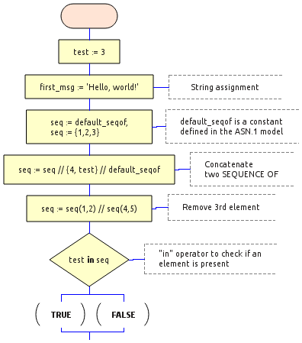
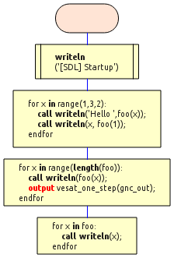
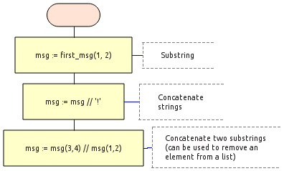
Advanced data manipulation
Declare variables of ASN.1 types
Use strings and arrays with an easy syntax
Use FOR loops

Slide 18
A great user experience
Context-dependent autocompletion
Hyperlinks
Export diagrams to PNG/PDF files
Convert SDL to Statechart
Smooth symbol placement
Context-dependent activation of symbol icons
Undo, redo, copy-paste, « vi »-mode, zoom
Syntax highlighting

Slide 19
But more important : OpenGEODE is designed for safe applications
The syntax and semantic checker is powerful, detecting issues that even Ada or F# compilers do not spot
  Non-determinism is forbidden
  Risk of overflows are detected statically
  Dead code (unreachable branches) are spotted
  Missing and duplicate answers in a DECISION (switch-case) are detected

Slide 20
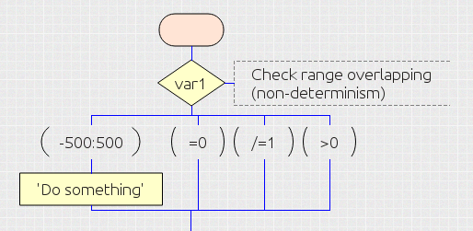
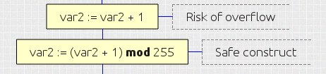
Example of errors the tool catches
Given this variable :
Do not try this :
dcl var1 INTEGER (-2147483648 .. 2147483647) dcl var2 INTEGER (0 .. 255)
[ERROR] Decision "var1": answers =0 and /=1 are overlapping in range [0 .. 0] [ERROR] Decision "var1": answers =0 and -500:500 are overlapping in range [0 .. 0] [ERROR] Decision "var1": answers /=1 and >0 are overlapping in range [2 .. 2147483647] [ERROR] Decision "var1": answers /=1 and -500:500 are overlapping in range [-500 .. 0] [ERROR] Decision "var1": answers /=1 and -500:500 are overlapping in range [2 .. 500] [ERROR] Decision "var1": answers >0 and -500:500 are overlapping in range [1 .. 500] [ERROR] "var2:= var2 + 1" : Expression in range [1.0..256.0], outside expected range [0..255]

Slide 21
Summary on the language
SDL includes a complete data model
  Declare and use variables within transition symbols
Design is complete
  Designers without expertise in programming languages can build complete executable models
  TASTE allows communication with external code
Best approach : model behaviour with SDL, algorithms with Simulink, and drivers with Ada or C

Slide 22
Backends, benchmarks
OpenGEODE comes with two backends : Ada and LLVM code generators
  Target safe code, without heap usage, without external dependencies
  Integrated with the ASN.1 Compiler from ESA/Neuropublic, generating C and SPARK/Ada code
  Generated code is simple, readable, and easily customizable, binaries are tiny and speedy
Size: Ada 100.00% LLVM 21.33% Time: Ada 100.00% LLVM 42.29% | Benchmark | Ada size (B) | LLVM size (B) | Ada time (us) | LLVM time (us) | |------------------+----------------+-----------------+-----------------+------------------| | test-controlflow | 42808 | 7280 | 2030 | 844 | | test-exitnested | 42800 | 6640 | 2018 | 845 | | test-expressions | 59256 | 19288 | 2036 | 859 | | test-operators | 48900 | 10352 | 2087 | 895 | | test-substrings | 51104 | 12624 | 2038 | 873 | | test10 | 44304 | 7768 | 2047 | 873 | | test11 | 42800 | 7156 | 2009 | 845 | | test8 | 49664 | 12624 | 2075 | 876 |

Slide 23
Maintenance, future work
OpenGEODE is less than 10,000 lines of code, including everything (parser, graphical editor, backends, checkers)
  Thanks to Python, Qt, and ANTLR....
  Code is well documented and easy to maintain
  Writing new backends is easy, a template is provided
  Several external contributors « forked » the source code and developed new features
Ongoing/Future work : verification with model checking, SDL to VHDL backend, simulation, more checks, improved SDL to statechart conversion, … Use on a space project ?

