Slide 1
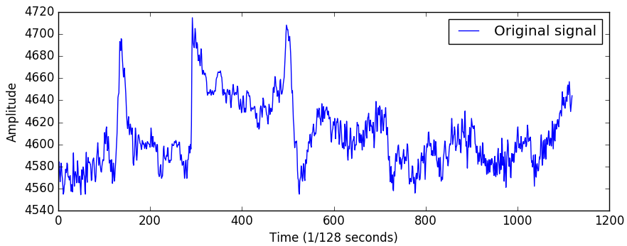
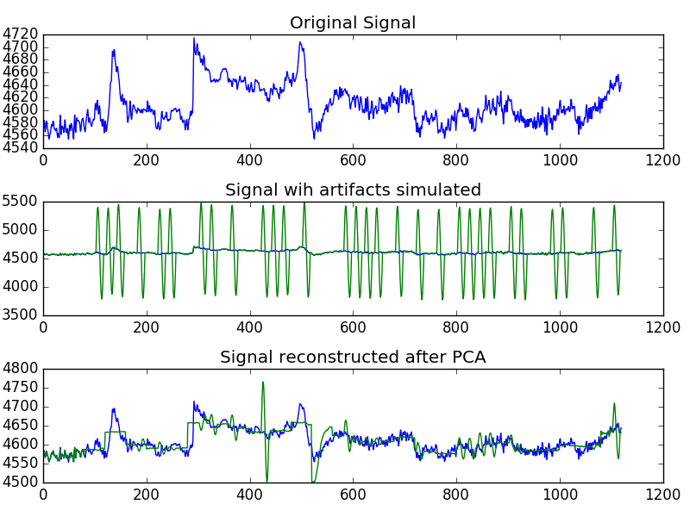
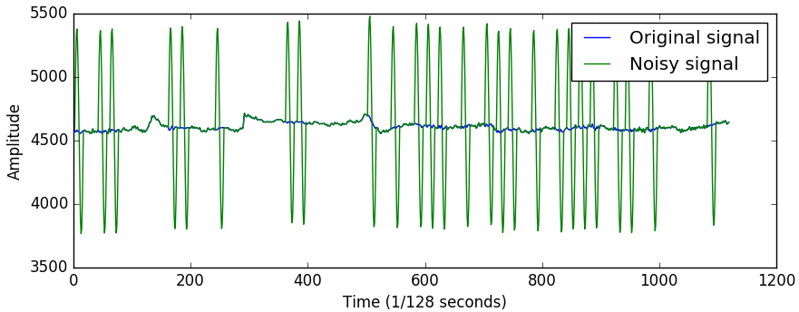
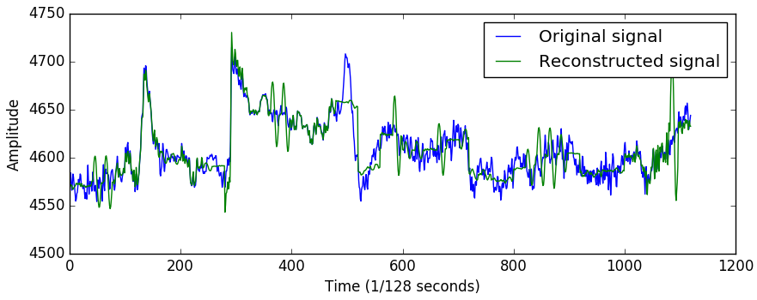
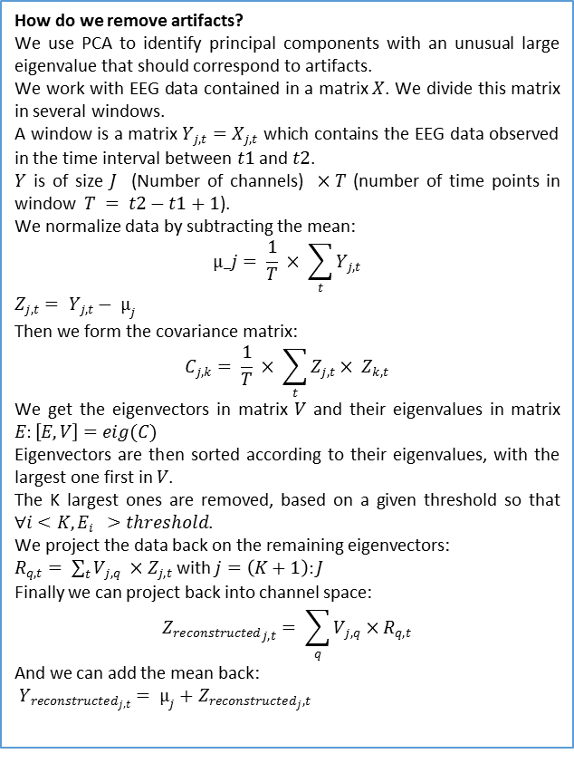
Marie LE GUILLY
Rasmus HAARSLEV
Troels THOMSEN
Artifact removal using PCA on EEG data
What are we trying to do?
When EEGs are recorded, electrodes are placed on the head of patients in order to measure the brain’s electrical activity. However, those measures can be disturbed by any muscular movement such as eye movement, that will create huge variations in the amplitude of the recorded signal. Those variations, called artifacts, make the recording noisy, and our purpose has been to try to remove those artifacts.
Results
Several parameters had to be adjusted. First, the threshold above which principal components are rejected. To compute it, a clean dataset is used as a training set, the rest of it being a testing set on which artifacts are simulated. We worked with three different kind of threshold:
The maximum eigenvalue found in the windows of the training set
The average of the eigenvalues of the windows of the training set
The average of the maximum of each window of the training set
Proinde die funestis interrogationibus praestituto imaginarius iudex equitum resedit magister adhibitis aliis iam quae essent agenda praedoctis, et adsistebant hinc inde notarii, quid quaesitum esset, quidve responsum.
Proinde die funestis interrogationibus praestituto imaginarius iudex equitum resedit magister adhibitis aliis iam quae essent agenda praedoctis, et adsistebant hinc inde notarii, quid quaesitum esset, quidve responsum.
How do we remove artifacts?
We use PCA to identify principal components with an unusual large eigenvalue that should correspond to artifacts.
We work with EEG data contained in a matrix $X$. We divide this matrix in several windows.
A window is a matrix $Y_{j,t}=X_{j,t}$ which contains the EEG data observed in the time interval between $t1$ and $t2$.
$Y$ is of size $J$ (Number of channels) $×T$ (number of time points in window $T = t2−t1+1$).
We normalize data by subtracting the mean:
$$µ_j= \frac{1}{T} × \sum_{t}^{ }{Y_{j,t}}$$
$Z_{j,t}= Y_{j,t}− µ_{j}$
Then we form the covariance matrix:
$$C_{j,k}= \frac{1}{T} × \sum_{t}^{ }{Z_{j,t}× Z_{k,t}}$$
We get the eigenvectors in matrix $V$ and their eigenvalues in matrix $E:\left[E,V\right]=eig(C)$
Eigenvectors are then sorted according to their eigenvalues, with the largest one first in $V$.
The K largest ones are removed, based on a given threshold so that $∀i<K, E_{i } >threshold$.
We project the data back on the remaining eigenvectors:
$R_{q,t}= \sum_{t}{V_{j,q}} ×Z_{j,t}$ with $j=\left(K+1\right):J$
Finally we can project back into channel space:
$${Z_{reconstructed}}_{j,t}= \sum_{q}{V_{j,q}×R_{q,t}}$$
And we can add the mean back:
$Y_{reconstructed_{j,t}}= µ_{j}+Z_{reconstructed_{j},t}$
Figure 1: representation of one channel of an EEG dataset
Figure 2: artifacts are simulated and added to the original dataset
Figure 3: after PCA, artifacts are removed

