Slide 1
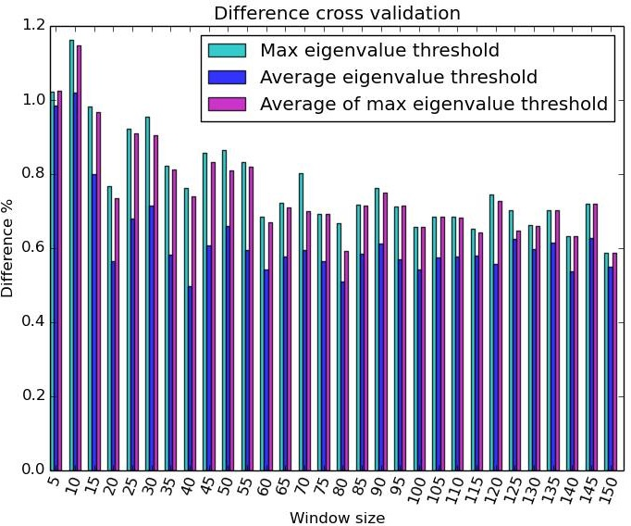
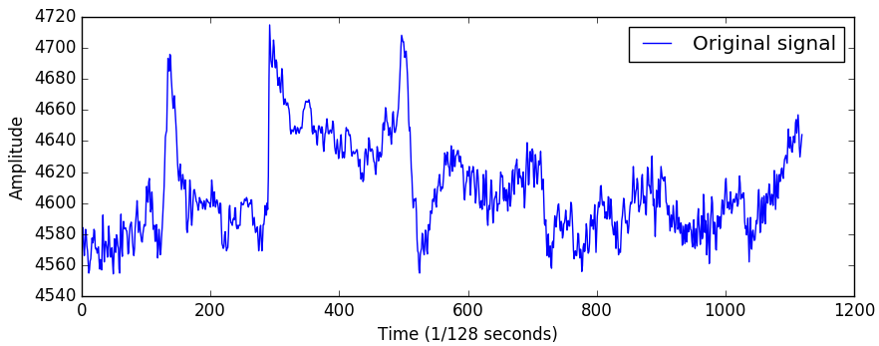
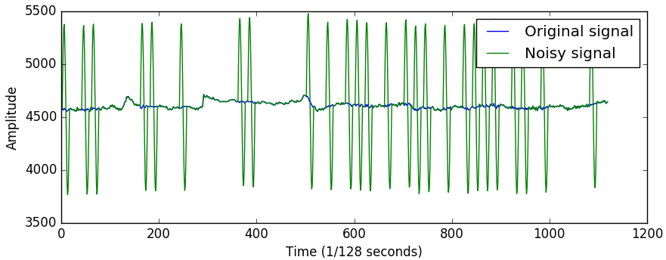
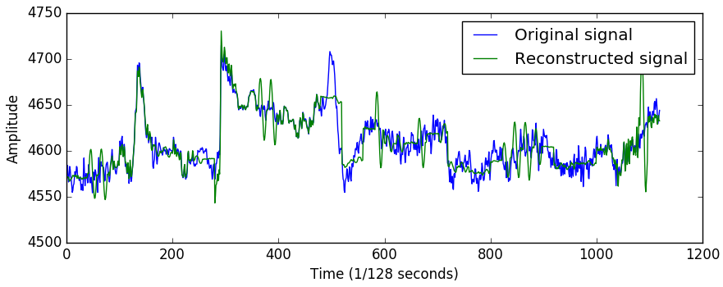

Artifact Removal in EEG Data Maie LE GUILLY - Rasmus HAARSLEV - Troels THOMSEN
1
Purpose
3
Results
Our purpose is to remove noise from EEG data, in order to allow for real-time signal analysis.
2
Methods
We use PCA to identify components with unusually large eigenvalues. If the eigenvalue is above the threshold found during calibration, there should be an artifact in that component and we try to remove it.
To compute the threshold for rejecting components we use a clean dataset as a training set. We calibrate the threshold on the first 20% of the dataset and then add simulated artifacts to the rest of it.
We use three different kind of threshold:
The maximum eigenvalue found in the windows of the training set
The average of the eigenvalues of the windows of the training set
The average of the maximum of each window of the training set
Figure 1: representation of one channel of an EEG dataset
Figure 4: cross-validation between thresholds and window size on a 1400 sample dataset
Threshold | Max | AVG | MAX_AVG
Sensitivity | 0.92 | 1.0 | 1.0
Specificity | 0.22 | 0.0 | 0.16
Figure 2: original dataset with simulated artifacts added
Figure 5: Sensitivity and specificity for the different threshold
For the max threshold and a window size of 40 samples with randomly added artifacts we have an average loss in the reconstructed dataset of 0.37%. If no artifacts are added this becomes a 0.045% loss.
For the same window size we can remove artifacts at a rate of 81Hz allowing real time artifact removal.
4
Conclusion
We can remove artifacts with an average loss of 0.37% at a rate estimated to support real time analysis.
Figure 3: original dataset together with the dataset reconstructed from artifact dataset

