Slide 1
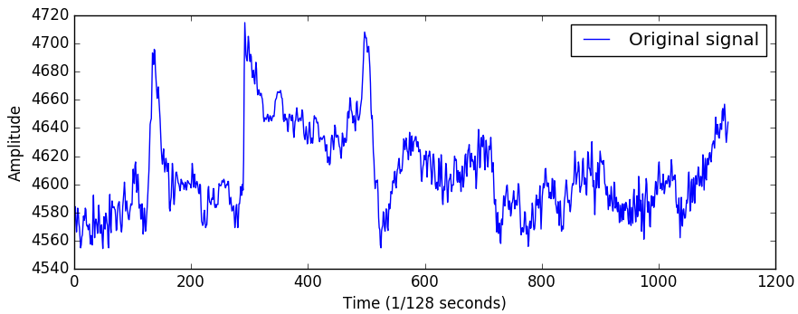
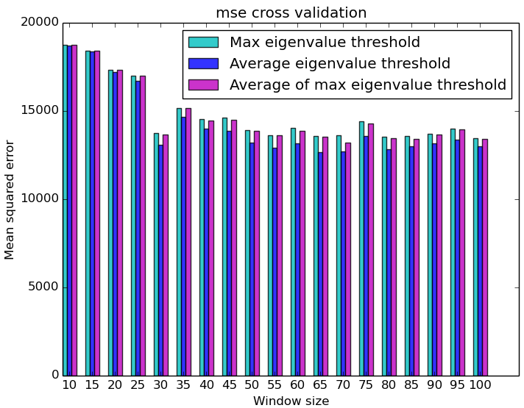
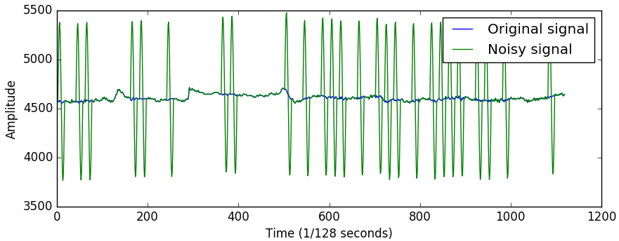
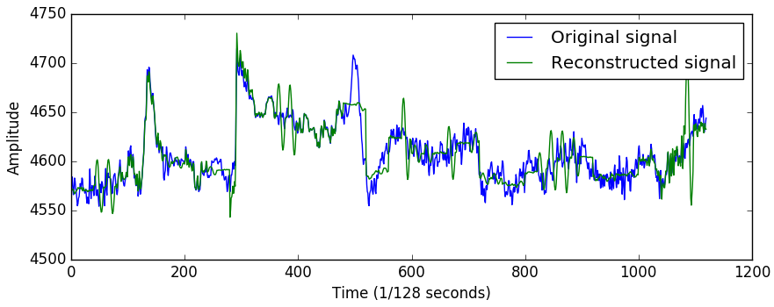
Marie LE GUILLY
Rasmus HAARSLEV
Troels THOMSEN
Artifact removal using PCA on EEG data
Background
When EEGs are recorded, electrodes are placed on the head of patients in order to measure the brain’s electrical activity. However, these measures can be disturbed by noise caused by muscular movements such as eyelid movement. This creates large spikes in amplitude of the recorded signal artifacts. Our purpose is to try to remove them.
Results
To compute the threshold for rejecting components we use a clean dataset as a training set. We calibrate the threshold on the first 20% of the dataset and then add simulated artifacts to the rest of it. We use three different kind of threshold:
The maximum eigenvalue found in the windows of the training set
The average of the eigenvalues of the windows of the training set
The average of the maximum of each window of the training set
We can measure sensivity/specificity:
For windows of size 128 samples, we can remove artifacts at a rate of 35Hz.
Figure 1: representation of one channel of an EEG dataset
Figure 2: original dataset with simulated artifacts added
Figure 4: cross-validation between thresholds and window size
Threshold | Max | AVG | MAX_AVG
Sensitivity | 1.0 | 1.0 | 1.0
Specificity | 0.64 | 0.0 | 0.61
Figure 3: original dataset together with the dataset reconstructed from artifact dataset

Slide 2
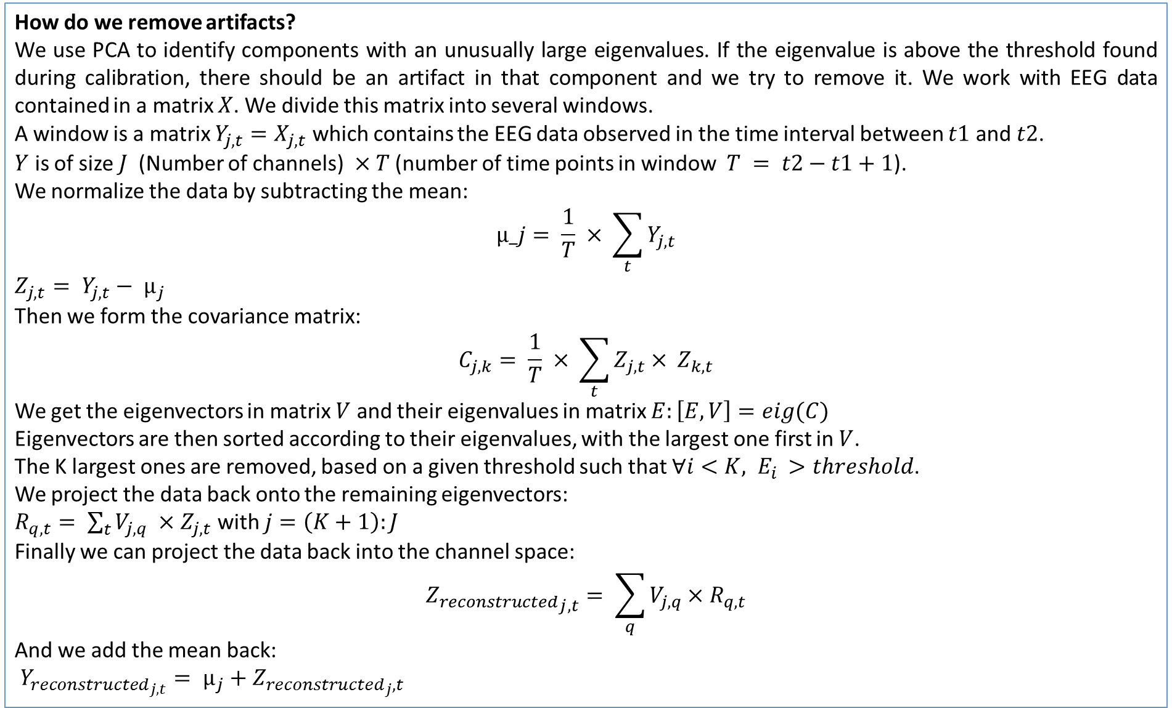
How do we remove artifacts?
We use PCA to identify components with an unusually large eigenvalues. If the eigenvalue is above the threshold found during calibration, there should be an artifact in that component and we try to remove it. We work with EEG data contained in a matrix $X$. We divide this matrix into several windows.
A window is a matrix $Y_{j,t}=X_{j,t}$ which contains the EEG data observed in the time interval between $t1$ and $t2$.
$Y$ is of size $J$ (Number of channels) $×T$ (number of time points in window $T = t2−t1+1$).
We normalize the data by subtracting the mean:
$$µ_j= \frac{1}{T} × \sum_{t}^{ }{Y_{j,t}}$$
$Z_{j,t}= Y_{j,t}− µ_{j}$
Then we form the covariance matrix:
$$C_{j,k}= \frac{1}{T} × \sum_{t}^{ }{Z_{j,t}× Z_{k,t}}$$
We get the eigenvectors in matrix $V$ and their eigenvalues in matrix $E:\left[E,V\right]=eig(C)$
Eigenvectors are then sorted according to their eigenvalues, with the largest one first in $V$.
The K largest ones are removed, based on a given threshold such that $∀i<K, E_{i }>threshold$.
We project the data back onto the remaining eigenvectors:
$R_{q,t}= \sum_{t}{V_{j,q}} ×Z_{j,t}$ with $j=\left(K+1\right):J$
Finally we can project the data back into the channel space:
$${Z_{reconstructed}}_{j,t}= \sum_{q}{V_{j,q}×R_{q,t}}$$
And we add the mean back:
$Y_{reconstructed_{j,t}}= µ_{j}+Z_{reconstructed_{j},t}$

