Slide 1
Midterm 2 Review

Slide 2
Exam Rules
This is a 75-minute exam.
The syllabus includes all material covered from chapter 6 to Chapter 9 (inclusive).
You can use a calculator (any type) in the exam.
This is a close Book and close Notes Exam.
You are not allowed to consult with any other student.
If you need to make specific assumptions to answer a question, make sure to state them explicitly in your answer.

Slide 3
Contents
Chapter 6: Process Synchronization
Chapter 7: Deadlock
Chapter 8: Main Memory
Chapter 9: Virtual Memory

Slide 4
Chapter 6: Process Synchronization
Critical-Section Problem
Race condition
Non-atomic
Peterson’s solution
Mutex and Semaphore
Bounded-Buffer Problem
Readers and Writers Problem

Slide 5
Sample Questions
Q1: Show the schedule in Draw Gantt chart using SRTF algorithm.
Q2: What is the average waiting time?
Q3: Other 4 algorithms.
P1->

Slide 6
Producer Consumer
In class we discussed a solution to the bounded-buffer producer and consumer problem by using three semaphores (mutex, empty, full):
Producer () { wait(empty); wait(mutex); /* produce to buffer */ signal(mutex); signal(full); } | Consumer () { wait(full); wait(mutex); /* consume from buffer */ signal(mutex); signal(empty); }

Slide 7
Reader-Writer Problem
Understand Readers are sharing one lock and Writers are not

Slide 8
Chapter 7: Deadlocks
4 conditions
Mutual Exclusion, No-Preemption, Hold and Wait, Circular Wait,
Resource-Allocation Graph
Wait-for Graph
Deadlock Prevention Methods
Deadlock Avoidance Methods
Banker’s algorithm
How to evaluate a state (safe/unsafe)?
How about new request to resources?

Slide 9
Sample Question 1:
Processes: P₀, P₁, P₂, P₃, P₄ , Resorses: A (10), B (5), C (7)
Snapshot at time T₀:
Allocation Max Available
A B C A B C A B C
P₀ 0 1 0 7 5 3 2 3 0
P₁ 3 0 2 3 2 2
P₂ 3 0 2 9 0 2
P₃ 2 1 1 2 2 2
P₄ 0 0 2 4 3 3
Can request for (0,2,0) by P₀ be granted?

Slide 10
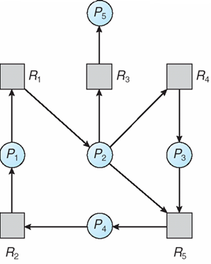
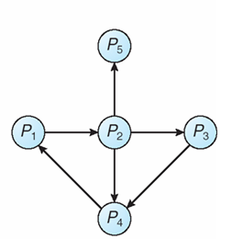
Sample Question 2:
Q1: What is the corresponding Wait-for Graph?
Q2: How many circular-waits exist in the wait-for graph? List the processes of each circular-wait.

Slide 11
Chapter 8: Main Memory
Fragmentation
Internal
External
Segmentation
Base, Limit
Paging
Page Tables
Hierarchical Page Table
Hashed Page Tables
Inverted Page Table

Slide 12
Chapter 8: Main Memory
1. A certain MMU converts 16-bit virtual address with 512-byte pages into 20-bit physical addresses. How big is the page table?
128 entries (2⁷)
2048 entries (2¹¹)
65536 entries (2¹⁶)
1048576 entries (2²⁰)
2. Assuming a 2-KB page size, what are the page numbers and offsets for the following address references (provided as decimal numbers):
For example: Address: 3085 ➔ page = 1; offset = 1037
Logical Address: 5289
3. Consider the following segment table:
What are the physical addresses for the logical address: 2, 50?
Segment | Base | Length
0 | 249 | 600
1 | 2300 | 14
2 | 98 | 100
3 | 1127 | 5800

Slide 13
Chapter 9: Virtual Memory
Virtual memory – separation of user logical memory from physical memory
Page Replacement Algorithms
FIFO
Optimal Algorithm
LRU
Second Chance Algorithm
What is Thrashing?

Slide 14
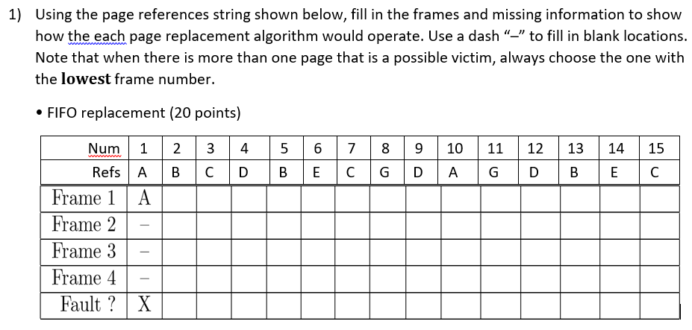
Sample Questions
What is the number of page fault?

