Slide 1
The Thirty-Ninth AAAI Conference on Artificial Intelligence (AAAI-25)
R-DTI: Drug Target Interaction Prediction Based on Second-Order Relevance Exploration
(1) construct a pre-trained structural feature extractor that mines the atomic relevance of each amino acid
the complex protein structures cannot be well represented by current protein sequence-based feature extractors
(2) An inter-feature structure-preserved Riemannian network is designed to expand the existing protein extraction patterns
the gap between protein and drug features increases the vulnerability of the obtained classifier thus degrading the prediction robustness
(3) develop a Riemannian classifier that uses the second-order protein-drug relevance with a unified feature space
Niu Wentao
Notes:
当前的基于蛋白质序列的特征提取器不能很好的表现蛋白质复杂的结构 ->构造预训练的结构提取器挖掘每个氨基酸的原子相关性
->设计了一种特征间结构保存的黎曼网络，以扩展现有的蛋白质提取模式 蛋白质与药物特征之间差距大，设计预测泛化能力强的分类器难度大
->开发一种黎曼分类器 ，其使用二阶蛋白质-药物相关性在统一的特征空间

Slide 2
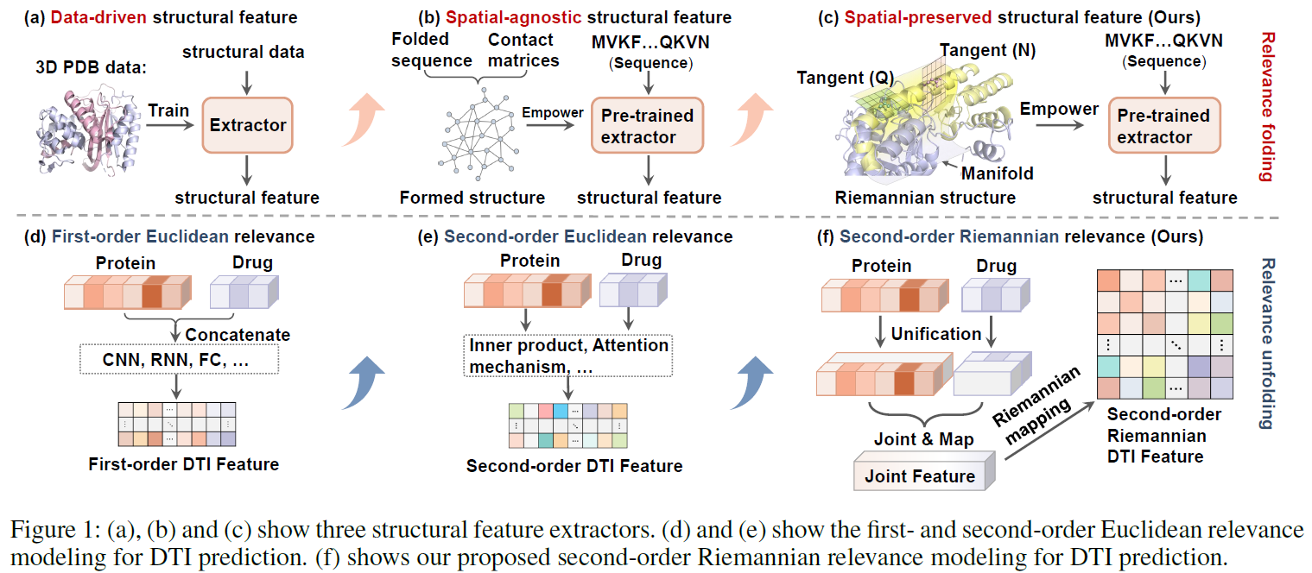
Limited by the small number of 3D protein samples
The training process lacks spatial structure information
The protein features are relatively long, resulting in the classifier's bias towards protein features
The feature Spaces of the two are difficult to unify, and matrix multiplication leads to excessive information density
Notes:
图1(a) 根据3D蛋白质结构数据 提取结构特征，但是受限于3D蛋白质数量样本较少 图1(b) 【与空间无关的结构特征】
尝试解决在没有结构数据的情况下提取结构特征的问题，其使用了预训练编码器，但是只通过接触矩阵+对比学习训练， 而没有三维属性和拓扑结构，无法获取有效的结构。 图2(a)【一阶欧几里得相关性】，concat后的特征提取，但由于该方式较依赖数据驱动，会使分类器训练偏向蛋白质特征，而抑制药物线索。 图2(b)【二阶欧几里得相关性】，通过矩阵乘法来融合特征，但蛋白质-药物特征空间较难统一，且信息密度过大导致较难收敛

Slide 3

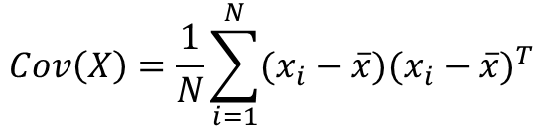
How does the author extract structural features from the sequence?
Construct the covariance matrix of amino acids vectors to emphasize the second-order correlation within a protein.
$$Cov\left(X\right)=\frac{1}{N}\sum_{i=1}^{N}{(x_{i}−\overline{x})(x_{i}−\overline{x})^{T}}$$
$x_{i}$ represents the amino acid vector
$X=\{x_{1},x_{2},…,x_{N}\}∈ℝ^{N×D}$,$Cov(X)∈ℝ^{D×D}$
If the variance of the sample is not 0, then it is positive definite
To preserve the topological relationships between amino acids within a protein, we consider amino acids distributed on the protein manifold.
Notes:
为了更好的提取氨基酸的结构特征，图1(c)构建氨基酸向量的协方差矩阵，以强调蛋白质内部的二阶相关性。
此外，为了保留氨基酸之间的拓扑关系，考虑了分布在蛋白质流形上氨基酸。
【蛋白质的三维结构本质上是一个非欧几里得几何体-可以被视作流形（manifold），尤其是黎曼流形】

Slide 4
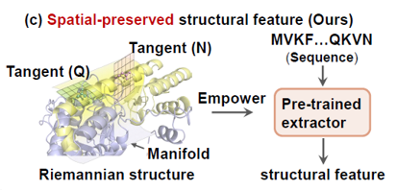

The authors use SPD matrices to construct Riemannian manifolds.
Why does the SPD matrix form a Riemannian manifold？
$$S_{++}^{n}=\{X∈R^{n×n}|X^{T}=X,x^{T}Xx>0 ∀x≠0\}$$
This set is all the symmetric positive definite matrices of $n×n$
This set satisfies the following properties:
It is an open series.
It is a smooth manifold (which can be differentiated)
Riemannian metrics can be defined, such as Affine-Invariant Metric.
Affine-Invariant Metric :
Given two SPD matrices P and Q, the distance between them is:
$$dist\left(P,Q\right)=||\log{(P^{−1/2}QP^{−1/2}){||}_{F}}$$
This distance takes into account the manifold geometry structure
Notes:
这个集合是𝑛×𝑛的所有对称正定矩阵的集合 这组矩阵具有以下特性：
它是一个开放序列。
它是一个光滑的流形（可以微分）可
定义黎曼度量，如 Affine-Invariant Metric【在 SPD 流形上定义的一种度量距离的方法，保证了无论你对输入矩阵做什么仿射变换，它们之间的距离不会改变】。

Slide 5
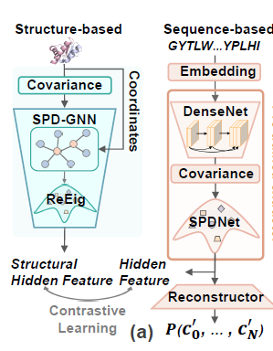
Regarding the training process of Figure 1 (c)
On one hand,
Vector representation of 1D embedding of proteins (B,N,128)
Calculate the covariance matrix and regularize its diagonal
Get the SPD(symmetric positive definite) matrix $P$
The protein sequence is represented as a point on a Riemannian manifold. Additionally, the overall structural characteristics of the protein sequence (covariance form) are indicated.
Captured the global structural relationship (the coordinated changes among all residues)
Notes:
捕捉了全局结构关系（所有残基之间的协同变化） 将蛋白质序列表示为一个在黎曼流形上的点，此外，表示了蛋白质序列的整体结构特征（协方差形式）

Slide 6
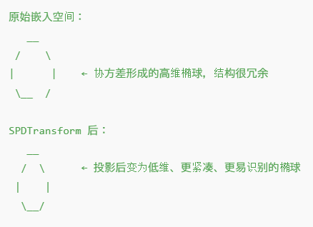
沿测地线方向做了一个投影或嵌入，能够：
学习结构上的“主方向”
排除无用维度
提升模型对结构差异的感知能力

Slide 7

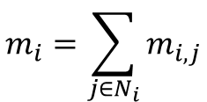

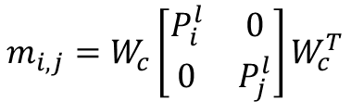
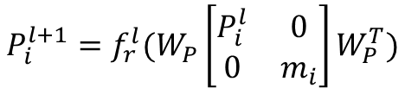
SPD Transform
feature extraction
$$P^{′}=WPW^{T}$$
Ensure that the output is still the SPD matrix (because the transformation maintains symmetry and positivity)
In Euclidean space, MLP is a linear layer + activation;
In the SPD manifold, (SPD Transform)*n is a continuous Riemannian transformation.
SPD-GNN
The update process of amino acid (node) features at each layer ($l$) is as follows:
$$m_{i,j}=W_{c}\left[\begin{matrix}P_{i}^{l} & 0 \\ 0 & P_{j}^{l}\end{matrix}\right]W_{c}^{T}$$
Get the information on the edge $m_{ij}$ from amino acid $j$ to amino acid $i$ in the layer $l$
$$m_{i}=\sum_{j∈N_{i}}{m_{i,j}}$$
Aggregate all the information of the edges with amino acid $i$ as the target node to obtain the neighbor summary representation of amino acid $i$
(The edge $m_{i,j}$ information is obtained from 3D coordinates +K-Nearest Neighbors Graph)
$$P_{i}^{l+1}=f_{r}^{l}(W_{P}\left[\begin{matrix}P_{i}^{l} & 0 \\ 0 & m_{i}\end{matrix}\right]W_{P}^{T})$$
Get the features of amino acid $i$ in the $l+1$ layer
$$Final: ℱ_{S}=\left\{P_{0},…,P_{N_{i}}\right\} [B,N,256]$$
Some eigenvalues in the covariance matrix may be very small, close to 0, which can lead to numerical instability or irreversibility.Therefore, the $f_{r}^{l}$ is used to ensure that all eigenvalues are greater than a certain positive number ε, so that the matrix is strictly positive definite and remains within the SPD manifold.
Notes:
保证输出仍是 SPD 矩阵（因为变换保持对称性和正定性） 特征变换：在欧几里得空间中 MLP 是线性层 + 激活； 在 SPD 流形中，(SPD Transform)*n 是连续的黎曼变换。
氨基酸(节点)特征在每一层的更新方式如下:
获取第l层，氨基酸j到氨基酸i的边mij上的信息 聚合以氨基酸i为目标节点的边的所有信息，以获得氨基酸i的邻居汇总表示
获取第L+1层，氨基酸i的特征， 协方差矩阵中的某些特征值可能非常小，接近 0，会导致数值不稳定或不可逆。因此，$f_{r}^{l}$ 层用于保证所有特征值大于某个正数 ε，
使得矩阵严格正定，保持在 SPD 流形内。

Slide 8


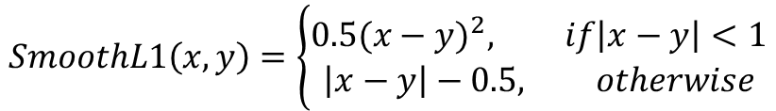






On the other hand,
the encoding embedding of protein sequences (B,N,1024) (derived from the Prot-Bert, a protein language model)
Extract text features using DenseNet
Calculate the covariance matrix and regularize its diagonal
$$ℱ_{T}=\left\{F_{0},…,F_{N_{i}}\right\} [B,N,256]$$
$$ℱ_{T}=\left\{F_{0},…,F_{N_{i}}\right\} [B,N,256]$$
$$ℱ_{S}=\left\{P_{0},…,P_{N_{i}}\right\} [B,N,256]$$
Linear, Multi-head Self-Attention, Linear
Pre-trained extractor
Contrastive Learning All corresponding vectors’ inner product = 1, and non-corresponding ones are 0
$$ℱ_{T_pos}=\left\{F_{0}^{pos},…,F_{N_{i}}^{pos} \right\} [B,N,3]$$
$$loss2$$
$$SmoothL1\left(x,y\right)=\left\{\begin{aligned}0.5(x−y)^{2}, if\left|x−y\right|<1 \\ \left|x−y\right|−0.5, otherwise\end{aligned}\right.$$
$$loss1$$
$$ℱ_{True}^{pos}=\left\{P_{0}^{pos},…,P_{N_{i}}^{pos} \right\} [B,N,3]$$
$$loss_{all}=loss1+0.1loss2$$
Notes:
另一方面，蛋白质序列的编码嵌入（源自Prot-Bert蛋白质语言模型） 使用DenseNet提取文本特征 所有对应向量都是完全一致（内积 = 1），非对应为 0

Slide 9
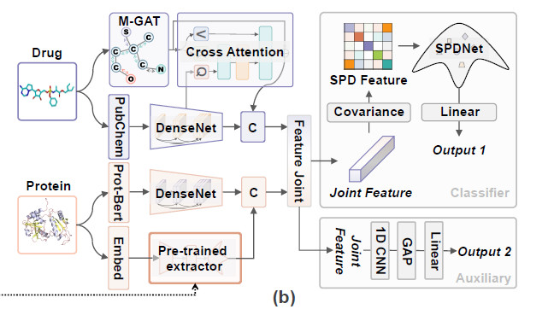




the encoding embedding from the Prot-Bert
DenseNet
$$F_{p}^{t}∈ℝ^{L_{p}×C_{t}}$$
torch.cat
$$Protein$$
$$F_{p}∈ℝ^{L_{p}×({C_{t}+C}_{s})}$$
Pre-trained extractor
the encoding embedding
DenseNet
$$F_{p}^{s}∈ℝ^{L_{p}×C_{s}}$$
the SPD matrix

Slide 10






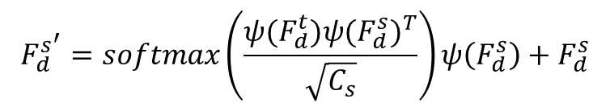




M-GAT
$$W_{a}=σ(ψ(F_{d}^{s^{l}})ψ(F_{d}^{s^{l}})^{T})$$
σ() and ψ() are the sigmoid and linear layers.
$W_{a}∈ℝ^{N_{a}×N_{a}}$ is the atomic relevance matrix
$F_{d}^{s^{l+1}}=(W_{a}∗A)ψ(F_{d}^{s^{l}})$+ $F_{d}^{s^{l}}$
Cross-Attention
$$F_{d}^{s^{′}}=softmax\left(\frac{ψ(F_{d}^{t})ψ(F_{d}^{s})^{T}}{\sqrt{C_{s}}}\right)ψ\left(F_{d}^{s}\right)+F_{d}^{s}$$
the encoding embedding from the Smiles-Bert
torch.cat
DenseNet
$$F_{d}^{t}∈ℝ^{L_{d}×C_{t}}$$
$$F_{d}∈ℝ^{L_{d}×({C_{t}+C}_{s})}$$
$$Drug$$
Rdkit
Cross-Attention
$$F_{d}^{s^{′}}∈ℝ^{L_{d}×C_{s}}$$
$$atomic vectors F_{d}^{s}∈ℝ^{N_{a}×C_{s}}$$
Molecular Graph Attention
(M-GAT) block
align
$$F_{d}^{s}∈ℝ^{L_{d}×C_{s}}$$
$$adjacency matrix A∈ℝ^{N_{a}×N_{a}}$$

Slide 11
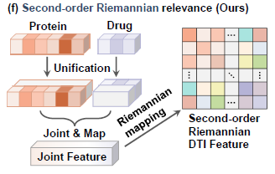
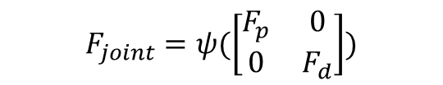
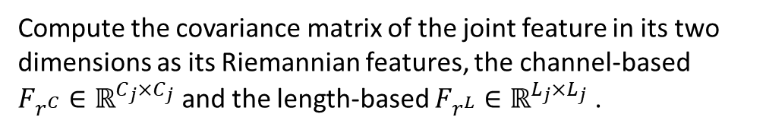
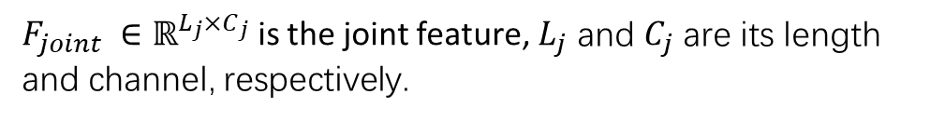
Compute the covariance matrix of the joint feature in its two
dimensions as its Riemannian features, the channel-based
${F_{r^{C}}∈ℝ}^{C_{j}×C_{j}}$ and the length-based ${F_{r^{L}}∈ℝ}^{L_{j}×L_{j}}$ .
$$F_{joint}=ψ(\left[\begin{matrix}F_{p} & 0 \\ 0 & F_{d}\end{matrix}\right])$$
The Riemannian features are compressed using SPDNet and converted into vectors, and then MLP are used to predict DTI
ψ() is the mapping process though linear and GELU layers.
$F_{joint} ∈ℝ^{L_{j}×C_{j}}$ is the joint feature, $L_{j}$ and $C_{j}$ are its length and channel, respectively.

Slide 12
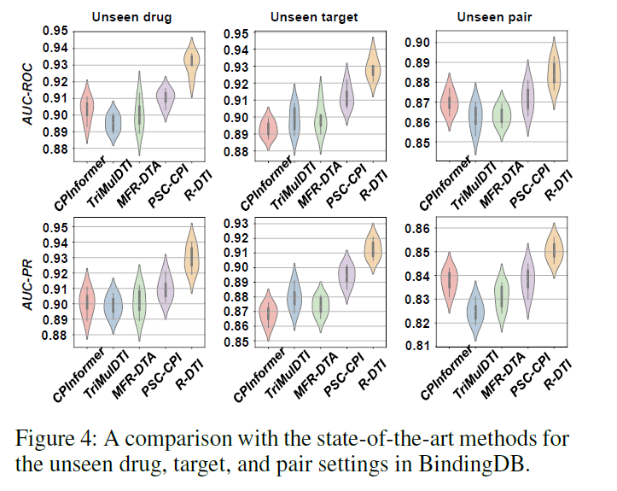
We find that most of these methods perform worse in the Unseen target subset than in the Unseen drug subset, indicating that their learned parameters are biased towards the proteins to some extent. However,
R-DTI using Riemannian SPD features, which is the covariance matrix of the joint protein and drug features, can effectively improve its generalization in the Unseen target subset.
Notes:
我们发现，大多数方法在 "未见目标 "子集中的表现都比在
"未见药物 "子集中的表现差，这表明它们学习到的参数在一定程度
上偏向于蛋白质。然而，使用黎曼 SPD 特征（即蛋白质和药物联合
特征的协方差矩阵）的 R-DTI 可以有效提高其在未见目标子集中的
泛化能力。

Slide 13
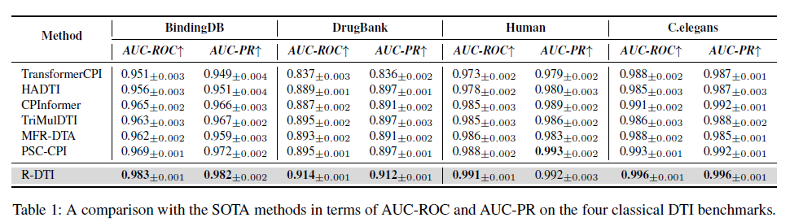
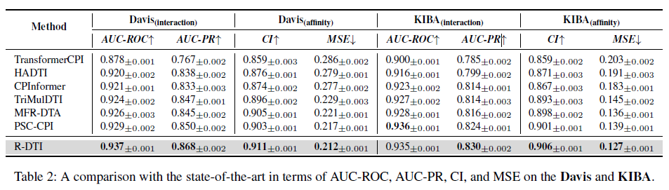

Slide 14
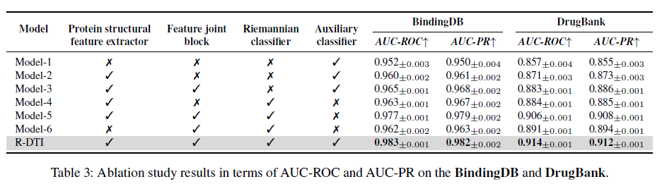
Despite the better predictive performance of the Riemannian classifiers, the complicated gradient computation from the second-order relevance calculation affects the parameter optimization of their upstream feature extractors. Therefore, we introduced an auxiliary classifier to help train the feature extractors, and the final model obtained, i.e., R-DTI, achieves the best performance.
Notes:
尽管黎曼分类器具有较好的预测性能，但二阶相关计算产生的复杂梯度计算影响了其上游特征提取器的参数优化。
因此，我们引入了一个辅助分类器来帮助训练特征提取器，最终得到的模型R-DTI达到了最好的性能。

Slide 15
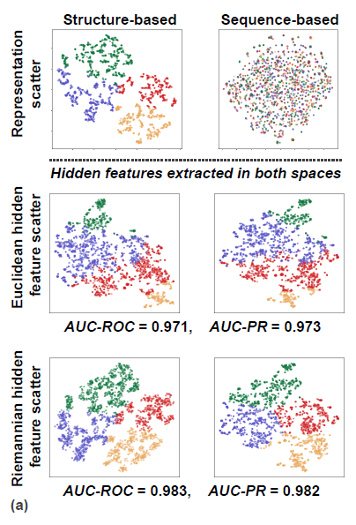

To prove the effectiveness of Riemannian networks in extracting hidden structural features of proteins
cluster the protein samples, which are not involved during
training, into four classes based on the 3D structural representation
$$𝒫^{a}=\{(p_{i}^{a},c_{i}^{a})\}_{i=1}^{N}$$
Obviously, the sequence representations are disordered due to the lack of structural information in the initial sequence embedding
train the sequence-based feature extractor and form the hidden features into two spaces, Euclidean and Riemannian SPD⁽¹⁾
the Euclidean hidden feature scatter is slightly distorted by the original structural features, i.e., there is a bias in the structural information when the protein features are transformed by the Euclidean extractor
(1)The Riemannian SPD features are extracted by the pretrained extractor mentioned above, and the Euclidean features are extracted by a similar extractor, that uses zero padding to make the amino acid structure representations equal in length.
Notes:
为了证明黎曼网络提取蛋白质隐藏结构特征的有效性
欧氏隐性特征散度会被原始结构特征轻微扭曲，即当蛋白质特征被欧氏提取器转换后，结构信息会出现偏差

Slide 16
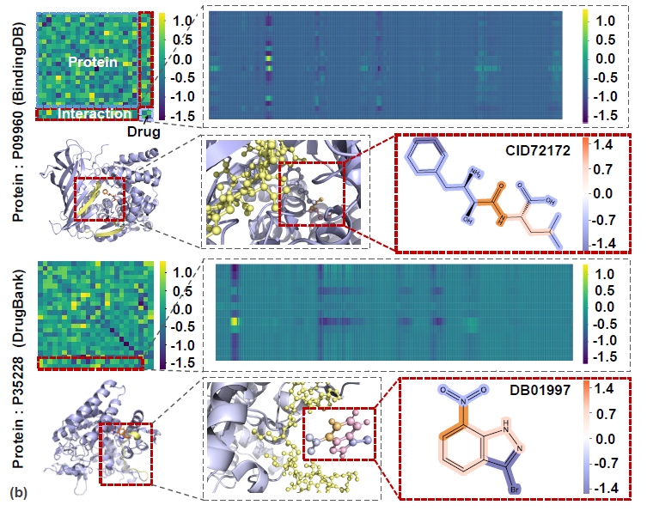
Based on the length-based Riemannian feature, we visualize two pairs of samples from BindingDB and Drug-Bank
It is easy to observe the interactive degree between the amino acids in the protein and the atoms in the drug by visualizing the length-based Riemannian feature
On this basis, we visualize the structure of the protein and the drug, highlighting their high response regions in yellow and orange, respectively.
Notes:
根据基于长度的黎曼特征，我们对来自 BindingDB 和 Drug-Bank 的两对样本进行了可视化处理

Slide 17










































近期工作：
优化模型
Protein Embedding: $Ρ$
Drug substructure: $D^{S}$
atoms set: $D^{A}$
Feature $D^{A}→P^{A}$: $F_{d→p}^{A}$
Drug Embedding: $D$
amino acids set: $P^{A}$
Feature $P^{S}→D^{S}$: $F_{p→d}^{s}$
Feature $P^{A}→D^{A}$: $F_{p→d}^{A}$
Protein substructure: $P^{S}$
Cross-attention: $∝$
Feature $D^{S}→P^{S}$: $F_{d→p}^{s}$
$$Ρ$$
$$P^{S}$$
$$∝$$
$$∝$$
$$Ρ$$
$$P^{A}$$
$$F_{d→p}^{s}$$
$$F_{d→p}^{A}$$
$$F_{d→p}^{A}$$
$$P^{S}$$
$$P^{S}$$
$$P^{A}$$
$$∝$$
$$Ρredicted Label$$
$$∝$$
$$∝$$
$$∝$$
$$∝$$
$$∝$$
$$F_{p→d}^{A}$$
$$D$$
$$D^{S}$$
$$D^{S}$$
$$D^{A}$$
$$D^{A}$$
$$F_{p→d}^{s}$$
$$F_{p→d}^{A}$$
$$∝$$
$$∝$$
$$D$$
$$D^{S}$$

