Slide 1
NLOS Demo
Jan 12, 2026

Slide 2
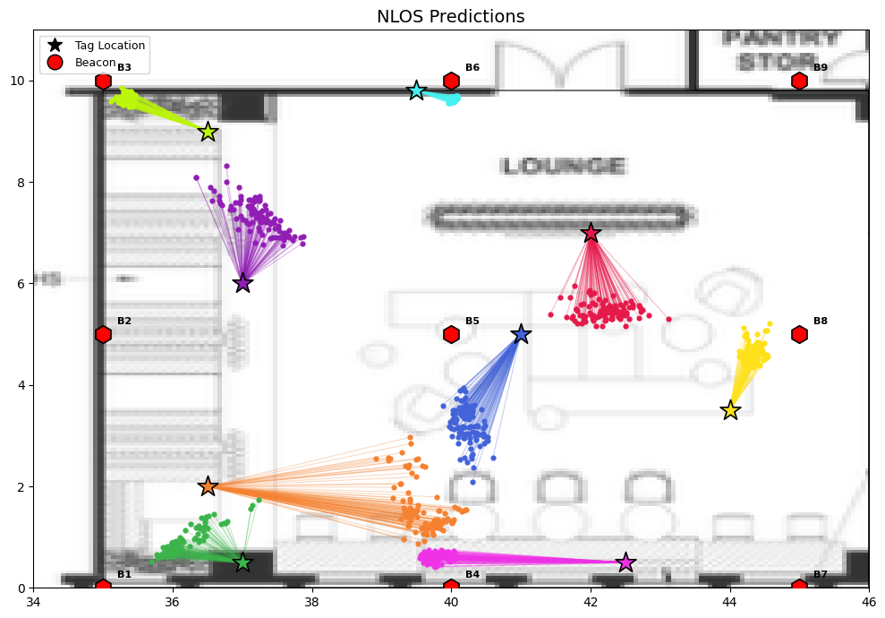
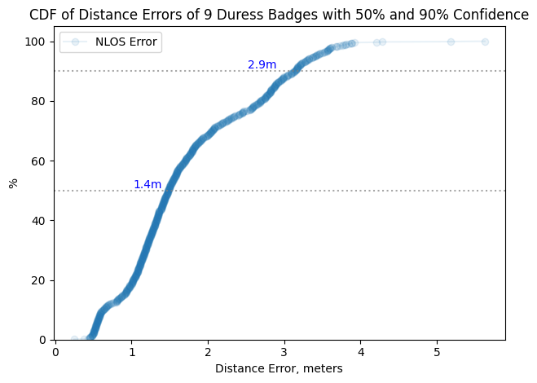
Duress_Demo_Stationary Tags
Installed 9 beacons in the Lounge area, spaced 5m apart
Placed 9 stationary duress badges in various locations
Applied a 5-data-packets for the final location
The error distance is 1.4m at a 50% confidence level and increases to 2.9m at 90% confidence. This higher error margin is due to one tag being placed inside enclosed booth, which weakens the signal and causes interference
Inside Booth

Slide 3
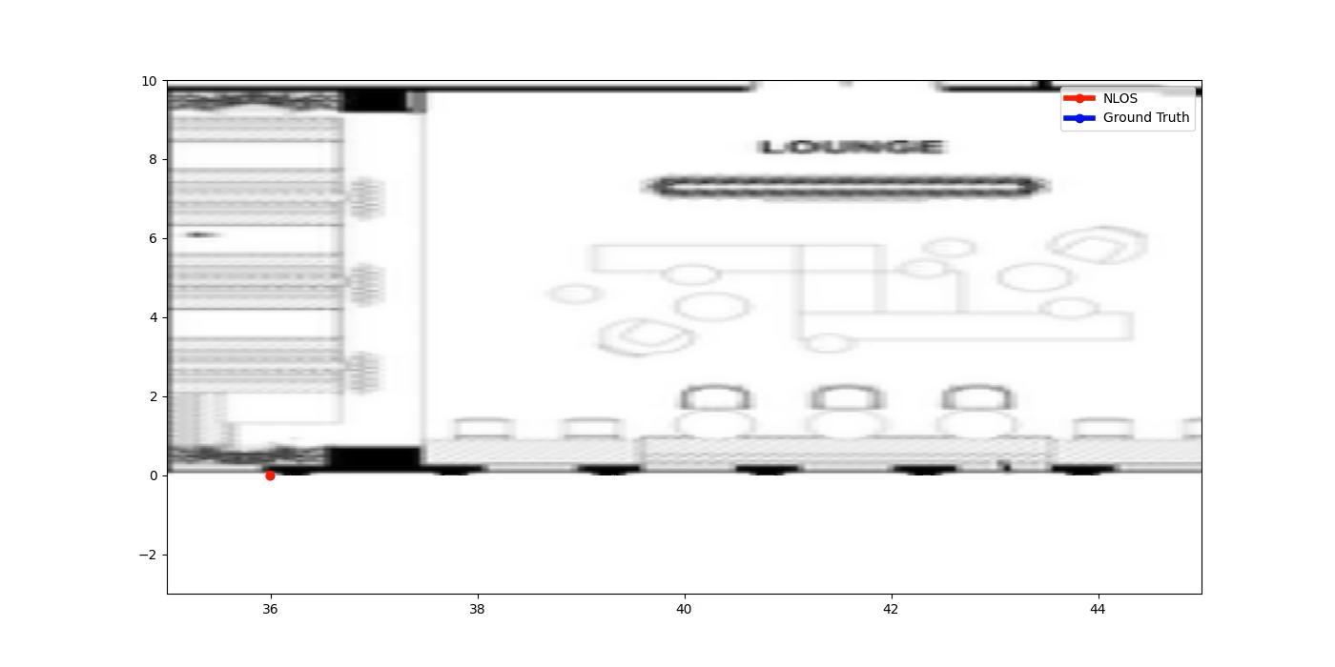
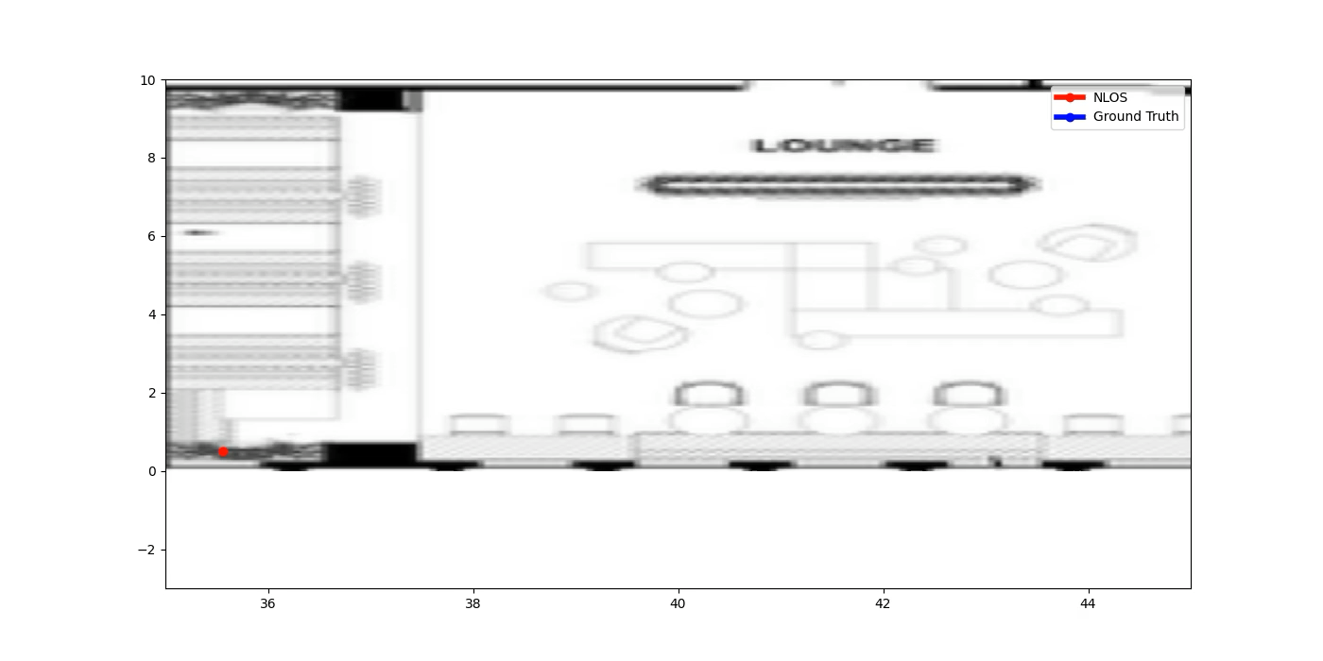
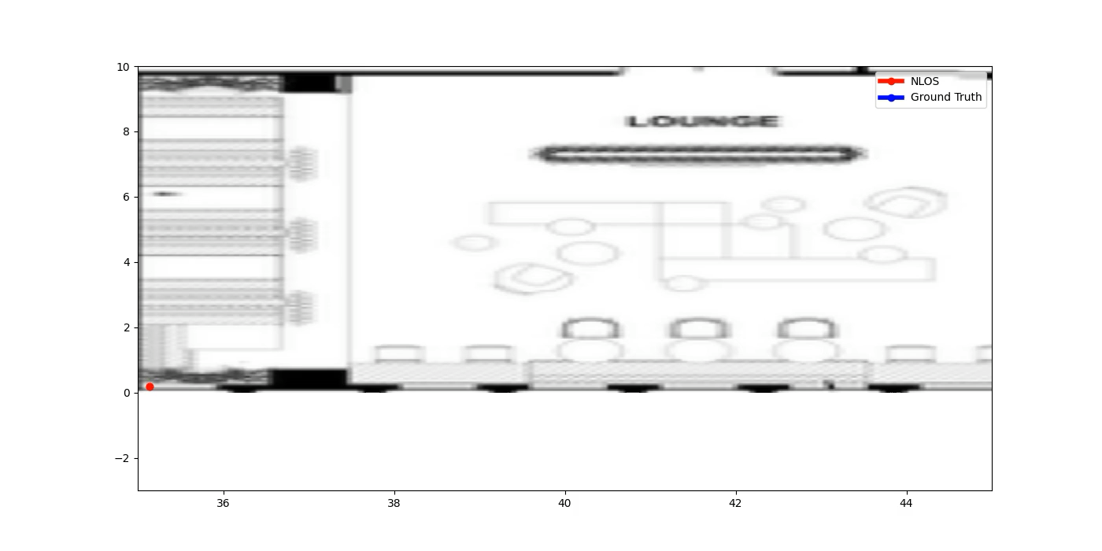
Duress_Demo_Moving Tags
Scenario 1: Slow Walk
Several walking scenarios were evaluated in the lounge area, including slow and normal walking.
Slow walking (scenario 1) enables the model to accurately reconstruct the full route with dense spatial estimates.
For normal walking (scenario 2), the reduced number of collected data packets leads to sparse spatial estimation. Despite this sparsity, the model consistently captures the overall trajectory and motion direction.
Start
Scenario 2: Normal Walk
Scenario 2: Normal Walk Across the Lounge

Slide 4
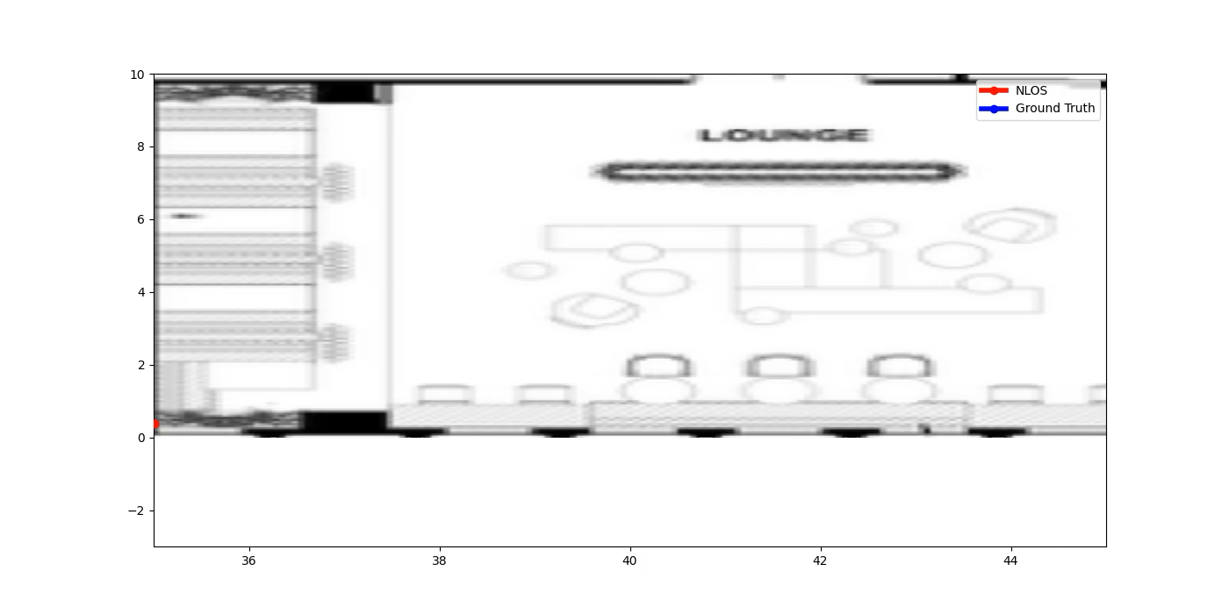
Duress_Demo_Moving Tags
Due to the limited number of data packets collected during fast motion, the model relies on past data and therefore cannot accurately relate to the true trajectory.
Scenario 4: Running
Start

Slide 5
Duress_Demo_Moving Tags

Slide 6
Duress_Demo_Moving Tags

Slide 7
Duress_Demo_Moving Tags_Open Area

Slide 8
Duress_Demo_Moving Tags

Slide 9
Lab Area

