Slide 1
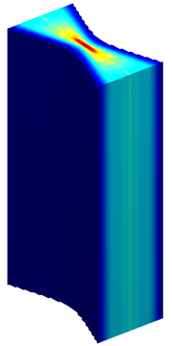
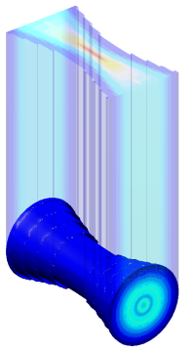
(a)
(i)
(ii)
Camera
Tube
lens
Low NA
High NA
Microscope
objective
SPIM
z
x
Beam
expansion
optics
Sample
chamber
Laser
Cylindrical
lens
y
x
(b)
DSLM
y
x
Beam
scanning
optics
Beam
expansion
optics
Laser
spherical
lens

