Slide 1
Empirical Study of Active Learning Algorithms
Chen Liu, Shi Gao and Ye Tian
University of California, Los Angeles

Slide 2
Motivation
A whole lot of unlabeled points available, but labels expensive
Choose data points which are most informative
Typical scenarios
Document (image, video) Labeling
Hand-writing recognition (Captcha)
Speech recognition
Goal: accurate classifier with minimum cost

Slide 3
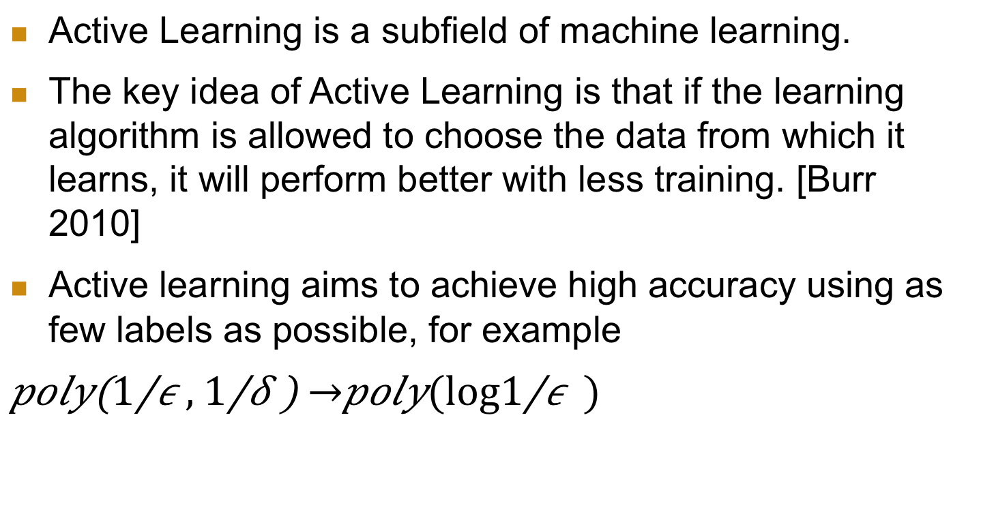
What is Active Learning?
Active Learning is a subfield of machine learning.
The key idea of Active Learning is that if the learning algorithm is allowed to choose the data from which it learns, it will perform better with less training. [Burr 2010]
Active learning aims to achieve high accuracy using as few labels as possible, for example
$$poly\left(\frac{1}{ε}, \frac{1}{δ}\right) →poly(\log{\frac{1}{ε}})$$

Slide 4
Active Learning
Example: threshold
Find transition between 0 and 1 labels in minimum steps
Version space
The “possible” hypothesis space according to seen labels
Idea: some data points give no additional information to narrow down the version space so we don’t need to learn from it.
?
?
?
?
0
0
?
1
?
?
1
?
?
?
0
1
x
x
x
x
x
x
x
x
x
x

Slide 5
Algorithms
Query by Committee
Active Perceptron
Margin Based Active Learning
These algorithms are efficient and have a proven theoretical error bound under certain assumptions
We will present
The algorithm description
Assumptions
Theoretical Bounds

Slide 6
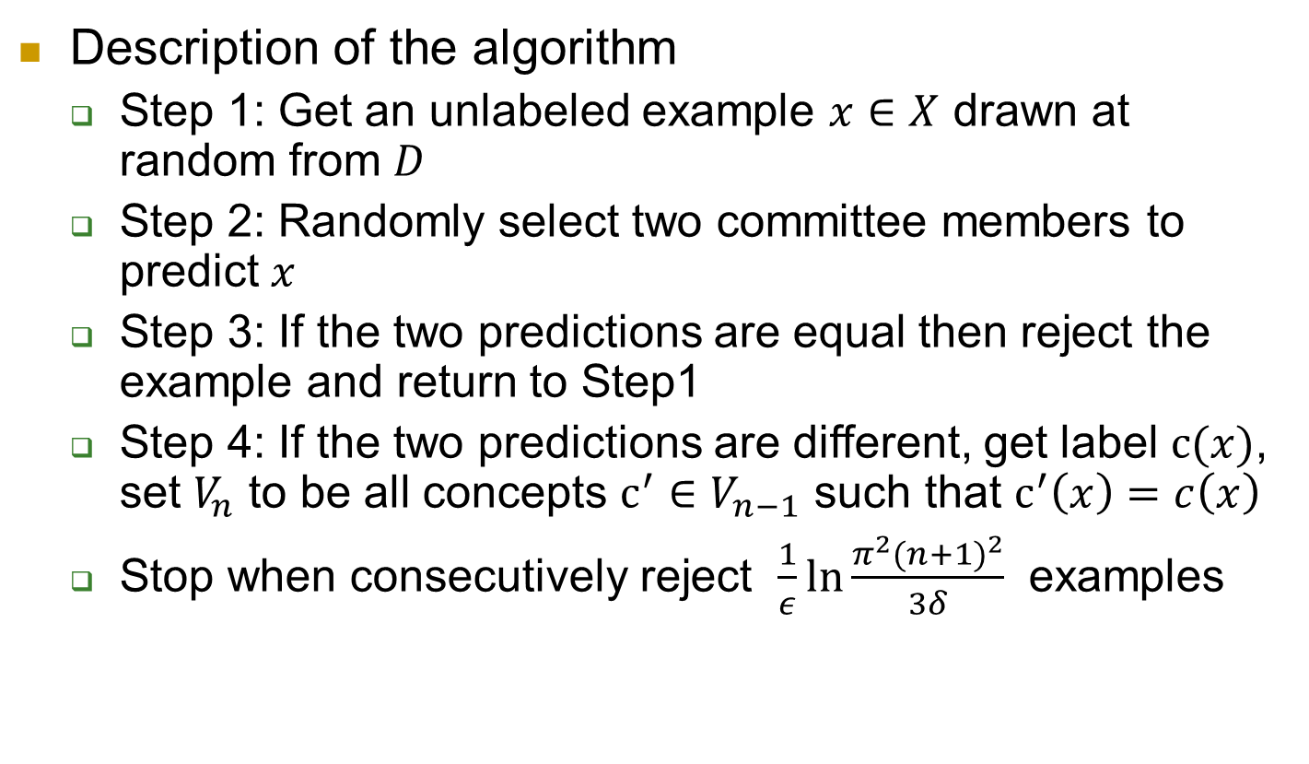
Query By Committee
Description of the algorithm
Step 1: Get an unlabeled example $x∈X$ drawn at random from $D$
Step 2: Randomly select two committee members to predict $x$
Step 3: If the two predictions are equal then reject the example and return to Step1
Step 4: If the two predictions are different, get label $c(x)$, set $V_{n}$ to be all concepts $c^{′}∈V_{n−1}$ such that $c^{′}\left(x\right)=c\left(x\right)$
Stop when consecutively reject $\frac{1}{ε}\ln{\frac{π^{2}{(n+1)}^{2}}{3δ}}$ examples
Notes:
QBC maintains a committee of hypotheses consistent with the labeled examples it has seen so far – a representation of the version space. For many real-world problems, the committee is infinite. The main obstacle in implementing QBC is the need to sample from the version space (step 2).
It is hard to do this with reasonable computational complexity in high dimension space.

Slide 7

Query By Committee
Information Gain
The instantaneous information gain from the i th label example
$$−\log{\frac{{Pr}_{p}(V_{i})}{{Pr}_{p}(V_{i−1})}}$$
It is proved that there exists a uniform lower bound $1/9+7/(18\ln{2})$ for information gain for any dimension.
Notes:
Gibbs prediction means to predict the label of example by picking a hypothesis h random from version space
Namely, QBC will reach a generalization error of$ε$ when using only $O(\log{\frac{1}{∈}})$ labels

Slide 8
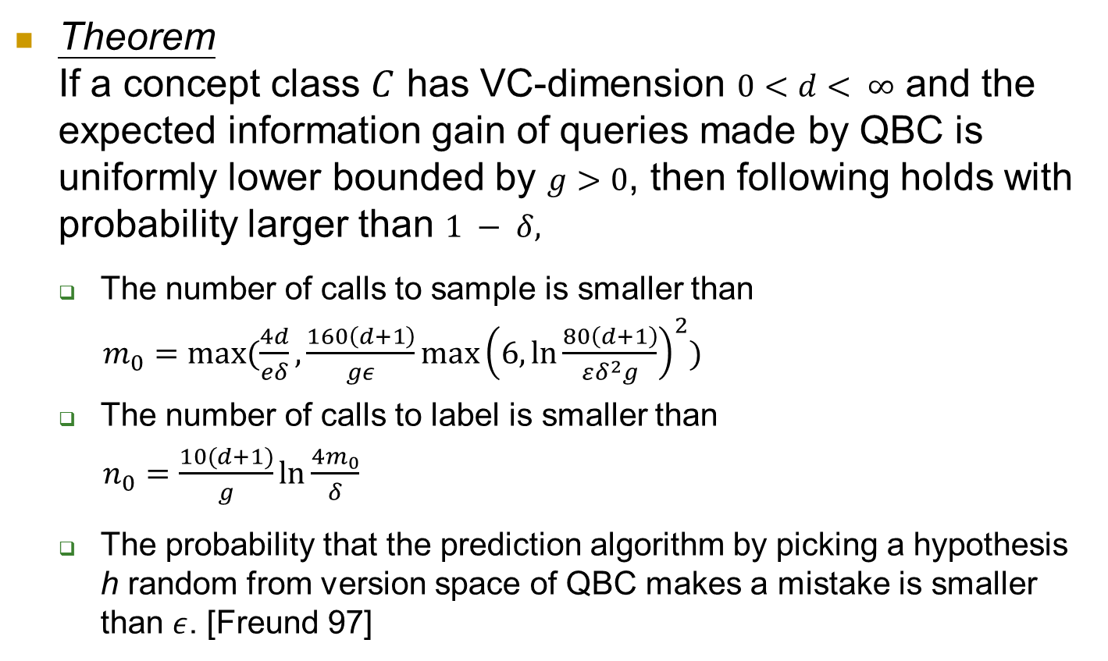
Query By Committee
Theorem If a concept class $C$ has VC-dimension $0<d< ∞$ and the expected information gain of queries made by QBC is uniformly lower bounded by $g>0$, then following holds with probability larger than $1 − δ,$
The number of calls to sample is smaller than
$m_{0}=max⁡(\frac{4d}{eδ},\frac{160\left(d+1\right)}{gε}\max{{\left(6, \ln{\frac{80\left(d+1\right)}{εδ^{2}g}}\right)}^{2}})$
The number of calls to label is smaller than
$n_{0}=\frac{10(d+1)}{g}\ln{\frac{4m_{0}}{δ}}$
The probability that the prediction algorithm by picking a hypothesis h random from version space of QBC makes a mistake is smaller than $ε$. [Freund 97]
Notes:
Gibbs prediction means to predict the label of example by picking a hypothesis h random from version space
Namely, QBC will reach a generalization error of$ε$ when using only $O(\log{\frac{1}{∈}})$ labels

Slide 9
Query By Committee
For many real-world problems, the committee is infinite.
The main obstacle in implementing QBC is to sample from the version space (Step 2). It is hard to do this with reasonable computational complexity when d is very large [Ran 2005].
QBC is very sensitive for noisy data sets.
We implement original QBC for low dimension data and Active-majority QBC [Liere 97] for high dimension data.
Use Winnow algorithm to maintain a finite committee
Notes:
QBC maintains a committee of hypotheses consistent with the labeled examples it has seen so far – a representation of the version space. For many real-world problems, the committee is infinite. The main obstacle in implementing QBC is the need to sample from the version space (step 2).
It is hard to do this with reasonable computational complexity in high dimension space. When there is a very large number of candidate hypotheses, explicitly representing them will not be practical.

Slide 10
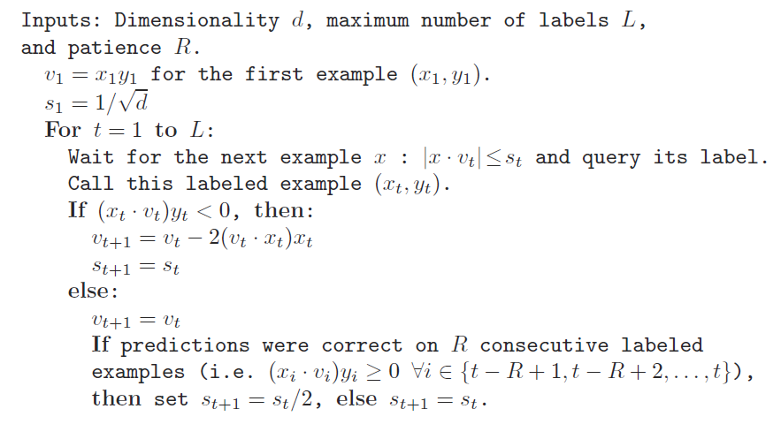
Active Perceptron
[Dasgupta 2005]

Slide 11
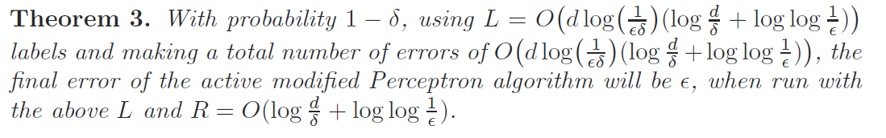
Active Perceptron
Assumptions
Data is uniformly distributed on unit ball centered at origin in R^n
There exists an oracle

Slide 12
Margin Based Active Learning
Basic idea: choose points with smallest margin to minimize sample complexity.
If the margin is large than a threshold, the learner reject the point and it will be labeled automatically. Otherwise, the learner query the label and put the point into “working set”
After enough labels seen, train a new model based on seen labels.
Repeat the process several iterations and the error rate reduced to \epsilon.
[Balcan et al. 2007]

Slide 13
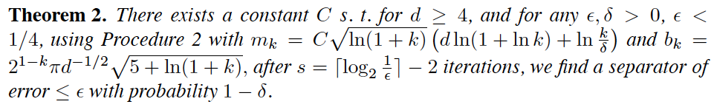
Margin Based Active Learning
Realizable Settings
Uniformly distributed on a unit ball in R^d
Exists an oracle concept
Parameter Settings
s
b
C
Bounds
M_k
error
Algorithm
Draw m_1 examples into working set Iterate k = 1…s find w_k consistent with all labeled examples in working set until m_k points are drawn into ws:
draw next x
if |w_k * x| < b_k
put x into ws
Notes:
Gibbs prediction means to predict the label of example by picking a hypothesis h random from version space
Namely, QBC will reach a generalization error of$ε$ when using only $O(\log{\frac{1}{∈}})$ labels

Slide 14



Margin Based Active Learning
Unrealizable Settings
Uniformly distributed on a unit ball in R^d
Satisfies low noise and
Parameter Settings
Alpha, beta
s
B
R
Bounds
Excess error
Algorithm
Draw m_1 examples into working set Iterate k = 1…s find w_k \in B(w_k-1, r) clear the working set until m_k points are drawn into ws:
draw next x
if |w_k * x| < b_k
put x into ws An approximate approach will not looking for w_k in B(w_k-1, r), but put unlabeled points into ws with their automatic labels.
Notes:
Gibbs prediction means to predict the label of example by picking a hypothesis h random from version space
Namely, QBC will reach a generalization error of$ε$ when using only $O(\log{\frac{1}{∈}})$ labels

Slide 15
Algorithms Recap
Important assumptions:
Algorithms | Linear Separable | Distribution of H | Distribution of X
QBC | Yes | Chosen from a known prior | Chosen from a known distribution on R^d
Active Perceptron | Yes | No | Uniform on unit sephere in R^d
Margin-based Active Learning | No | No | Uniform on unit sephere in R^d
Theoretical bound comparison:
Margin-based < Active Perceptron = QBC

Slide 16
Experiment Setup
Synthesized Dataset
Uniform distributed points on unit sphere centered at origin
Exists an oracle linear separator
Split into training / testing set:
Training points 5000
Testing points 3000
Compare classification accuracy on testing set
Compare with theoretical error bound
Compare with baseline method: Perceptron

Slide 17
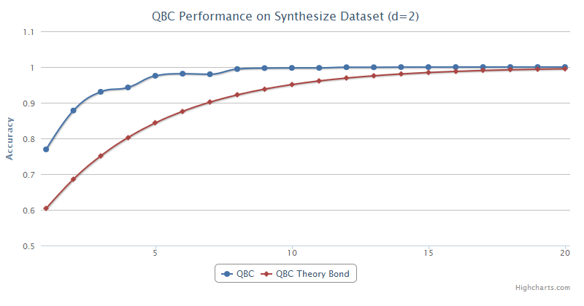
Experiment-Linear Separable

Slide 18
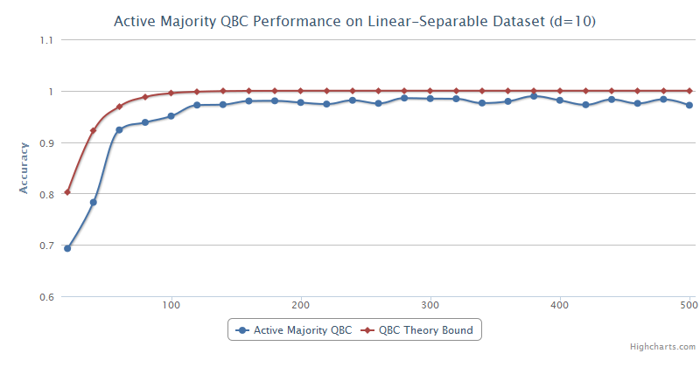
Experiment-Linear Separable

Slide 19
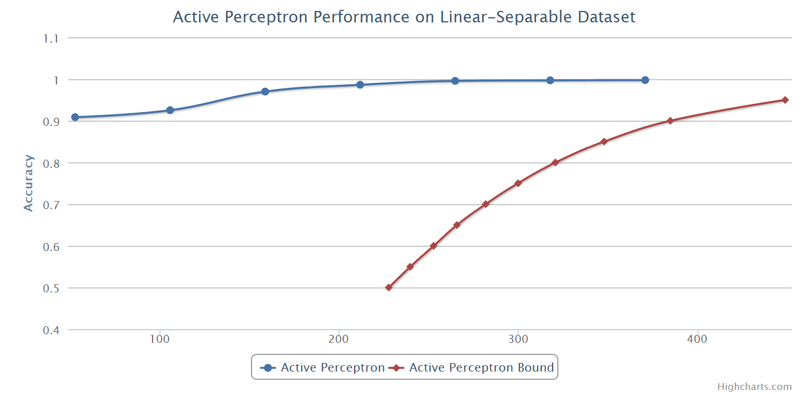
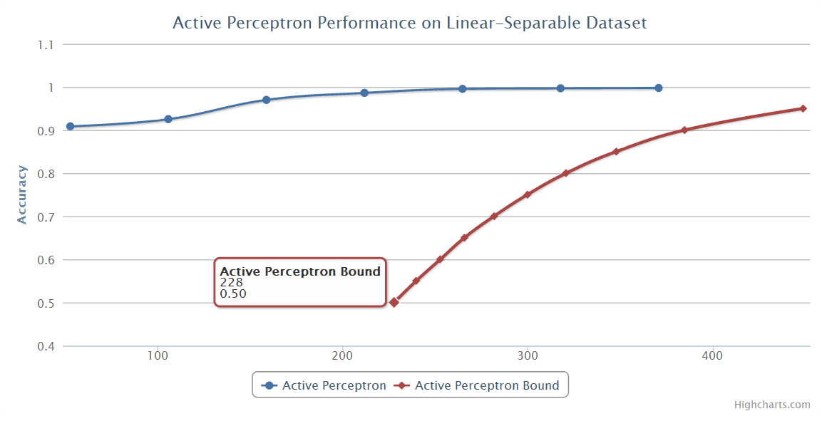
Experiment-Linear Separable

Slide 20
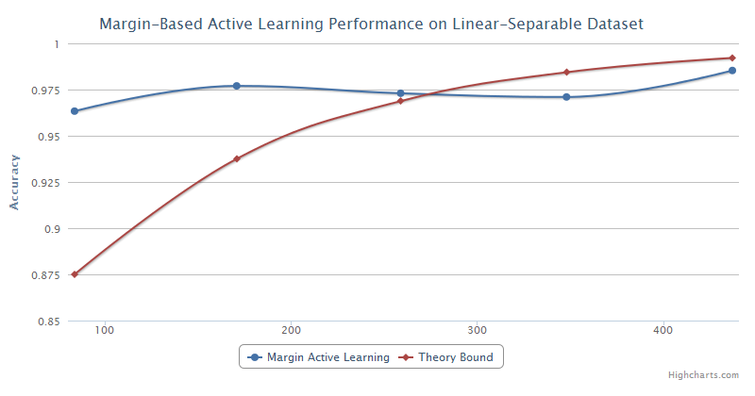
Experiment-Linear Separable

Slide 21
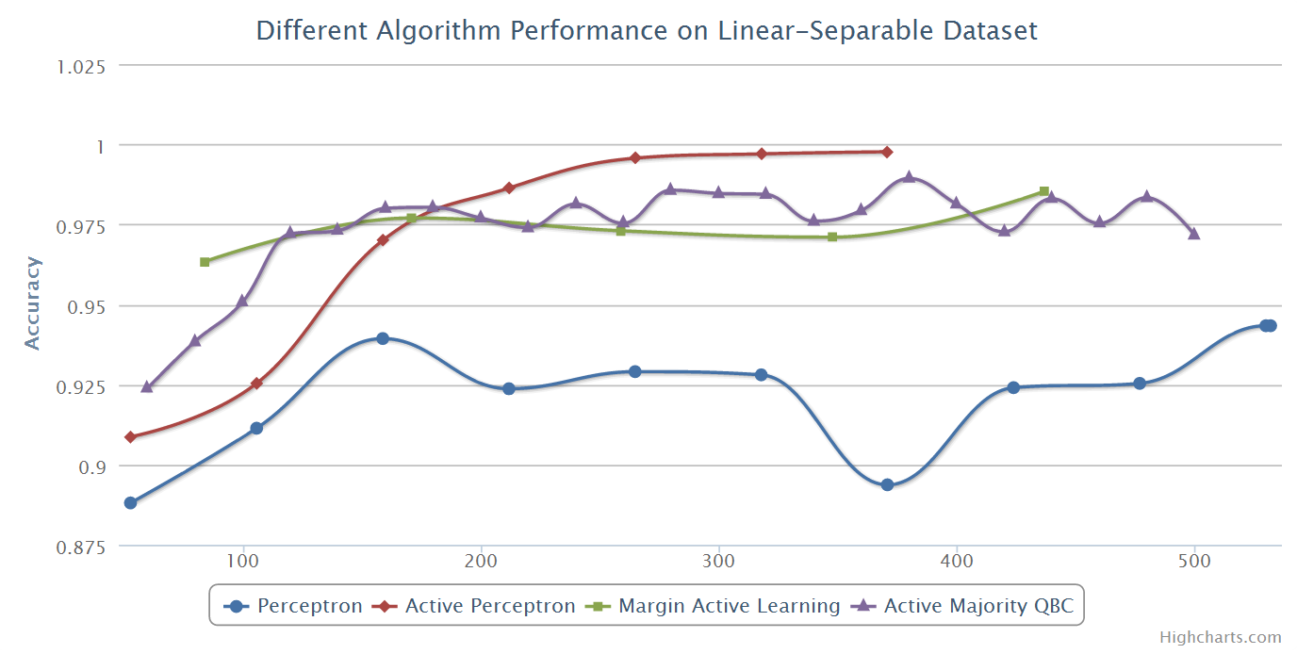
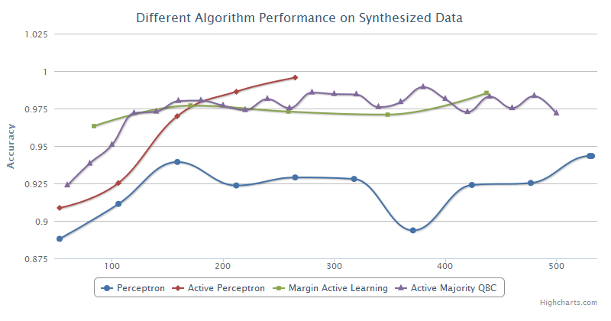
Experiment-Linear Separable

Slide 22
Experiment Setup
Experiment 2: Real world dataset (20news)
Document classification problem
Perform three binary classification tasks
Recreation vs Computer
PC vs Mac
Politics vs Religion
Learn an linear classifier
Feature of the document
Normalized tf-idf weighted term vector for each document
Challenges comparing to synthesis data
Assumption on linear separable data won’t hold
Assumption on concept class distribution won’t hold
Assumption on data distribution won’t hold
Very high dimension (60000+ distinct terms)

Slide 23
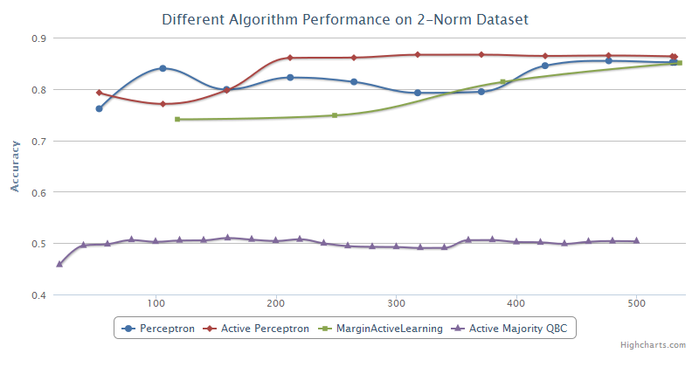
Experiment-Noisy

Slide 24
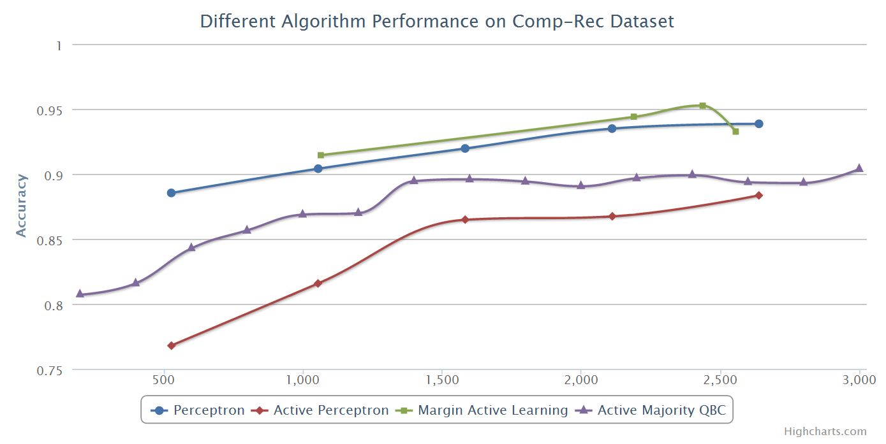
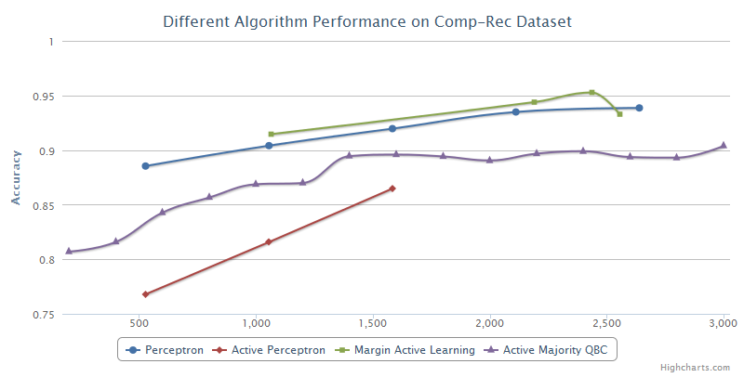
Experiment-Real Data

Slide 25
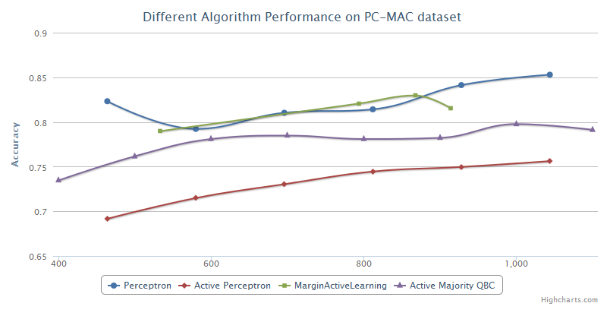
Experiment-Real Data

Slide 26
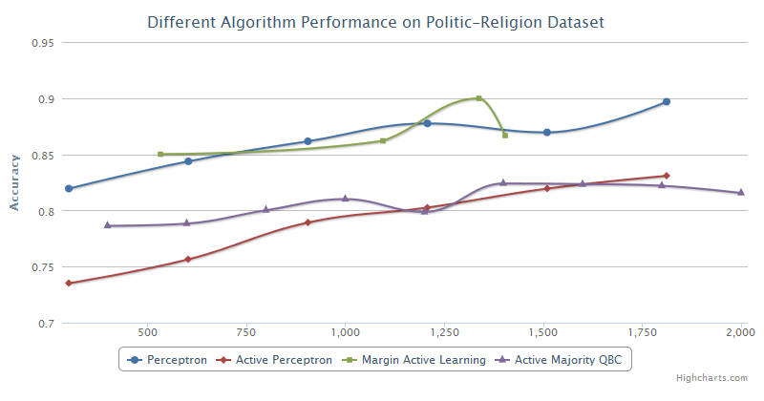
Experiment-Real Data

Slide 27
Closing Remarks
Active learning algorithms performs very well if all assumptions are satisfied.
However, since the assumptions are hardly satisfied in real world database, the performance gain is not as much as expected.

Slide 28
Ongoing
Generate a noisy dataset but satisfies the assumption of margin-based active learning algorithm
Use SVM instead of perceptron for the basic routine of learning for margin-based active learning

Slide 29
Reference
[1] Dasgupta, Kalai, and Monteleoni. Analysis of Perceptron-based Active Learning. COLT, 2005. [2] Freund, Seung, Shamir, and Tishby. Selective Sampling Using the Query by Committee Algorithm. Machine Learning, 1997. [3] Balcan, Broder and Zhang. Margin-based Active Learning. COLT, 2007.
[4] Active Learning Literature Survey, Burr Settles,Computer Sciences Technical Report, January 26, 2010

Slide 30
Q & A

