Slide 1
Empirical Study of Active Learning Algorithms
Chen Liu, Shi Gao and Ye Tian
University of California, Los Angeles

Slide 2
Motivation
Supervised Learning: require labels for every point
In many scenarios, plenty of unlabeled points available, but labels expensive
Typical scenarios
Document (image, video) Labeling
Speech recognition
Solution: Active learning

Slide 3
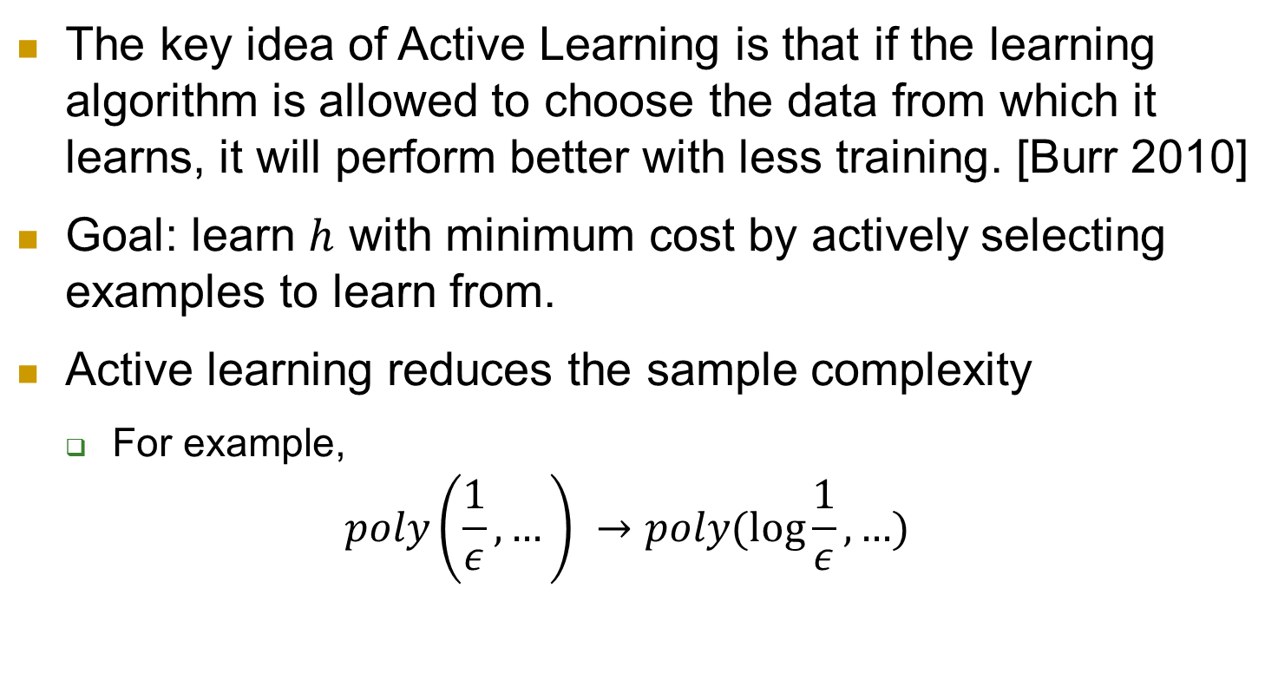
What is Active Learning?
The key idea of Active Learning is that if the learning algorithm is allowed to choose the data from which it learns, it will perform better with less training. [Burr 2010]
Goal: learn $h$ with minimum cost by actively selecting examples to learn from.
Active learning reduces the sample complexity
For example,
$$poly\left(\frac{1}{ε}, …\right) →poly(\log{\frac{1}{ε},…})$$

Slide 4
Active Learning
Example: 2-dimensional linear separator
Data points are unit vectors following uniform distribution
Version space
The “possible” hypothesis space according to seen labels
Idea: some data points give no additional information to narrow down the version space so we don’t need to learn from it.

Slide 5
Outline of Our Project
We implement three active learning algorithms:
Query by Committee
Active Perceptron
Margin Based Active Learning
We will present
Algorithm description and their assumptions
Theoretical bounds
Experiment evaluation on synthetic data and real data
Analysis on the experiment results

Slide 6
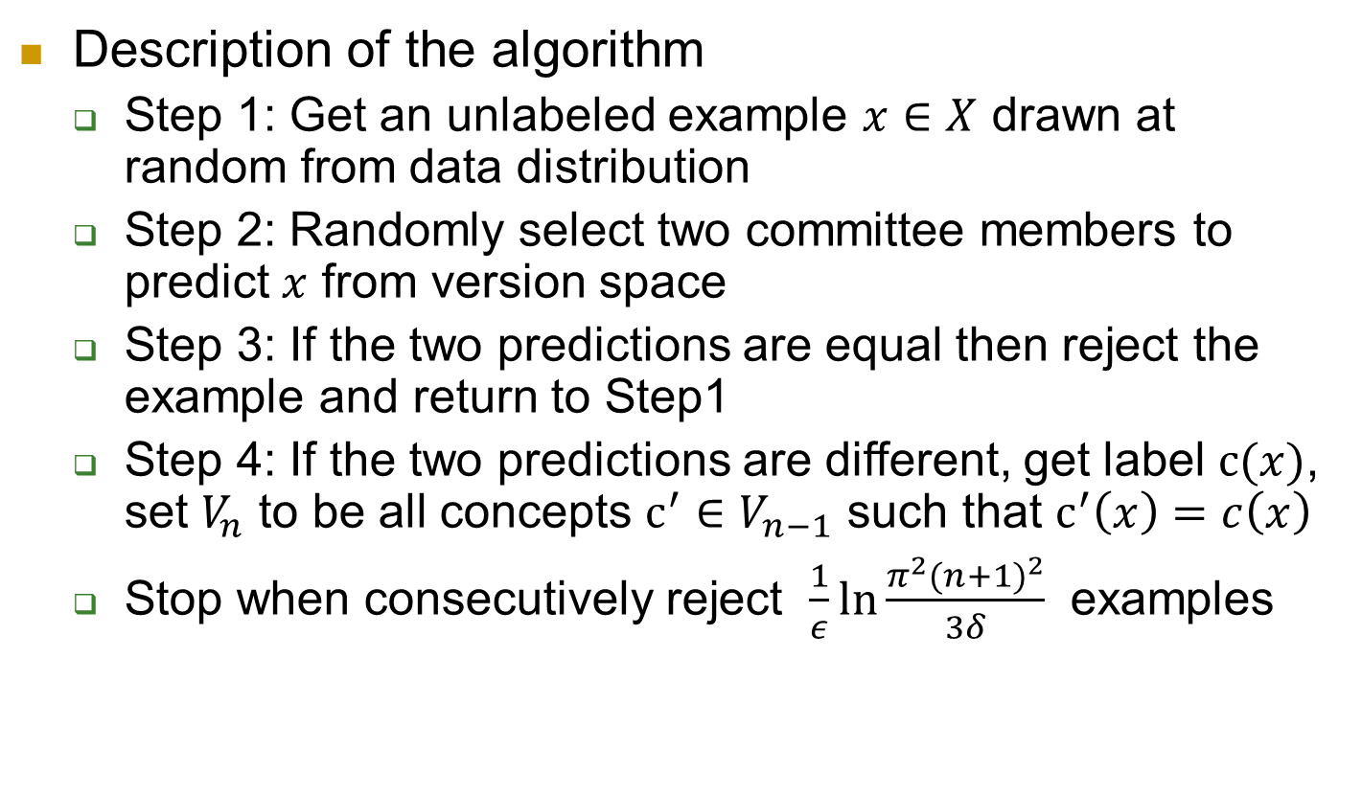
Query By Committee - Algorithm
Description of the algorithm
Step 1: Get an unlabeled example $x∈X$ drawn at random from data distribution
Step 2: Randomly select two committee members to predict $x$ from version space
Step 3: If the two predictions are equal then reject the example and return to Step1
Step 4: If the two predictions are different, get label $c(x)$, set $V_{n}$ to be all concepts $c^{′}∈V_{n−1}$ such that $c^{′}\left(x\right)=c\left(x\right)$
Stop when consecutively reject $\frac{1}{ε}\ln{\frac{π^{2}{(n+1)}^{2}}{3δ}}$ examples
Notes:
QBC maintains a committee of hypotheses consistent with the labeled examples it has seen so far – a representation of the version space. For many real-world problems, the committee is infinite. The main obstacle in implementing QBC is the need to sample from the version space (step 2).
It is hard to do this with reasonable computational complexity in high dimension space.

Slide 7
Query By Committee -Assumptions
Hypothesis H is from a prior distribution
Data is from a know distribution
No noise in data
Notes:
QBC maintains a committee of hypotheses consistent with the labeled examples it has seen so far – a representation of the version space. For many real-world problems, the committee is infinite. The main obstacle in implementing QBC is the need to sample from the version space (step 2).
It is hard to do this with reasonable computational complexity in high dimension space.

Slide 8

Query By Committee
Information Gain
The instantaneous information gain from the i th label example
$$g=−\log{\frac{{Pr}_{p}(V_{i})}{{Pr}_{p}(V_{i−1})}}$$
It is proved that there exists a uniform lower bound $1/9+7/(18\ln{2})$ for information gain for any dimension.
Notes:
Prove process
There exists a lower bound for the cumulative information content of first n_0 queries
There exists a higher bound for the cumulative information content of the first m_0 examples
From 1 and 2, drive a inequality about m_0 and n_0
The number of consecutive rejected examples guarantees that the algorithm stops before testing m_0 + 1 examples
Gibbs prediction by QBC and consecutive rejected examples gives a bound of $ε$

Slide 9
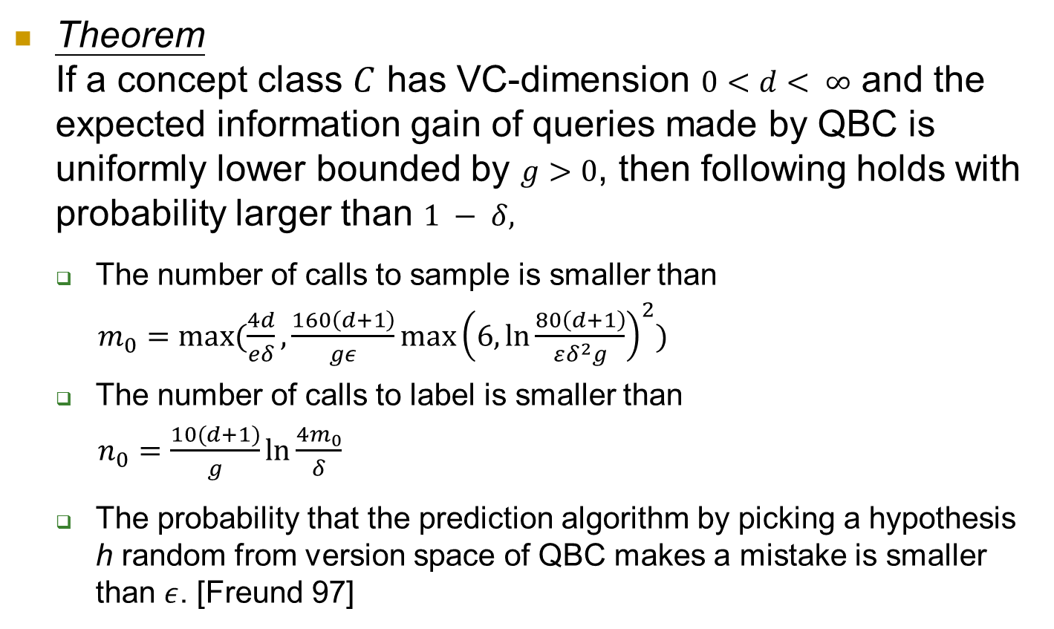
Query By Committee
Theorem If a concept class $C$ has VC-dimension $0<d< ∞$ and the expected information gain of queries made by QBC is uniformly lower bounded by $g>0$, then following holds with probability larger than $1 − δ,$
The number of calls to sample is smaller than
$m_{0}=max⁡(\frac{4d}{eδ},\frac{160\left(d+1\right)}{gε}\max{{\left(6, \ln{\frac{80\left(d+1\right)}{εδ^{2}g}}\right)}^{2}})$
The number of calls to label is smaller than
$n_{0}=\frac{10(d+1)}{g}\ln{\frac{4m_{0}}{δ}}$
The probability that the prediction algorithm by picking a hypothesis h random from version space of QBC makes a mistake is smaller than $ε$. [Freund 97]
Notes:
Gibbs prediction means to predict the label of example by picking a hypothesis h random from version space
Namely, QBC will reach a generalization error of$ε$ when using only $O(\log{\frac{1}{∈}})$ labels

Slide 10
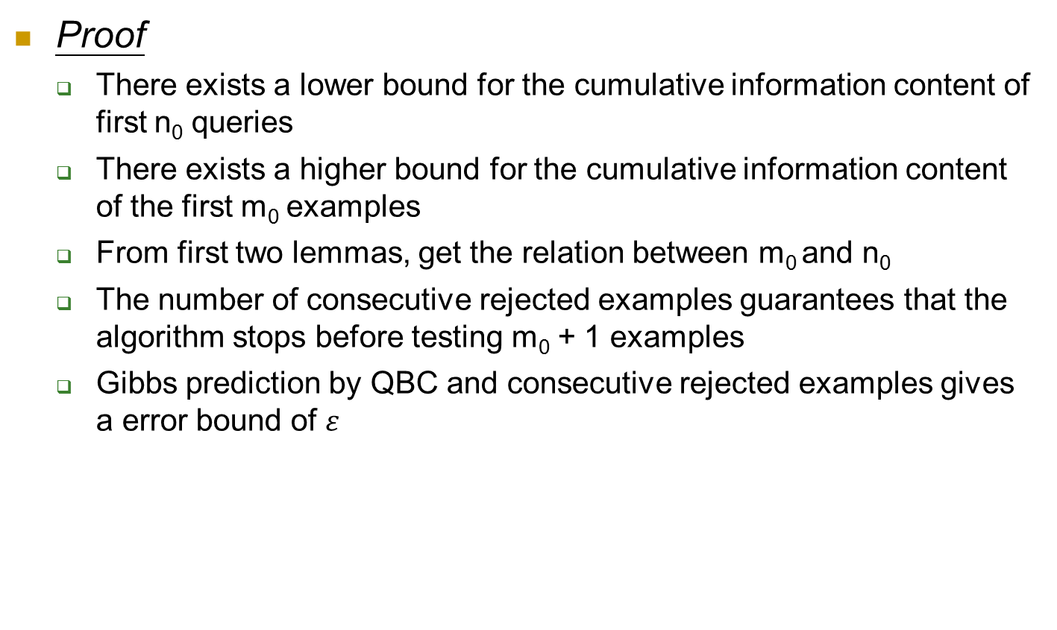
Query By Committee
Proof
There exists a lower bound for the cumulative information content of first n₀ queries
There exists a higher bound for the cumulative information content of the first m₀ examples
From first two lemmas, get the relation between m₀ and n₀
The number of consecutive rejected examples guarantees that the algorithm stops before testing m₀ + 1 examples
Gibbs prediction by QBC and consecutive rejected examples gives a error bound of $ε$

Slide 11
Query By Committee
For many real-world problems, the committee is infinite.
The main obstacle in implementing QBC is to sample from the version space (Step 2). It is hard to do this with reasonable computational complexity when d is very large [Ran 2005].
QBC is very sensitive for noisy data sets.
We implement original QBC for low dimension data and Active-majority QBC [Liere 97] for high dimension data.
Use Winnow algorithm to maintain a finite committee
Notes:
QBC maintains a committee of hypotheses consistent with the labeled examples it has seen so far – a representation of the version space. For many real-world problems, the committee is infinite. The main obstacle in implementing QBC is the need to sample from the version space (step 2).
It is hard to do this with reasonable computational complexity in high dimension space. When there is a very large number of candidate hypotheses, explicitly representing them will not be practical.

Slide 12
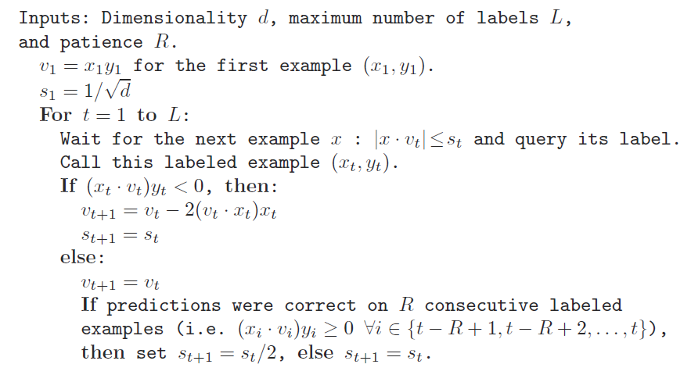
Active Perceptron - Algorithm
[Dasgupta 2005]

Slide 13
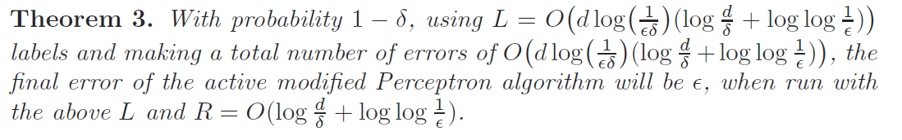
Active Perceptron
Assumptions
Data points are unit vectors following uniform distribution
Data is separable
Theoretical bound

Slide 14
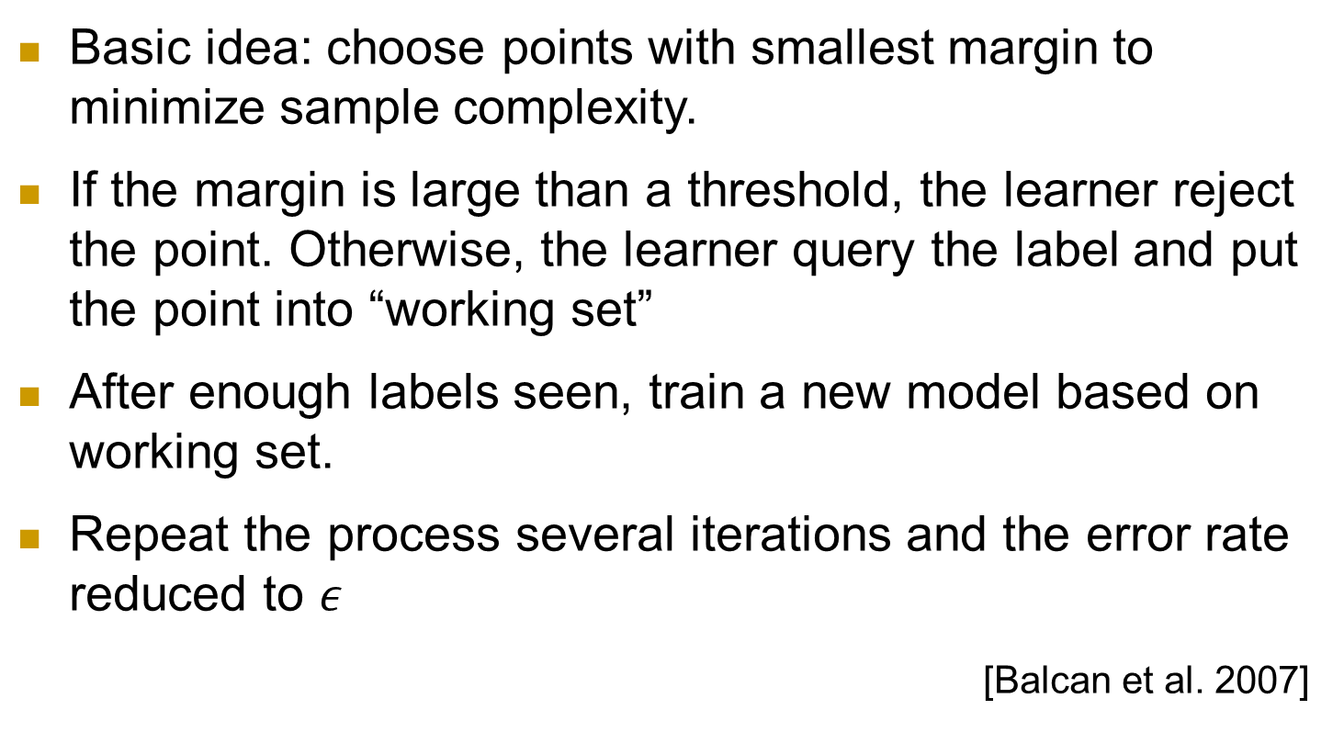
Margin Based Active Learning
Basic idea: choose points with smallest margin to minimize sample complexity.
If the margin is large than a threshold, the learner reject the point. Otherwise, the learner query the label and put the point into “working set”
After enough labels seen, train a new model based on working set.
Repeat the process several iterations and the error rate reduced to $ε$
[Balcan et al. 2007]

Slide 15
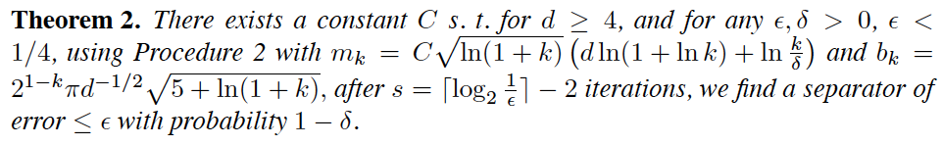
Margin Based Active Learning
Realizable Settings
Uniformly distributed on a unit ball in R^{d}
Exists an oracle concept
Parameter Settings
s
b
C
Bounds
M_k
error
Algorithm
Draw m₁ examples into working set Iterate k = 1…s find w_{k} consistent with all labeled examples in working set until m_{k} points are drawn into ws:
draw next x
if |w_{k} * x| < b_{k}
put x into ws
Notes:
Gibbs prediction means to predict the label of example by picking a hypothesis h random from version space
Namely, QBC will reach a generalization error of$ε$ when using only $O(\log{\frac{1}{∈}})$ labels

Slide 16


Margin Based Active Learning
Unrealizable Settings
Uniformly distributed on a unit ball in R^{d}
Satisfies low noise around w*
Parameter Settings
Alpha, beta
s
B
R
Bounds
Excess error
Algorithm
Draw m₁ examples into working set Iterate k = 1…s find w_{k} \in B(w__{k-1}, r) clear the working set until m_{k} points are drawn into ws:
draw next x
if |w_{k} * x| < b_{k}
put x into ws An approximate approach will not looking for w_{k} in B(w_{k-1}, r), but put unlabeled points into ws with their automatic labels.
Notes:
Gibbs prediction means to predict the label of example by picking a hypothesis h random from version space
Namely, QBC will reach a generalization error of$ε$ when using only $O(\log{\frac{1}{∈}})$ labels

Slide 17



Low-noise Assumptions for non-separable case
There exists a know parameter $β>0$

Slide 18
Algorithms Recap
Important assumptions:
Algorithms | Data Separable | Distribution of H | Distribution of X
QBC | Yes | Chosen from a known prior | Chosen from a known distribution on R^{d}
Active Perceptron | Yes | No | Uniform on unit sphere in R^{d}
Margin-based Active Learning | No | No | Uniform on unit sphere in R^{d}
Theoretical bound comparison:
Margin-based < Active Perceptron = QBC
Notes:
Distribution of H is used to help bound the error of Gibbs Sampling

Slide 19
Experiment Evaluation
Experiment 1: Synthesized dataset
Experiment 2: Real world dataset
Text classification problem

Slide 20
Experiment 1 Setup
Synthesized Dataset
Uniform distributed points on unit sphere centered at origin
Exists an oracle linear separator
Split into training / testing set:
Training points 5000
Testing points 3000
Compare classification accuracy on testing set
Compare with theoretical error bound
Compare with baseline method: Perceptron

Slide 21
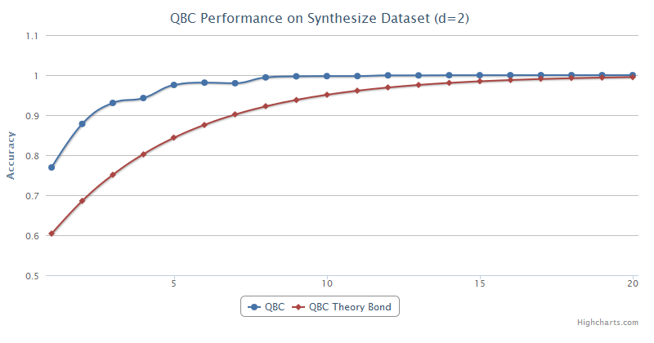
Experiment-Linear Separable

Slide 22
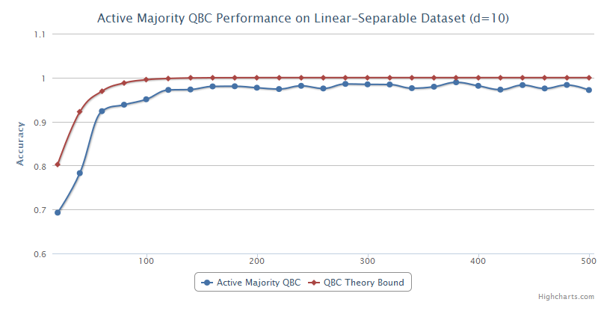
Experiment-Linear Separable

Slide 23
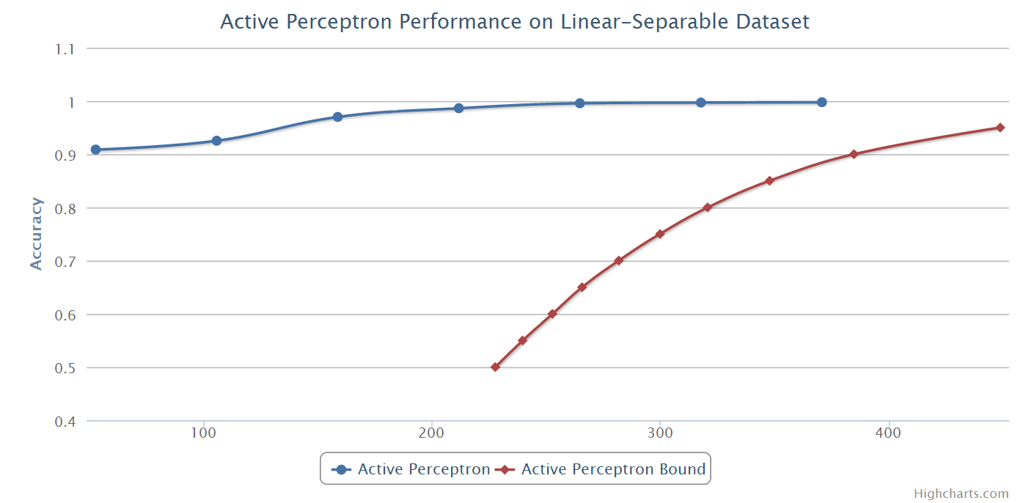
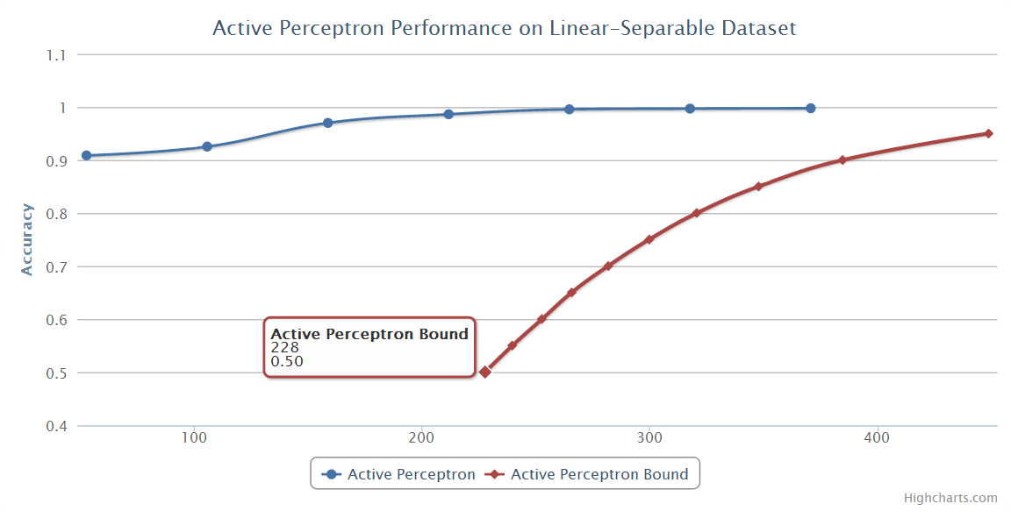
Experiment-Linear Separable

Slide 24
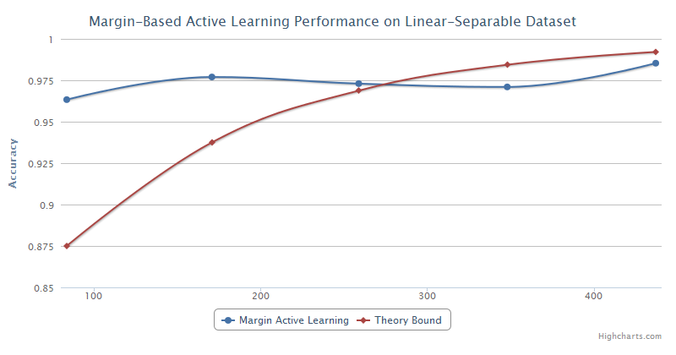
Experiment-Linear Separable

Slide 25
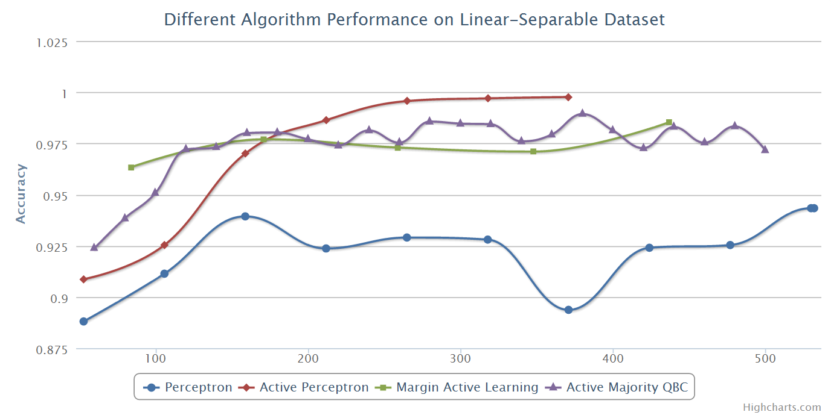
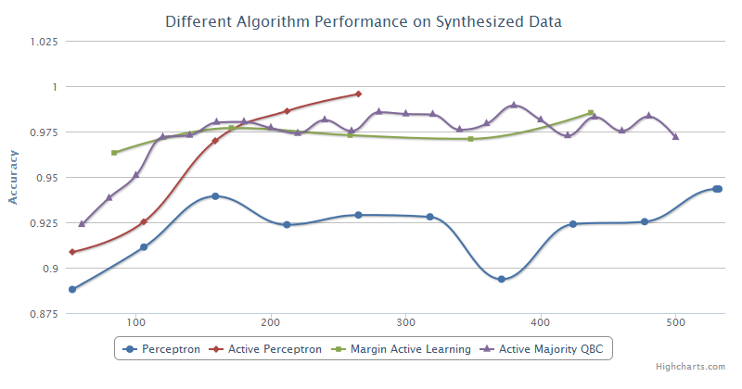
Experiment-Linear Separable

Slide 26
Experiment Setup
Experiment 2: Real world dataset (20news)
Document classification problem
Perform three binary classification tasks
Recreation vs Computer (Easy)
Politics vs Religion (Slightly Difficult)
PC vs Mac (Difficult)
Learn an linear classifier
Feature of the document
Normalized tf-idf weighted term vector for each document
Challenges comparing to synthesis data
Assumption on linear separable data won’t hold
Assumption on concept class distribution won’t hold
Assumption on data distribution won’t hold
Very high dimension (60000+ distinct terms)

Slide 27
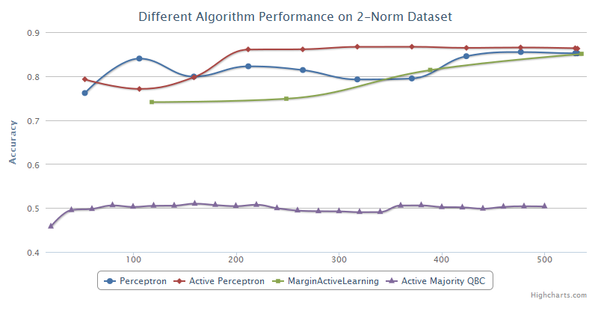
Experiment-Noisy

Slide 28
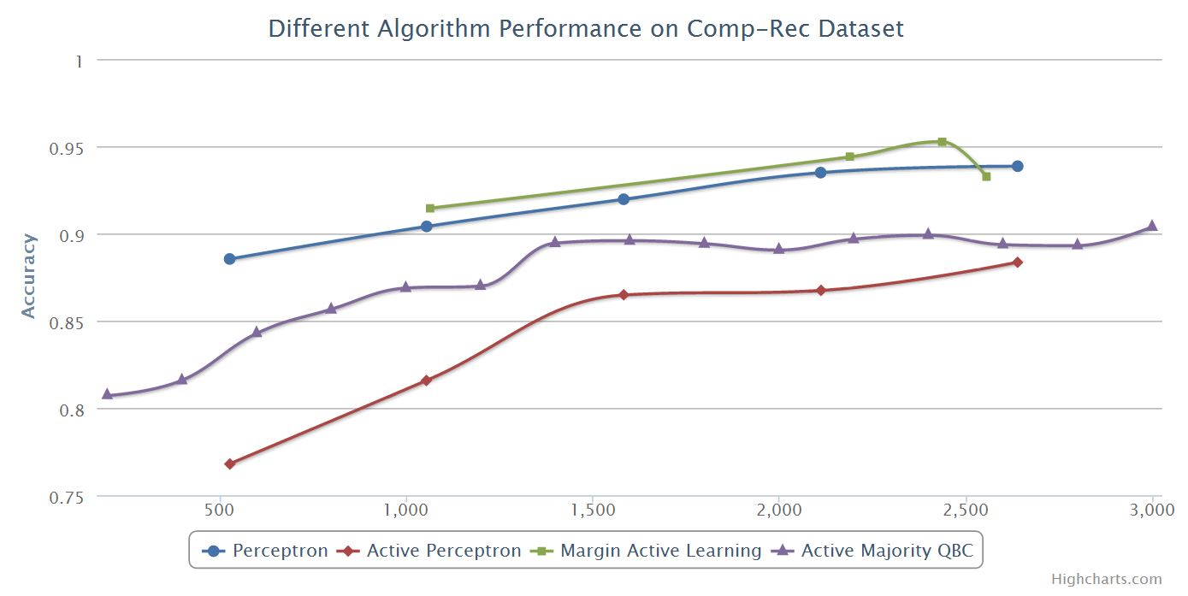
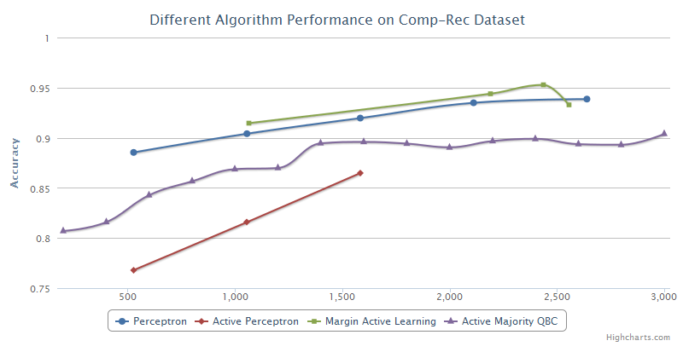
Experiment-Real Data

Slide 29
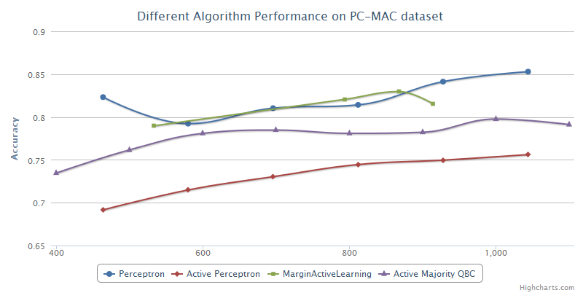
Experiment-Real Data

Slide 30
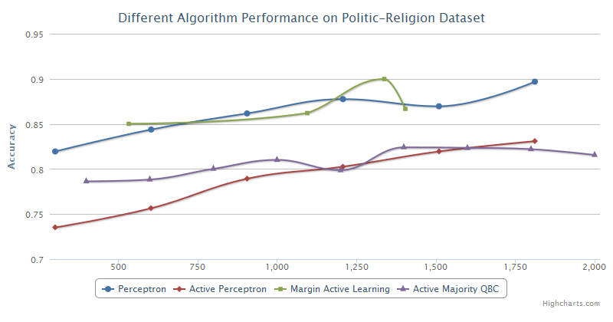
Experiment-Real Data

Slide 31
Closing Remarks
Active learning algorithms performs very well if all assumptions are satisfied.
However, since the assumptions are hardly satisfied in real world data, the performance gain is not as much as expected.
Non-separable: sensitive to noise
Unknown distribution: bounds not valid
High dimension: still high sample complexity because the complexity actually depends on d.

Slide 32
Ongoing
Generate a noisy dataset but satisfies the assumption of margin-based active learning algorithm
Use SVM instead of perceptron for the basic routine of learning for margin-based active learning

Slide 33
Reference
[1] Dasgupta, Kalai, and Monteleoni. Analysis of Perceptron-based Active Learning. COLT, 2005. [2] Freund, Seung, Shamir, and Tishby. Selective Sampling Using the Query by Committee Algorithm. Machine Learning, 1997. [3] Balcan, Broder and Zhang. Margin-based Active Learning. COLT, 2007.
[4] Active Learning Literature Survey, Burr Settles,Computer Sciences Technical Report, January 26, 2010
[5] Active Learning with Committees for Text Categorization. In proceedings of the Fourteenth National Conference on Artificial Intelligence, 1997 [6] Query by Committee Made Real, Ran Gilad-Bachrach, Amir Navot and Naftali Tishby, NIPS 2005

Slide 34
Thank you!
Q & A

