Slide 1
Empirical Study of Active Learning Algorithms
Chen Liu, Shi Gao and Ye Tian
University of California, Los Angeles

Slide 2
Motivation
A whole lot of unlabeled points available, but labels expensive
Choose data points which are most informative
Learn Actively:
Select the query
Maximize the accuracy
Minimize the cost (the number of labeling)
Goal: accurate classifier with minimum cost

Slide 3
Motivation
The condition of active learning
A large number of unlabeled points
Can query any point for label
Example: threshold
Find transition between 0 and 1 labels in minimum steps
?
?
?
?
0
0
?
1
?
?
1
?
?
?
0
1
x
x
x
x
x
x
x
x
x
x

Slide 4
Problem Statement

Slide 5
Algorithms
Active Perceptron
Margin Based Active Learning
Query by Committee
Query an example based on the degree of disagreement between committee of classifiers
Select “most informative” data to optimize expected gain

Slide 6
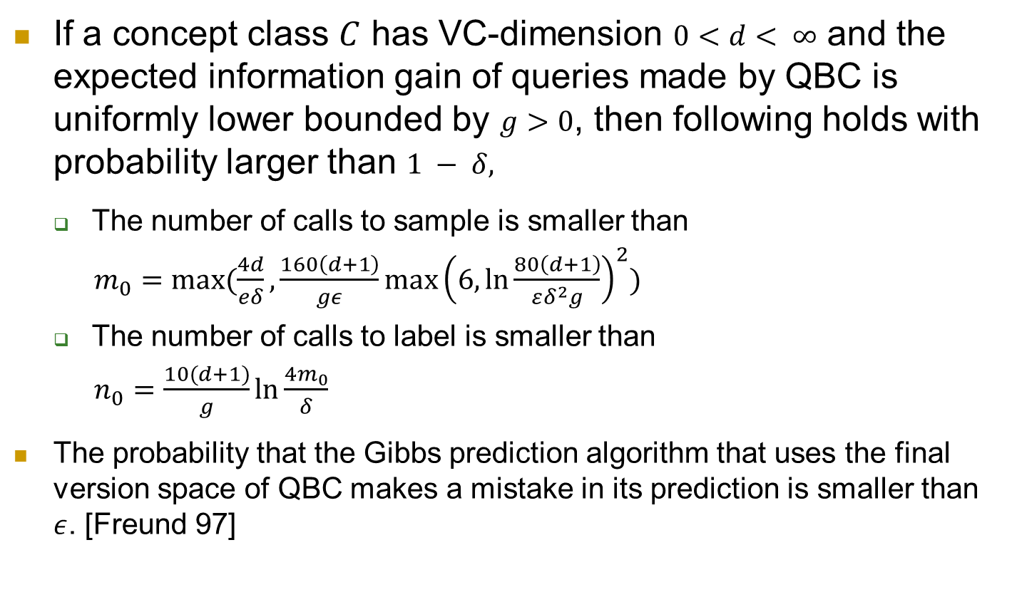
Query By Committee
If a concept class $C$ has VC-dimension $0<d< ∞$ and the expected information gain of queries made by QBC is uniformly lower bounded by $g>0$, then following holds with probability larger than $1 − δ,$
The number of calls to sample is smaller than
$m_{0}=max⁡(\frac{4d}{eδ},\frac{160\left(d+1\right)}{gε}\max{{\left(6, \ln{\frac{80\left(d+1\right)}{εδ^{2}g}}\right)}^{2}})$
The number of calls to label is smaller than
$n_{0}=\frac{10(d+1)}{g}\ln{\frac{4m_{0}}{δ}}$
The probability that the Gibbs prediction algorithm that uses the final version space of QBC makes a mistake in its prediction is smaller than $ε$. [Freund 97]
Notes:
Gibbs prediction means to predict the label of example by picking a hypothesis h random from version space
Namely, QBC will reach a generalization error of$ε$ when using only $O(\log{\frac{1}{δ}})$ labels

Slide 7
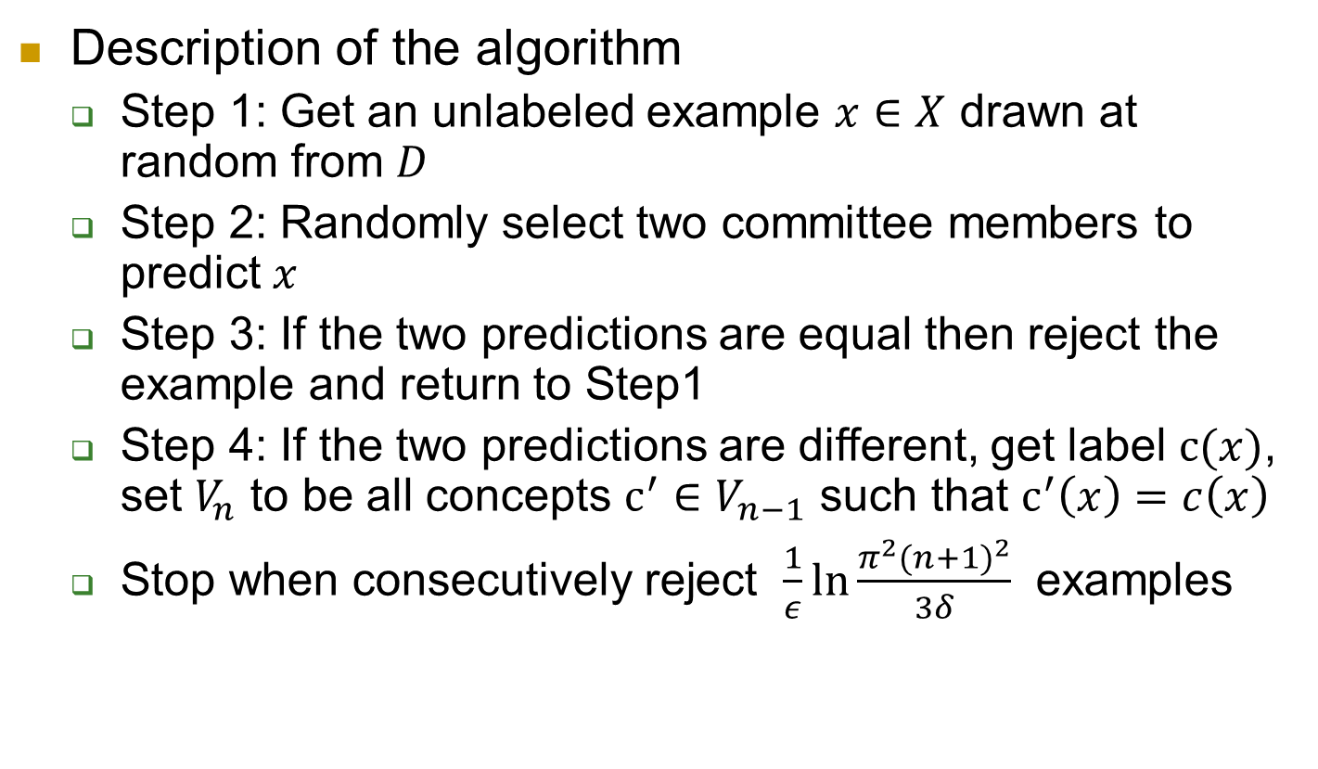
Query By Committee
Description of the algorithm
Step 1: Get an unlabeled example $x∈X$ drawn at random from $D$
Step 2: Randomly select two committee members to predict $x$
Step 3: If the two predictions are equal then reject the example and return to Step1
Step 4: If the two predictions are different, get label $c(x)$, set $V_{n}$ to be all concepts $c^{′}∈V_{n−1}$ such that $c^{′}\left(x\right)=c\left(x\right)$
Stop when consecutively reject $\frac{1}{ε}\ln{\frac{π^{2}{(n+1)}^{2}}{3δ}}$ examples
Notes:
QBC maintains a committee of hypotheses consistent with the labeled examples it has seen so far – a representation of the version space. For many real-world problems, the committee is infinite. The main obstacle in implementing QBC is the need to sample from the version space (step 2).
It is hard to do this with reasonable computational complexity in high dimension space.

Slide 8
Query By Committee
For many real-world problems, the committee is infinite.
The main obstacle in implementing QBC is to sample from the version space (Step 2). It is hard to do this with reasonable computational complexity when d is very large [Ran 2005].
QBC is very sensitive for noisy data sets.
We implement original QBC for low dimension data and Active-majority QBC [Liere 97] for high dimension data.
Notes:
QBC maintains a committee of hypotheses consistent with the labeled examples it has seen so far – a representation of the version space. For many real-world problems, the committee is infinite. The main obstacle in implementing QBC is the need to sample from the version space (step 2).
It is hard to do this with reasonable computational complexity in high dimension space. When there is a very large number of candidate hypotheses, explicitly representing them will not be practical.

Slide 9
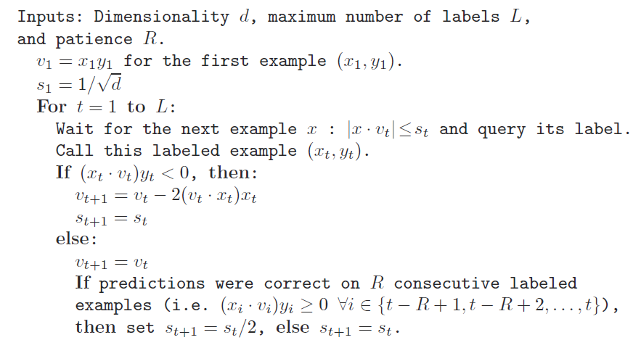
Active Perceptron

Slide 10
Margin Based Active Learning

Slide 11
Experiment Setup
Synthesized Dataset
10-dimension random data set
10-dimension noisy data set
Real Dataset
20 Newsgroups dataset
Randomly select 3 categories[?]
21,334 unique tokens in titles

Slide 12
Experiment

Slide 13
Closing Remarks
Three existing active learning algorithms with theory bounds are analyzed.
We implement the typical algorithms and apply them to synthesis and real world data sets to evaluate performance by comparing the actual performance with the theoretical results.

Slide 14
Q & A

Slide 15
Reference
[1] Dasgupta, Kalai, and Monteleoni. Analysis of Perceptron-based Active Learning. COLT, 2005. [2] Freund, Seung, Shamir, and Tishby. Selective Sampling Using the Query by Committee Algorithm. Machine Learning, 1997. [3] Balcan, Broder and Zhang. Margin-based Active Learning. COLT, 2007.

