Slide 1
Empirical Study of Active Learning Algorithms
Chen Liu, Shi Gao and Ye Tian
University of California, Los Angeles

Slide 2
Motivation
A whole lot of unlabeled points available, but labels expensive
Choose data points which are most informative
Typical scenarios
Document (image, video) Labeling
Hand-writing recognition (Captcha)
Speech recognition
Goal: accurate classifier with minimum cost

Slide 3
Motivation
The condition of active learning
A large number of unlabeled points
Can query any point for label
Example: threshold
Find transition between 0 and 1 labels in minimum steps
?
?
?
?
0
0
?
1
?
?
1
?
?
?
0
1
x
x
x
x
x
x
x
x
x
x

Slide 4
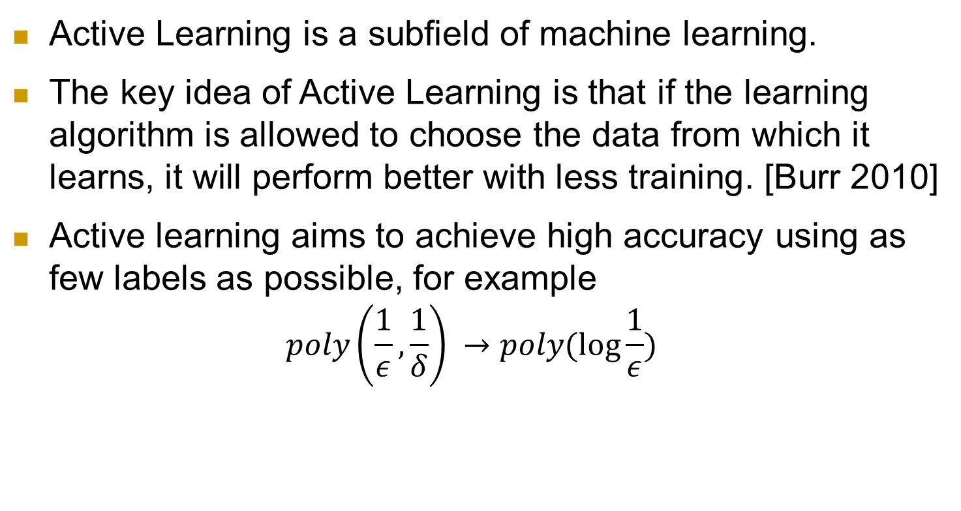
What is Active Learning?
Active Learning is a subfield of machine learning.
The key idea of Active Learning is that if the learning algorithm is allowed to choose the data from which it learns, it will perform better with less training. [Burr 2010]
Active learning aims to achieve high accuracy using as few labels as possible, for example
$$poly\left(\frac{1}{ε}, \frac{1}{δ}\right) →poly(\log{\frac{1}{ε}})$$

Slide 5
Algorithms
Margin Based Active Learning
Active Perceptron
Query by Committee
…

Slide 6
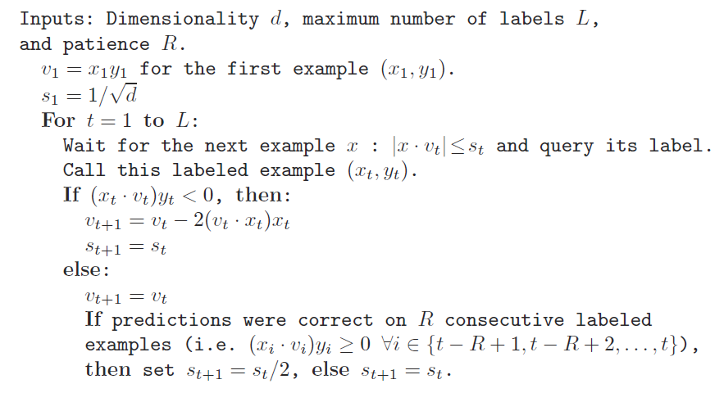
Active Perceptron
[Dasgupta 2005]

Slide 7
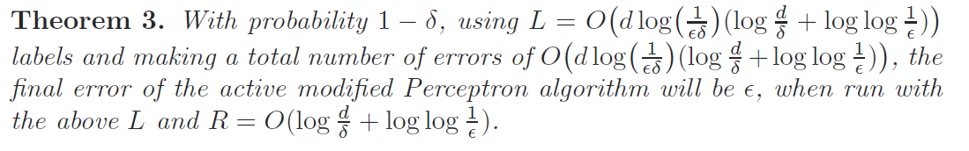
Active Perceptron

Slide 8
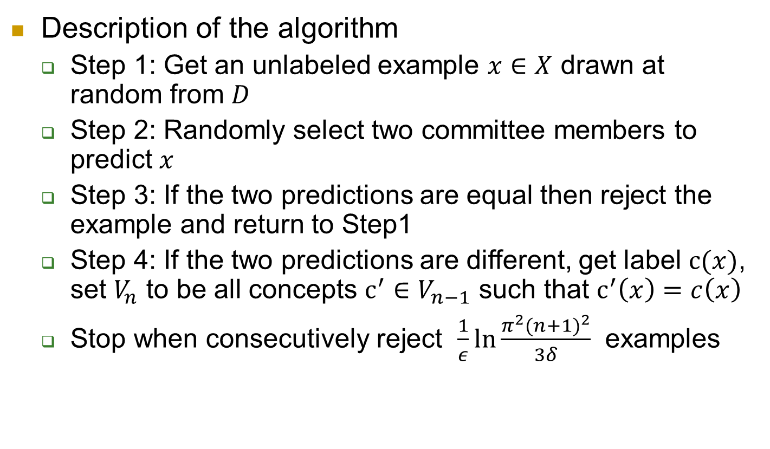
Query By Committee
Description of the algorithm
Step 1: Get an unlabeled example $x∈X$ drawn at random from $D$
Step 2: Randomly select two committee members to predict $x$
Step 3: If the two predictions are equal then reject the example and return to Step1
Step 4: If the two predictions are different, get label $c(x)$, set $V_{n}$ to be all concepts $c^{′}∈V_{n−1}$ such that $c^{′}\left(x\right)=c\left(x\right)$
Stop when consecutively reject $\frac{1}{ε}\ln{\frac{π^{2}{(n+1)}^{2}}{3δ}}$ examples
Notes:
QBC maintains a committee of hypotheses consistent with the labeled examples it has seen so far – a representation of the version space. For many real-world problems, the committee is infinite. The main obstacle in implementing QBC is the need to sample from the version space (step 2).
It is hard to do this with reasonable computational complexity in high dimension space.

Slide 9

Query By Committee
Information Gain
The instantaneous information gain from the i th label example
$$−\log{\frac{{Pr}_{p}(V_{i})}{{Pr}_{p}(V_{i−1})}}$$
It is proved that there exists a uniform lower bound $1/9+7/(18\ln{2})$ for information gain for any dimension.
Notes:
Gibbs prediction means to predict the label of example by picking a hypothesis h random from version space
Namely, QBC will reach a generalization error of$ε$ when using only $O(\log{\frac{1}{∈}})$ labels

Slide 10
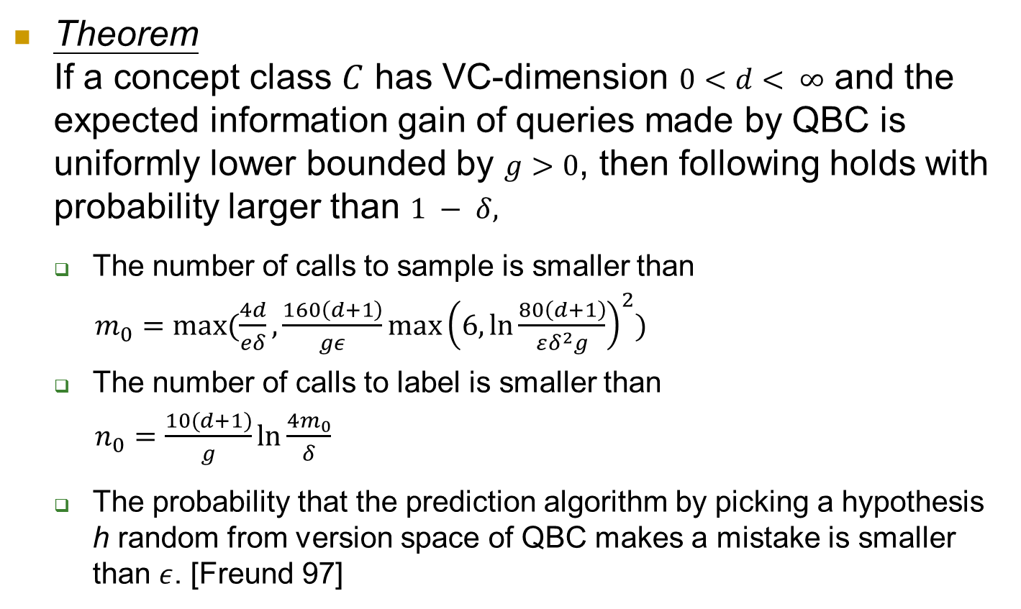
Query By Committee
Theorem If a concept class $C$ has VC-dimension $0<d< ∞$ and the expected information gain of queries made by QBC is uniformly lower bounded by $g>0$, then following holds with probability larger than $1 − δ,$
The number of calls to sample is smaller than
$m_{0}=max⁡(\frac{4d}{eδ},\frac{160\left(d+1\right)}{gε}\max{{\left(6, \ln{\frac{80\left(d+1\right)}{εδ^{2}g}}\right)}^{2}})$
The number of calls to label is smaller than
$n_{0}=\frac{10(d+1)}{g}\ln{\frac{4m_{0}}{δ}}$
The probability that the prediction algorithm by picking a hypothesis h random from version space of QBC makes a mistake is smaller than $ε$. [Freund 97]
Notes:
Gibbs prediction means to predict the label of example by picking a hypothesis h random from version space
Namely, QBC will reach a generalization error of$ε$ when using only $O(\log{\frac{1}{∈}})$ labels

Slide 11
Query By Committee
For many real-world problems, the committee is infinite.
The main obstacle in implementing QBC is to sample from the version space (Step 2). It is hard to do this with reasonable computational complexity when d is very large [Ran 2005].
QBC is very sensitive for noisy data sets.
We implement original QBC for low dimension data and Active-majority QBC [Liere 97] for high dimension data.
Use Winnow algorithm to maintain a finite committee
Notes:
QBC maintains a committee of hypotheses consistent with the labeled examples it has seen so far – a representation of the version space. For many real-world problems, the committee is infinite. The main obstacle in implementing QBC is the need to sample from the version space (step 2).
It is hard to do this with reasonable computational complexity in high dimension space. When there is a very large number of candidate hypotheses, explicitly representing them will not be practical.

Slide 12
Margin Based Active Learning

Slide 13
Experiment Setup
Synthesized Dataset
10-dimension random data set
10-dimension noisy data set
Real Dataset
20 Newsgroups dataset
Randomly select 3 categories[?]
21,334 unique tokens in titles

Slide 14
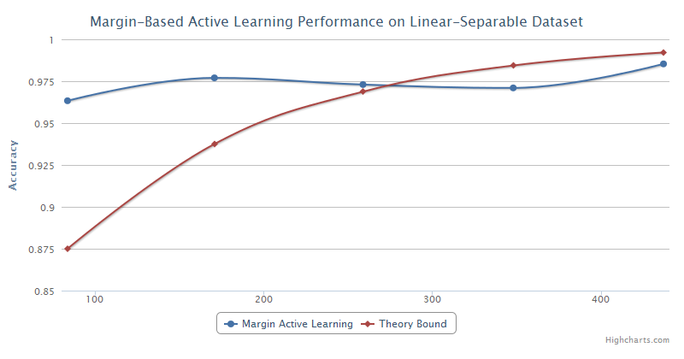
Experiment-Linear Separable

Slide 15
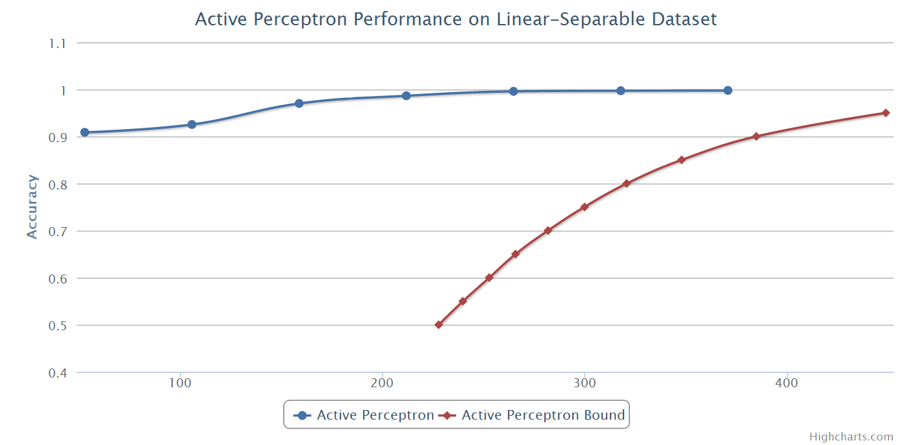
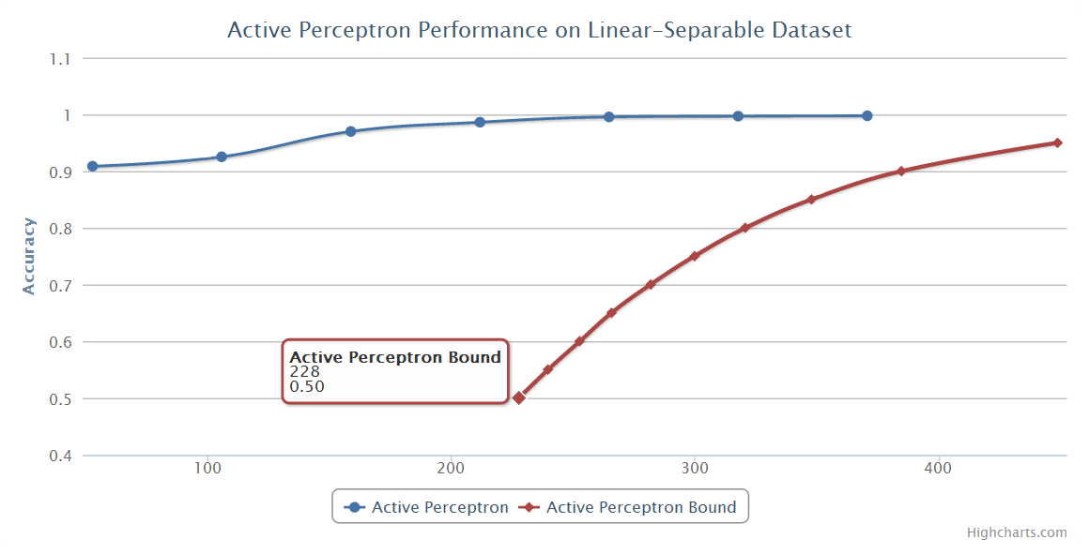
Experiment-Linear Separable

Slide 16
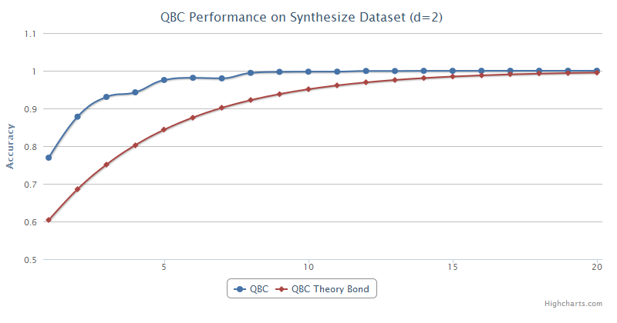
Experiment-Linear Separable

Slide 17
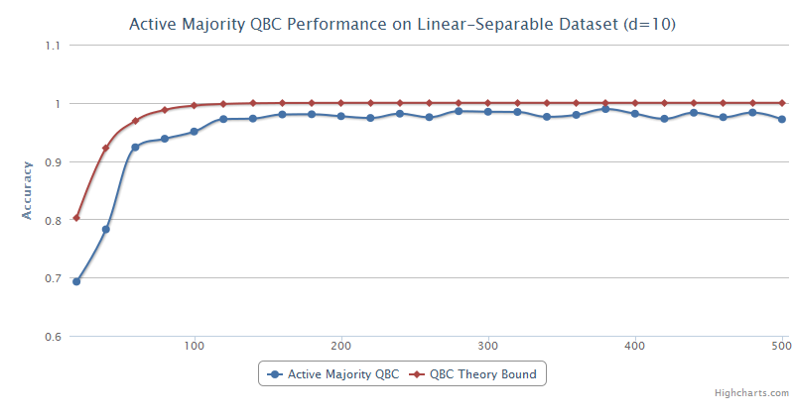
Experiment-Linear Separable

Slide 18
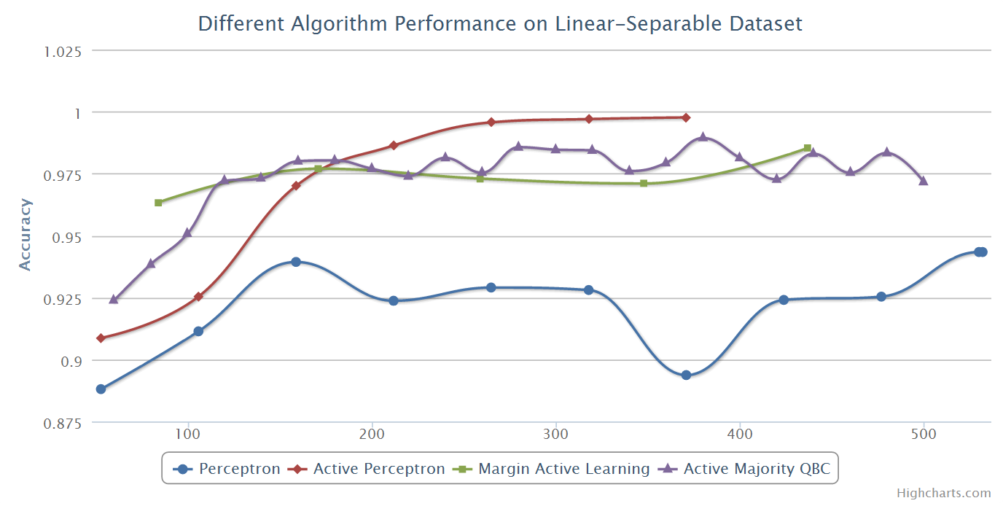
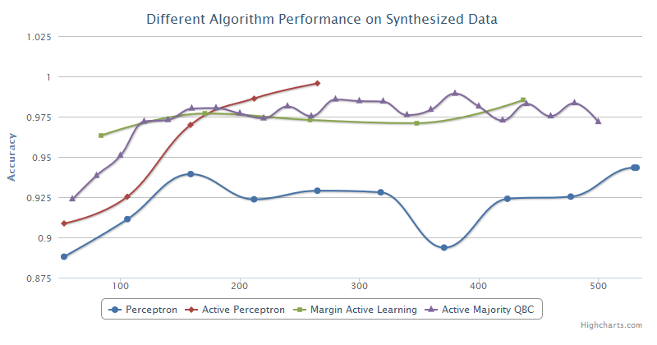
Experiment-Linear Separable

Slide 19
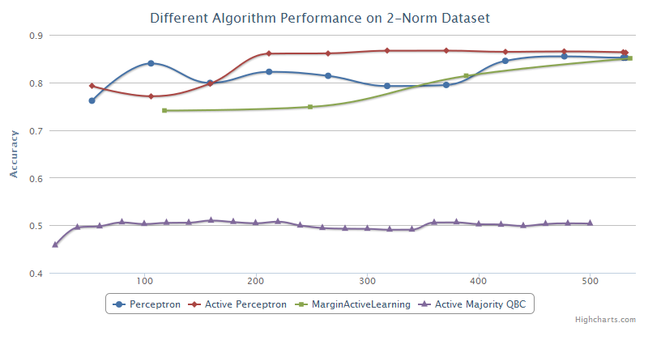
Experiment-Noisy

Slide 20
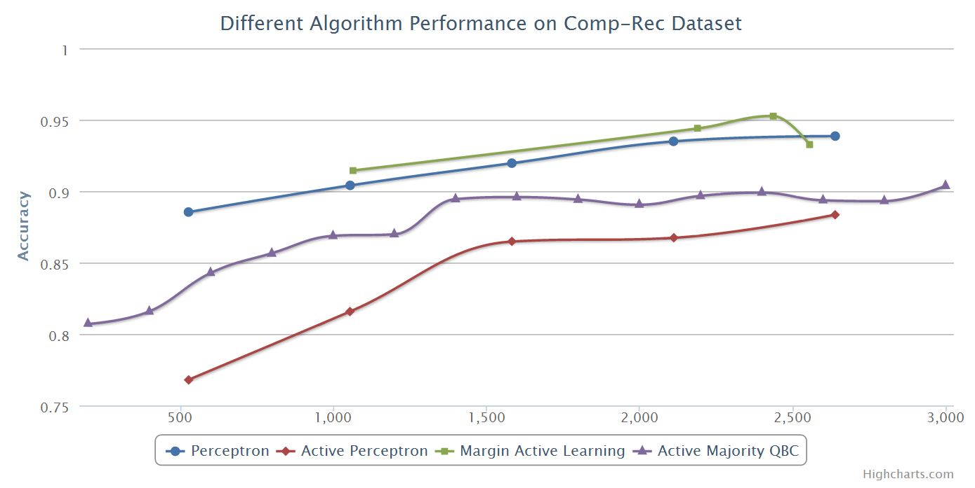
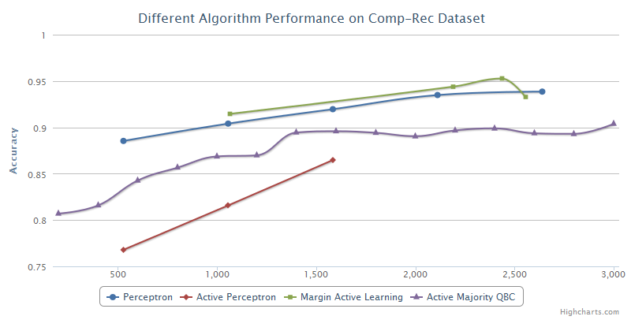
Experiment-Real Data

Slide 21
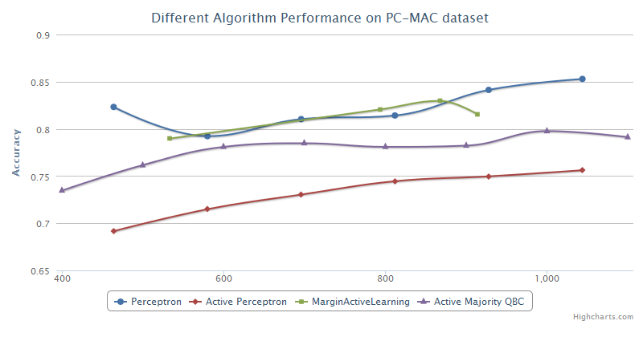
Experiment-Real Data

Slide 22
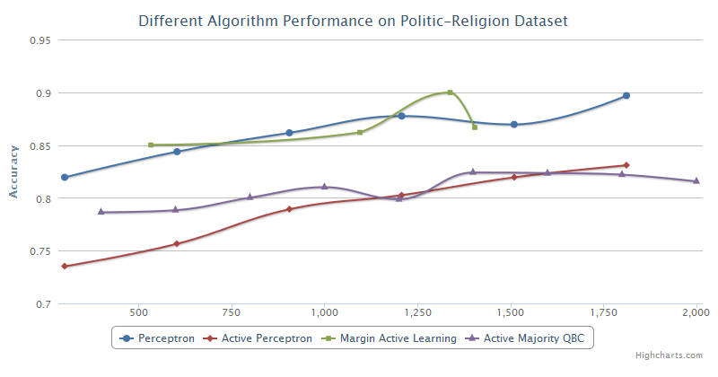
Experiment-Real Data

Slide 23
Closing Remarks
Three existing active learning algorithms with theory bounds are analyzed.
We implement the typical algorithms and apply them to synthesis and real world data sets to evaluate performance by comparing the actual performance with the theoretical results.

Slide 24
Q & A

Slide 25
Reference
[1] Dasgupta, Kalai, and Monteleoni. Analysis of Perceptron-based Active Learning. COLT, 2005. [2] Freund, Seung, Shamir, and Tishby. Selective Sampling Using the Query by Committee Algorithm. Machine Learning, 1997. [3] Balcan, Broder and Zhang. Margin-based Active Learning. COLT, 2007.
[4] Active Learning Literature Survey, Burr Settles,Computer Sciences Technical Report, January 26, 2010

