Slide 1
Active Learning
Chen Liu, Shi Gao and Ye Tian
University of California, Los Angeles

Slide 2
Motivation
A whole lot of unlabeled points available, but labels expensive
Choose data points which are most informative
Learn Actively:
Select the query
Maximize the accuracy
Minimize the cost (the number of labeling)
Goal: accurate classifier with minimum cost

Slide 3
Motivation
The condition of active learning
A large number of unlabeled points
Can query any point for label
Example: threshold
Find transition between 0 and 1 labels in minimum steps
?
?
?
?
0
0
?
1
?
?
1
?
?
?
0
1
x
x
x
x
x
x
x
x
x
x

Slide 4
Problem Statement

Slide 5
Algorithms
Active Perceptron
Margin Based Active Learning
Query by Committee
Query an example based on the degree of disagreement between committee of classifiers
Select “most informative” data to optimize expected gain

Slide 6
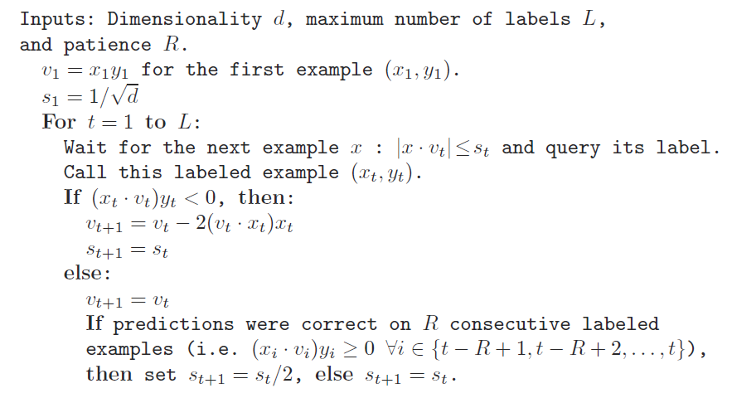
Active Perceptron

Slide 7
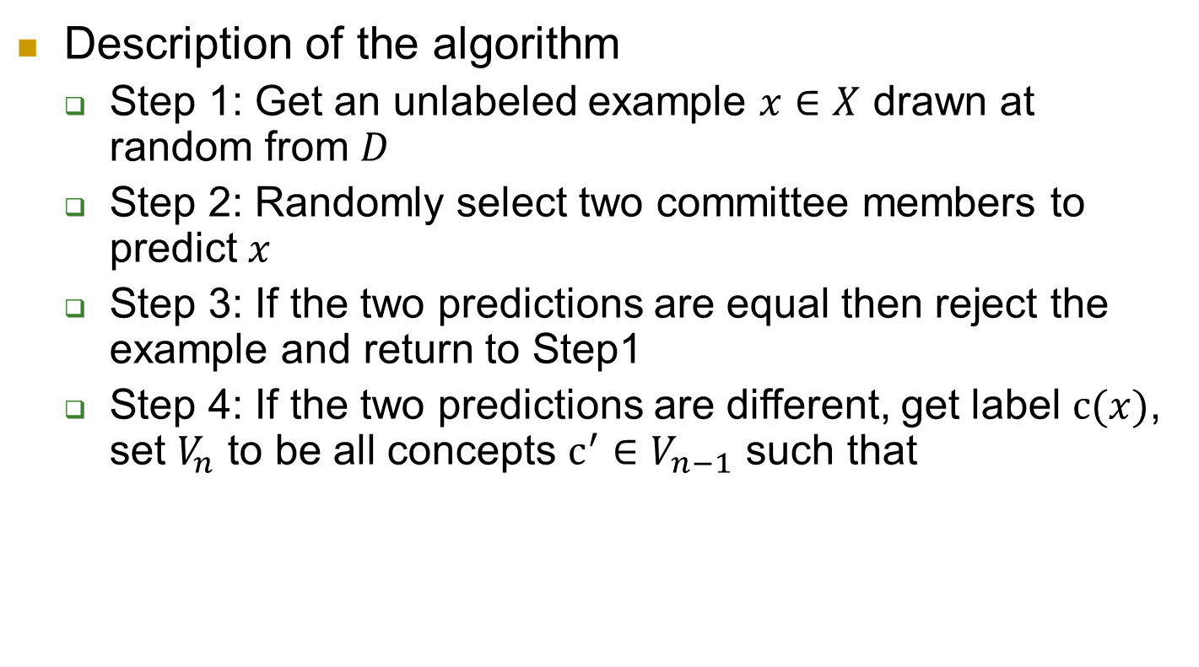
Query By Committee
Description of the algorithm
Step 1: Get an unlabeled example $x∈X$ drawn at random from $D$
Step 2: Randomly select two committee members to predict $x$
Step 3: If the two predictions are equal then reject the example and return to Step1
Step 4: If the two predictions are different, get label $c(x)$, set $V_{n}$ to be all concepts $c^{′}∈V_{n−1}$ such that

Slide 8
THANK YOU!

