Slide 1
Active Learning
Chen Liu, Shi Gao and Ye Tian
University of California, Los Angeles

Slide 2
Motivation
A whole lot of unlabeled points available, but labels expensive
Choose data points which are most informative
Learn Actively:
Select the query
Maximize the accuracy
Minimize the cost (the number of labeling)
Goal: accurate classifier with minimum cost

Slide 3
Motivation
The condition of active learning
A large number of unlabeled points
Can query any point for label
Example: threshold
Find transition between 0 and 1 labels in minimum steps
?
?
?
?
0
0
?
1
?
?
1
?
?
?
0
1
x
x
x
x
x
x
x
x
x
x

Slide 4
Problem Statement

Slide 5
Algorithms
Active Perceptron
Margin Based Active Learning
Query by Committee
Query an example based on the degree of disagreement between committee of classifiers
Select “most informative” data to optimize expected gain

Slide 6
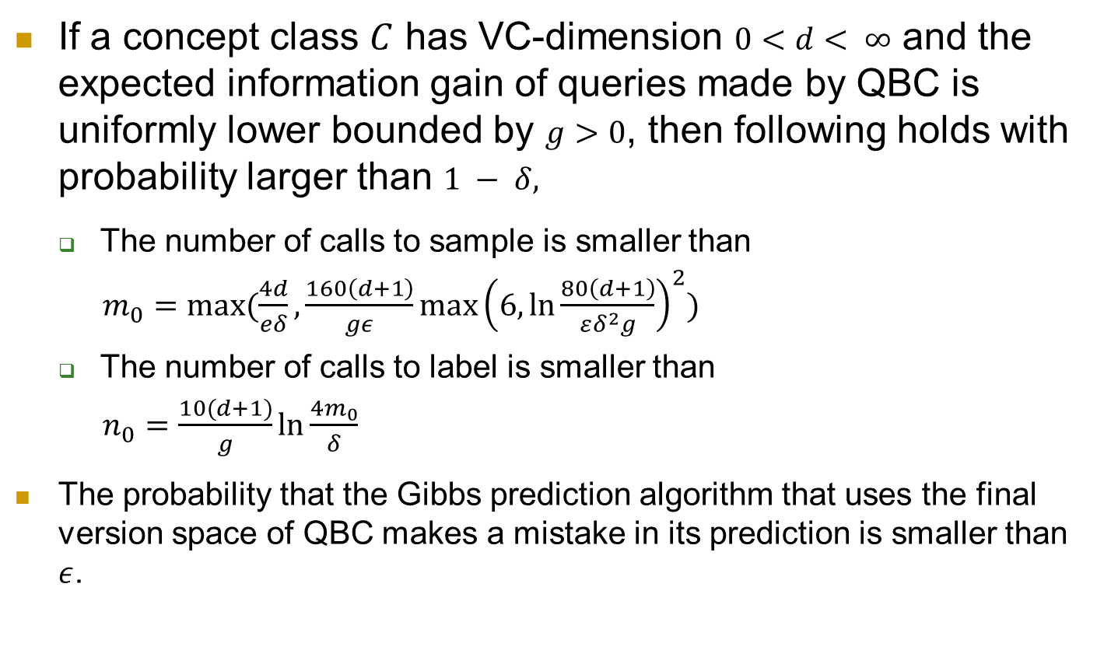
Query By Committee
If a concept class $C$ has VC-dimension $0<d< ∞$ and the expected information gain of queries made by QBC is uniformly lower bounded by $g>0$, then following holds with probability larger than $1 − δ,$
The number of calls to sample is smaller than
$m_{0}=max⁡(\frac{4d}{eδ},\frac{160\left(d+1\right)}{gε}\max{{\left(6, \ln{\frac{80\left(d+1\right)}{εδ^{2}g}}\right)}^{2}})$
The number of calls to label is smaller than
$n_{0}=\frac{10(d+1)}{g}\ln{\frac{4m_{0}}{δ}}$
The probability that the Gibbs prediction algorithm that uses the final version space of QBC makes a mistake in its prediction is smaller than $ε$.
Notes:
Gibbs prediction means to predict the label of example by picking a hypothesis h random from version space
Namely, QBC will reach a generalization error of$ε$ when using only $O(\log{\frac{1}{δ}})$ labels

Slide 7
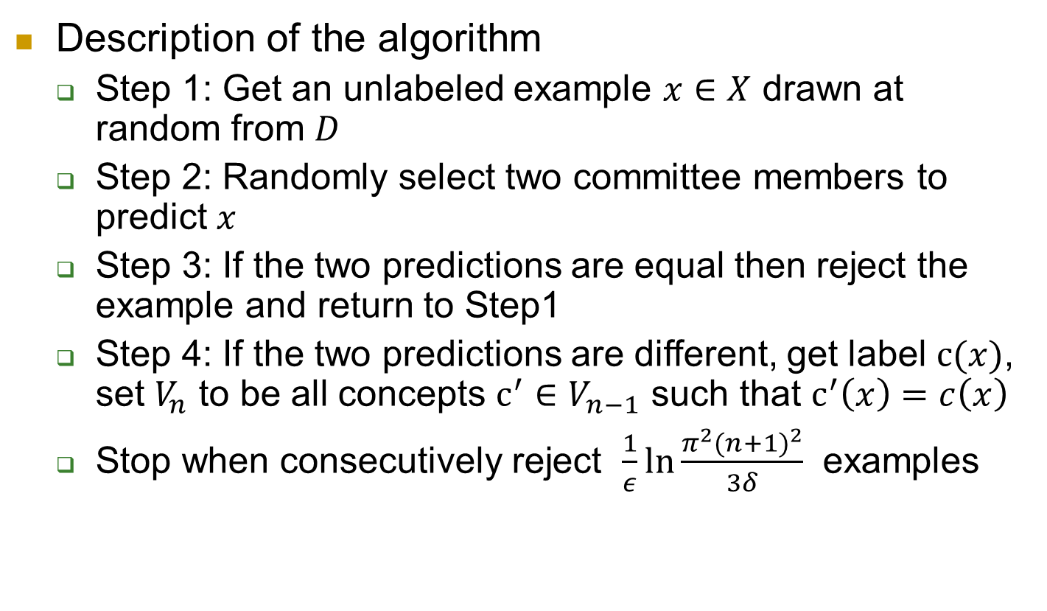
Query By Committee
Description of the algorithm
Step 1: Get an unlabeled example $x∈X$ drawn at random from $D$
Step 2: Randomly select two committee members to predict $x$
Step 3: If the two predictions are equal then reject the example and return to Step1
Step 4: If the two predictions are different, get label $c(x)$, set $V_{n}$ to be all concepts $c^{′}∈V_{n−1}$ such that $c^{′}\left(x\right)=c\left(x\right)$
Stop when consecutively reject $\frac{1}{ε}\ln{\frac{π^{2}{(n+1)}^{2}}{3δ}}$ examples
Notes:
QBC maintains a committee of hypotheses consistent with the labeled examples it has seen so far – a representation of the version space. For many real-world problems, the committee is infinite. The main obstacle in implementing QBC is the need to sample from the version space (step 2).
It is hard to do this with reasonable computational complexity in high dimension space.

Slide 8
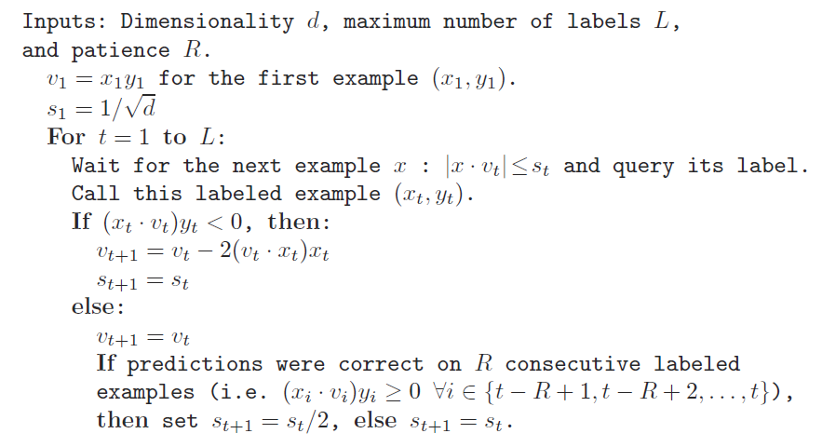
Active Perceptron

Slide 9
Margin Based Active Learning

Slide 10
THANK YOU!

