Slide 1
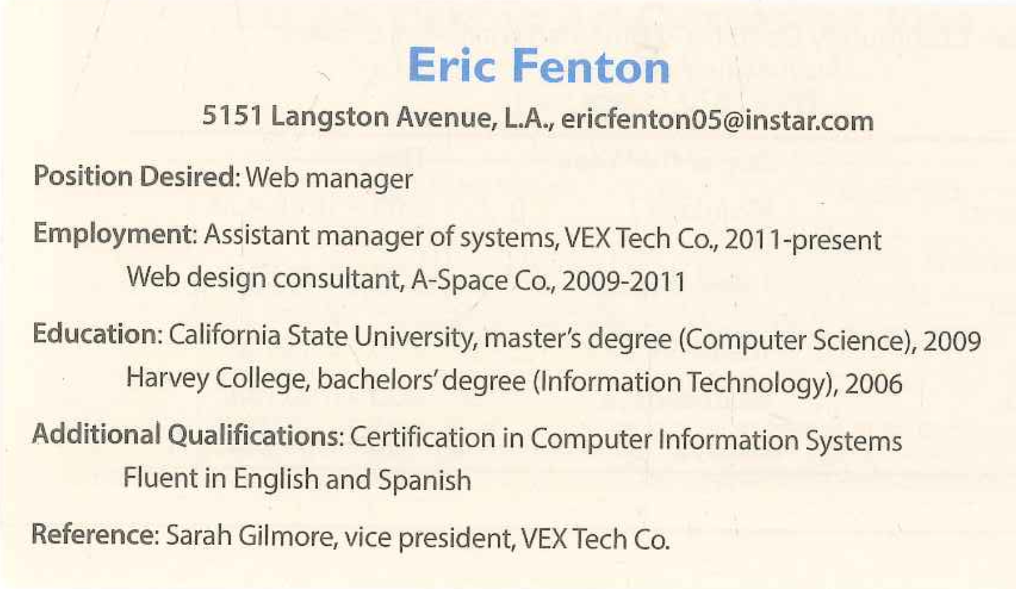
TOPIC 4: RESUME

Slide 2
TOPIC 4: RESUME
Graduate from | He graduated from Wilson College in 2010.
Get | He got a bachelor’s degree in business administration in 2010
From A to B/ Work at A as B | From 2010 to 2012, he worked at Dream Advertising Company as a marketing assistant.
Since A/ has been working at | Since 2020, he has been working at Dream Company as a marketing assistant
Be good at | He is good at English

Slide 3
TOPIC 4: RESUME
Q8: What position is he applying for, and how much does he want to get paid?
Ans: He is applying for a sale manger position, and he wants to get paid 50 thousand dollar a year.
Q9: We’re looking for someone who has international experience and is good at languages other than English for our new project. Is he qualified for that?
Ans: Yes, I think so. He took part in an internship program at River Plaza Hotel in Prance from 2006 to 2007, and he is fluent in French.
Q10: Could you give me more details information on his work experience?
Ans: He has worked at 2 different companies so far. First, he worked at HACP Corporation as a sales representative from 2008 to 2012. And the, he has been working at the Hudson Trade as an assistant sales manager since 2013.

Slide 4
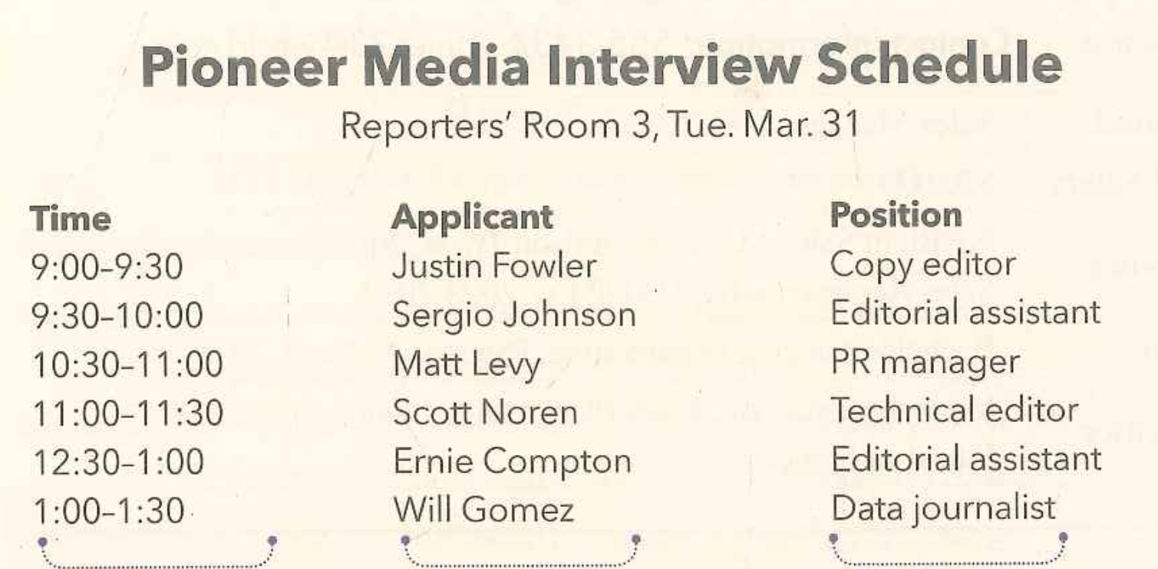
TOPIC 5: INTERVIEW SCHEDULE

Slide 5
TOPIC 5: INTERVIEW SCHEDULE
Applicant/ Candidate | There are 2 applicants/ candidates.
Have | You will have 3 interviews.
There will be an interview with…/ have an interview with/ will interview | There will be an interview with Rod Garderner. You will be an interview with Rod Garderner. You will interview Rod Garderner.
Apply for the A position | She is applying for the trainer position
Has been canceled | There was an interview, but it has been canceled.
Has been moved to | There was an interview, but it has been moved to 4 p.m.

Slide 6
TOPIC 5: INTERVIEW SCHEDULE
Q8: Where will the interviews be held, and what time does the first one start?
Ans: The interviews will be held in Room A and the first one will start at 10 A.M.
Q9: We are interviewing two people for a spinning instructor position, right?
Ans: Actually, no. There is one interview for a spinning instructor position, It’s with Janet Healy at 10:30 A.M.
Q10: As far as I know, we are going to interview some applicants for a personal trainer position. Could you give me all the details about those interviews?
Ans: Sure. There are 2 interviews for the personal trainer position. First, we will have an interview with Dana Carvey at 11A.M. She studied Sports Science. Second, we will interview Bill Nighy at 1 P.M. According to his résumé, he can work only on weekends.

Slide 7
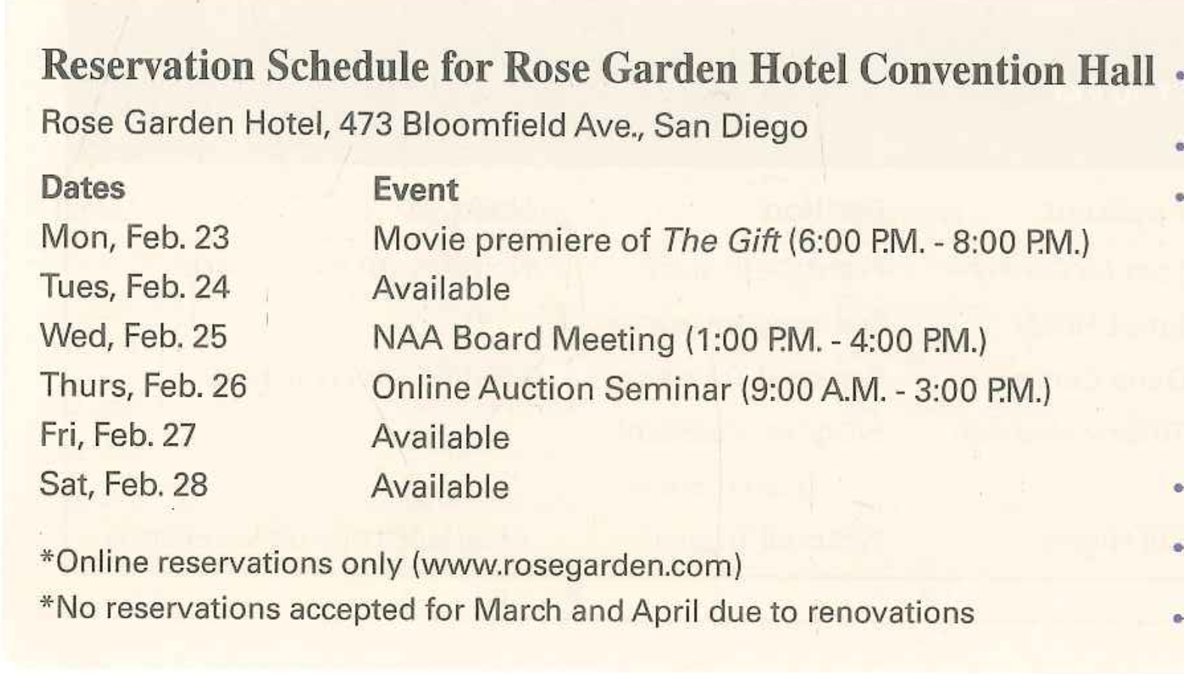
TOPIC 6: ORDER FORM/ RESERVATION

Slide 8
TOPIC 6: ORDER FORM/ RESERVATION
Q8: Where is your flower shop, and what time do you open?
Ans: We are at 415 Bryant Street and we open at 11 A.M every day.
Q9: I think my boss said he already made a payment. Is that right?
Ans: I’m afraid not. You’re supposed to make a payment upon pickup.
Q10: I don’t know how many flowers he ordered. Can you tell me all the details of his order?
Ans: Sure. He ordered a dozen sunflowers for 70 dollars. Also, he ordered 10 roses and 15 daisies, and they are 30 dollars and 37 dollars and 50 cents, respectively. You need to pay 137 dollars and 50 cents in total.

Slide 9
PRACTICE 1: STEVE BENTLY
Q8: When did he receive his bachelor’s degree, and where did he earn it?
Ans: He received his bachelor’s Degree from Boston University in 2013.
Q9: We hold a dessert festival every year, so we’re looking for someone who can bake as well. Is there any indication on Mr. Bentley’s résumé that he has baking skills?
Ans: Yes. According to his resume, he has a certification in banking and pastry.
Q10: Can you please give me details about his employment?
Ans: Sure. From 2013 to 2015, he worked as an apprentice at Grill King Restaurant in Boston. And, since 2016 , he’s been working as a line chef at Hotel Gresham in New York.

Slide 10
PRACTICE 2: ALPHA PUBLISHING
Where will the interviews be held, and who is the first interviewee?
Ans: The Interviews will be held in Conference Room B, and the first interview is Daniel Anderson.
As far as I remember, we have two applicants for the editorial department. Is that right?
Ans: Let me see, Originally, there were 2 applicants for the editorial department- Gabriel Devline and Neil Wright. But the interview with Neil Wright has been canceled, so no we have one applicant.
I think we should hire experienced staff. Can you give me all the details about the interviews with applicants who have more than 5 years of experience?
Ans: Sure. First, there will be an interview with Liam Moore at 2 P.M. He is applying for a positon in marketing. After that, you will interview Emily Lewis, who is applying to work in the legal department. They both have 6 years of experience.

Slide 11
PRACTICE 3: RIDE-ON VEHICLE
What type of vehicle did he book?
Ans: He booked full size sedan.
I heard that we make a change to the reservation, we have to pay 10 dollars. Is that correct?
Ans: Actually, no. You have to pay 15 dollar for any changes to the reservation.
I can’t remember what time to pick up and drop off the car. Can you give me all the details about the pick-up and drop-off?
Ans: Certainly. You’re supposed to pick up the car on July 26th at 10 A.M. at Cleveland International Airport. and return it on August 1st at 3 P.M at Dayton International Airport.

Slide 12
PRACTICE 4: JOSEPH CRANDALL
What is his current job and where does he work?
Joseph Crandall is an assistant sales manager at Jackson and Rooney, where he has been working since 2012.
We need someone who can market our products online. Is he qualified to do this?
Yes, I believe he is qualified to do online marketing as he holds a certificate in Digital and Web marketing.
Can you tell me about his educational background in detail, please?
Of course. He has two degrees. He received his bachelor’s degree in Marketing from Boston University in 2005 and in 2007 he earned his master’s degree in Advertising from the university of Massachusetts.

Slide 13
PRACTICE 5: VANESSA CHARLES
Where did she get her master’s degree and what did she study?
For her master’s degree, Vanessa Charles attended the University of California to study Business Management and she graduated in 2010.
We need someone who is comfortable with using the computer for this position. Is she qualified?
Yes, it seems that she is qualified for this job in terms of computer skills as she is proficient in Excel and word processing
We’d like to hire a well-rounded and highly experienced employee. What are the details of her work experience?
She has been in the workforce since 2010. From 2010 to 2011, she was a sales assistant at Minnie’s Market. She then went on to be a recruitment representative of Smart Savings, where she worked for two years. Currently, she is a human resources analyst at Faufer Incorporated and she has held this position since 2013.

Slide 14
PRACTICE 6: ORDER SUMMARY
When and to what address will you deliver my order?
Your order will be delivered on November 11 sometime between 3 and 5 in the afternoon. It’ll be delivered to 415 Westwood Avenue, apartment 3.
I’m so forgetful these days and I can’t remember what I need to pay. How much is my order and can I pay upon delivery?
The total cost of your purchase is $29.27. and you already paid it online however you do have to pay a delivery fee of #5 when we deliver your order.
I’m about to order more items and I don’t want to make duplicate orders. Can you confirm the details of my order?
Sure. You bought one non-food item, three types of beverages and 2 produce items. Specifically, you purchased 6 rolls of kitchen towels, a box of bottled water, 10 cans of lemon soda, a carton of milk, 2 bags of apples, and finally one bag of potatoes.

Slide 15
PRACTICE 7: GINO’S ITALIAN KITCHEN
What is the address of your restaurant, and what are your business hours?
Our restaurant is located at 500 Mulberry Street. We’re open from 11 to 10 on weekdays and 1 to 11:30 on weekends.
I think 6 of our family members will gather for a birthday party at the restaurant. Is it ok if I don’t make a reservation beforehand?
Sorry but that won’t be OK. We require that you make a reservation in advance for groups of 4 or more people.
I’d like to know all the details about the set menus you offer. Can you please tell me about them?
Sure, we offer 2 types of set menus. The first is the Couple Set menu which is $15 per person and recommended for 2 people. That set comes with one paster, 2 salads and 2 drinks. The other set menu is called the Family Set menu. That option is recommended for 4 people and is $25 per person. It includes 2 pastas, 1 pizza, 1 salad and 4 drinks.

Slide 16
PRACTICE 8: WESTON TECHNOLOGY
What time will the last interview start? Who is the applicant?
The last interview will start at 3:30 p.m.. You will interview Linda Moore. Please keep it in mind.
I heard that two of the applicants currently work at Compton Corporation. Is that right?
Actually you have the wrong information. There were two interviews but one has been canceled. Now there is only one applicant.
Could you please tell me all you can about people applying for the digital designer position?
There are 2 applicants for the digital designer position. At 11:15 a.m., you will interview Dave Madden who is currently working at DuWell Software. At 1:45 p.m., you will attend an interview with Elizabeth Coleman. She is currently working at Lionel Tech.

Slide 17
PRACTICE 9: BLUE MOUNTAIN SKI
We don’t have any ski equipment. How much is the rental fee?
It will cost $35 per person per day.
I want to plan our trip for October. Would that be possible?
Actually we are open from November to March. We are not open in October.
Do you have any ski slopes that are longer than 3km?
There are 2 ski slopes that are longer than 3km. one of them is called Mountaineer Slope. It is 3.5 kilometers long. It takes one and a half hours to finish the course. It is an intermediate level slope. The other is called Master Slope. It is 4km long. It takes 2 hours to finish the course. It is an advanced level slope.

