Slide 1
SALT
Tim, Feras, Issa

Slide 2
Agenda
Problem and Solution (Feras)
Main Requirements (Feras)
Database (Tim)
Interface (Issa)
First Build (Tim)

Slide 3
Problem and Solution
Students need guidance in understanding cyber security concepts and terminology that come from vetted, peer-reviewed sources made available during their studies.
To create an interactive knowledge base called Security Availability Library Tool (SALT).
SALT will:
Provide a library of concepts and terminology based on peer-reviewed or industry standards
Be aligned with Information Technology Program security courses offered at Arizona State University.
Be peer-reviewed by the Information Technology Program faculty that teach Security courses.

Slide 4
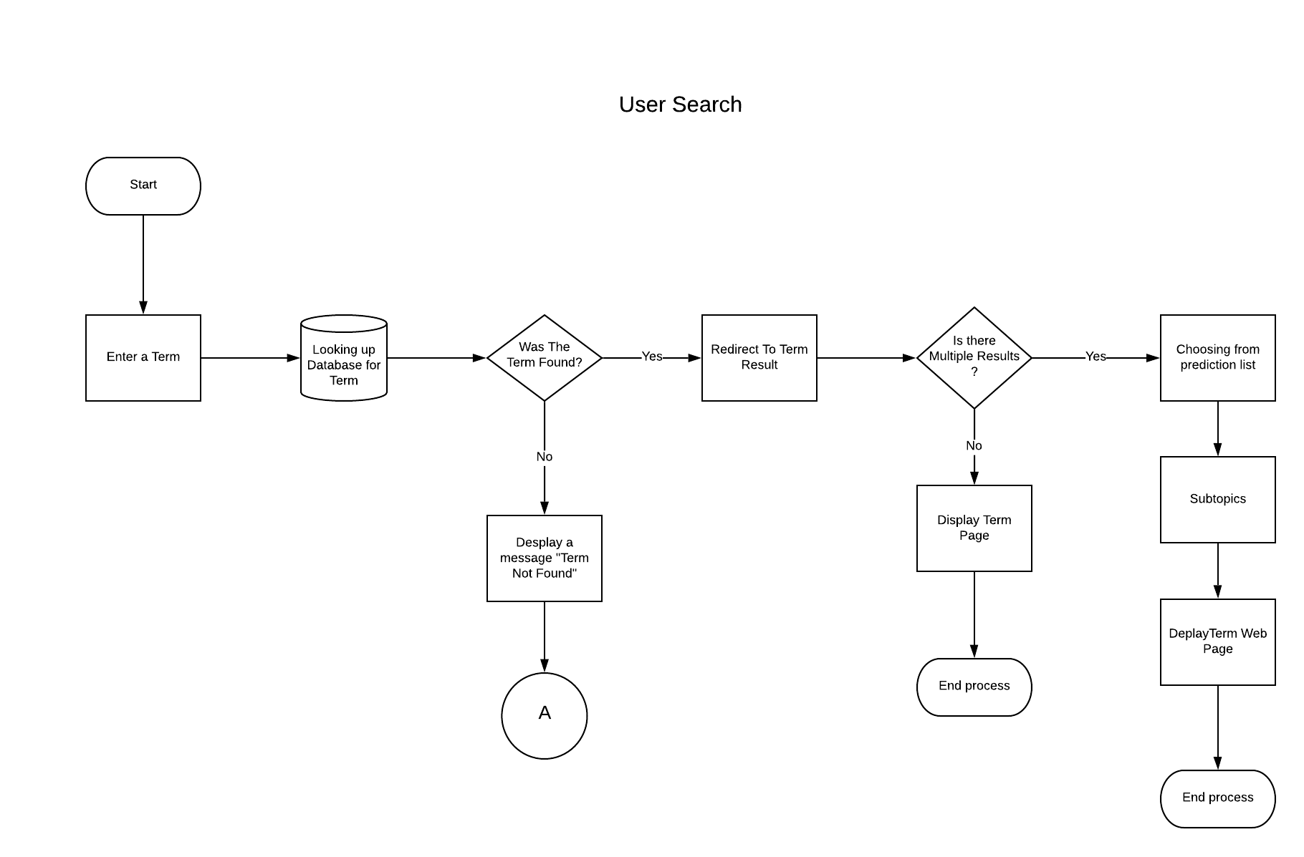
Main Requirements: 1. User Search
User will be able to type a word in the search bar and view the full result
The system will display potential search results as the users type
Be told if it’s not in the library
Value: To provide the users with results that are peer-reviewed and easy to understand.

Slide 5
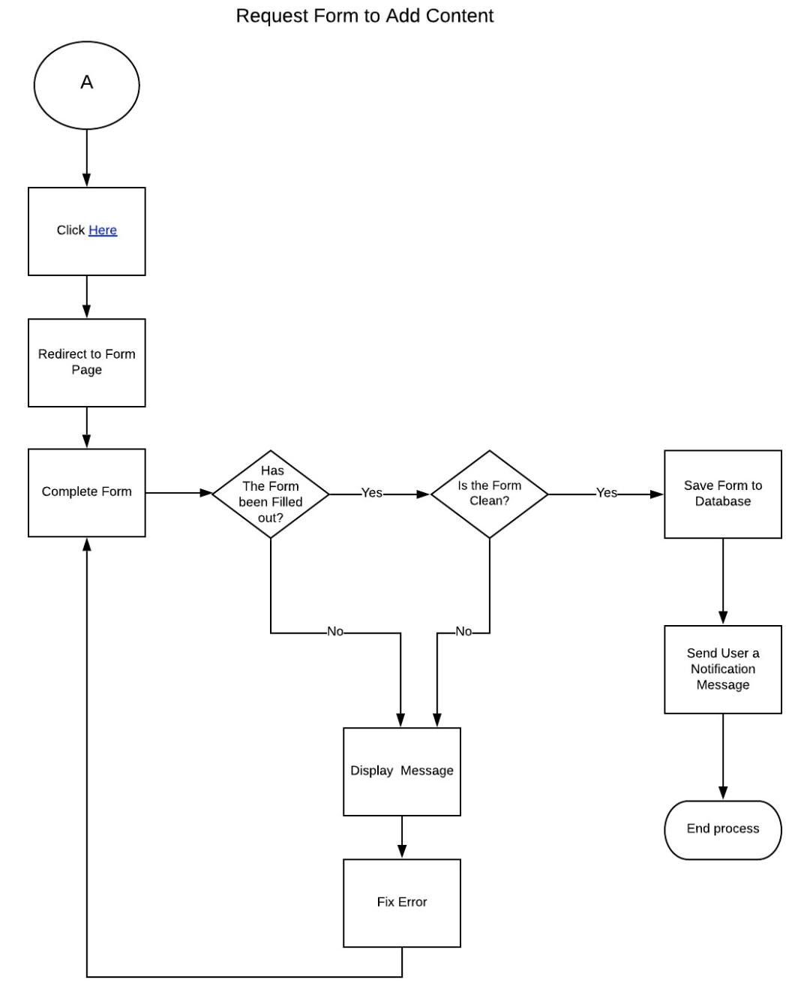
Main Requirements: 2. Request Form to Add Content
If a user is unable to find a term, he can request to have it added.
Get redirected to a form
Form has to have filters (No profanity or empty fields)
Value: To ensure that students have their questions answered, to keep the library fresh and to keep the faculty aware of what students want to learn about.

Slide 6
Main Requirements: 3. Load Library for Administrator
Gather requirements from admin
Scrape the requirements from a list of approved sites
Send them to the database an administrator can access
Give admin the ability to approve, edit or deny each entry
Value: This will provide the administrator with the definitions they want to see on the site. It will also automate and speed up the process of loading the library.

Slide 7
Main Requirements: 4. Usage Metric Dashboard
Admin can view how many times each word was searched via a dashboard
Value: To gain quantitative feedback on how the site is performing.

Slide 8
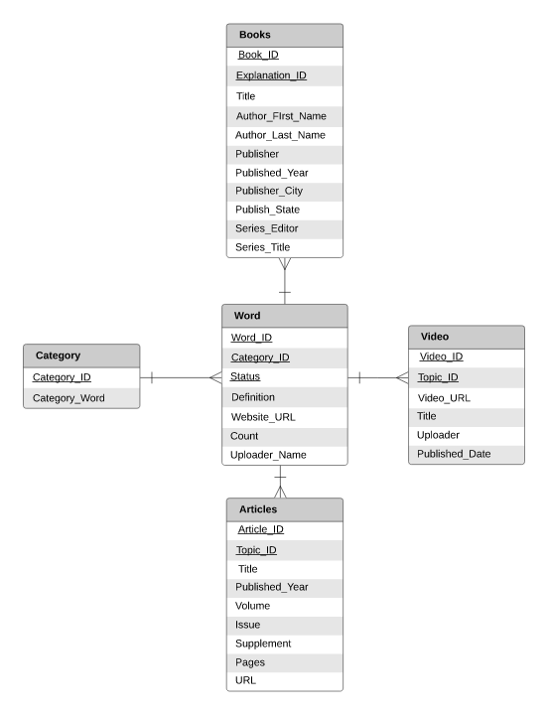
Database ERD
Each word is a part of a category (Cloud Computing, CIA, etc)
Each word has attributes
Also each has a reference type

Slide 9
Interface

Slide 10
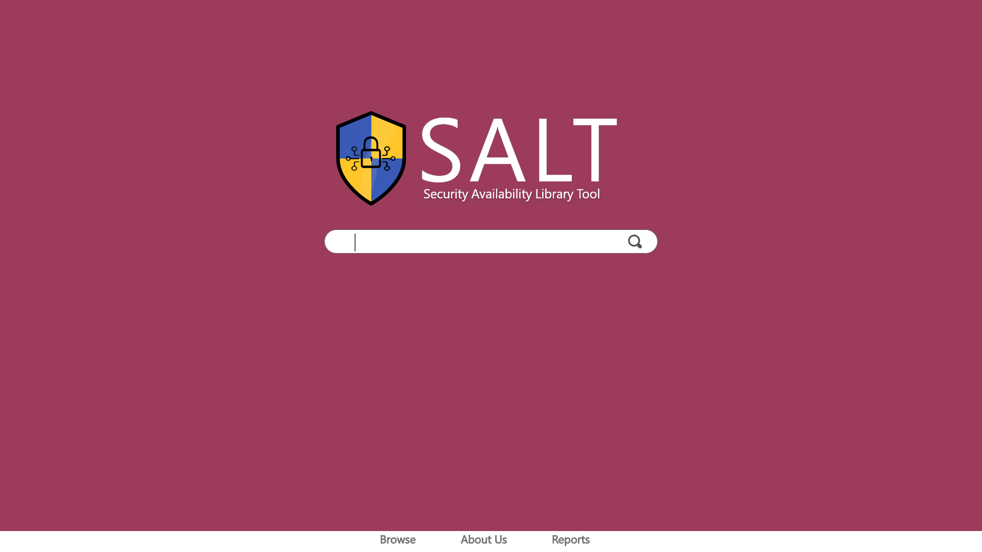
Notes:
First page the user sees
They can interact with the search bar it has links on the footer to different pages

Slide 11
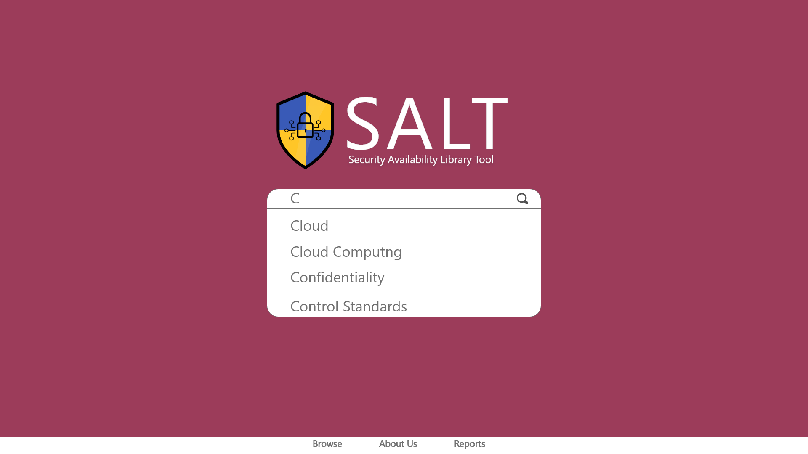
Notes:
When the user types, a drop down list appears containing words that begin with the typed letters

Slide 12
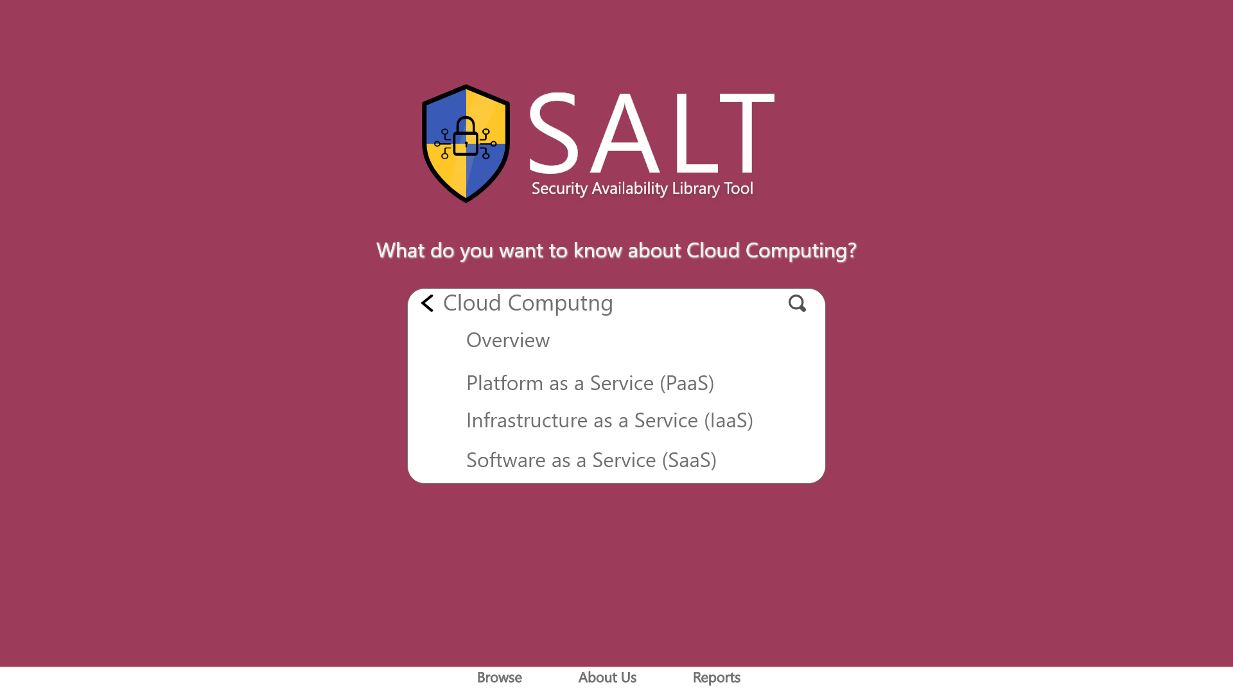
Notes:
The user can select an overview of cloud computing or one a subtopic related to it

Slide 13
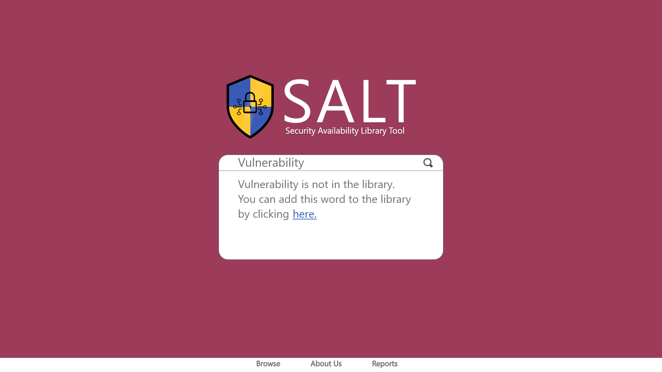
Notes:
If a user searched for a word not in the library, the system will display that to them and give them the option to add it themselves.

Slide 14
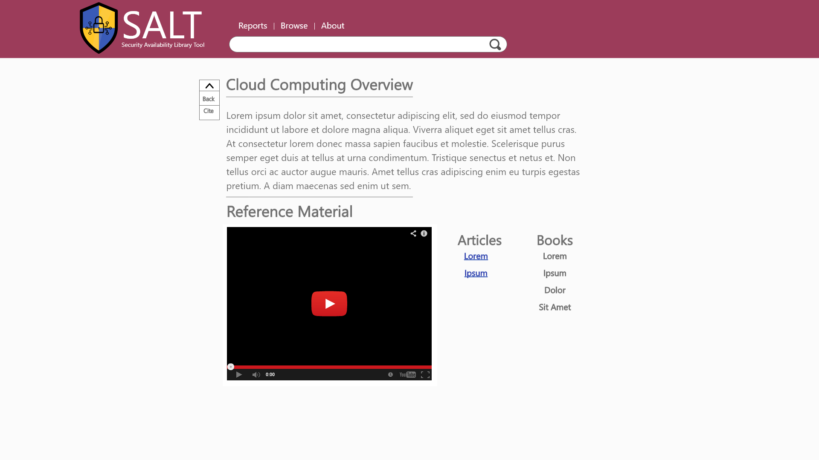
Notes:
Definition page gives an explanation and reference material

Slide 15
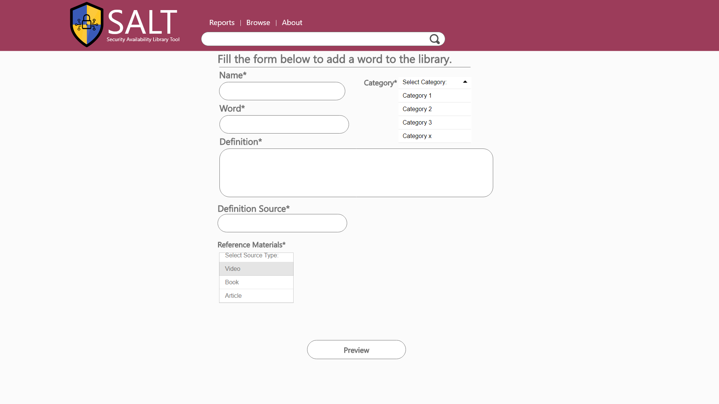

Slide 16
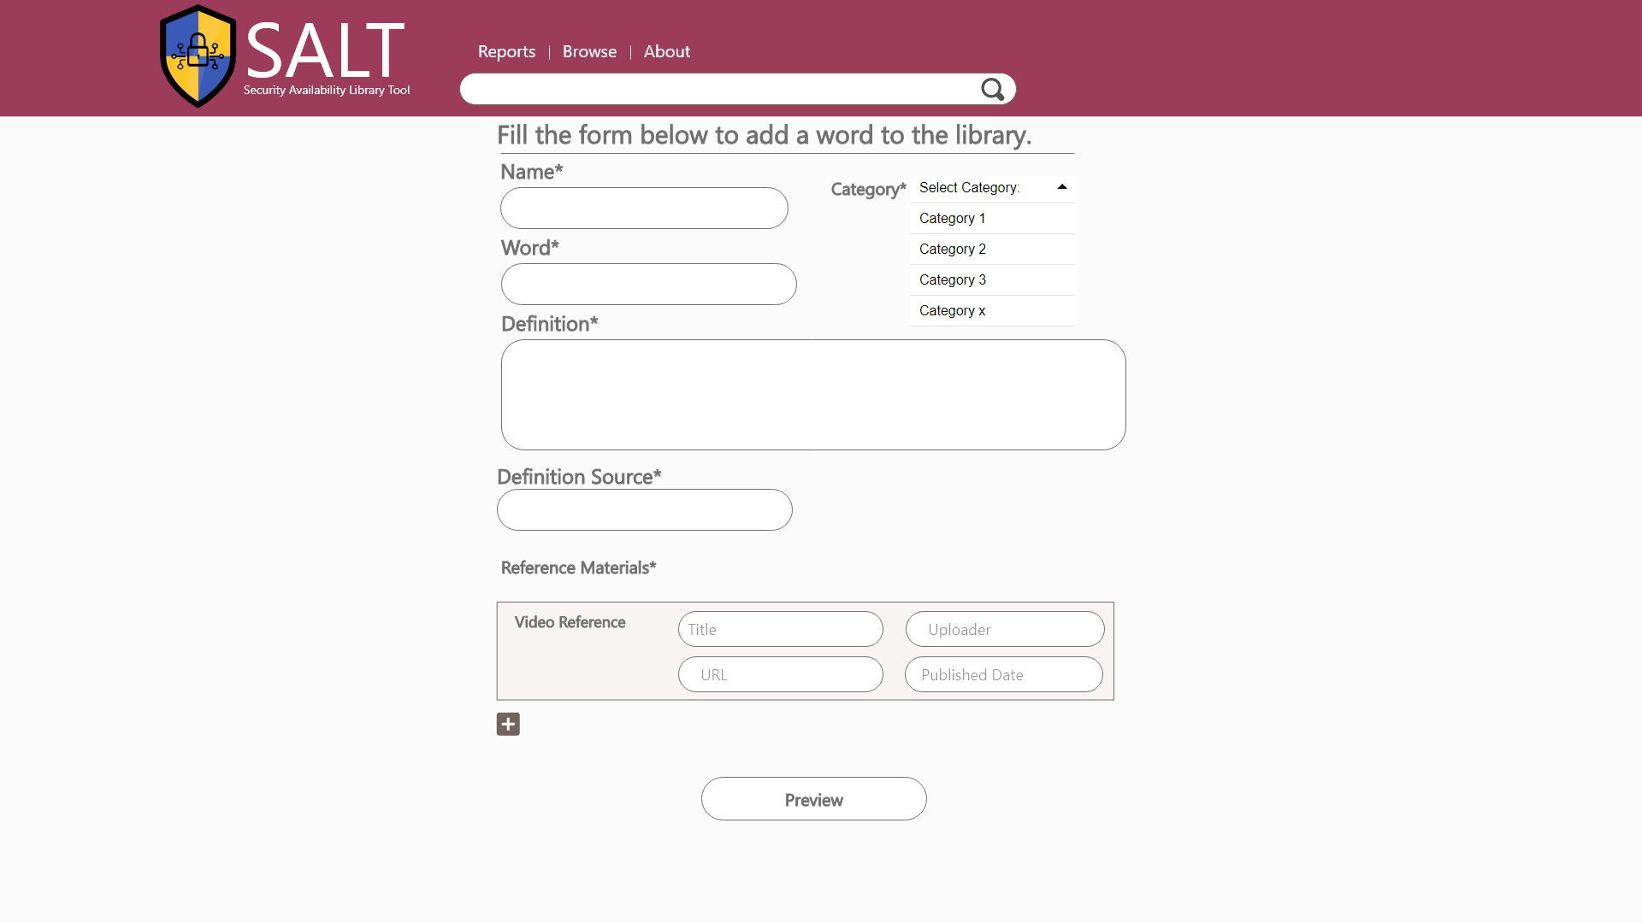

Slide 17
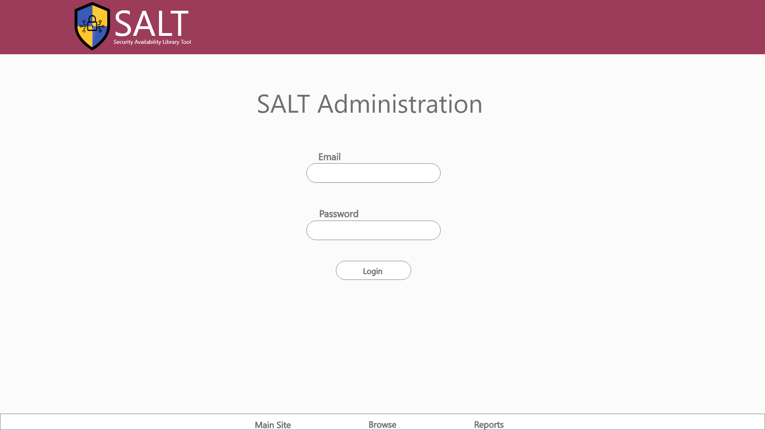

Slide 18
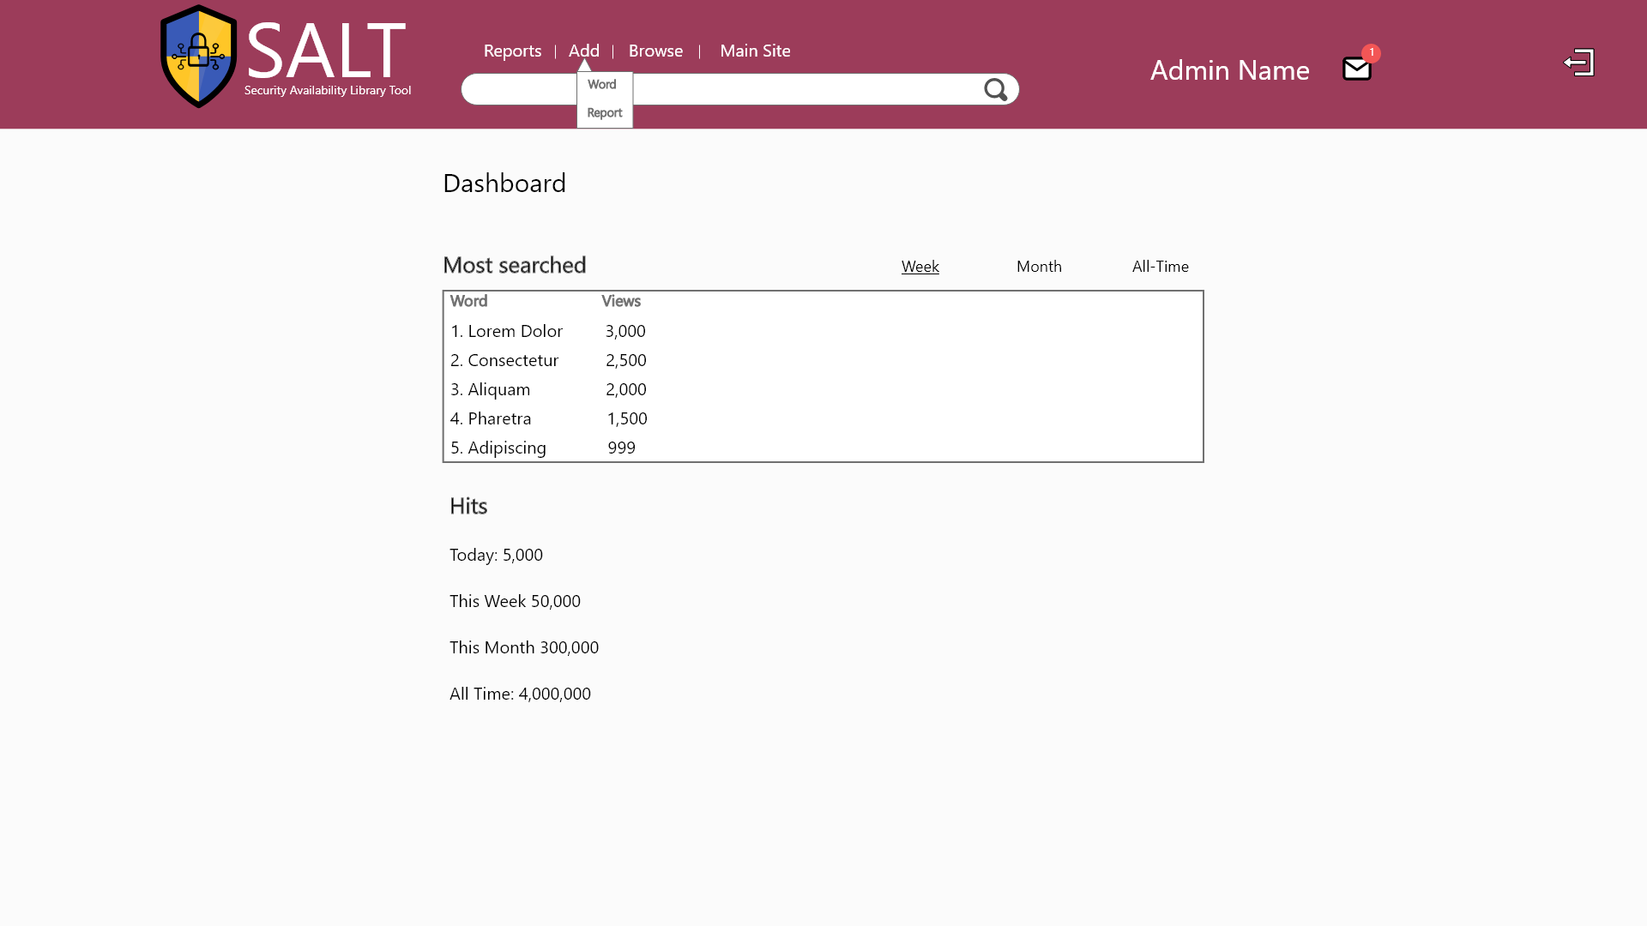

Slide 19
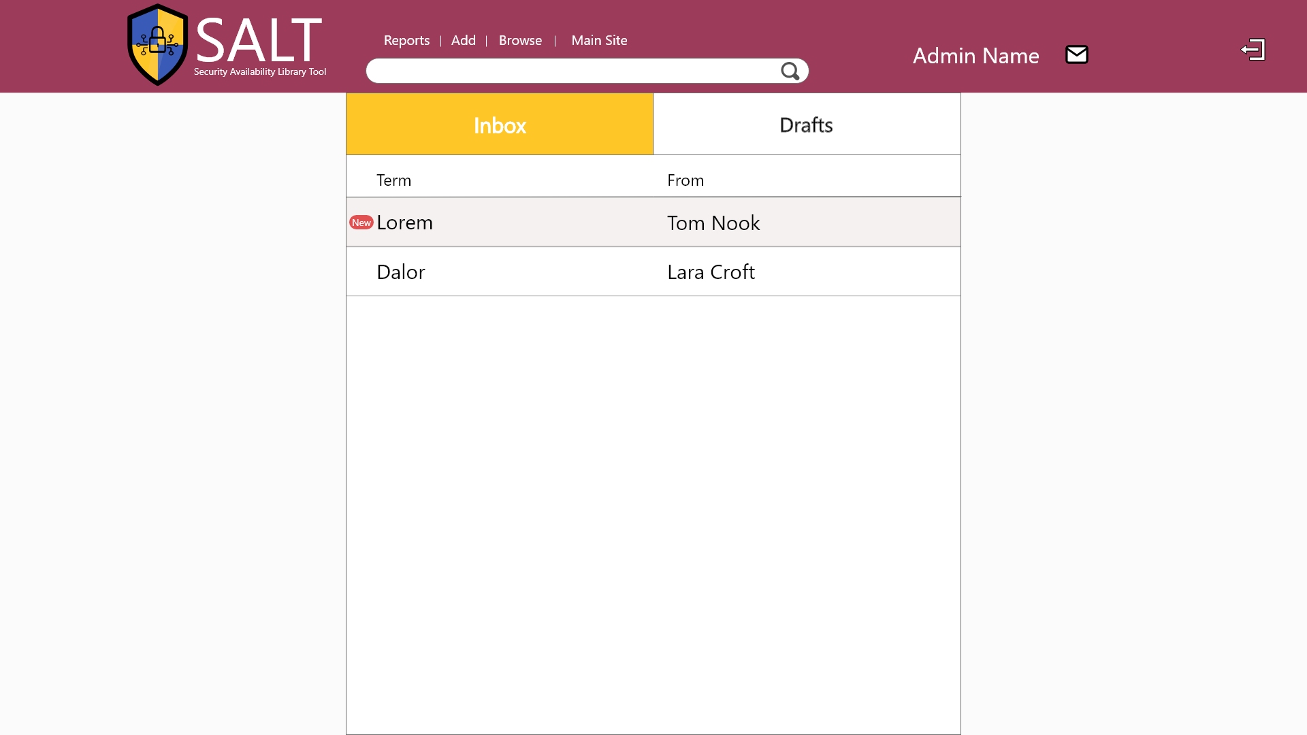

Slide 20
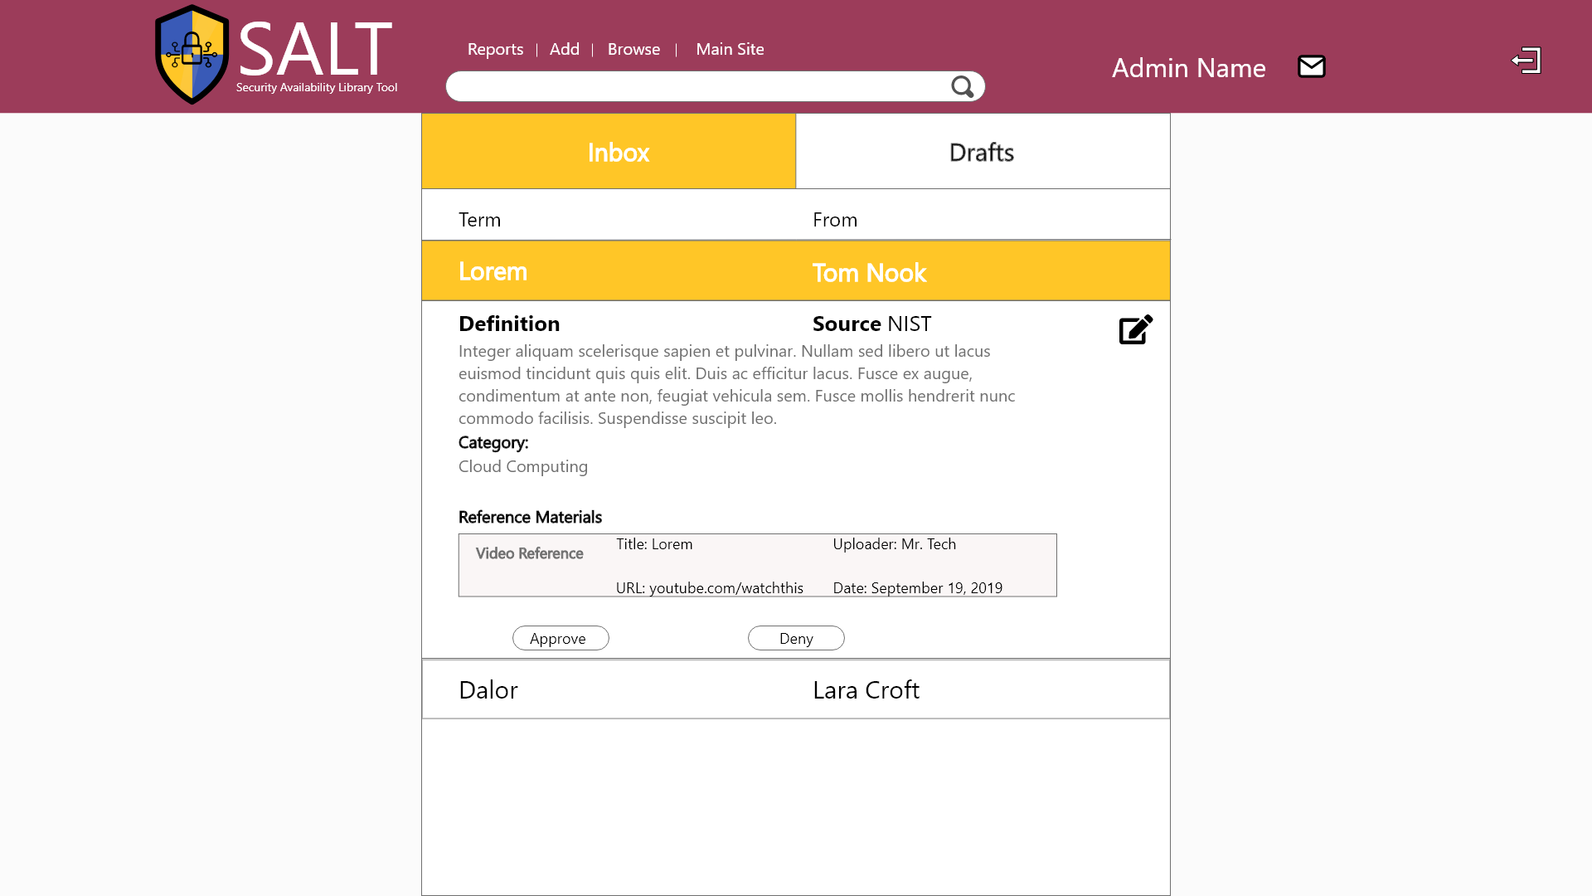

Slide 21
First Build
Website
GUI for Administrator
Function 1: Search
Function 2: Request form
Notes:
Our administrator will be able to accept requests and users can search the website.

