Slide 1
Covid-19 analysis in uk
Data analytics using python
Tuna tuncay

Slide 2
Problem definition
Covid has been the major problem of all economies for the past 2 years. UK Government like others is fighting against the pandemic predominantly with vaccines. As the data analyst working with UK government, I am expected to identify trends and patterns that will guide through promoting vaccination.

Slide 3
Scope and methodology
Analysis is based on 3 data sets:
Cases: Death, hospitalized, recovered and cases are provided for Jan’20 –Oct’21.
Vaccinated: Number of people who took first and second dose are provided for Jan’20-Oct’21.
Tweets: 15-23/05/2022 twitter data is provided.
Relationship between cases, death and hospitalization is examined. Effect of vaccinees and peoples Case, death and vaccine numbers are analyses in state/province level. Recommendations on where to focus next on vaccination and how to focus is studied.

Slide 4

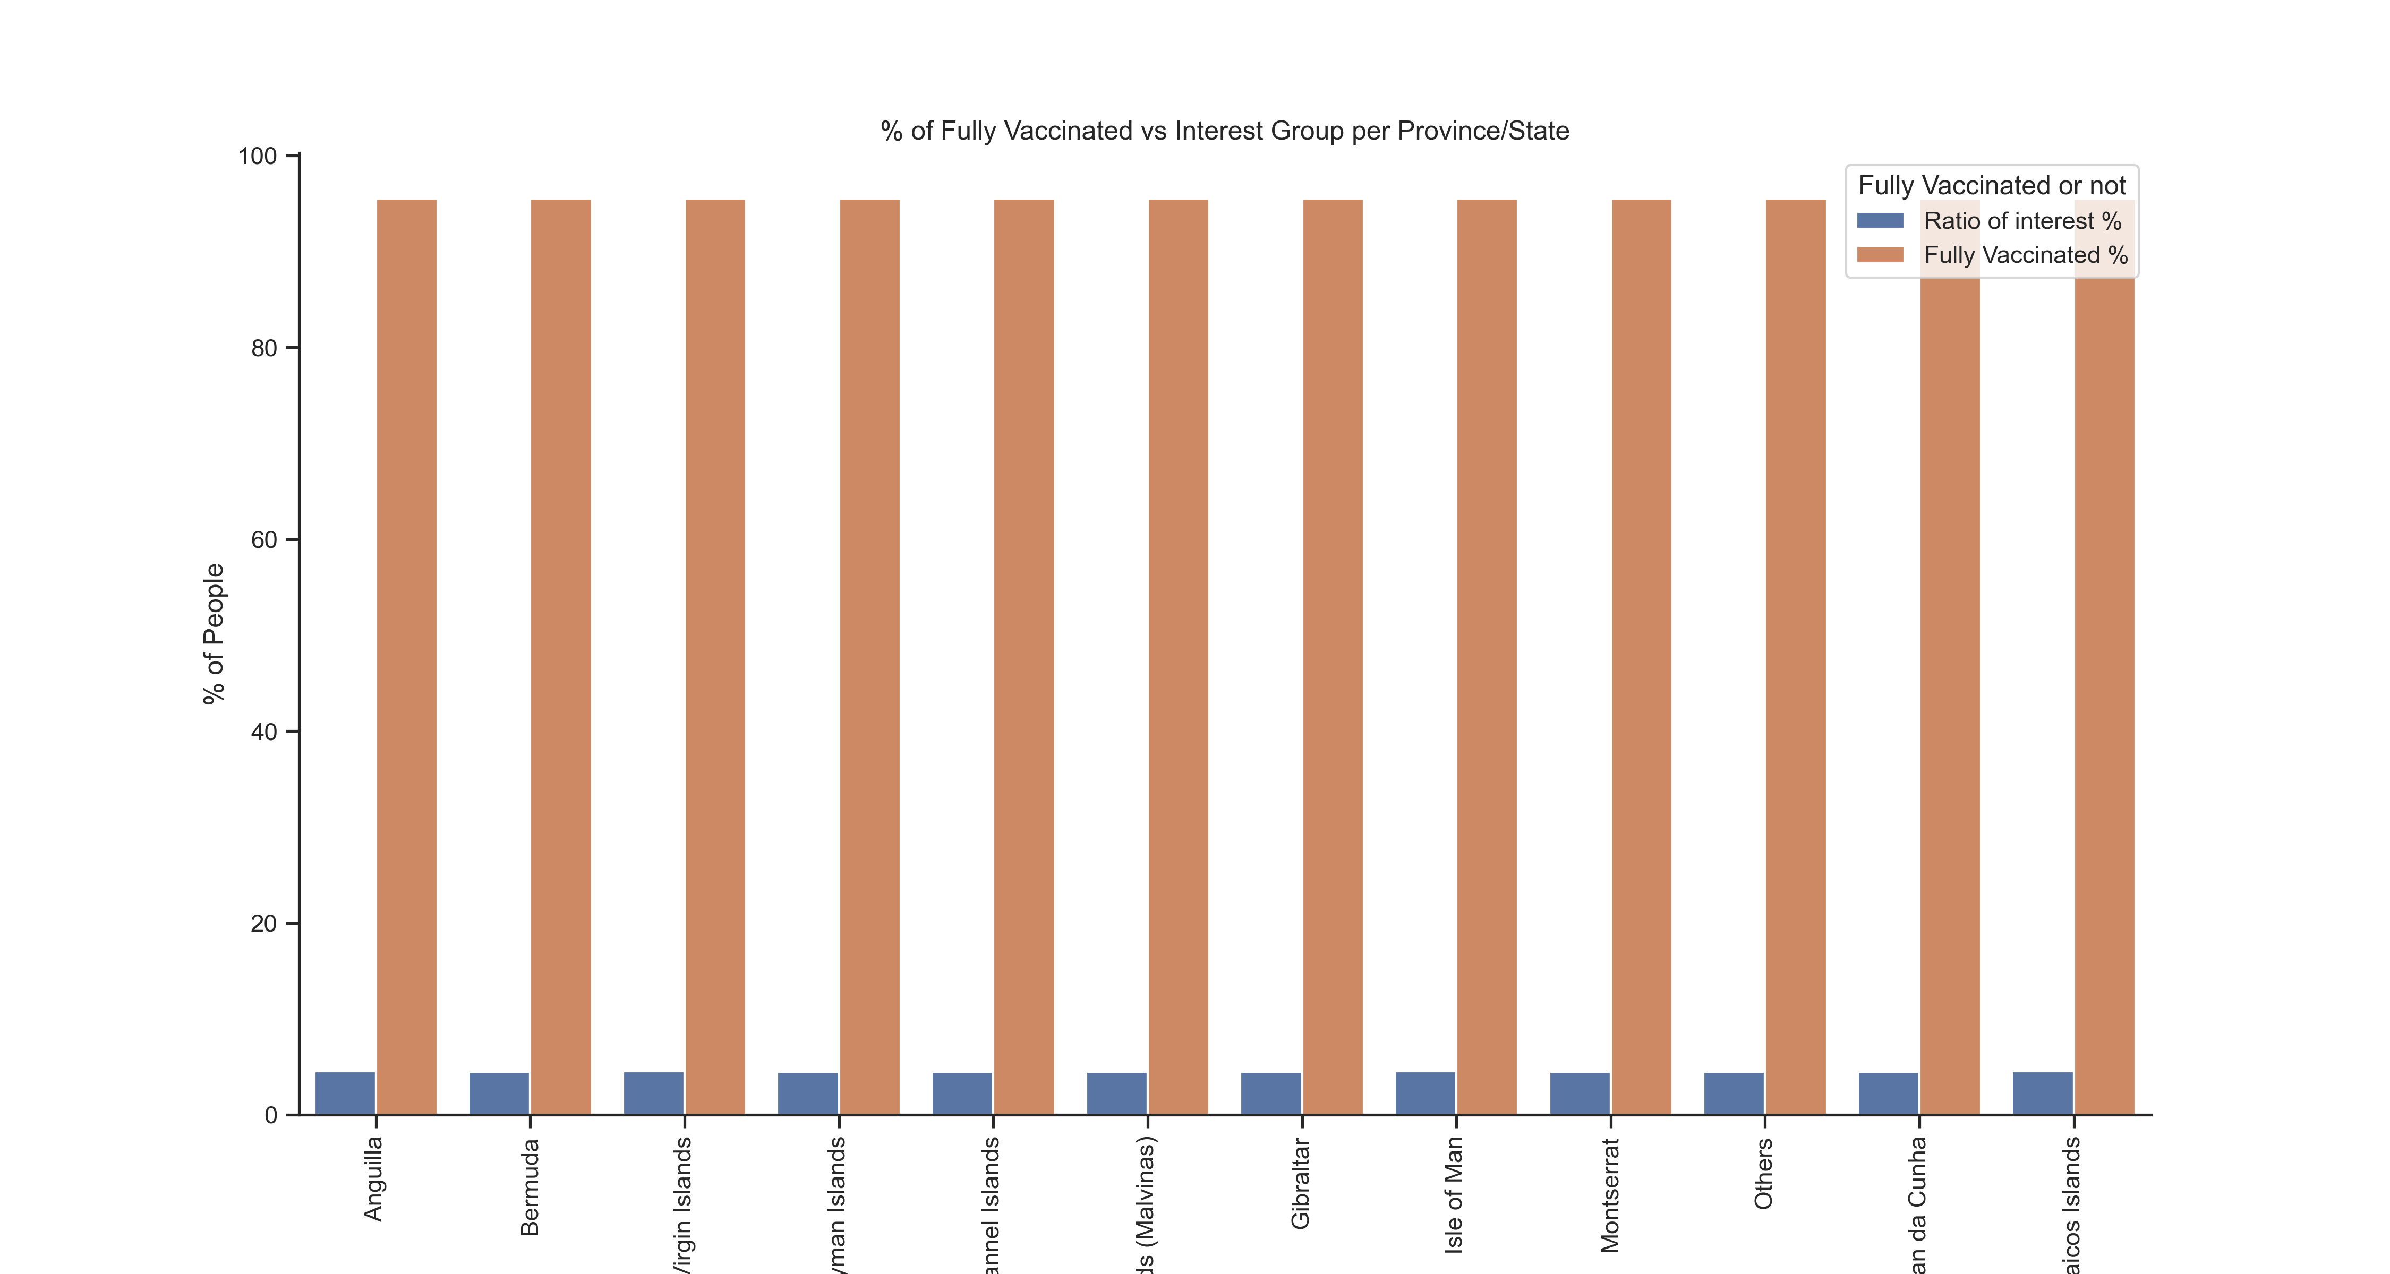
Key findings
12 different regions are analysed.
Gibraltar region has the biggest number of nominal vaccinated people.
All regions have similar vaccination rates. Not fully vaccinated % of people are around 4.5% for all regions.
Important to note: Vaccination % calculated second dose takers over first dose takers. Better approach would be percentage of the population.

Slide 5
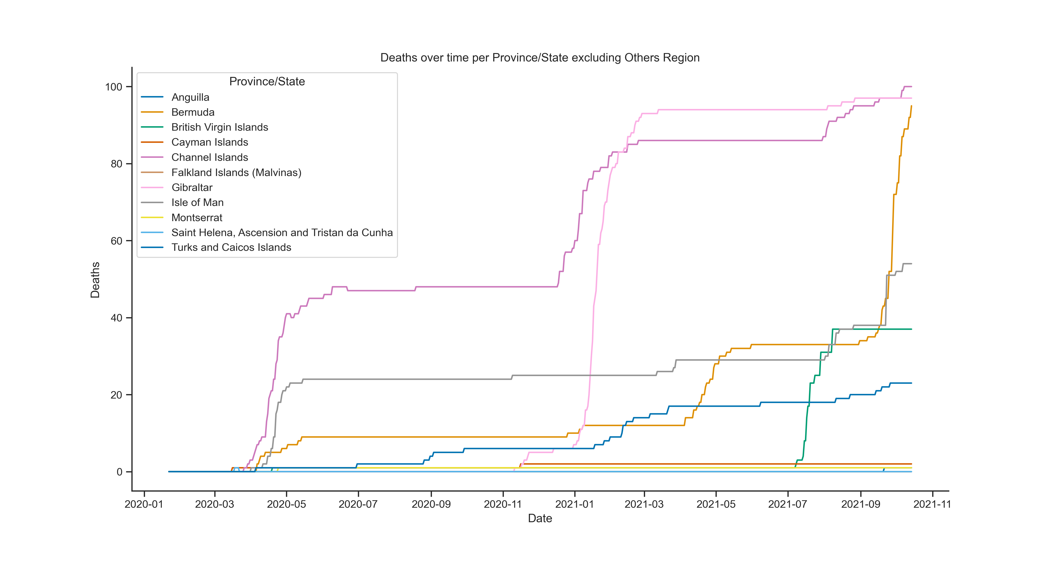
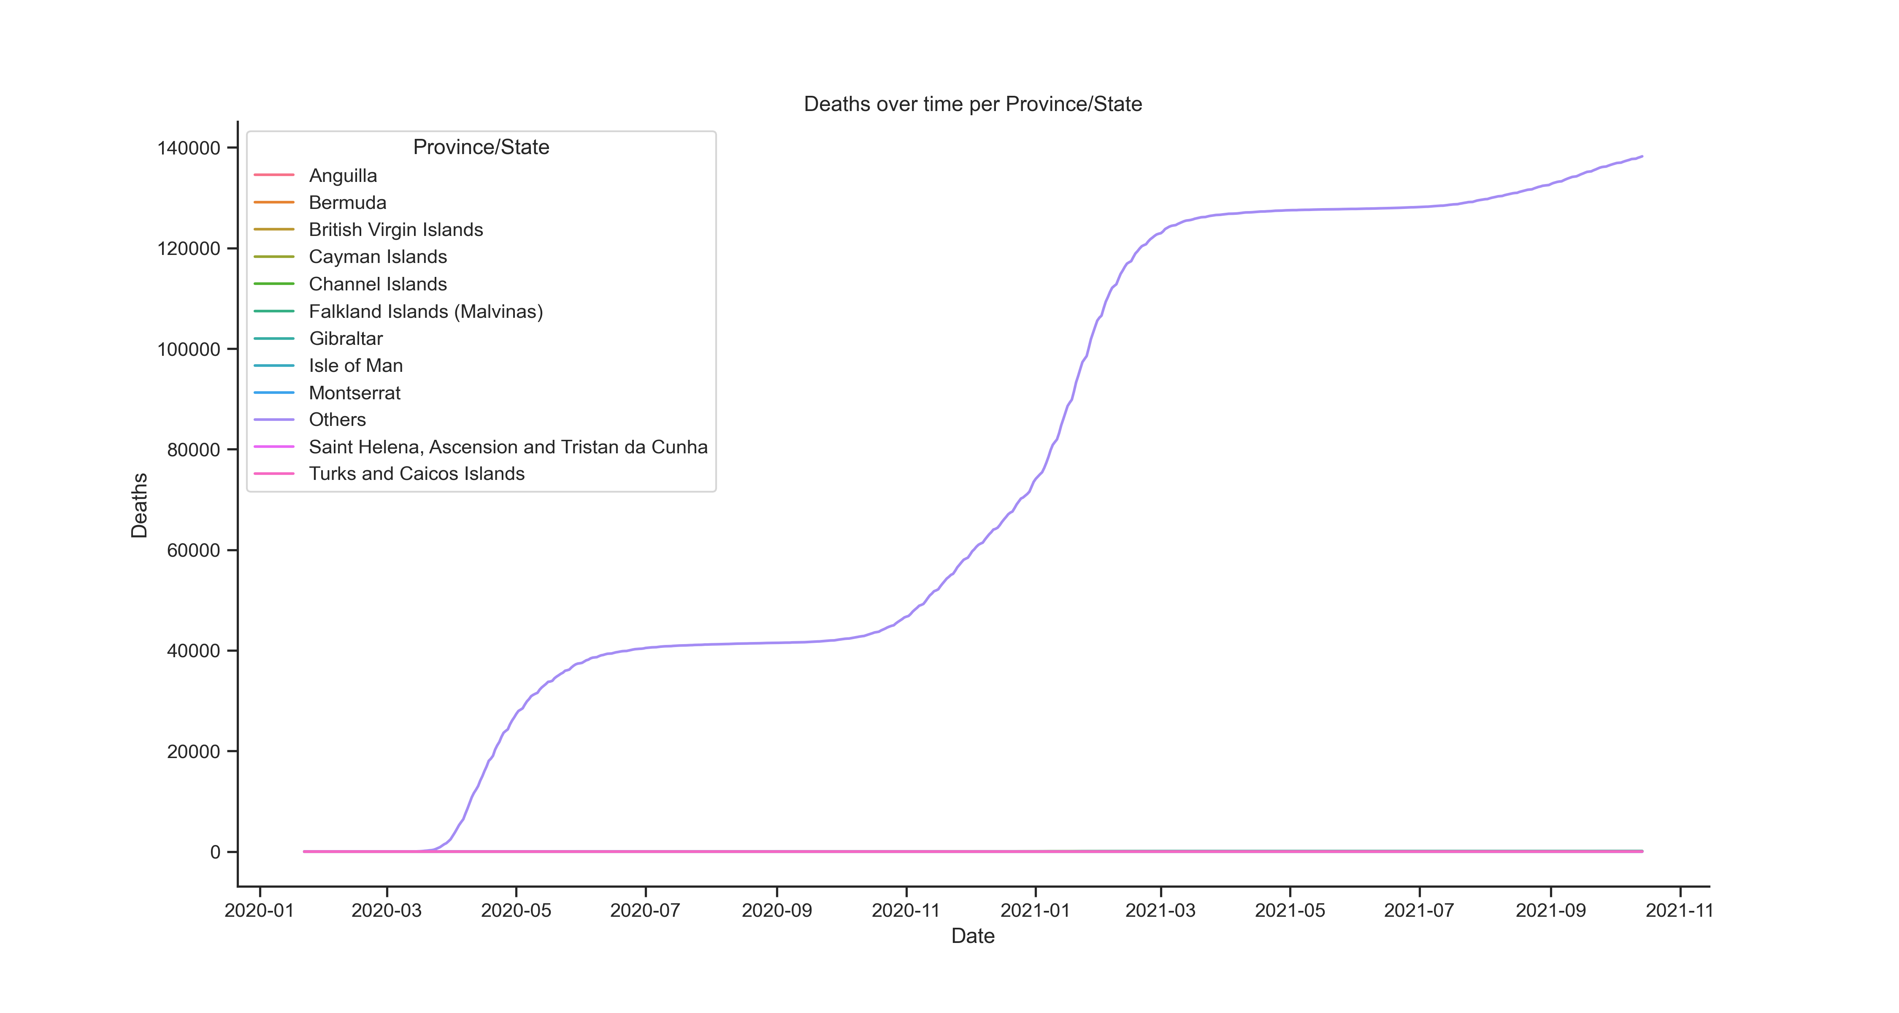
KEY FINDINGS
Death numbers in the data are cumulative sums .
There are 2 main death cycles for almost all provinces.
Some provinces (Anguilla, Isla of Man, Bermuda) start having a sharp increase in death numbers at the beginning of the pandemic (03/2020) whereas some others (Turk & Caicos, Gibraltar) kept themselves almost safe till Q42020.

Slide 6
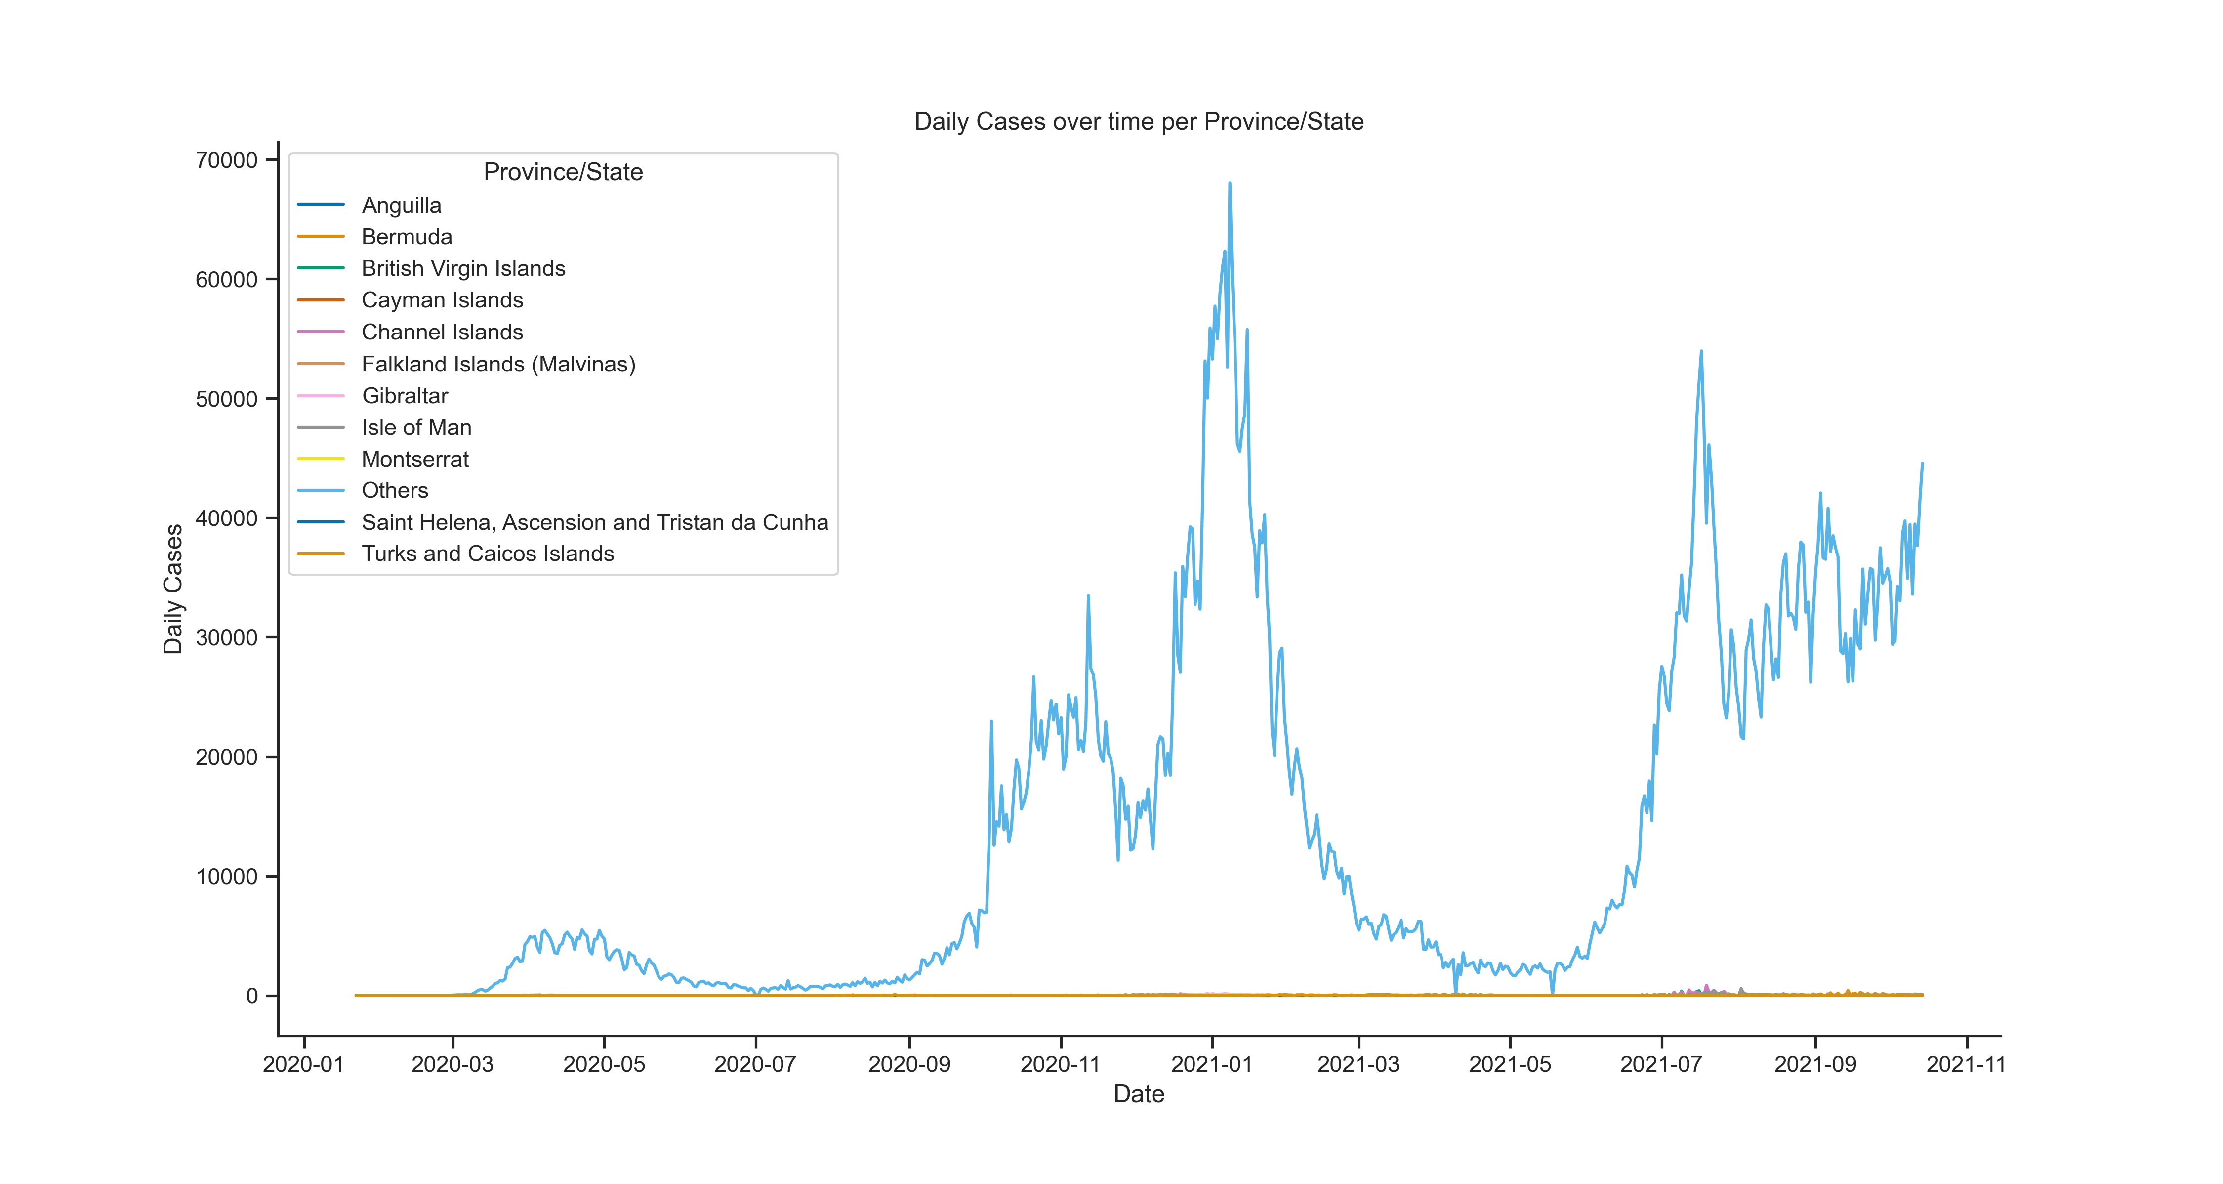
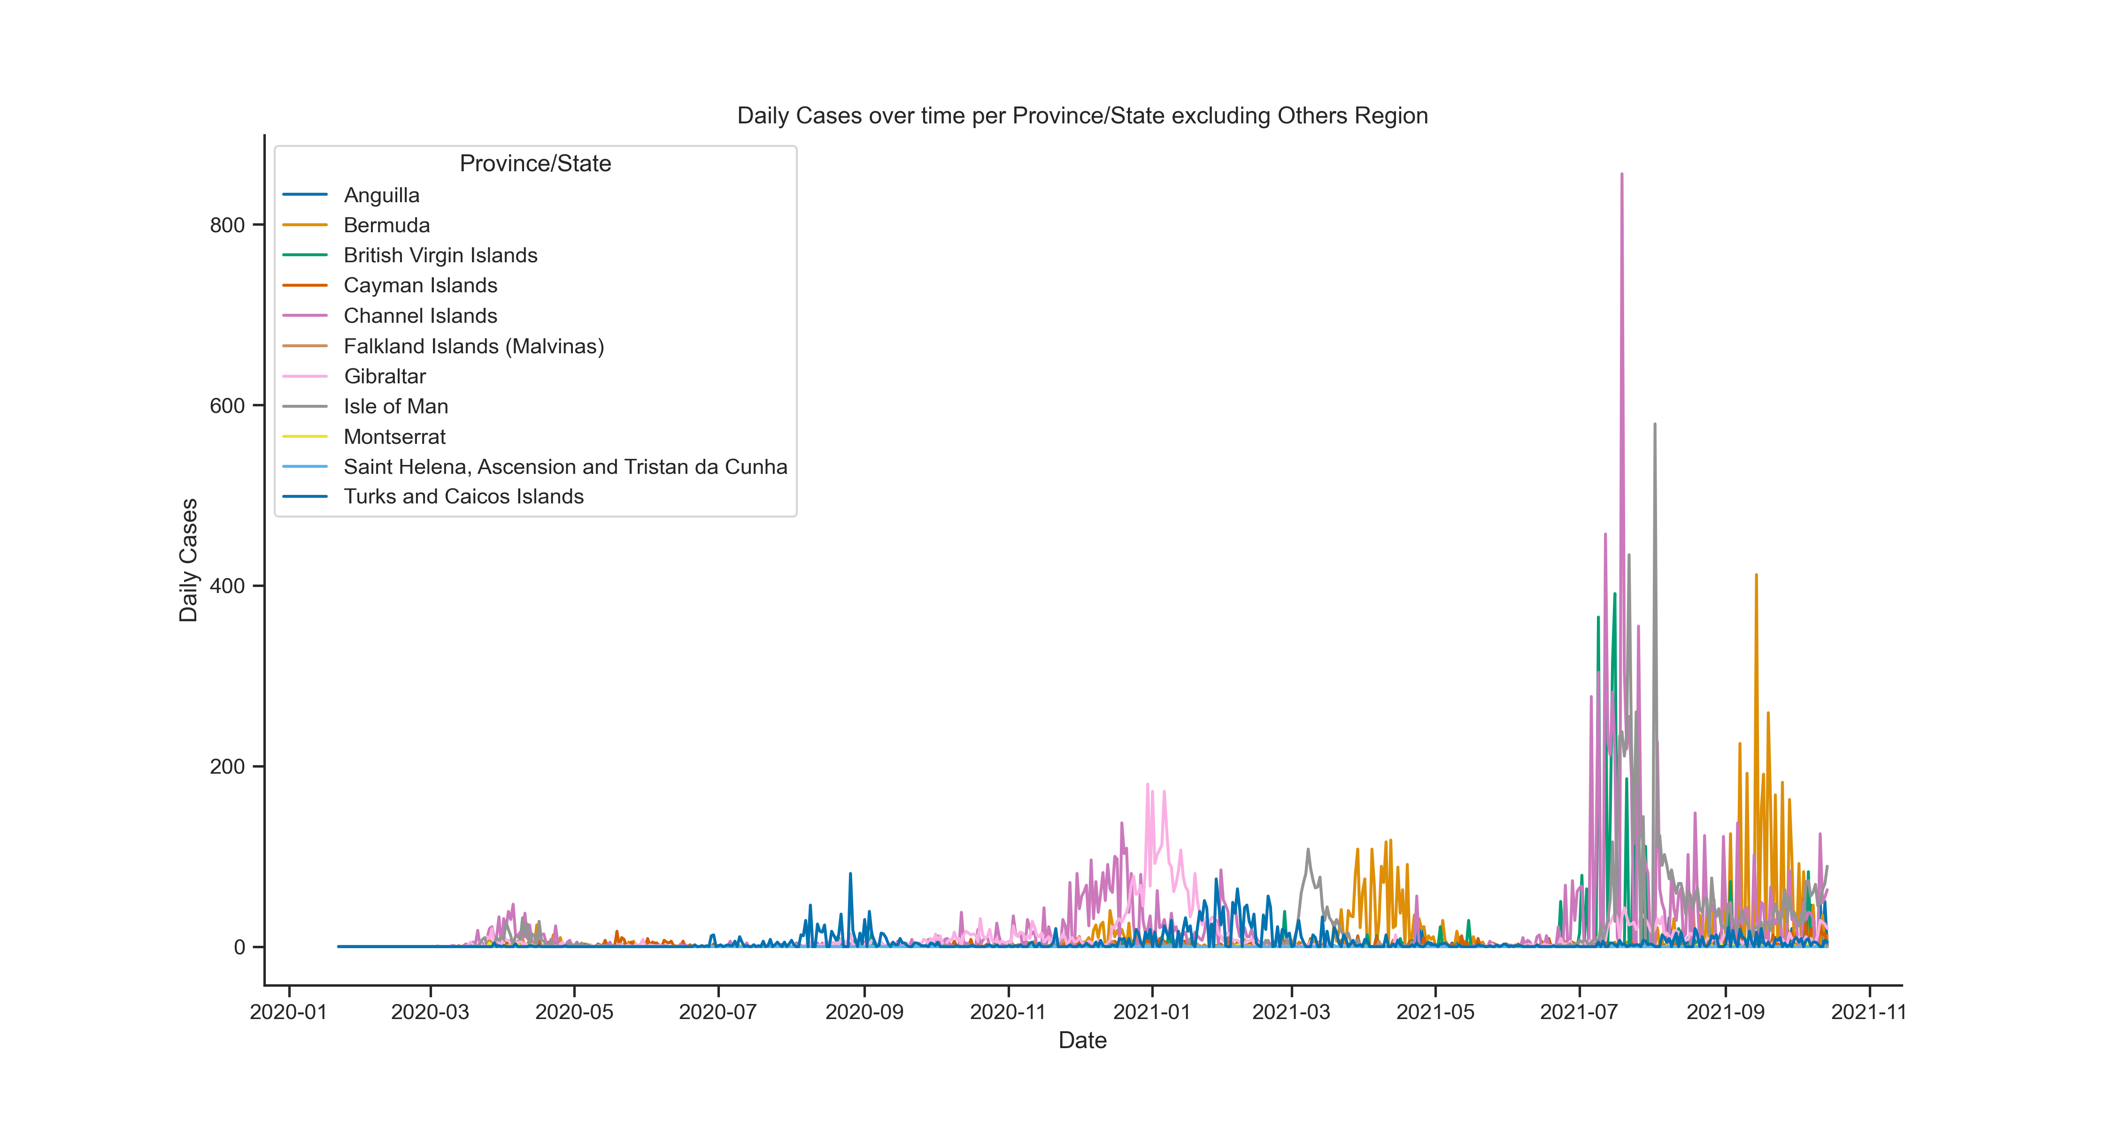
Key findings
3 peaks in daily case numbers.
Daily case numbers are bigger in each peak compared to previous one. However, I don’t see sharp increase in death numbers in the last peak. This should be the positive affect of vaccination.

Slide 7
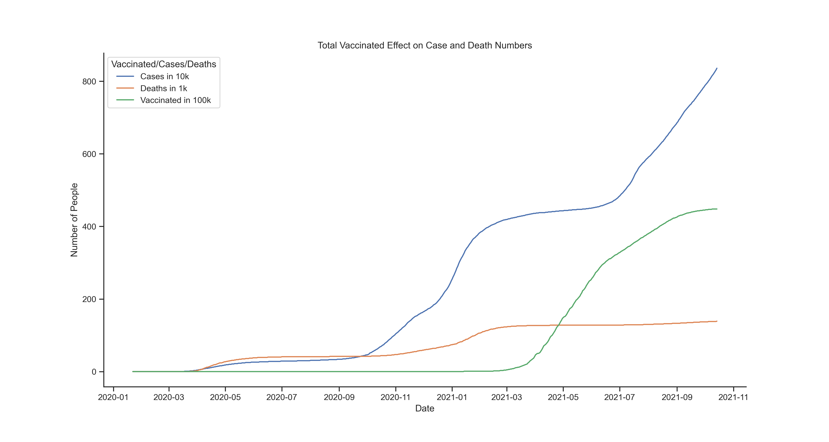
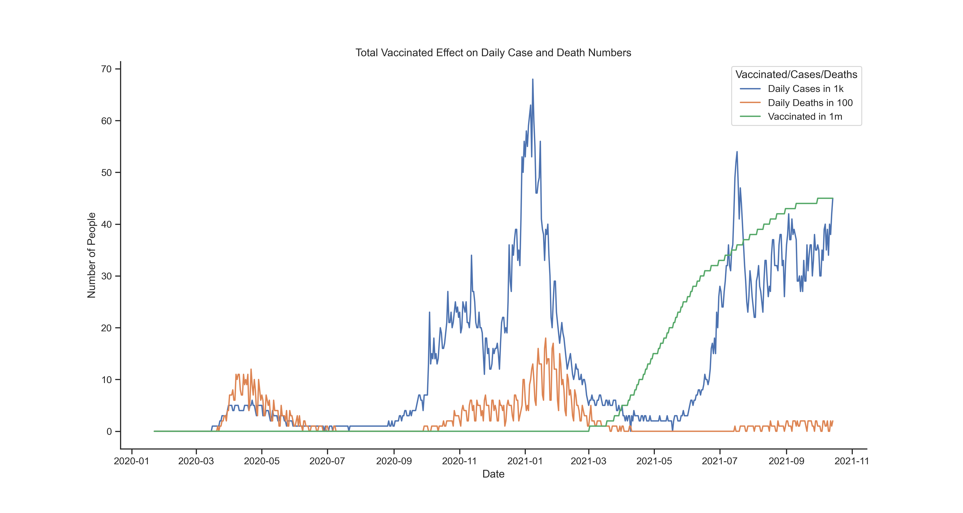
Key findings
After vaccine rollout, even the case numbers surge, death numbers are not increasing dramatically.

Slide 8
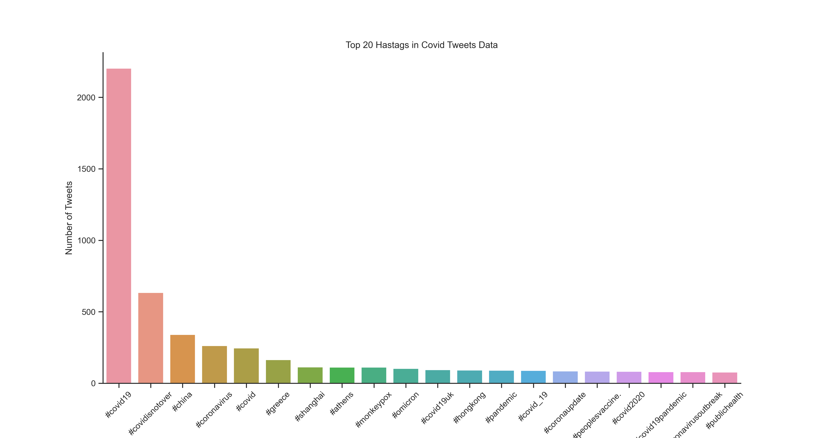
Key findings
Top 20 hashtags are almost all related to Covid name.
The vaccine hashtag is only captured once in top 20.

Slide 9
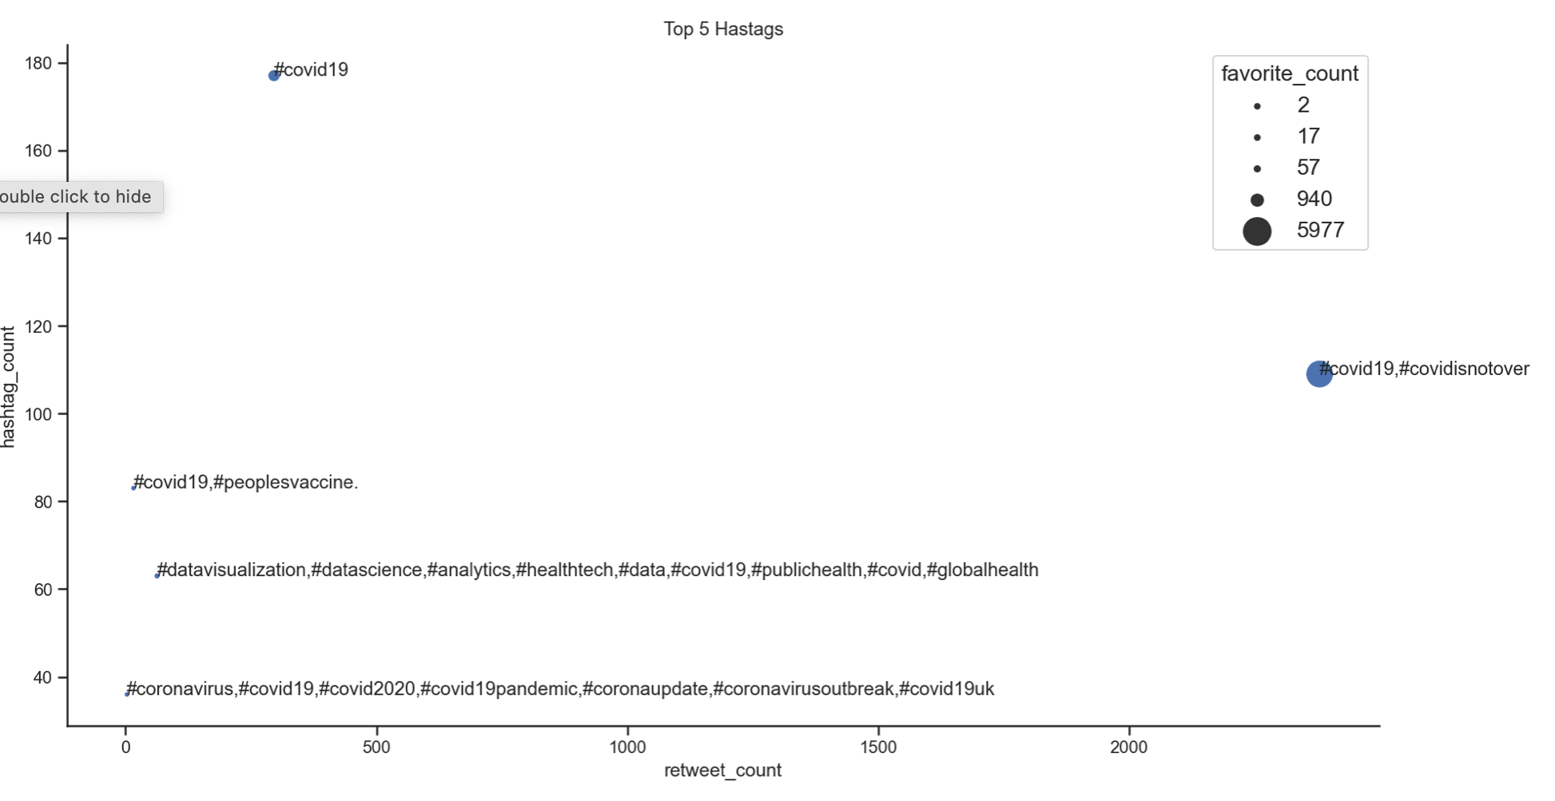
Key findings
People use #peoplesvaccine hashtag with #covid19 hashtag.
Hashtag count for #peoplesvaccine is the third one but it is not retweeted nor favourited by others.

Slide 10
Conclusion and further analysis
The timeline for Covid 19 pandemic has been unique for different regions in UK. However, pattern and trends are pretty much similar for all.
Vaccines changed the whole picture. By the introduction of vaccines, death curve flattened even with the increasing case numbers
All provinces have similar vaccinations rates when we make the calculation over all first dose takers. I would like to analyse further with the population data.
Timing of tweets data was not inline with the other datasets. It helped me to have initial thoughts on people’s perception about vaccines. II would love to check twitter hashtags and trending topics historically for similar dates.

