Slide 1
Demand for Computational Speed
Reasons to Employ Parallel Processing
Continual demand for greater computational speed from a computer system than is currently possible
Areas requiring great computational speed include numerical modeling and simulation of scientific and engineering problems.
Computations must be completed within a “reasonable” time period.

Slide 2
Grand Challenge Problems
One that cannot be solved in a reasonable amount of time with today’s computers. Obviously, an execution time of 10 years is always unreasonable.
Examples
Modeling large DNA structures
Global weather forecasting
Modeling motion of astronomical bodies.

Slide 3
Weather Forecasting
Atmosphere modeled by dividing it into 3-dimensional cells.
Calculations of each cell repeated many times to model passage of time.

Slide 4
Global Weather Forecasting Example
Suppose whole global atmosphere divided into cells of size 1 mile × 1 mile × 1 mile to a height of 10 miles (10 cells high) - about 5 × 10⁸ cells.
Suppose each calculation requires 200 floating point operations. In one time step, 10¹¹ floating point operations necessary.
To forecast the weather over 7 days using 1-minute intervals, a computer operating at 1Gflops (10⁹ floating point operations/s) takes 10⁶ seconds or over 10 days.
To perform calculation in 5 minutes requires computer operating at 3.4 Tflops (3.4 × 10¹² floating point operations/sec).

Slide 5
Modeling Motion of Astronomical Bodies
Each body attracted to each other body by gravitational forces. Movement of each body predicted by calculating total force on each body.
With N bodies, N - 1 forces to calculate for each body, or approx. N² calculations. (N log₂ N for an efficient approx. algorithm.)
After determining new positions of bodies, calculations repeated.

Slide 6
A galaxy might have, say, 10¹¹ stars.
Even if each calculation done in 1 ms (extremely optimistic figure), it takes 10⁹ years for one iteration using O(N²) algorithm and almost a year for one iteration using an efficient N log₂N approximate algorithm.

Slide 7
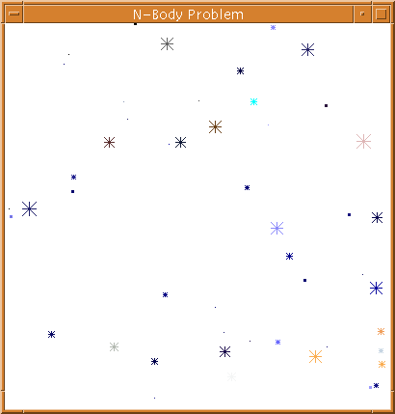
Astrophysical N-body simulation by Scott Linssen (undergraduate UNC-Charlotte student).

Slide 8
Parallel Computing
Using more than one computer, or a computer with more than one processor, to solve a problem.
Motives
Usually faster computation - very simple idea - that n computers operating simultaneously can achieve the result n times faster - it will not be n times faster for various reasons.
Other motives include: fault tolerance, larger amount of memory available, ...

Slide 9
Background
Parallel computers - computers with more than one processor - and their programming - parallel programming - has been around for more than 45 years.

Slide 10
Functional Parallelism
Functional Parallelism may be possible when there are independent processes or threads that apply different operations to different data items

Slide 11
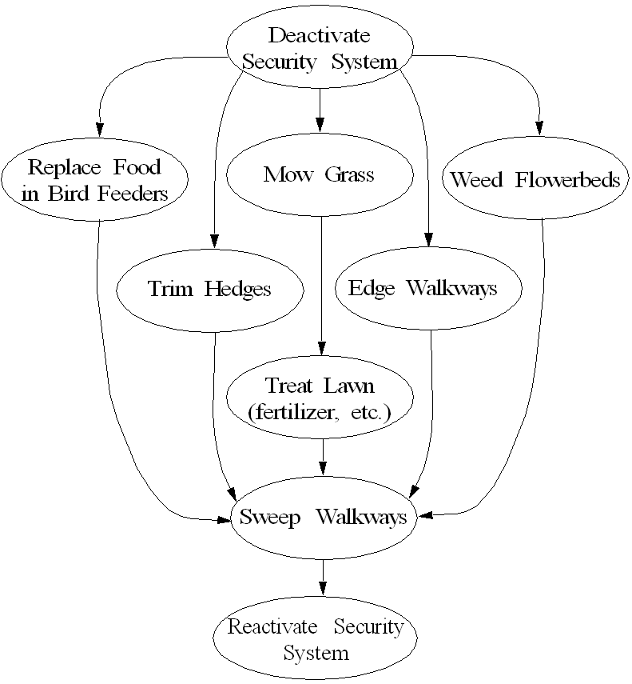
Landscape Management
Example

Slide 12
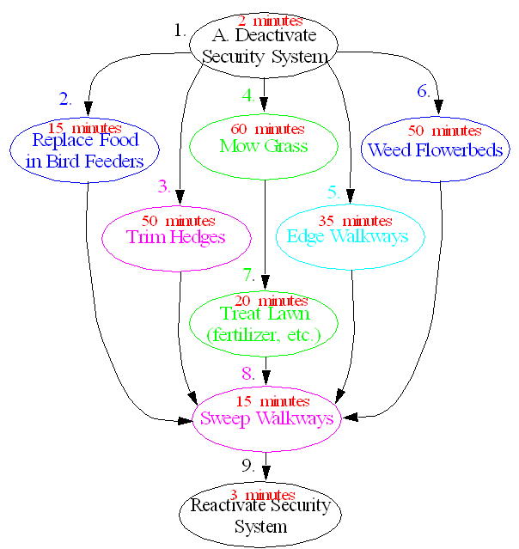
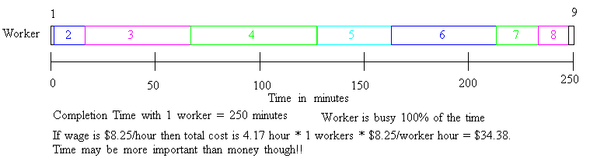

Slide 13
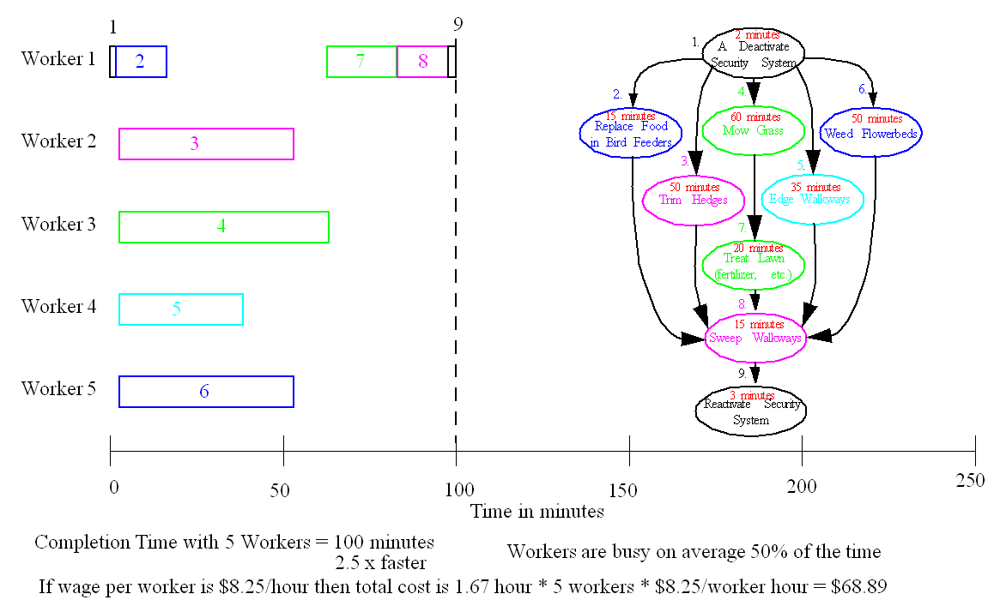

Slide 14
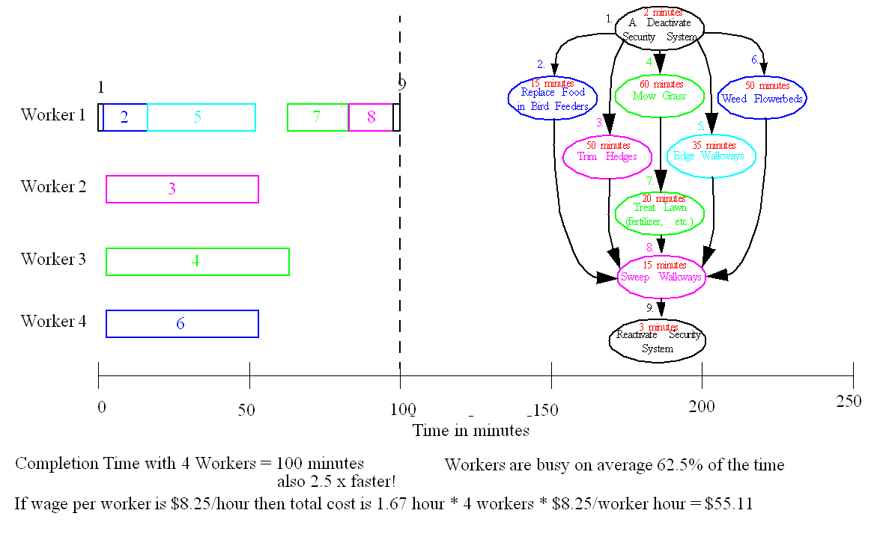

Slide 15
Speedup Factor
where t_{s} is execution time on a single processor and t_{p} is execution time on a multiprocessor.
S(p) gives increase in speed by using multiprocessor.
Use best sequential algorithm with single processor system. Underlying algorithm for parallel implementation might be (and is usually) different.

Slide 17
Speedup factor can also be cast in terms of computational steps:
Can also extend time complexity to parallel computations.

Slide 18
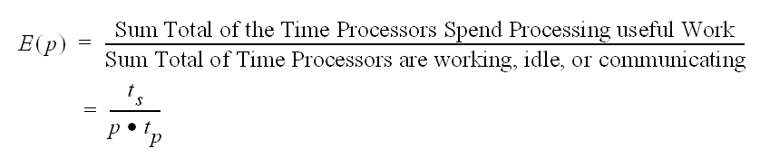
Efficiency
where ts is execution time on a single processor and tp is execution time on a multiprocessor.

Slide 20

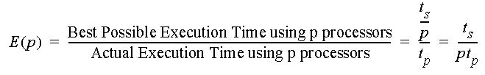
Efficiency
where t_{s} is execution time on a single processor and t_{p} is execution time on a multiprocessor.
Again use best sequential algorithm with single processor system. Underlying algorithm for parallel implementation might be (and is usually) different.

Slide 21

Cost

Slide 24

Speedup Factor
where t_{s} is execution time on a single processor and t_{p} is execution time on a multiprocessor.
Use best sequential algorithm with single processor system. Underlying algorithm for parallel implementation might be (and is usually) different.

Slide 25
Maximum Speedup
Maximum speedup is usually p with p processors (linear speedup).
Possible to get superlinear speedup (greater than p) but usually a specific reason such as:
Extra memory in multiprocessor system
Nondeterministic algorithm

Slide 26
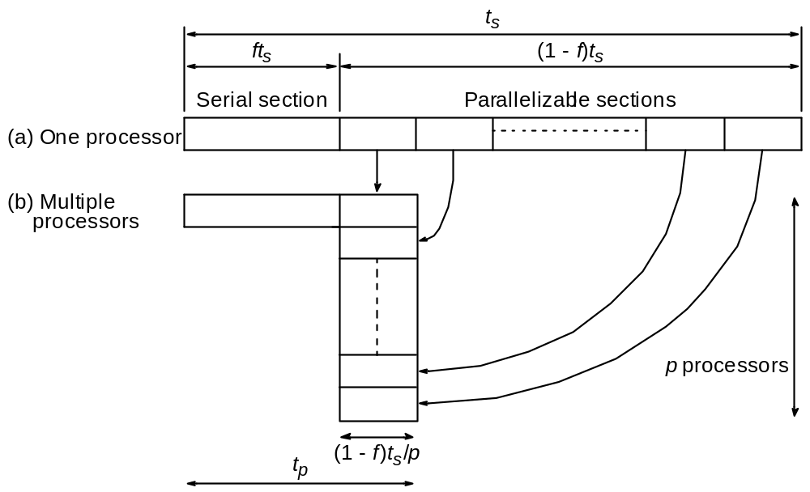
Maximum Speedup
Amdahl’s law

Slide 27
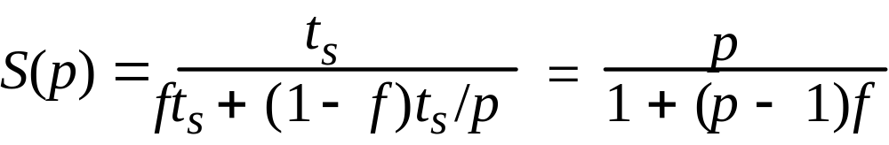
Speedup factor is given by:
This equation is known as Amdahl’s law

Slide 28
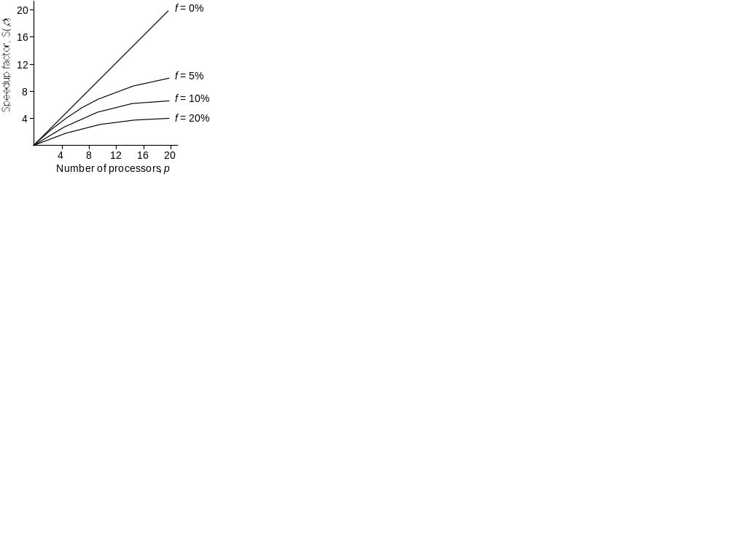
Speedup against number of processors
Even with infinite number of processors, maximum speedup limited to 1/f .
Example: With only 5% of computation being serial, maximum speedup is 20, irrespective of number of processors.

Slide 29
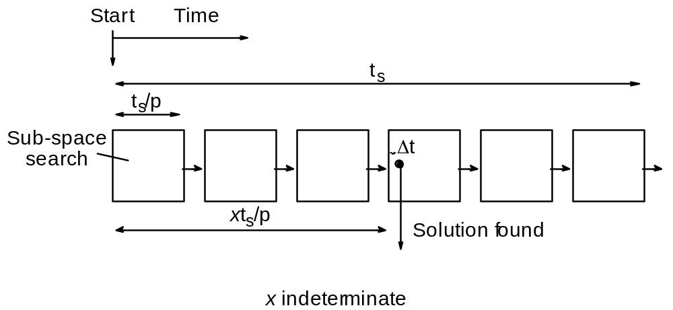
Superlinear Speedup example - Searching
(a) Searching each sub-space sequentially

Slide 30
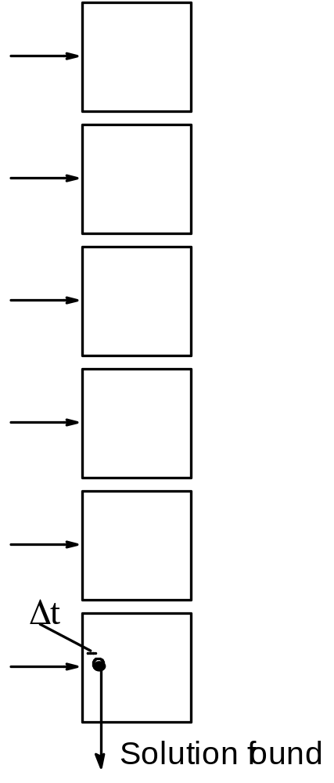
(b) Searching each sub-space in parallel

Slide 31
Speed-up then given by
t
x
×
-
s
-
-
-
+
Δ
t
()
p
Sp
=
-
-
-
-
-
-
-
-
-
-
-
-
-
-
-
-
-
-
-
-
-
-
-
-
-
-
-
-
-
-
Δ
t

Slide 32
Worst case for sequential search when solution found in last sub-space search. Then parallel version offers greatest benefit, i.e.
p
–
1
×
Δ
-
-
-
-
-
-
-
-
-
-
-
-
t
+
t
s
p
()
-
→
∞
-
-
-
-
-
-
-
-
-
-
-
-
-
-
-
-
-
-
-
-
-
-
-
-
-
-
-
-
-
-
-
-
-
-
-
-
-
-
Sp
=
-
Δ
t
as
Δ
t tends to zero

Slide 33
Least advantage for parallel version when solution found in first sub-space search of the sequential search, i.e.
Actual speed-up depends upon which subspace holds solution but could be extremely large.
()
Δ
t
Sp
-
-
-
=
-
=
1
Δ
t

